Slide 1
2020 National Survey on Drug Use and Health: Women
Substance Abuse and Mental Health Services Administration
U.S. Department of Health and Human Services
July 2022

Slide 2
About This Presentation
The estimates in these slides have been rounded for the purposes of presentation. Any appearance of estimates not summing exactly to a known total are due to this rounding.
Some slides present the same analysis across multiple years. The underlying populations from which these estimates are derived change across years since the number of people in the United States changes across years. Thus, a change in proportions does not equal a constant change in the weighted count.

Slide 3
National Survey on Drug Use and Health (NSDUH)
NSDUH is a comprehensive household interview survey of substance use, substance use disorders, mental health, and the receipt of treatment services for these disorders in the United States.
NSDUH covers the civilian, noninstitutionalized population, aged 12 or older:
  Includes: Households, college dorms, homeless in shelters, civilians on military bases
Sample includes all 50 states and DC

Slide 4
Who is Not Covered by NSDUH?
Children under age 12
Populations with potential serious mental health/substance use issues:
  Institutionalized populations:
    Incarcerated
    Hospitalized
    Nursing homes
  Homeless populations not in homeless shelters

Slide 5
How Do We Use NSDUH?
Provides a window into the state of substance use and mental health issues in the United States
Provides insights that can be studied in the context of data from other agencies to help in decision-making about what types of resources are needed and where resources should be directed
Helps to guide policy in addressing:
  Problematic substance use
  Prevalence of mental illness
  The intersection of substance use and mental health issues
  State-level treatment and prevention needs by providing data at the state level

Slide 6
Changes to NSDUH in 2020
Data typically collected from January to December; collected in Q1 and Q4 only during 2020
Changed to multi-mode collection in Q4 of 2020: web survey added
Change from DSM-IV to DSM-5 impacted SUD estimates
New and expanded item content: nicotine vaping, receipt of telehealth services, adolescent suicide, COVID-19 impacts
Approximately 67,500 persons are interviewed annually; the final 2020 sample consisted of 36,284 completed interviews

Slide 7
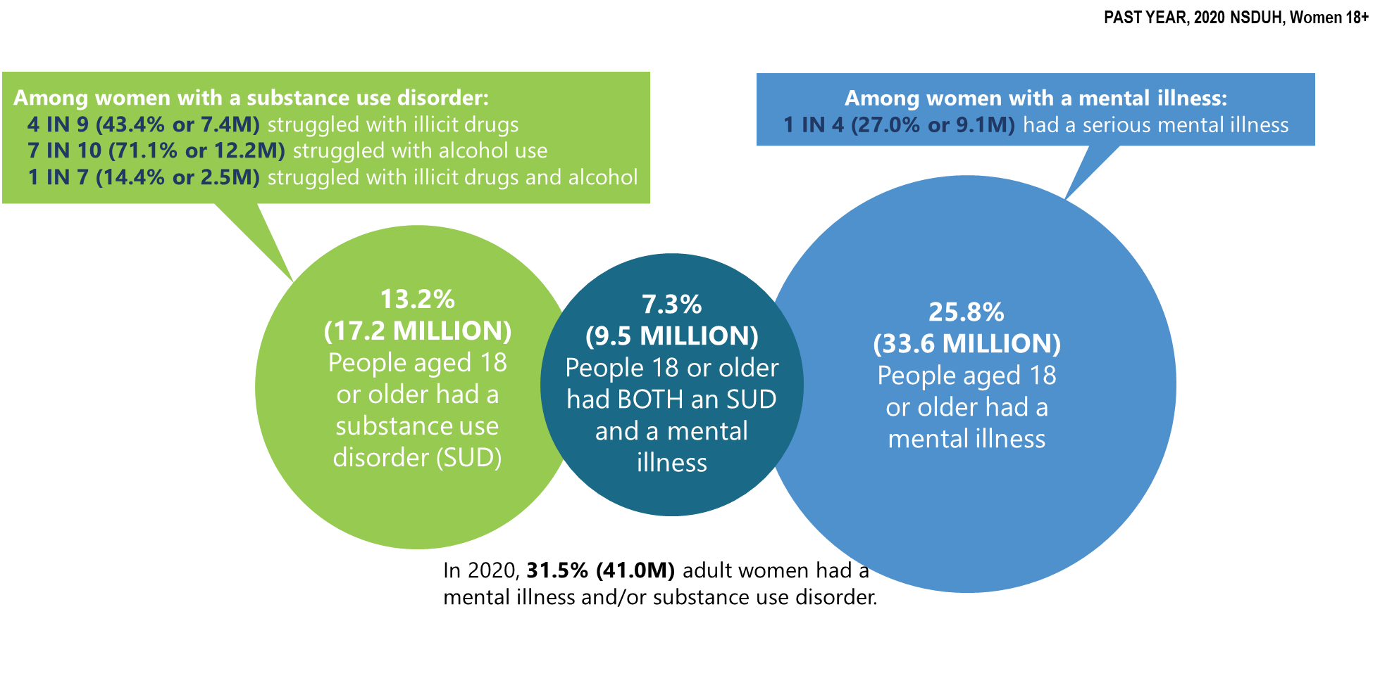
Mental Illness and Substance Use Disorders in America in the Past Year: Among Women Aged 18+
Notes:
The estimates in these slides have been rounded for the purposes of presentation. Any appearance of estimates not summing exactly to a known total are due to this rounding.
Some slides present the same analysis across multiple years. The underlying populations from which these estimates are derived change across years since the number of people in the United States changes across years. Thus, a change in proportions does not equal a constant change in the weighted count.
TALKING POINTS:
Millions of women struggle with substance use disorder and mental illness.
Almost three quarters of women with SUD struggled with alcohol use.
One in four women with mental illness experienced serious mental illness.
9.5 million women had both an SUD and mental illness.

Slide 8
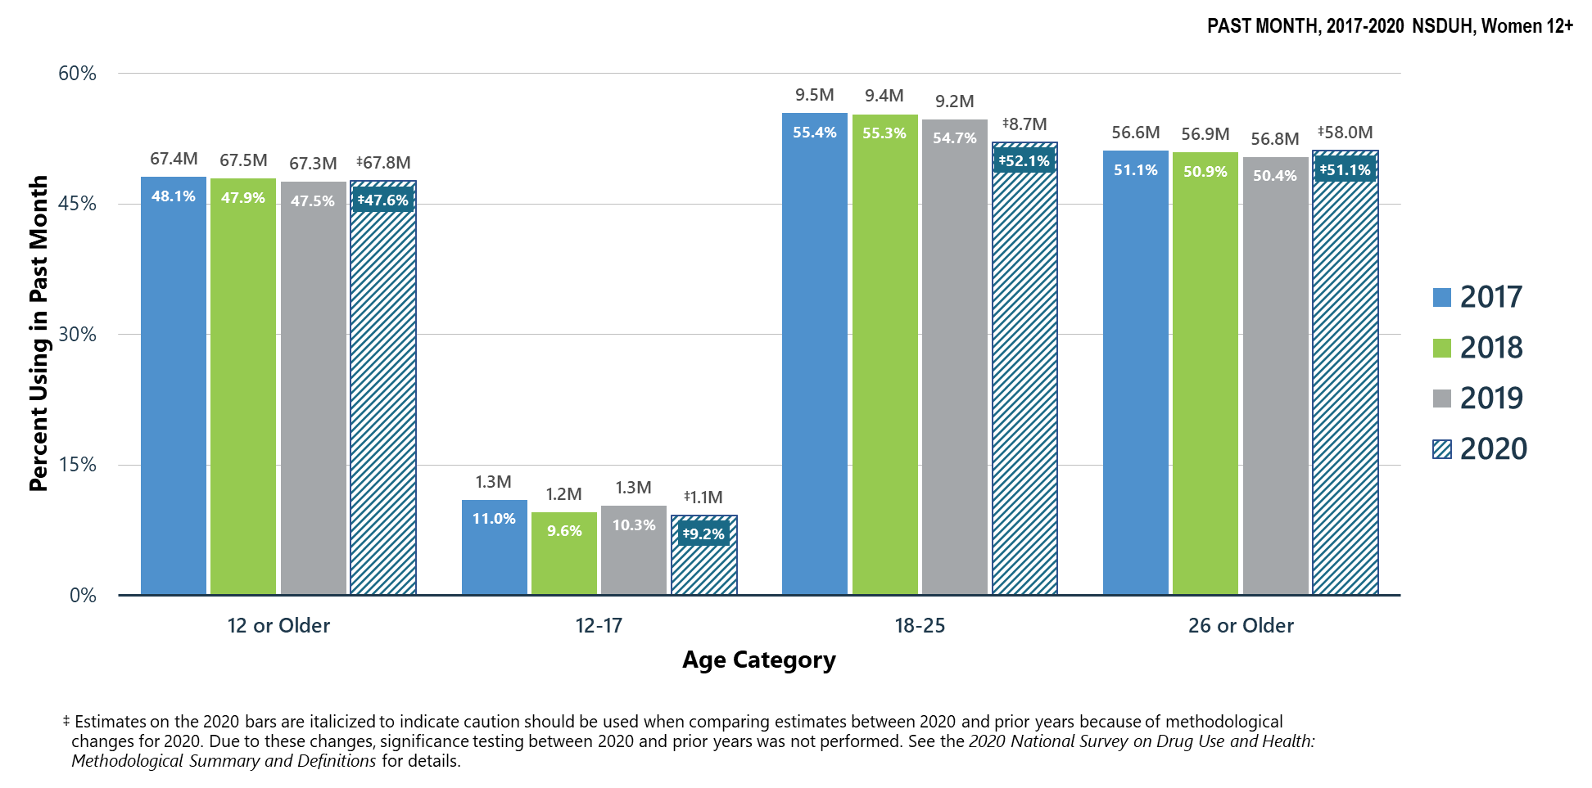
Alcohol Use in Past Month: Among Women Aged 12+
Notes:
The estimates in these slides have been rounded for the purposes of presentation. Any appearance of estimates not summing exactly to a known total are due to this rounding.
Some slides present the same analysis across multiple years. The underlying populations from which these estimates are derived change across years since the number of people in the United States changes across years. Thus, a change in proportions does not equal a constant change in the weighted count.
TALKING POINTS:
In 2020, nearly half of women aged 12 or older used alcohol during the past month.
Women aged 18 to 25 and 26 or older had higher rates of alcohol use than youths aged 12 to 17.
2020 estimates were not directly compared to estimates from prior years due to methodological changes in 2020.

Slide 9
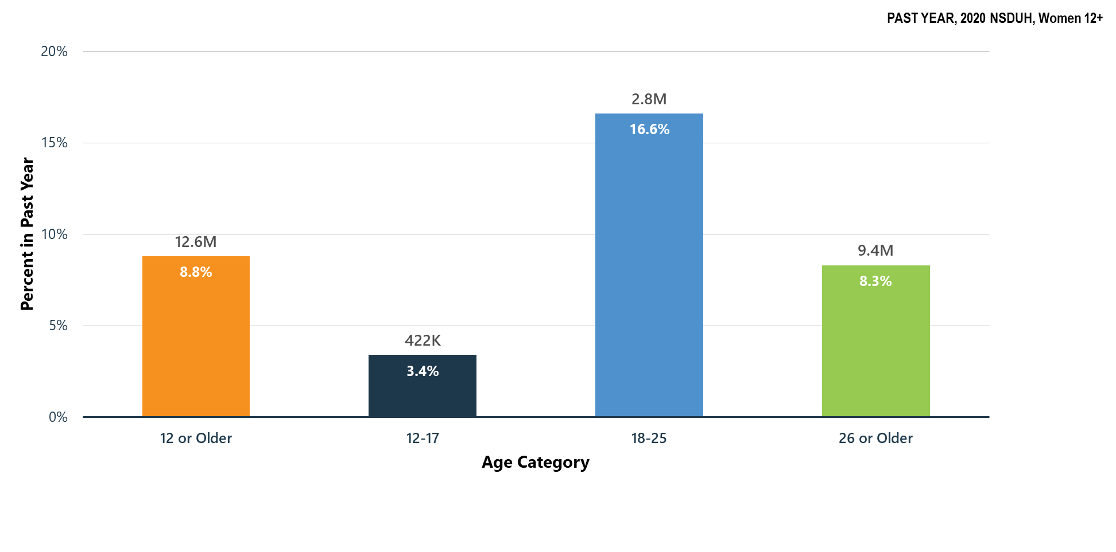
Alcohol Use Disorder in Past Year: Among Women Aged 12+
Notes:
The estimates in these slides have been rounded for the purposes of presentation. Any appearance of estimates not summing exactly to a known total are due to this rounding.
Some slides present the same analysis across multiple years. The underlying populations from which these estimates are derived change across years since the number of people in the United States changes across years. Thus, a change in proportions does not equal a constant change in the weighted count.
TALKING POINTS:
In NSDUH, alcohol use disorder is measured using questions based on the diagnostic criteria specified in the Diagnostic and Statistical Manual of Mental Disorders, also known as DSM. Starting in 2020, NSDUH used the criteria specified in DSM-5, which was published in 2013.
In 2020, the percentage of women who had past year alcohol use disorder was highest among young adults aged 18 to 25.

Slide 10
Summary: Alcohol Use in 2020
Among women aged 12 to 17 in 2020:
  9.2 percent (or 1.1 million people) used alcohol in the past month
  3.4 percent (or 422,000 people) had an alcohol use disorder
Among women aged 18 to 25 in 2020:
  52.1 percent (or 8.7 million people) used alcohol in the past month
  16.6 percent (or 2.8 million people) had an alcohol use disorder
Among women aged 26 or older in 2020:
  51.1 percent (or 58.0 million people) used alcohol in the past month
  8.3 percent (or 9.4 million people) had an alcohol use disorder

Slide 11
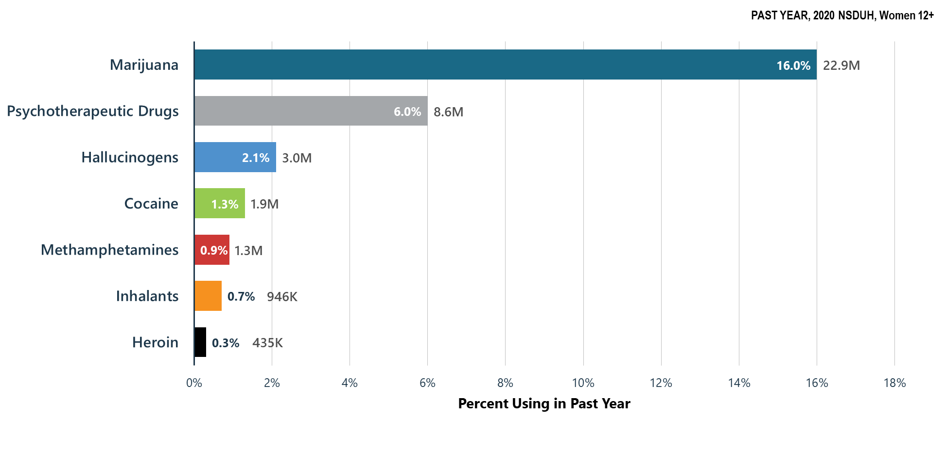
Illicit Drug Use in Past Year: Among Women Aged 12+
Notes:
The estimates in these slides have been rounded for the purposes of presentation. Any appearance of estimates not summing exactly to a known total are due to this rounding.
Some slides present the same analysis across multiple years. The underlying populations from which these estimates are derived change across years since the number of people in the United States changes across years. Thus, a change in proportions does not equal a constant change in the weighted count.
TALKING POINTS:
The 2020 NSDUH defines illicit drug use as the use of marijuana, cocaine (including crack), heroin, hallucinogens, inhalants, and methamphetamine, as well as the misuse of prescription stimulants, tranquilizers, sedatives, and pain relievers.
In NSDUH, misuse of prescription drugs was defined as use in any way not directed by a doctor, including use without a prescription of one's own; use in greater amounts, more often, or longer than told to take a drug; or use in any other way not directed by a doctor.
The most commonly used illicit drug in the past year was marijuana followed by the misuse of psychotherapeutic drugs (prescription stimulants, tranquilizers, sedatives, and pain relievers).

Slide 12
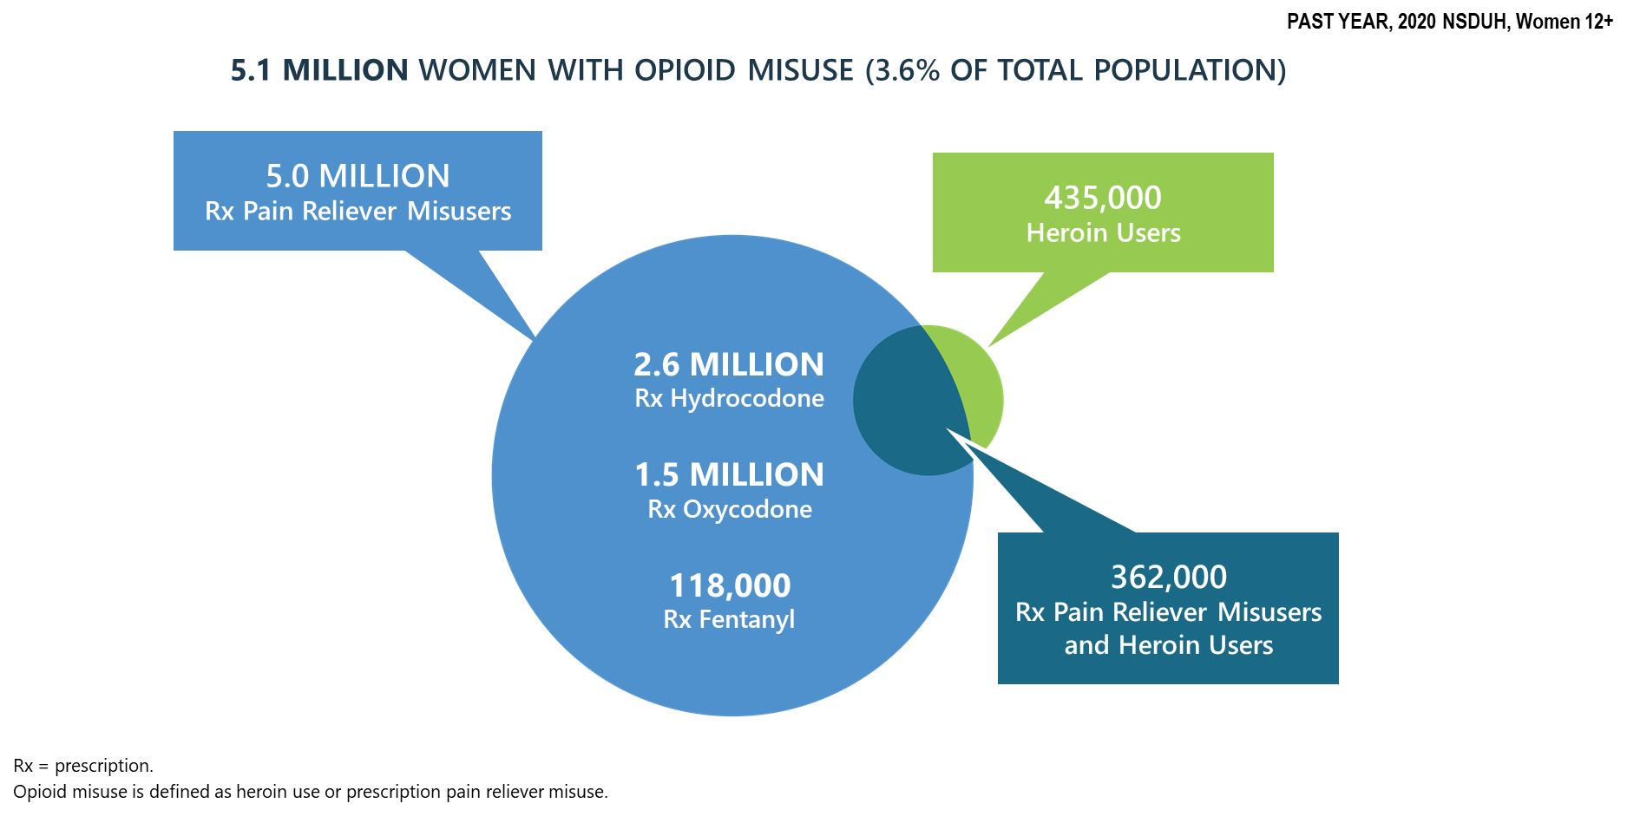
Prescription Pain Reliever Misuse and Heroin Use in Past Year: Among Women Aged 12+
Notes:
The estimates in these slides have been rounded for the purposes of presentation. Any appearance of estimates not summing exactly to a known total are due to this rounding.
Some slides present the same analysis across multiple years. The underlying populations from which these estimates are derived change across years since the number of people in the United States changes across years. Thus, a change in proportions does not equal a constant change in the weighted count.
TALKING POINTS:
Opioids are a group of chemically similar drugs that include heroin and prescription opioids, such as hydrocodone (e.g., Vicodin®), oxycodone (e.g., OxyContin®), and morphine.
Prescription pain reliever misuse and heroin use fall under the umbrella of opioid misuse.
Of those who misused opioids, the vast majority were misusers of prescription pain relievers.
Of those who used heroin, less than 1 in 5 used heroin alone.

Slide 13
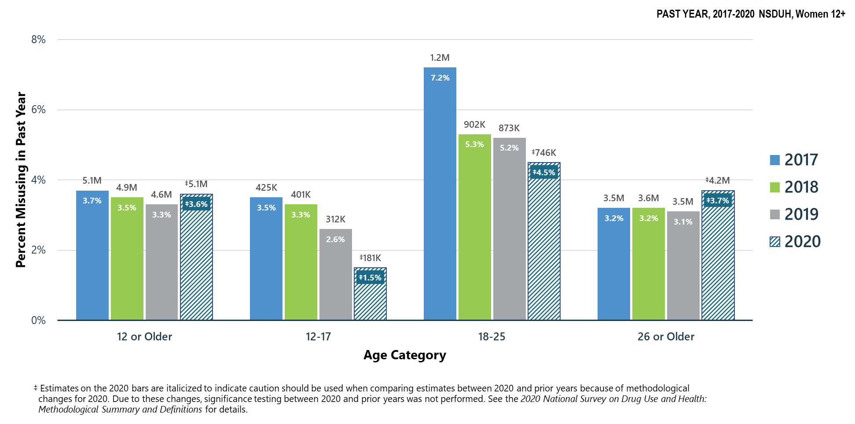
Opioid Misuse in Past Year: Among Women Aged 12+
Notes:
The estimates in these slides have been rounded for the purposes of presentation. Any appearance of estimates not summing exactly to a known total are due to this rounding.
Some slides present the same analysis across multiple years. The underlying populations from which these estimates are derived change across years since the number of people in the United States changes across years. Thus, a change in proportions does not equal a constant change in the weighted count.
TALKING POINTS:
In 2020, young adult women aged 18 to 25 and women aged 26 or older had higher percentages of opioid misuse in the past year than youths aged 12 to 17.

Slide 14
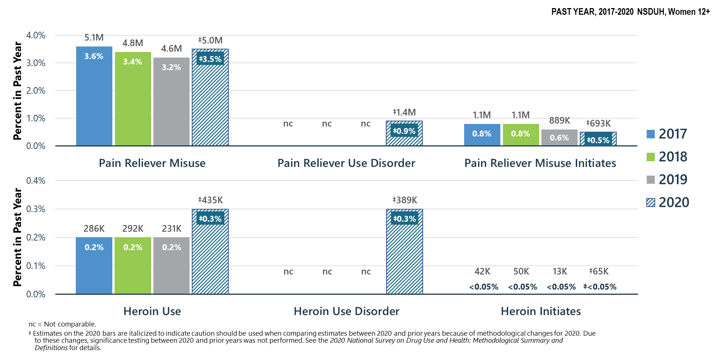
Prescription Pain Reliever Misuse and Heroin Use in Past Year: Among Women Aged 12+
Notes:
The estimates in these slides have been rounded for the purposes of presentation. Any appearance of estimates not summing exactly to a known total are due to this rounding.
Some slides present the same analysis across multiple years. The underlying populations from which these estimates are derived change across years since the number of people in the United States changes across years. Thus, a change in proportions does not equal a constant change in the weighted count.
TALKING POINTS:
Misuse of prescription pain relivers is much more common than heroin use.
Likewise, pain reliever use disorder is more common than heroin use disorder.

Slide 15
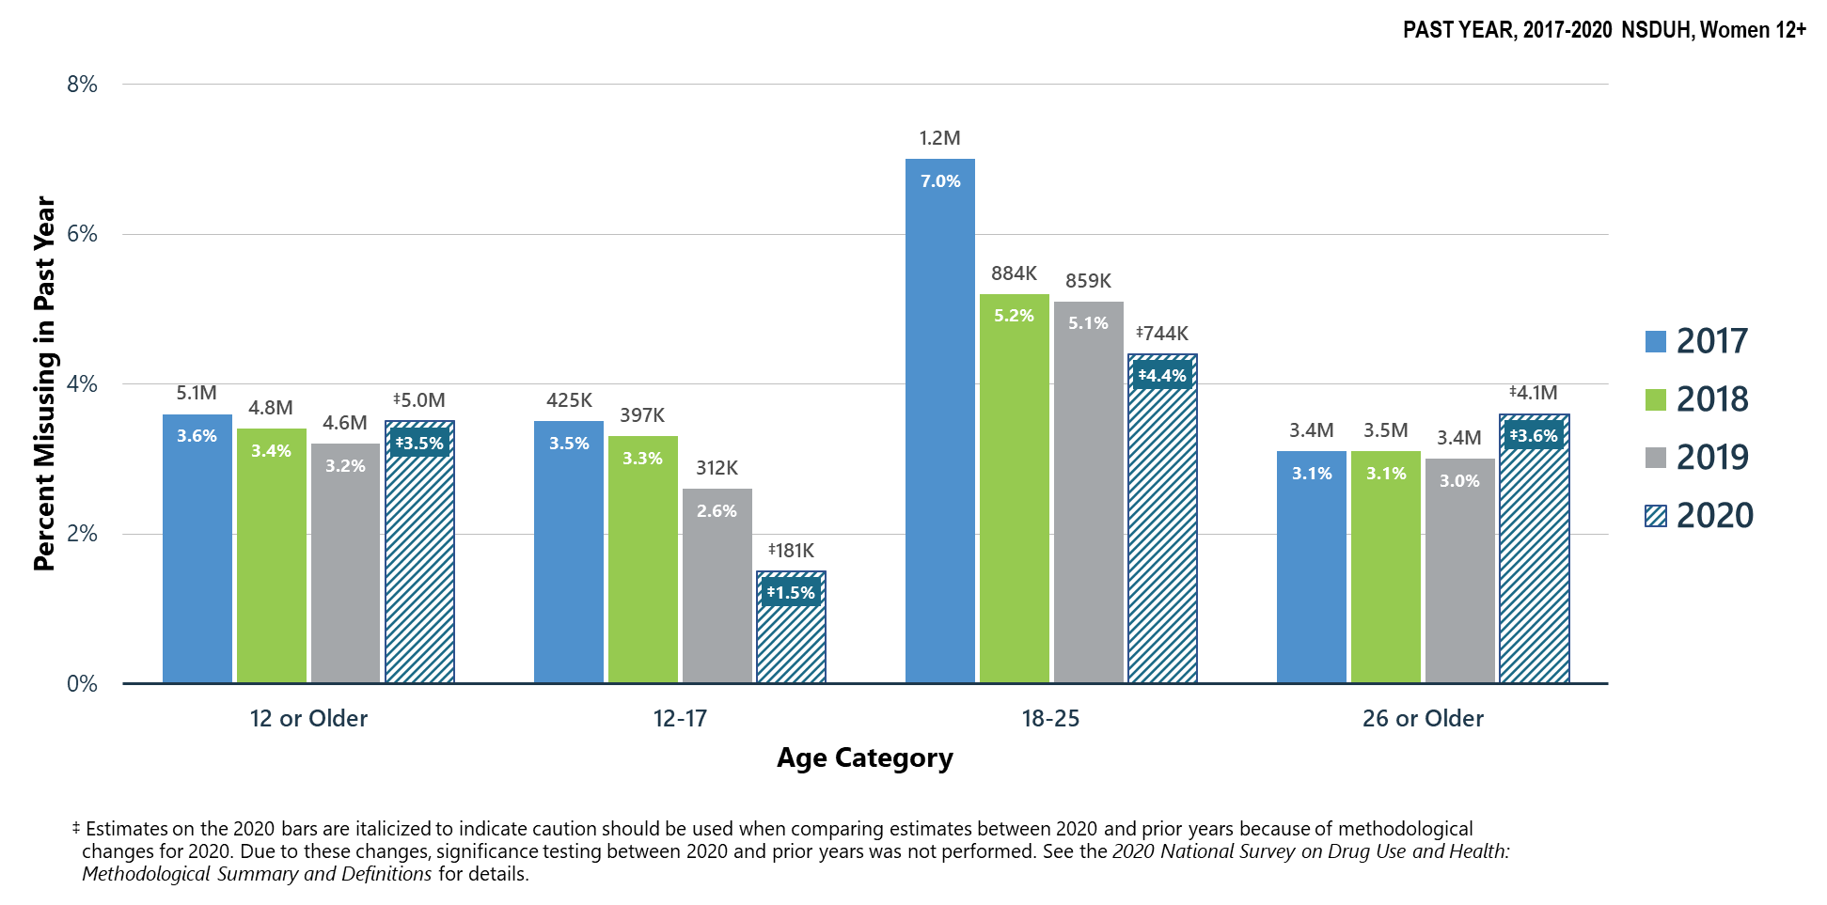
Prescription Pain Reliever Misuse in Past Year: Among Women Aged 12+
Notes:
The estimates in these slides have been rounded for the purposes of presentation. Any appearance of estimates not summing exactly to a known total are due to this rounding.
Some slides present the same analysis across multiple years. The underlying populations from which these estimates are derived change across years since the number of people in the United States changes across years. Thus, a change in proportions does not equal a constant change in the weighted count.
TALKING POINTS:
In 2020, young adult women aged 18 to 25 and women aged 26 or older had higher percentages of prescription pain reliever misuse in the past year than youths aged 12 to 17.

Slide 16
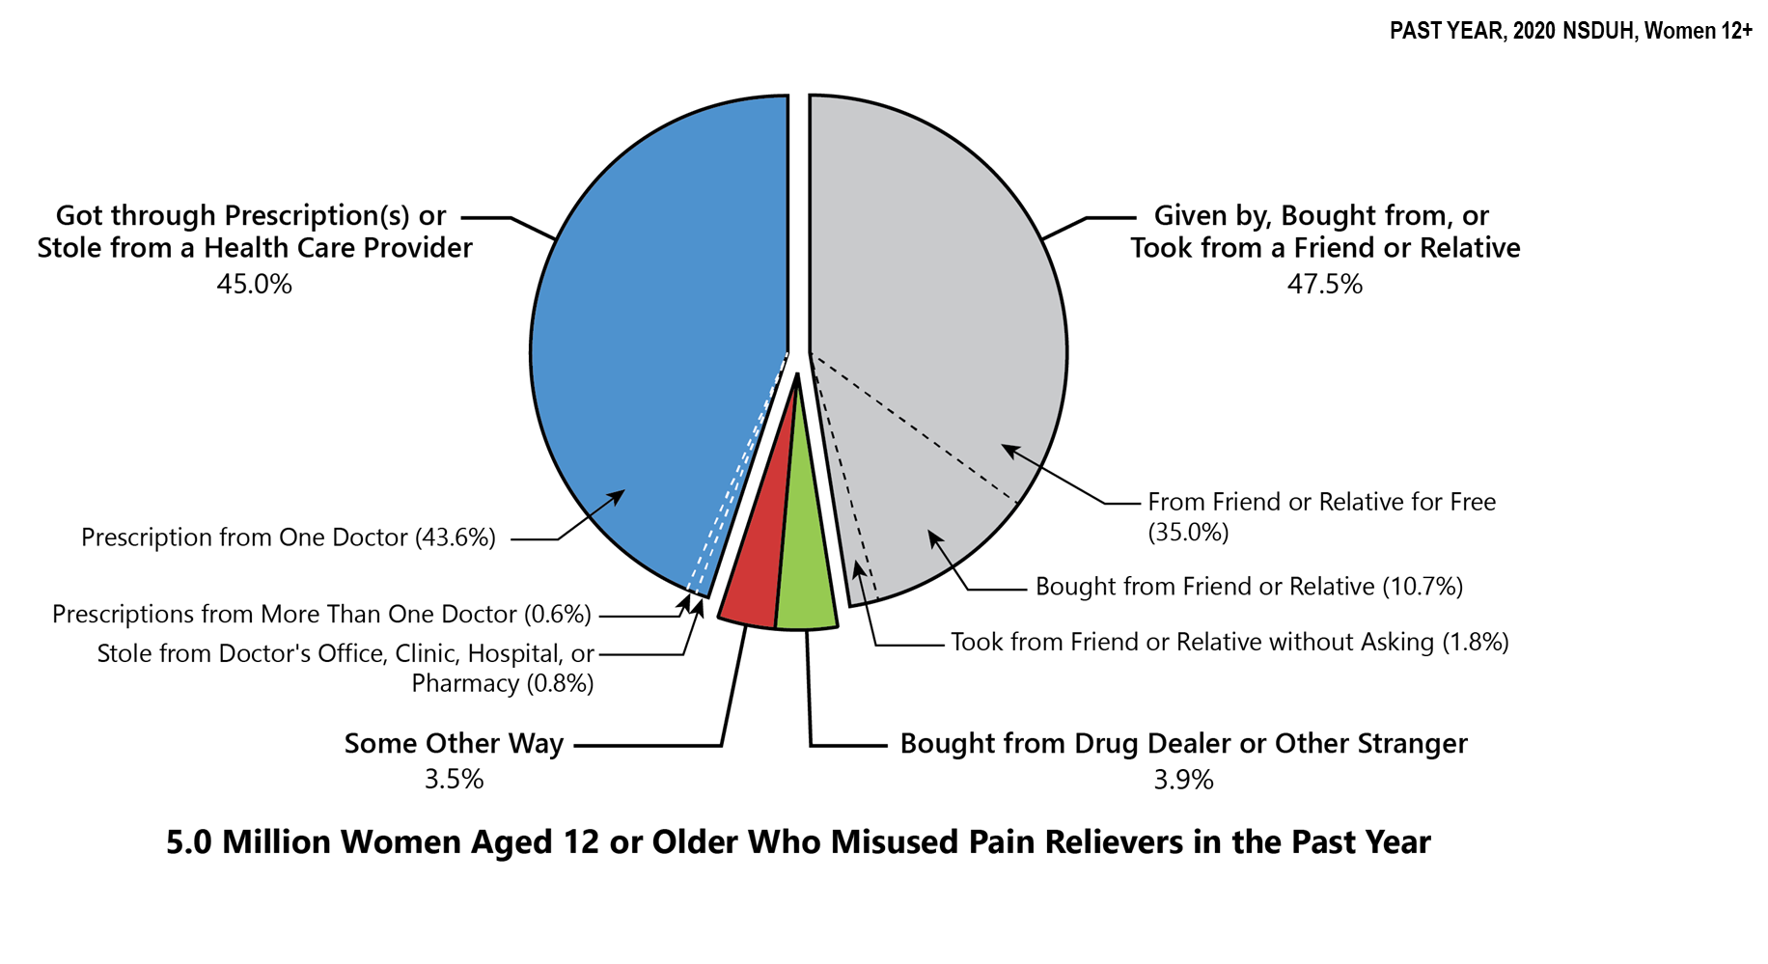
Sources Where Pain Relievers Were Obtained for Most Recent Misuse in Past Year: Among Women Aged 12+ Who Misused Prescription Pain Relievers in Past Year
Notes:
The estimates in these slides have been rounded for the purposes of presentation. Any appearance of estimates not summing exactly to a known total are due to this rounding.
Some slides present the same analysis across multiple years. The underlying populations from which these estimates are derived change across years since the number of people in the United States changes across years. Thus, a change in proportions does not equal a constant change in the weighted count.
TALKING POINTS:
The most common source for the last pain reliever misused was from a friend or relative in some way (i.e., being given them, buying them, or taking them without asking).
Nearly half of women who misused prescription pain relievers obtained the pain relievers through prescription(s) or stole pain relievers from a health care provider.

Slide 17
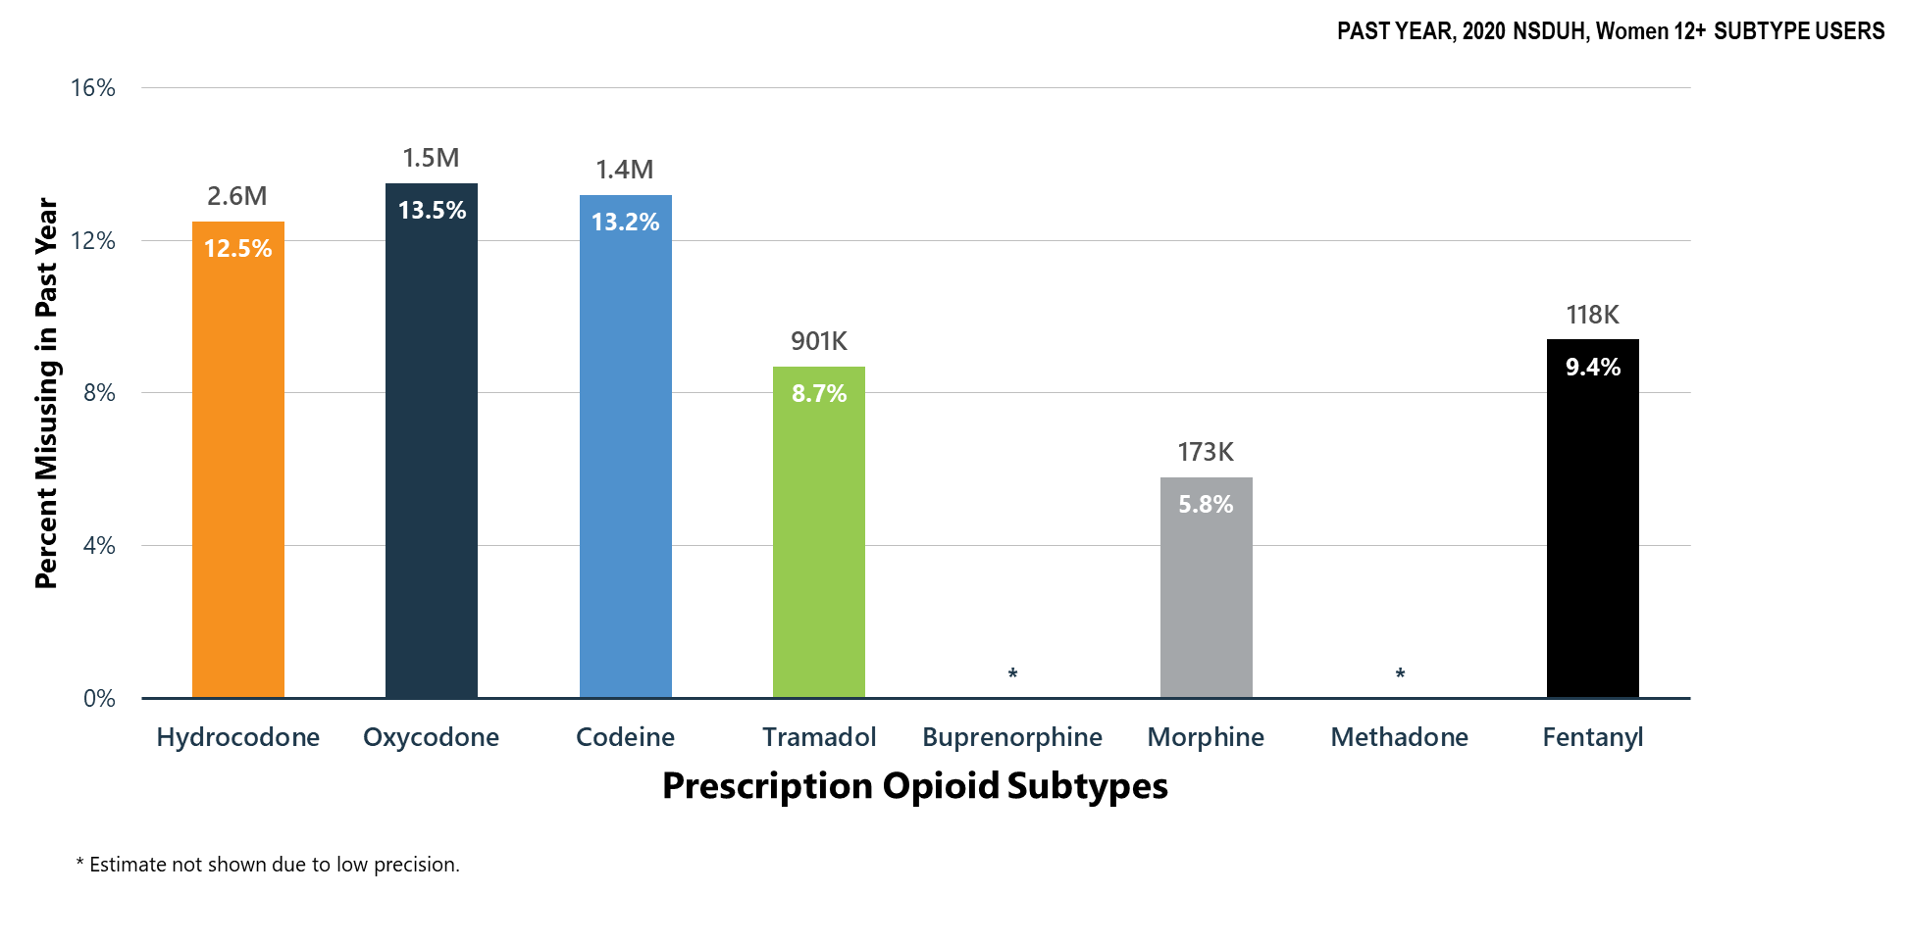
Misuse of Prescription Opioid Subtypes in Past Year: Among Women Aged 12+ Who Had Any Use of the Prescription Opioid
Notes:
The estimates in these slides have been rounded for the purposes of presentation. Any appearance of estimates not summing exactly to a known total are due to this rounding.
Some slides present the same analysis across multiple years. The underlying populations from which these estimates are derived change across years since the number of people in the United States changes across years. Thus, a change in proportions does not equal a constant change in the weighted count.
TALKING POINTS:
Women aged 12 or older who used hydrocodone, oxycodone, or codeine products during the past year had higher rates of past year misuse of the drug than women who used morphine or fentanyl.

Slide 18
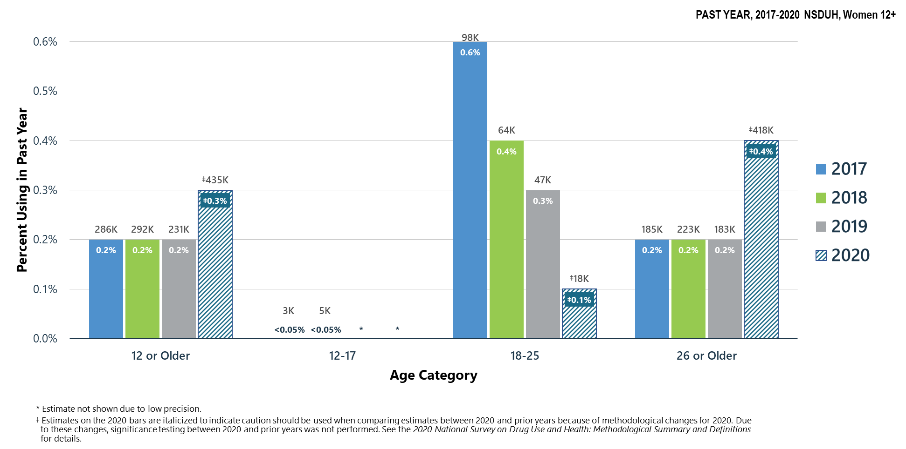
Heroin Use in Past Year: Among Women Aged 12+
Notes:
The estimates in these slides have been rounded for the purposes of presentation. Any appearance of estimates not summing exactly to a known total are due to this rounding.
Some slides present the same analysis across multiple years. The underlying populations from which these estimates are derived change across years since the number of people in the United States changes across years. Thus, a change in proportions does not equal a constant change in the weighted count.
TALKING POINTS:
In 2020, women aged 26 or older had the highest percentage of heroin use in the past year compared with other age groups.
Estimates for youths aged 12 to 17 could not be calculated with sufficient precision.

Slide 19
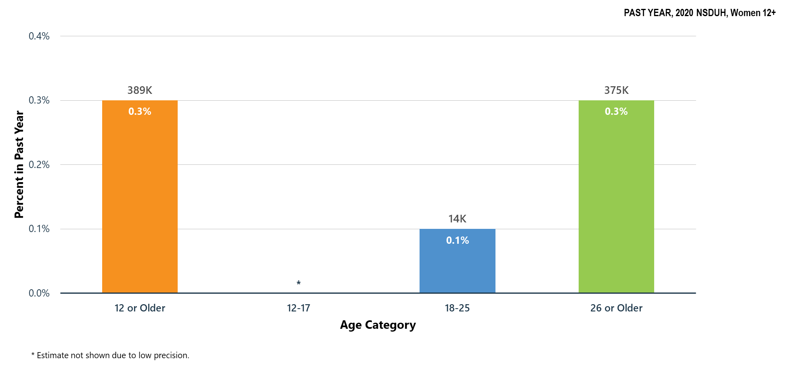
Heroin Use Disorder in Past Year: Among Women Aged 12+
Notes:
The estimates in these slides have been rounded for the purposes of presentation. Any appearance of estimates not summing exactly to a known total are due to this rounding.
Some slides present the same analysis across multiple years. The underlying populations from which these estimates are derived change across years since the number of people in the United States changes across years. Thus, a change in proportions does not equal a constant change in the weighted count.
TALKING POINTS:
In 2020, women aged 26 or older had the highest percentage of heroin use disorder in the past year.
Estimates for youths aged 12 to 17 could not be calculated with sufficient precision.

Slide 20
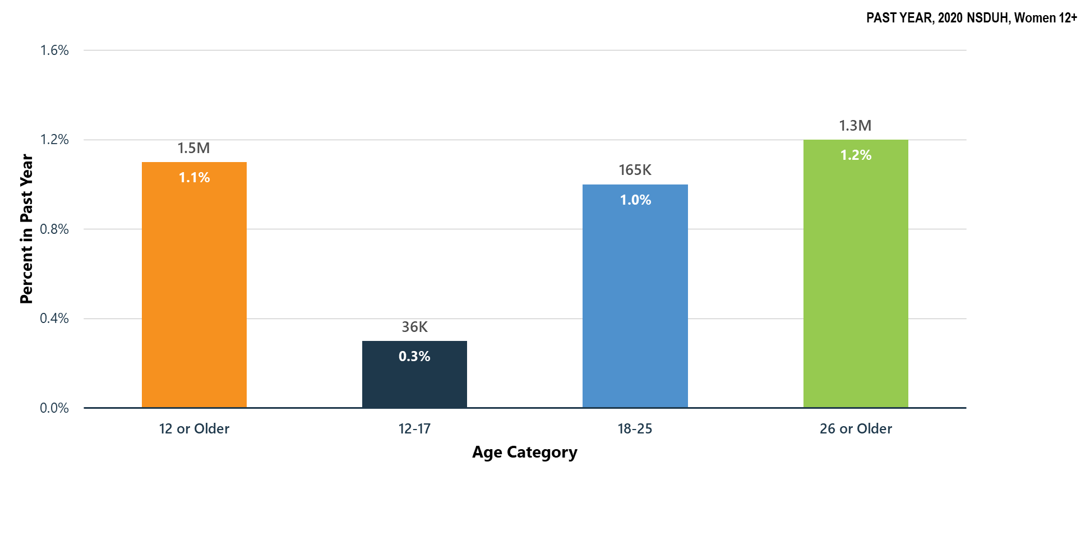
Opioid Use Disorder in Past Year: Among Women Aged 12+
Notes:
The estimates in these slides have been rounded for the purposes of presentation. Any appearance of estimates not summing exactly to a known total are due to this rounding.
Some slides present the same analysis across multiple years. The underlying populations from which these estimates are derived change across years since the number of people in the United States changes across years. Thus, a change in proportions does not equal a constant change in the weighted count.
TALKING POINTS:
Respondents were classified as having an opioid use disorder if they met DSM-5 criteria for heroin use disorder or prescription pain reliever use disorder, or both.
In 2020, young adult women aged 18 to 25 and women aged 26 or older had higher percentages of opioid use disorder in the past year than youths aged 12 to 17.

Slide 21
Summary: Opioid Misuse in 2020
Opioid misuse is primarily driven by prescription pain reliever misuse.
Most prescription pain relievers that are misused are obtained from a prescription to the misuser or given to the misuser for free by a friend or relative.
Among women aged 12 to 17 in 2020:
  1.5 percent (or 181,000 people) misused opioids in the past year
  0.3 percent (or 36,000 people) had an opioid use disorder
Among women aged 18 to 25 in 2020:
  4.5 percent (or 746,000 people) misused opioids in the past year
  1.0 percent (or 165,000 people) had an opioid use disorder
Among women aged 26 or older in 2020:
  3.7 percent (or 4.2 million people) misused opioids in the past year
  1.2 percent (or 1.3 million people) had an opioid use disorder

Slide 22
Other Illicit Substances

Slide 23
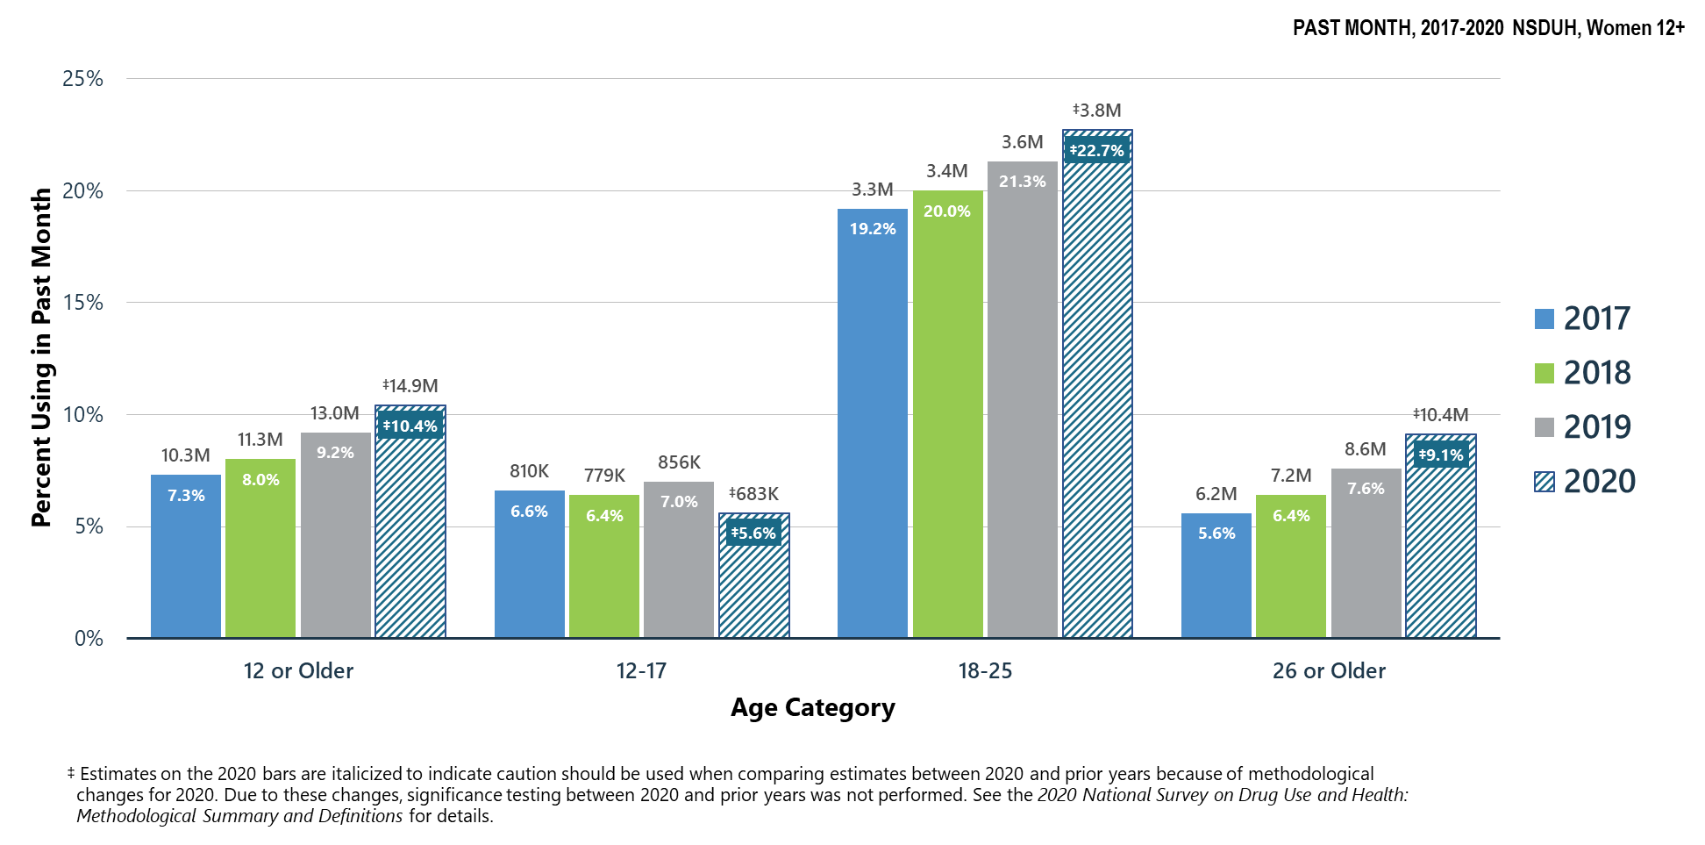
Marijuana Use in Past Month: Among Women Aged 12+
Notes:
The estimates in these slides have been rounded for the purposes of presentation. Any appearance of estimates not summing exactly to a known total are due to this rounding.
Some slides present the same analysis across multiple years. The underlying populations from which these estimates are derived change across years since the number of people in the United States changes across years. Thus, a change in proportions does not equal a constant change in the weighted count.
TALKING POINTS:
In 2020, marijuana was the most commonly used illicit drug.
The percentage of past month marijuana use was highest among young adult women aged 18 to 25, followed by women aged 26 or older, then by youths aged 12 to 17.

Slide 24
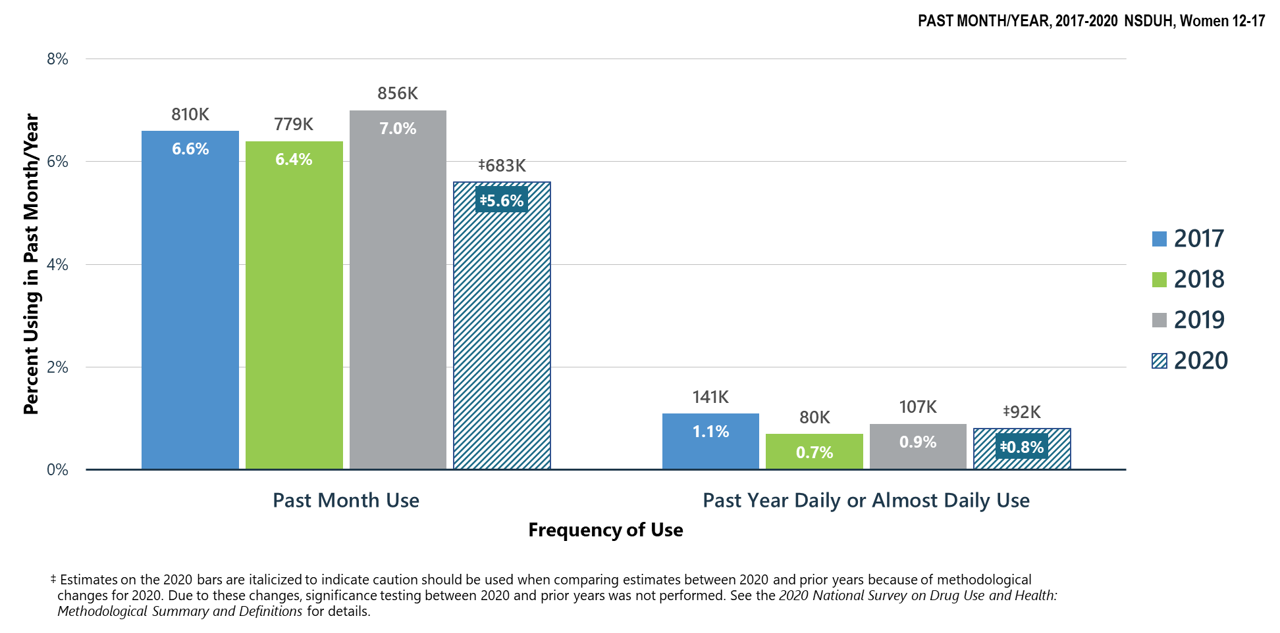
Frequency of Marijuana Use: Among Female Youths Aged 12-17
Notes:
The estimates in these slides have been rounded for the purposes of presentation. Any appearance of estimates not summing exactly to a known total are due to this rounding.
Some slides present the same analysis across multiple years. The underlying populations from which these estimates are derived change across years since the number of people in the United States changes across years. Thus, a change in proportions does not equal a constant change in the weighted count.
TALKING POINTS:
In 2020, less than 1 percent of female youths aged 12 to 17 used marijuana daily or almost daily in the past year.

Slide 25
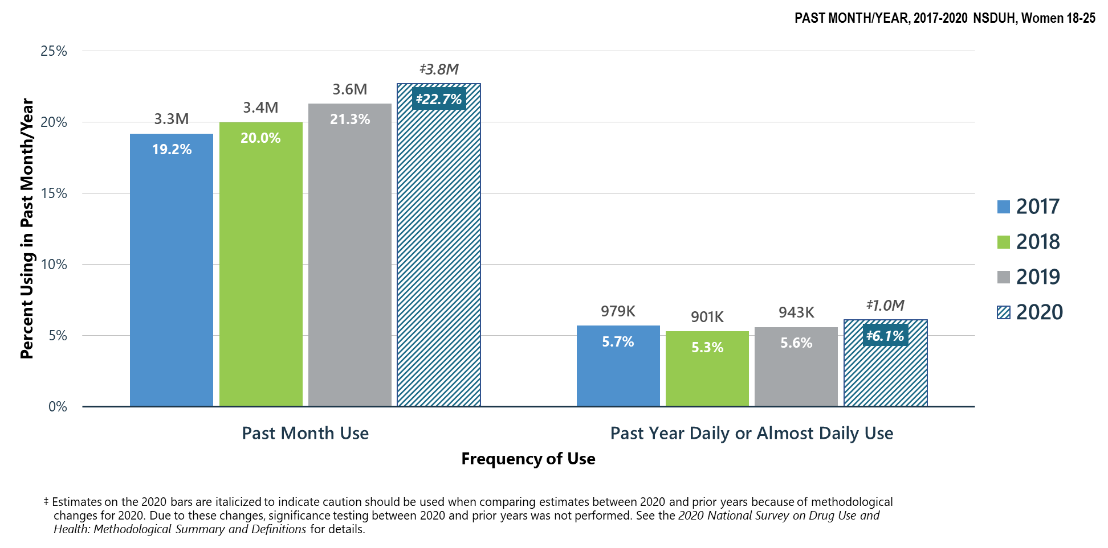
Frequency of Marijuana Use: Among Young Adult Women Aged 18-25
Notes:
The estimates in these slides have been rounded for the purposes of presentation. Any appearance of estimates not summing exactly to a known total are due to this rounding.
Some slides present the same analysis across multiple years. The underlying populations from which these estimates are derived change across years since the number of people in the United States changes across years. Thus, a change in proportions does not equal a constant change in the weighted count.
TALKING POINTS:
In 2020, young adult women aged 18 to 25 had the highest percentage of past year daily or almost daily marijuana use compared with other age groups.

Slide 26
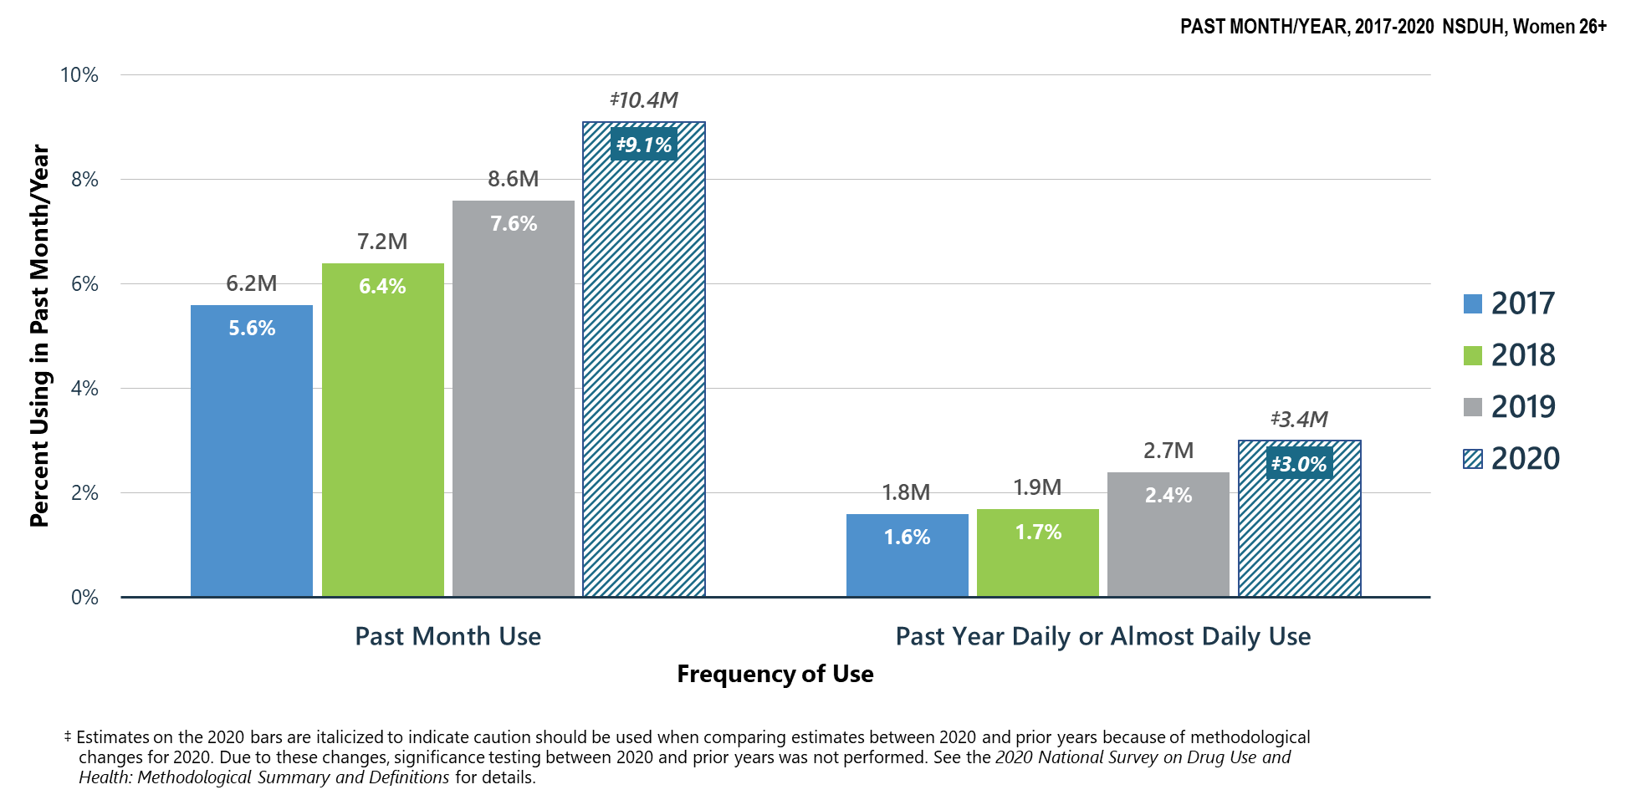
Frequency of Marijuana Use: Among Women Aged 26+
Notes:
The estimates in these slides have been rounded for the purposes of presentation. Any appearance of estimates not summing exactly to a known total are due to this rounding.
Some slides present the same analysis across multiple years. The underlying populations from which these estimates are derived change across years since the number of people in the United States changes across years. Thus, a change in proportions does not equal a constant change in the weighted count.
TALKING POINTS:
In 2020, women aged 26 or older had a lower percentage of past month marijuana use and past year daily or almost daily marijuana use than young adult women aged 18 to 25.

Slide 27
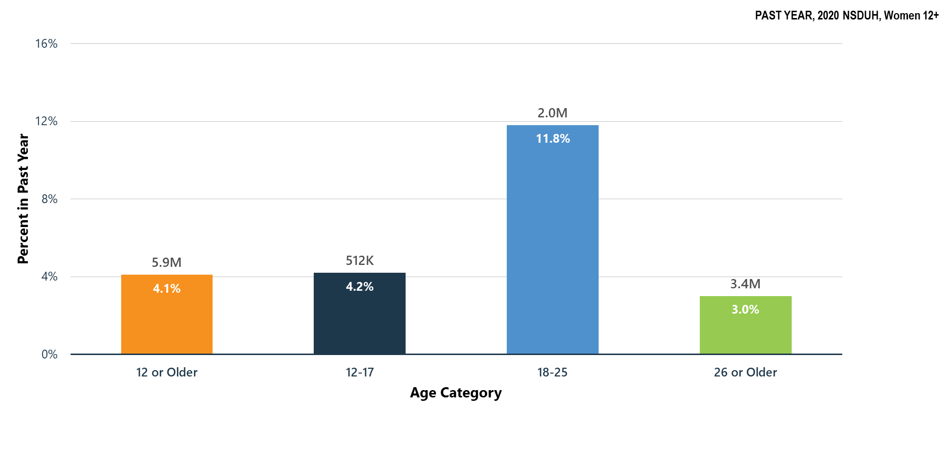
Marijuana Use Disorder in Past Year: Among Women Aged 12+
Notes:
The estimates in these slides have been rounded for the purposes of presentation. Any appearance of estimates not summing exactly to a known total are due to this rounding.
Some slides present the same analysis across multiple years. The underlying populations from which these estimates are derived change across years since the number of people in the United States changes across years. Thus, a change in proportions does not equal a constant change in the weighted count.
TALKING POINTS:
Young adult women aged 18 to 25 had the highest percentage of marijuana use disorder in the past year when compared to youths aged 12 to 17 and women aged 26 or older.
The higher percentage of young adult women with a marijuana use disorder was consistent with the higher percentage among this age group for marijuana use in the past month.

Slide 28
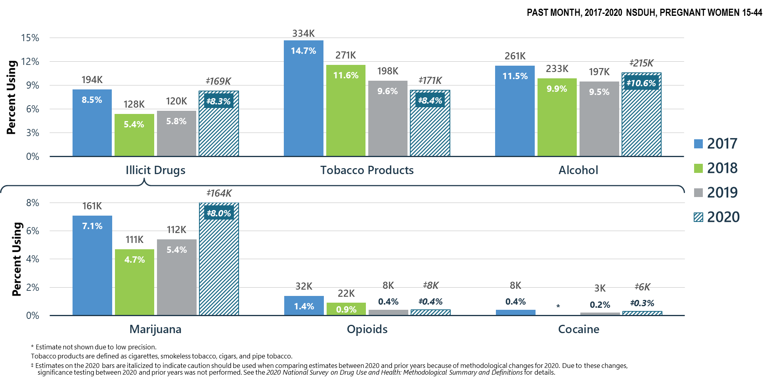
Substance Use in Past Month: Among Pregnant Women Aged 15-44
Notes:
The estimates in these slides have been rounded for the purposes of presentation. Any appearance of estimates not summing exactly to a known total are due to this rounding.
Some slides present the same analysis across multiple years. The underlying populations from which these estimates are derived change across years since the number of people in the United States changes across years. Thus, a change in proportions does not equal a constant change in the weighted count.
TALKING POINTS:
In 2020, between 8 percent and 11 percent of pregnant women aged 15 to 44 used illicit drugs, tobacco products, or alcohol in the past month.
The most commonly used illicit drug among pregnant women in this age group was marijuana.

Slide 29
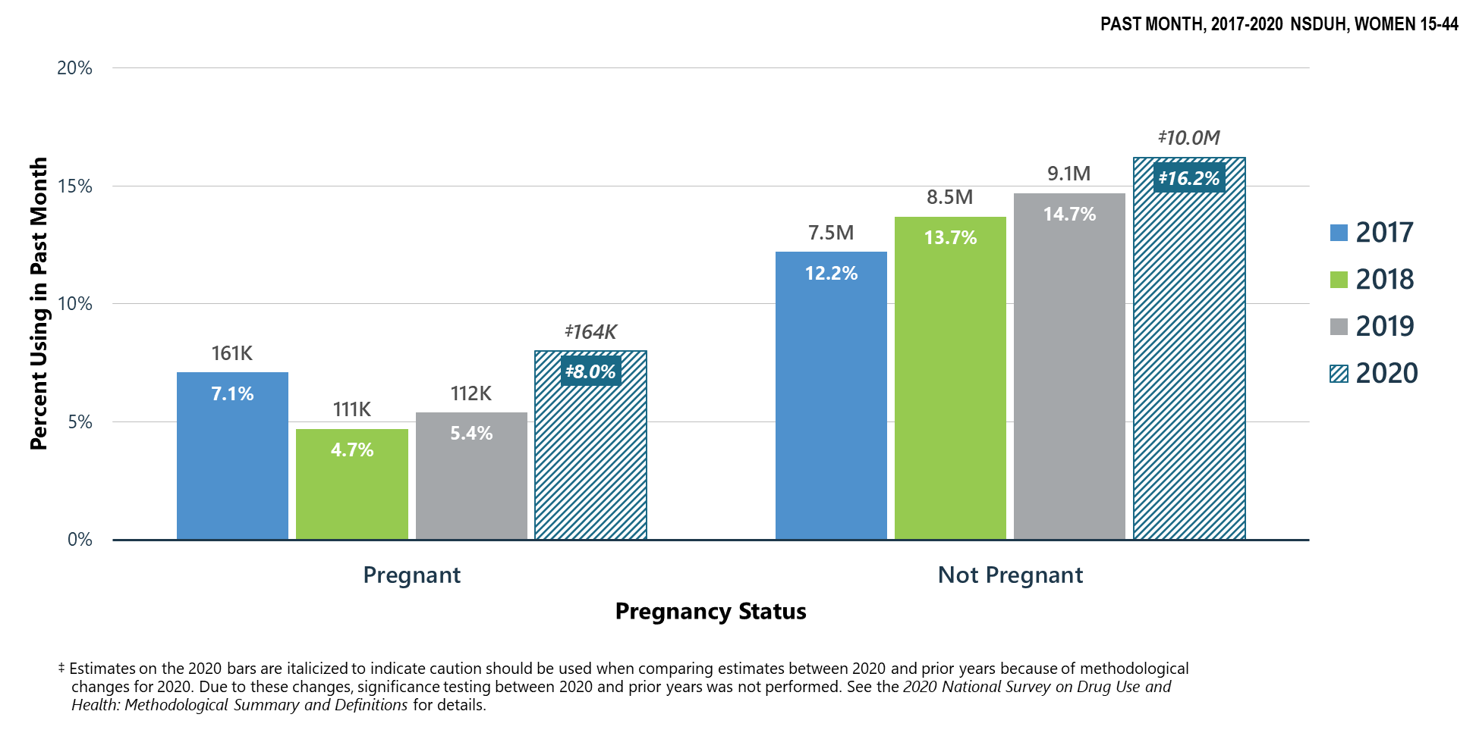
Marijuana Use in Past Month: Among Women Aged 15-44;
By Pregnancy Status
Notes:
The estimates in these slides have been rounded for the purposes of presentation. Any appearance of estimates not summing exactly to a known total are due to this rounding.
Some slides present the same analysis across multiple years. The underlying populations from which these estimates are derived change across years since the number of people in the United States changes across years. Thus, a change in proportions does not equal a constant change in the weighted count.
TALKING POINTS:
In 2020, pregnant women aged 15 to 44 were less likely to use marijuana in the past month than their non-pregnant counterparts.

Slide 30
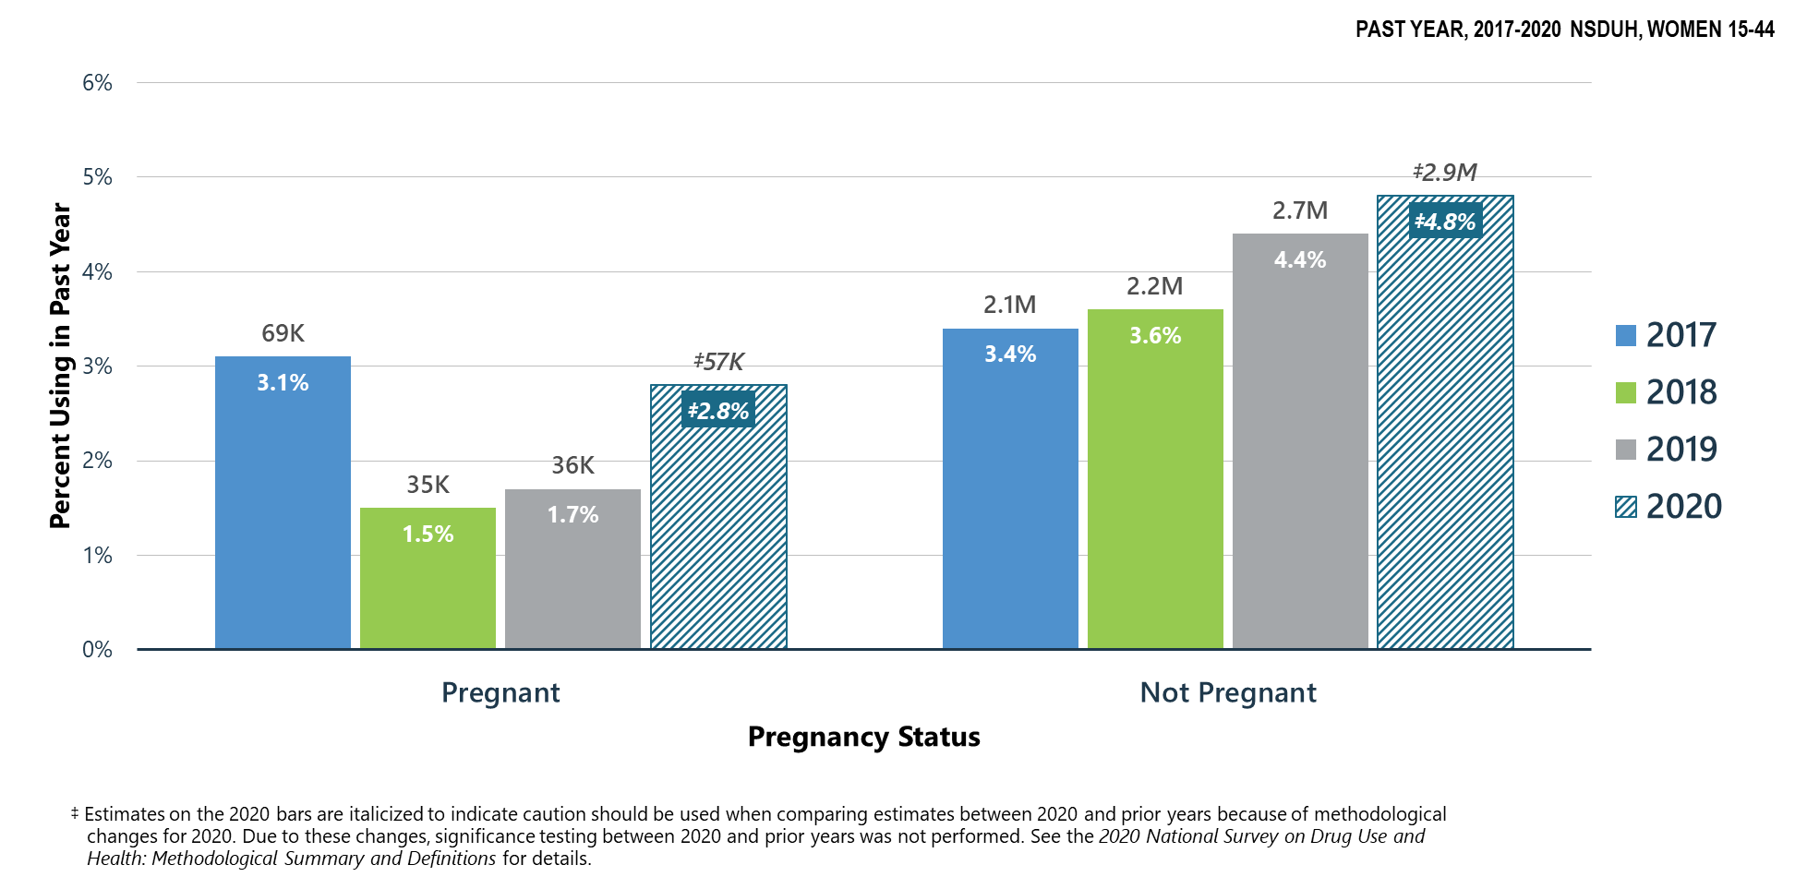
Daily or Almost Daily Marijuana Use in Past Year: Among Women Aged 15-44; By Pregnancy Status
Notes:
The estimates in these slides have been rounded for the purposes of presentation. Any appearance of estimates not summing exactly to a known total are due to this rounding.
Some slides present the same analysis across multiple years. The underlying populations from which these estimates are derived change across years since the number of people in the United States changes across years. Thus, a change in proportions does not equal a constant change in the weighted count.
TALKING POINTS:
In 2020, 2.8 percent of pregnant women used marijuana daily or almost daily during the past year, as did 4.8 percent of their non-pregnant counterparts. These percentages are not significantly different from one another.

Slide 31
Summary: Marijuana Use in 2020
Among women aged 12 to 17 in 2020:
  5.6 percent (or 683,000 people) used marijuana in the past month
  4.2 percent (or 512,000 people) had a marijuana use disorder
Among women aged 18 to 25 in 2020:
  22.7 percent (or 3.8 million people) used marijuana in the past month
  11.8 percent (or 2.0 million people) had a marijuana use disorder
Among women aged 26 or older in 2020:
  9.1 percent (or 10.4 million people) used marijuana in the past month
  3.0 percent (or 3.4 million people) had a marijuana use disorder
Among pregnant women aged 15 to 44 in 2020:
  8.0 percent (or 164,000 women) used marijuana in the past month

Slide 32
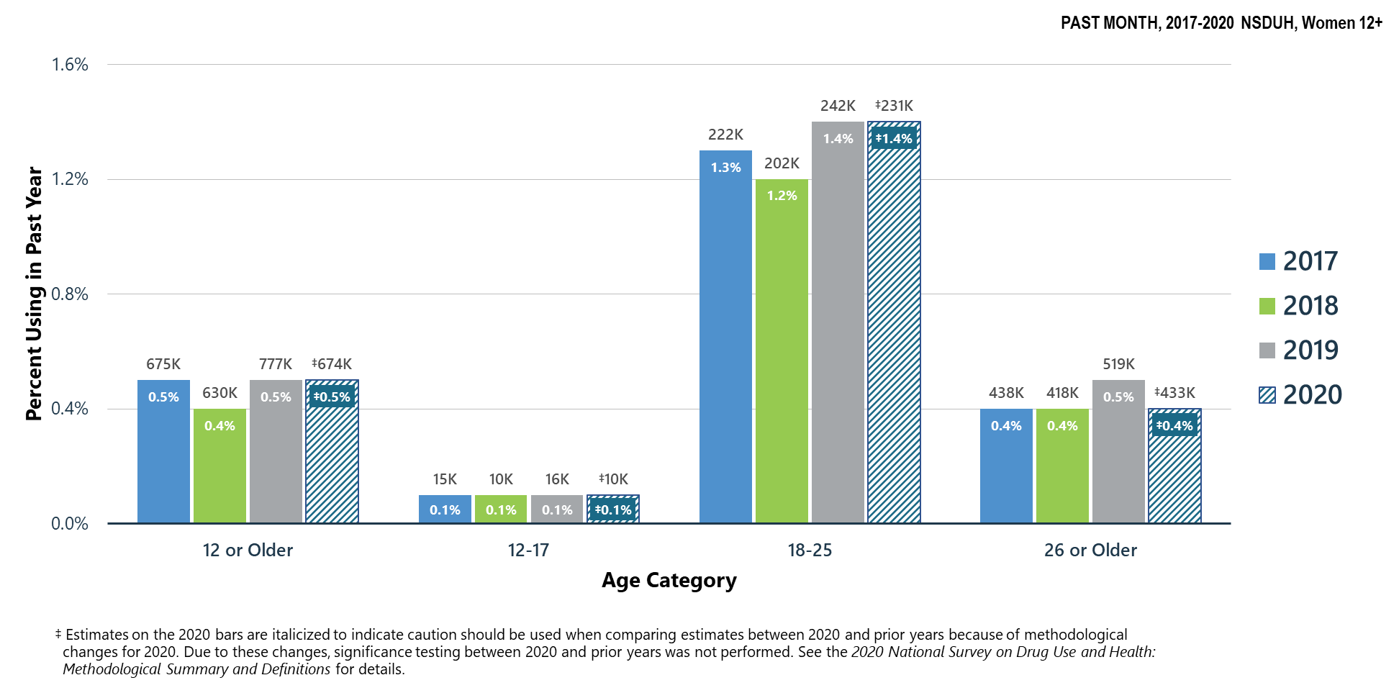
Cocaine Use in Past Year: Among Women Aged 12+
Notes:
The estimates in these slides have been rounded for the purposes of presentation. Any appearance of estimates not summing exactly to a known total are due to this rounding.
Some slides present the same analysis across multiple years. The underlying populations from which these estimates are derived change across years since the number of people in the United States changes across years. Thus, a change in proportions does not equal a constant change in the weighted count.
TALKING POINTS:
Cocaine use includes the use of crack cocaine.
In 2020, young adult women aged 18 to 25 had the highest percentage of cocaine use in the past year, followed by women aged 26 or older, then by youths aged 12 to 17.

Slide 33
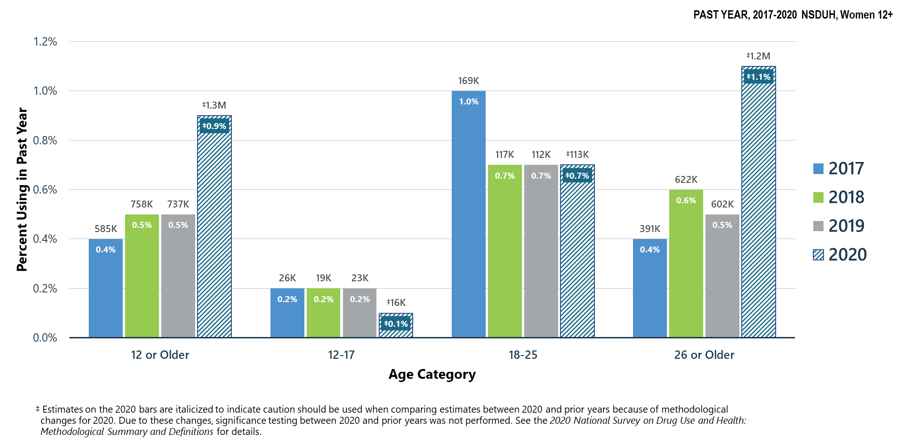
Methamphetamine Use in Past Year: Among Women Aged 12+
Notes:
The estimates in these slides have been rounded for the purposes of presentation. Any appearance of estimates not summing exactly to a known total are due to this rounding.
Some slides present the same analysis across multiple years. The underlying populations from which these estimates are derived change across years since the number of people in the United States changes across years. Thus, a change in proportions does not equal a constant change in the weighted count.
Talking Points:
Although methamphetamine is legally available by prescription (Desoxyn®), most methamphetamine used in the United States is produced and distributed illicitly rather than through the pharmaceutical industry. The misuse of prescription stimulants is covered on the next slide.
In 2020, female youths aged 12 to 17 had a lower percentage of past year methamphetamine use when compared to young adult women aged 18 to 25 and women aged 26 or older.

Slide 34
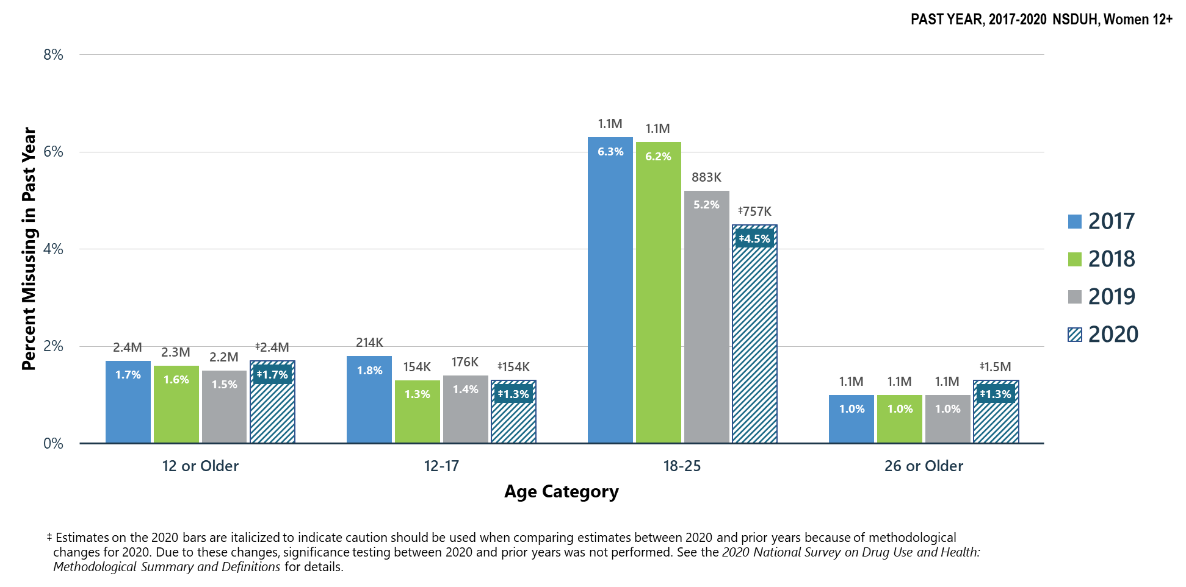
Misuse of Prescription Stimulants in Past Year: Among Women Aged 12+
Notes:
The estimates in these slides have been rounded for the purposes of presentation. Any appearance of estimates not summing exactly to a known total are due to this rounding.
Some slides present the same analysis across multiple years. The underlying populations from which these estimates are derived change across years since the number of people in the United States changes across years. Thus, a change in proportions does not equal a constant change in the weighted count.
TALKING POINTS:
Methamphetamine has not been included as a prescription stimulant, unless respondents specified the prescription form of methamphetamine (Desoxyn®) as some other stimulant they had misused in the past year.
In 2020, young adult women aged 18 to 25 had the highest percentage of prescription stimulant misuse in the past year.

Slide 35
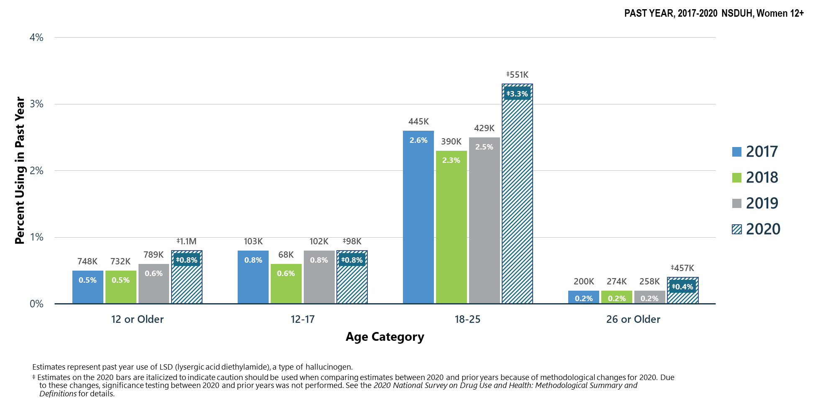
LSD Use in Past Year: Among Women Aged 12+
Notes:
The estimates in these slides have been rounded for the purposes of presentation. Any appearance of estimates not summing exactly to a known total are due to this rounding.
Some slides present the same analysis across multiple years. The underlying populations from which these estimates are derived change across years since the number of people in the United States changes across years. Thus, a change in proportions does not equal a constant change in the weighted count.
TALKING POINTS:
Several drugs are grouped under the category of hallucinogens, including LSD.
In 2020, young adult women aged 18 to 25 had a higher percentage of LSD use in the past year compared to female youths aged 12 to 17 and women aged 26 or older.

Slide 36
Summary: Other Substance Use in 2020
Among women aged 12 to 17 in 2020:
  0.1 percent (or 10,000 people) used cocaine in the past year
  0.1 percent (or 16,000 people) used methamphetamine in the past year
  1.3 percent (or 154,000 people) misused prescription stimulants in the past year
  0.8 percent (or 98,000 people) used LSD in the past year
Among women aged 18 to 25 in 2020:
  1.4 percent (or 231,000 people) used cocaine in the past year
  0.7 percent (or 113,000 people) used methamphetamine in the past year
  4.5 percent (or 757,000 people) misused prescription stimulants in the past year
  3.3 percent (or 551,000 people) used LSD in the past year
Among women aged 26 or older in 2020:
  0.4 percent (or 433,000 people) used cocaine in the past year
  1.1 percent (or 1.2 million people) used methamphetamine in the past year
  1.3 percent (or 1.5 million people) misused prescription stimulants in the past year
  0.4 percent (or 457,000 people) used LSD in the past year

Slide 37
Polysubstance Use
and Mental Illness

Slide 38
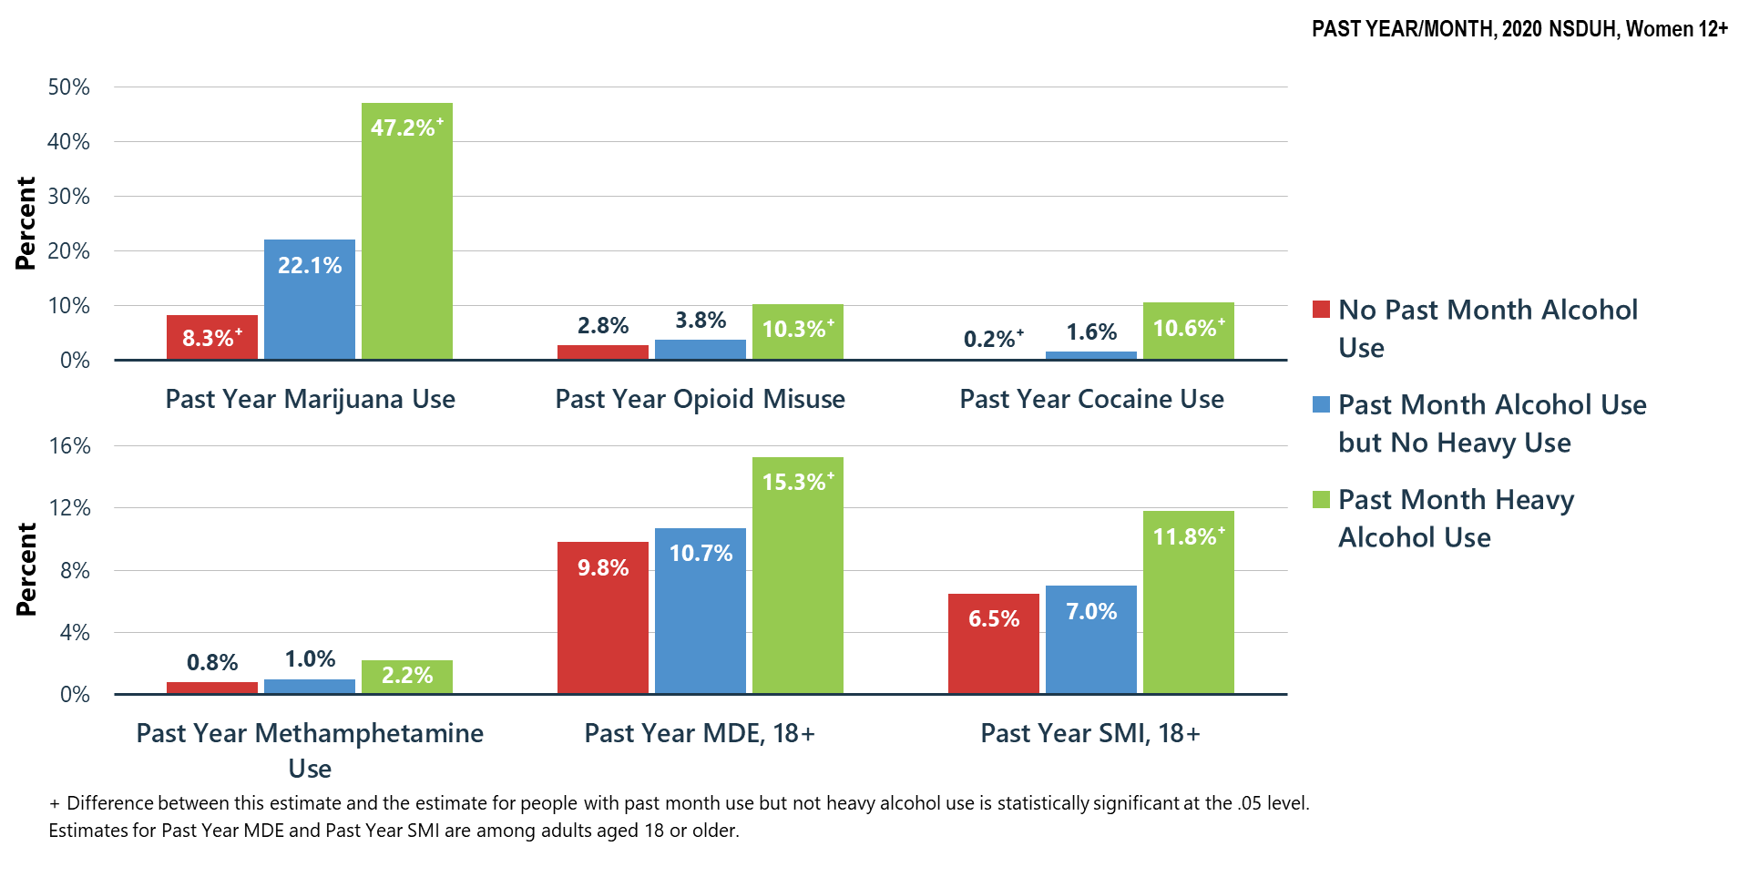
Substance Use in Past Year: Among Women Aged 12+; Major Depressive Episode (MDE) and Serious Mental Illness (SMI) in Past Year: Among Women Aged 18+; By Level of Alcohol Use in Past Month
Notes:
The estimates in these slides have been rounded for the purposes of presentation. Any appearance of estimates not summing exactly to a known total are due to this rounding.
Some slides present the same analysis across multiple years. The underlying populations from which these estimates are derived change across years since the number of people in the United States changes across years. Thus, a change in proportions does not equal a constant change in the weighted count.
TALKING POINTS:
Nearly 50 percent of the women aged 12 or older reporting heavy alcohol use in the past month also endorsed marijuana use in the past year. Women engaging in heavy alcohol use also reported significantly higher rates of opioid and cocaine misuse/use than women endorsing alcohol use, but had no heavy alcohol use.
These findings are consistent with literature suggesting that having an SUD for one substance significantly increases risk for developing SUDs for additional substances (e.g., studies have found that individuals with an alcohol use disorder are at twice the risk for developing an opioid use disorder) (Crummy et al., 2020).
NSDUH found that women aged 18 or older engaging in heavy alcohol use had a higher percentage of an MDE and SMI in the past year than adults who used alcohol, but had no heavy alcohol use in the past month.
Findings are consistent with literature suggesting depression and alcohol use disorder often co-occur. Studies have found that individuals with depression have a three-fold risk for developing alcohol use disorder in their lifetime (Schouten et al., 2022).
Crummy, E. A., O’Neal, T. J., Baskin, B. M., & Ferguson, S. M. (2020). One is not enough: understanding and modeling polysubstance use. Frontiers in Neuroscience, 14, 569.
Schouten, M. J., Christ, C., Dekker, J. J., Riper, H., Goudriaan, A. E., & Blankers, M. (2022). Digital interventions for people with co-occurring depression and problematic alcohol use: A systematic review and meta-analysis. Alcohol and Alcoholism, 57(1), 113-124.

Slide 39
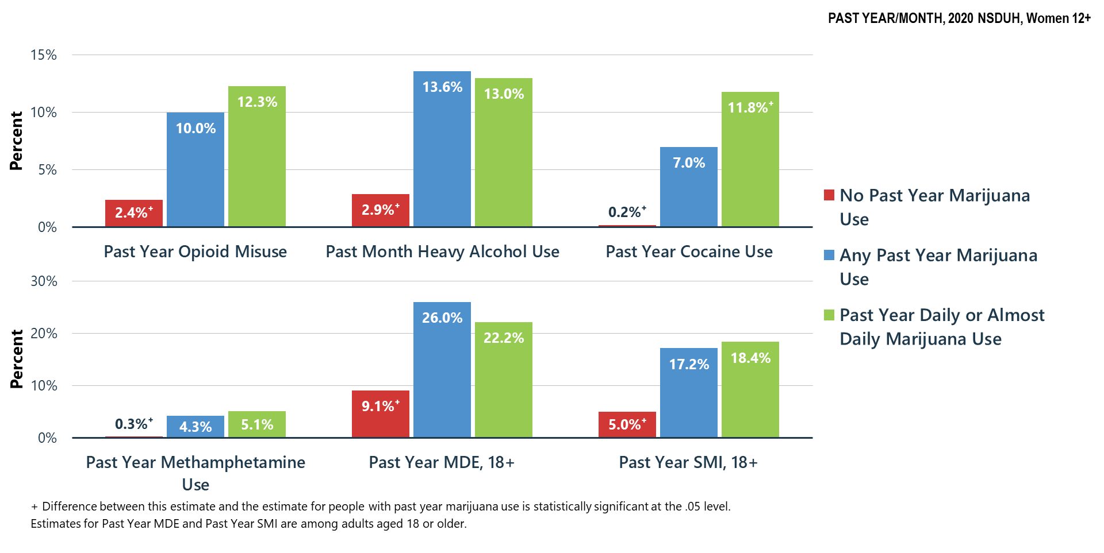
Substance Use in Past Year/Month: Among Women Aged 12+; Major Depressive Episode (MDE) and Serious Mental Illness (SMI) in Past Year: Among Women Aged 18+; By Level of Marijuana Use in Past Year
Notes:
The estimates in these slides have been rounded for the purposes of presentation. Any appearance of estimates not summing exactly to a known total are due to this rounding.
Some slides present the same analysis across multiple years. The underlying populations from which these estimates are derived change across years since the number of people in the United States changes across years. Thus, a change in proportions does not equal a constant change in the weighted count.
TALKING POINTS:
Women aged 12 or older who did not use marijuana in the past year were less likely to have used or misused other substances than women who had used marijuana in the past year. Women aged 18 or older were also less likely to have an MDE or SMI in the past year.
Women aged 12 or older who used marijuana daily or almost daily in the past year were more likely to have used cocaine in the past year than women who had used marijuana in the past year.
Co-occurring substance use and mental illness are common. Mental illness and substance use is often conceptualized as having a bidirectional relationship—in that substance use often leads to and exacerbates mental illness and mental illness can be a precursor for substance misuse. Literature has suggested that substance use (e.g., marijuana, alcohol) may be used as a way of regulating emotions (in the short term)—but exacerbating depression symptom severity in the long-term (Weiss et al., 2022).
Weiss, N. H., Kiefer, R., Goncharenko, S., Raudales, A. M., Forkus, S. R., Schick, M. R., & Contractor, A. A. (2022). Emotion regulation and substance use: A meta-analysis. Drug and Alcohol Dependence, 230, 109131.

Slide 40
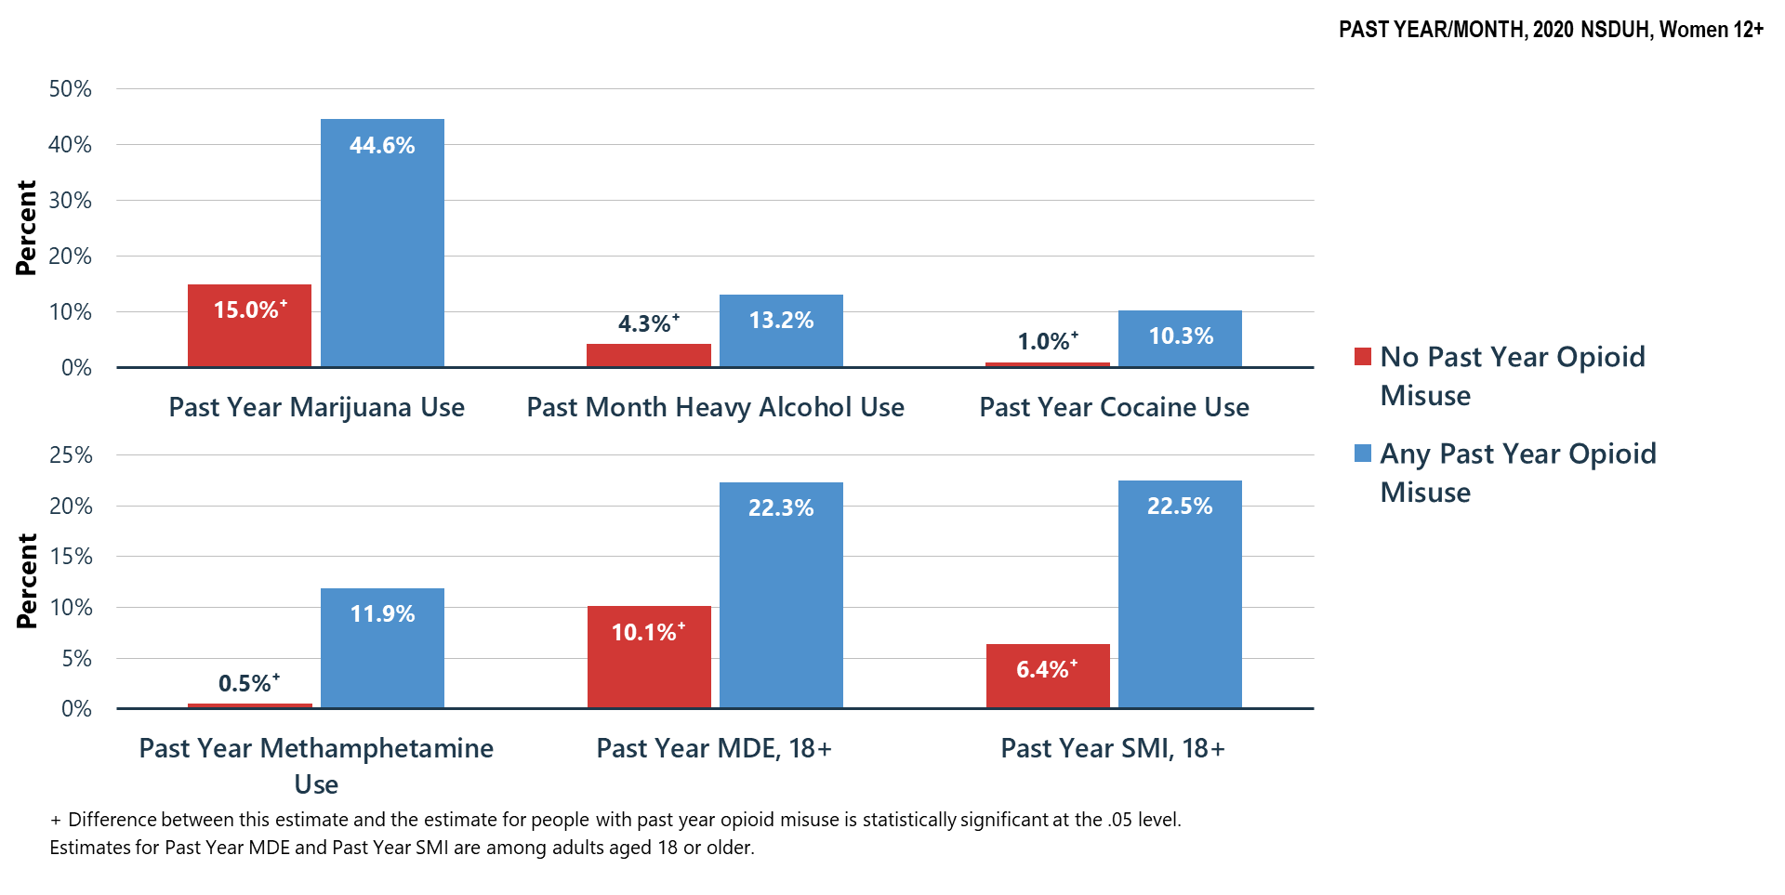
Substance Use in Past Year/Month: Among Women Aged 12+; Major Depressive Episode (MDE) and Serious Mental Illness (SMI) in Past Year: Among Women Aged 18+; By Level of Opioid Misuse in Past Year
Notes:
The estimates in these slides have been rounded for the purposes of presentation. Any appearance of estimates not summing exactly to a known total are due to this rounding.
Some slides present the same analysis across multiple years. The underlying populations from which these estimates are derived change across years since the number of people in the United States changes across years. Thus, a change in proportions does not equal a constant change in the weighted count.
TALKING POINTS:
The opioid epidemic continues to plague the United States. In 2019, more than 70 percent of drug overdose fatalities involved opioids. Opioid use often co-occurs with other substance misuse, including stimulants and cocaine (Mattson et al., 2021).
Women aged 12 or older who misused opioids in the past year had a higher percentage of past year marijuana use, past month heavy alcohol use, past year cocaine use, and past year methamphetamine use than women who did not misuse opioids in the past year.
Women aged 18 or older who misused opioids in the past year had a higher percentage of an MDE or SMI in the past year than women who did not misuse opioids in the past year.
Polysubstance use including opioids is particularly dangerous and is associated with increased death rates when compared with death rates of adults who use only one substance (Mattson et al., 2021).
Mattson, C. L., Tanz, L. J., Quinn, K., Kariisa, M., Patel, P., & Davis, N. L. (2021). Trends and geographic patterns in drug and synthetic opioid overdose deaths—United States, 2013–2019. Morbidity and Mortality Weekly Report, 70(6), 202.

Slide 41
Substance Use in Past Year/Month: Among Women Aged 12+; Major Depressive Episode (MDE) and Serious Mental Illness (SMI) in Past Year: Among Women Aged 18+; By Level of Methamphetamine Use in Past Year
Data not shown – low precision

Slide 42
Summary
Polysubstance use is common—if a person is having problems with one substance, they may be having problems with other substances
Treatment providers must screen for and treat all substance use disorders and problem substance use
Association of substance misuse and mental illness is clear—we must all do a better job of helping Americans understand these relationships and risks

Slide 43
Mental Health

Slide 44
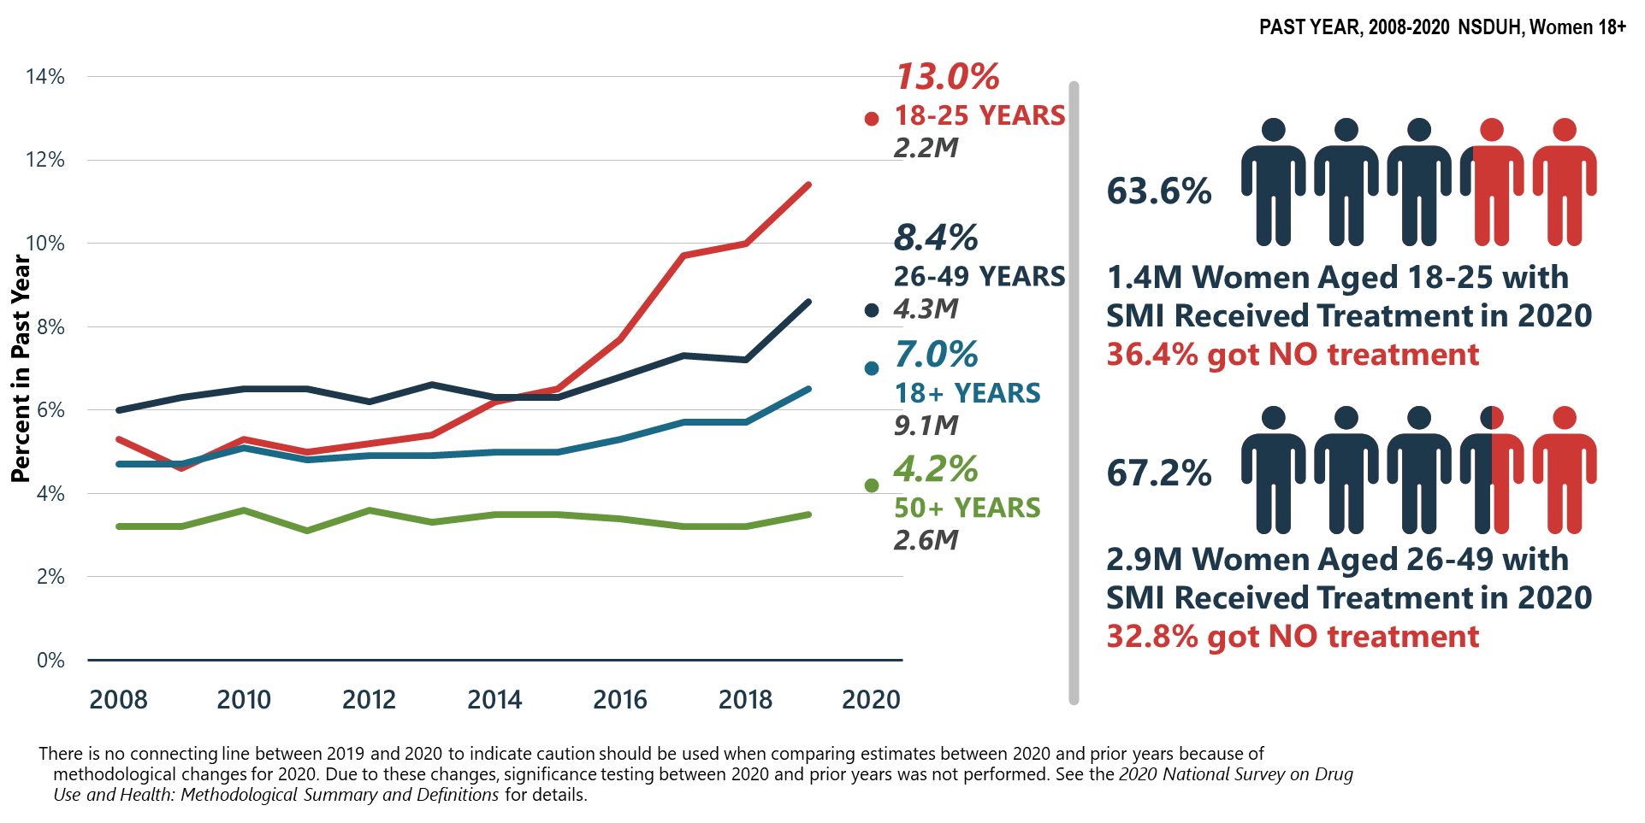
Serious Mental Illness (SMI) in Past Year: Among Women Aged 18+
Notes:
The estimates in these slides have been rounded for the purposes of presentation. Any appearance of estimates not summing exactly to a known total are due to this rounding.
Some slides present the same analysis across multiple years. The underlying populations from which these estimates are derived change across years since the number of people in the United States changes across years. Thus, a change in proportions does not equal a constant change in the weighted count.
TALKING POINTS:
In 2020, young adult women aged 18 to 25 had the highest percentage of SMI, followed by women aged 26-49, then women aged 50 or older.
SMI continues to be on the rise, particularly in young adults, which is consistent with literature showing mental health concerns in young adults have significantly increased over the past decade (Twenge et al., 2019).
Of the individuals reporting SMI, more than one third had not received mental health treatment of any kind in 2020. This data is evidence to suggest that improving access to mental health treatment remains an important target for improvement and innovation.
Twenge, J. M., Cooper, A. B., Joiner, T. E., Duffy, M. E., & Binau, S. G. (2019). Age, period, and cohort trends in mood disorder indicators and suicide-related outcomes in a nationally representative dataset, 2005–2017. Journal of Abnormal Psychology, 128(3), 185.

Slide 45
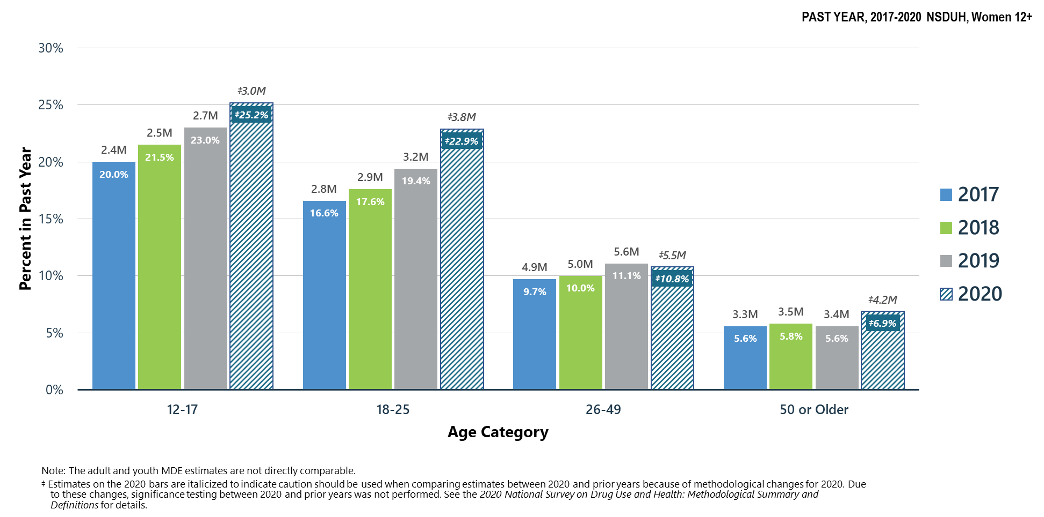
Major Depressive Episodes in Past Year: Among Women Aged 12+
Notes:
The estimates in these slides have been rounded for the purposes of presentation. Any appearance of estimates not summing exactly to a known total are due to this rounding.
Some slides present the same analysis across multiple years. The underlying populations from which these estimates are derived change across years since the number of people in the United States changes across years. Thus, a change in proportions does not equal a constant change in the weighted count.
TALKING POINTS:
In 2020, the percentage of women who had an MDE was highest among women aged 18 to 25, followed by women aged 26 to 49, then women aged 50 or older. Estimates of MDE are not compared between youths aged 12 to 17 and adults aged 18 or older.
Youths and young adults continue to report rising rates of MDE, consistent with recent literature that found rates of depression increased by 52 percent between 2005 and 2017 among adolescents and 63 percent between 2009 and 2017 in young adults (Twenge et al., 2019).
Twenge, J. M., Cooper, A. B., Joiner, T. E., Duffy, M. E., & Binau, S. G. (2019). Age, period, and cohort trends in mood disorder indicators and suicide-related outcomes in a nationally representative dataset, 2005–2017. Journal of Abnormal Psychology, 128(3), 185.

Slide 46
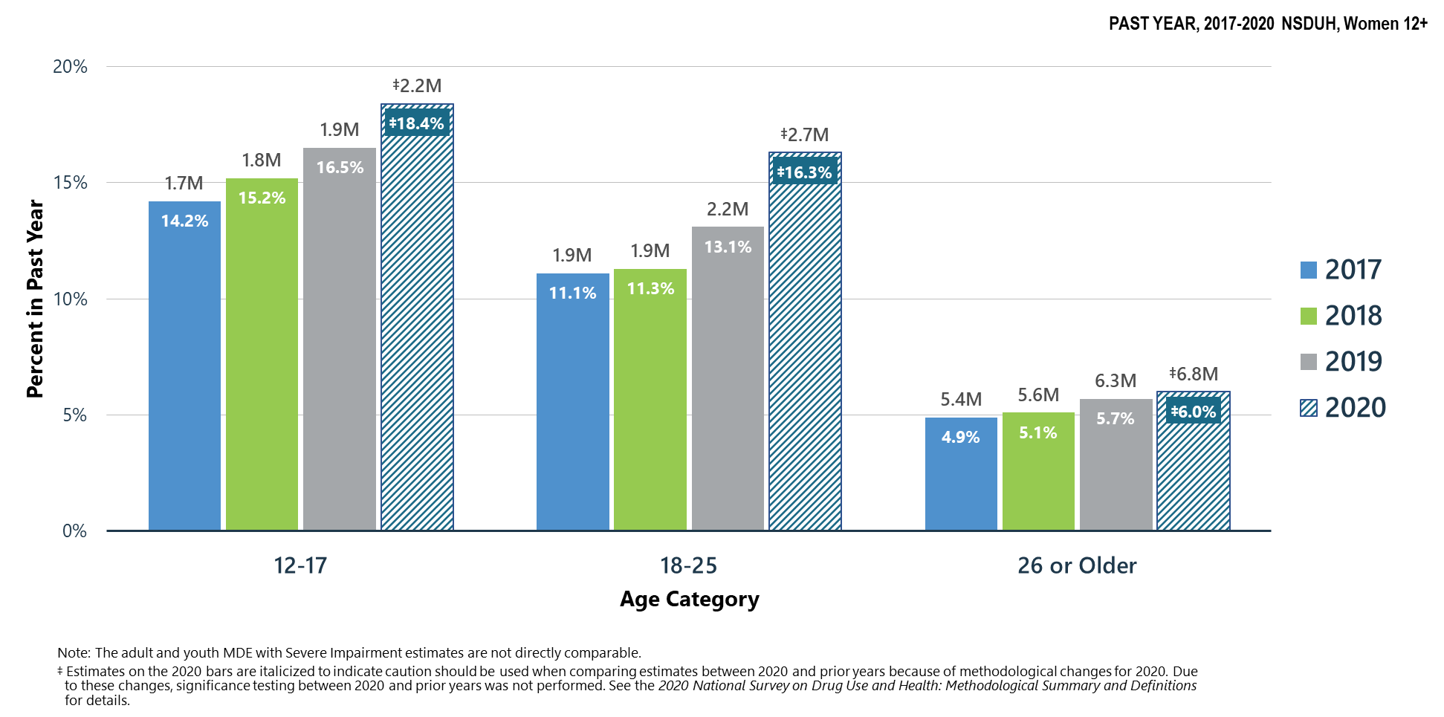
Major Depressive Episodes with Severe Impairment in Past Year: Among Women Aged 12+
Notes:
The estimates in these slides have been rounded for the purposes of presentation. Any appearance of estimates not summing exactly to a known total are due to this rounding.
Some slides present the same analysis across multiple years. The underlying populations from which these estimates are derived change across years since the number of people in the United States changes across years. Thus, a change in proportions does not equal a constant change in the weighted count.
TALKING POINTS:
MDE with Severe Impairment is defined as those individuals with higher scores on the Sheehan Disability Scale.
In 2020, young adult women aged 18 to 25 were more than twice as likely to experience MDE with Severe Impairment than women aged 26 or older. Estimates of MDE with Severe Impairment are not compared between youths aged 12 to 17 and adults aged 18 or older.
These findings support literature suggesting that rates of mental illness are rising more quickly in adolescents and young adults (Twenge et al., 2019).
Twenge, J. M., Cooper, A. B., Joiner, T. E., Duffy, M. E., & Binau, S. G. (2019). Age, period, and cohort trends in mood disorder indicators and suicide-related outcomes in a nationally representative dataset, 2005–2017. Journal of Abnormal Psychology, 128(3), 185.

Slide 47
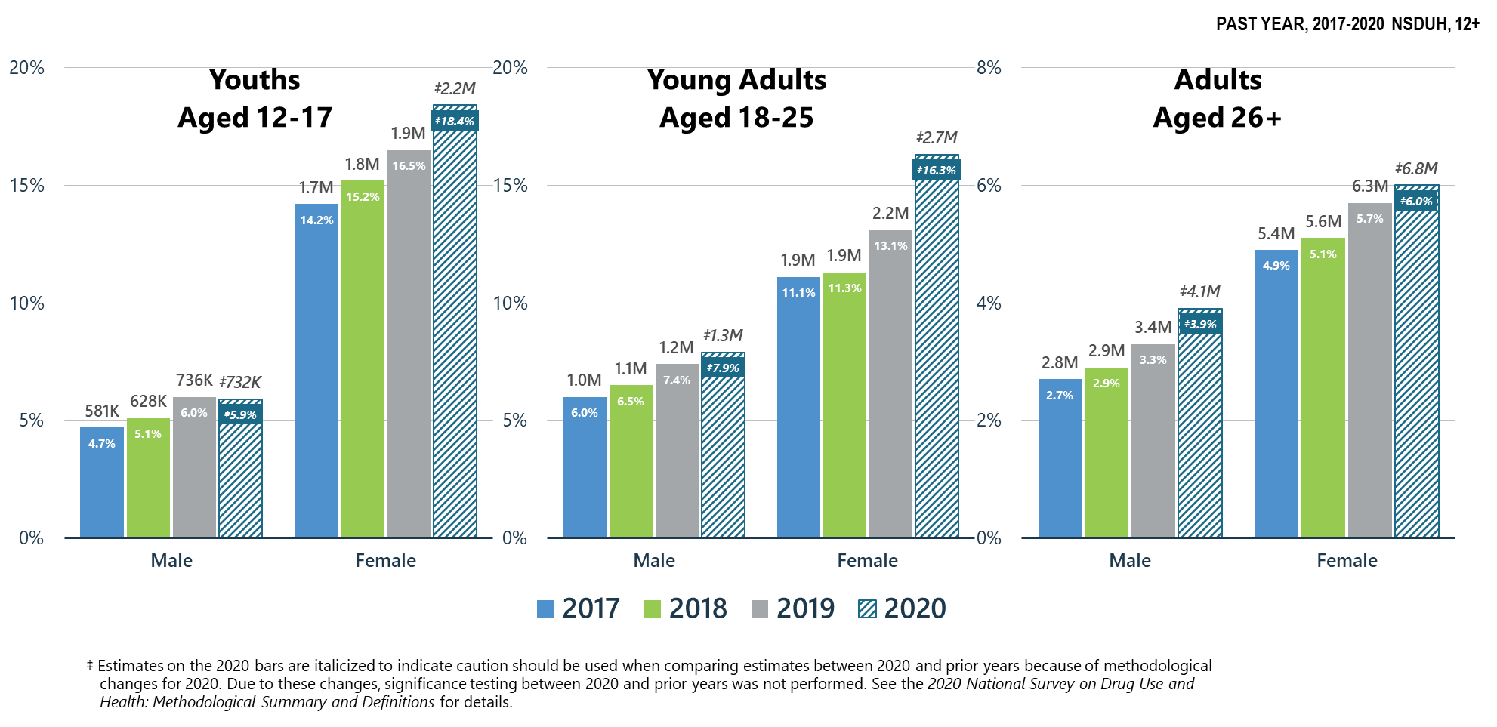
Major Depressive Episodes with Severe Impairment in Past Year: Among People Aged 12+
Notes:
The estimates in these slides have been rounded for the purposes of presentation. Any appearance of estimates not summing exactly to a known total are due to this rounding.
Some slides present the same analysis across multiple years. The underlying populations from which these estimates are derived change across years since the number of people in the United States changes across years. Thus, a change in proportions does not equal a constant change in the weighted count.
TALKING POINTS:
In 2020, females aged 18 to 25 reported higher rates of MDE with Severe Impairment than adults aged 26 or older. Estimates of MDE with Severe Impairment are not compared between youths aged 12 to 17 and adults aged 18 or older.
This is consistent with recent research suggesting that the rates of severe mood disorders have significantly increased among adolescents and young adults in the past 10 years, especially among females (e.g., Twenge et al., 2019; Yard et al., 2021).
Twenge, J. M., Cooper, A. B., Joiner, T. E., Duffy, M. E., & Binau, S. G. (2019). Age, period, and cohort trends in mood disorder indicators and suicide-related outcomes in a nationally representative dataset, 2005–2017. Journal of Abnormal Psychology, 128(3), 185.
Yard, E., Radhakrishnan, L., Ballesteros, M. F., Sheppard, M., Gates, A., Stein, Z., ... Stone, D. M. (2021). Emergency department visits for suspected suicide attempts among persons aged 12–25 years before and during the COVID-19 pandemic—United States, January 2019–May 2021. Morbidity and Mortality Weekly Report, 70(24), 888.

Slide 48
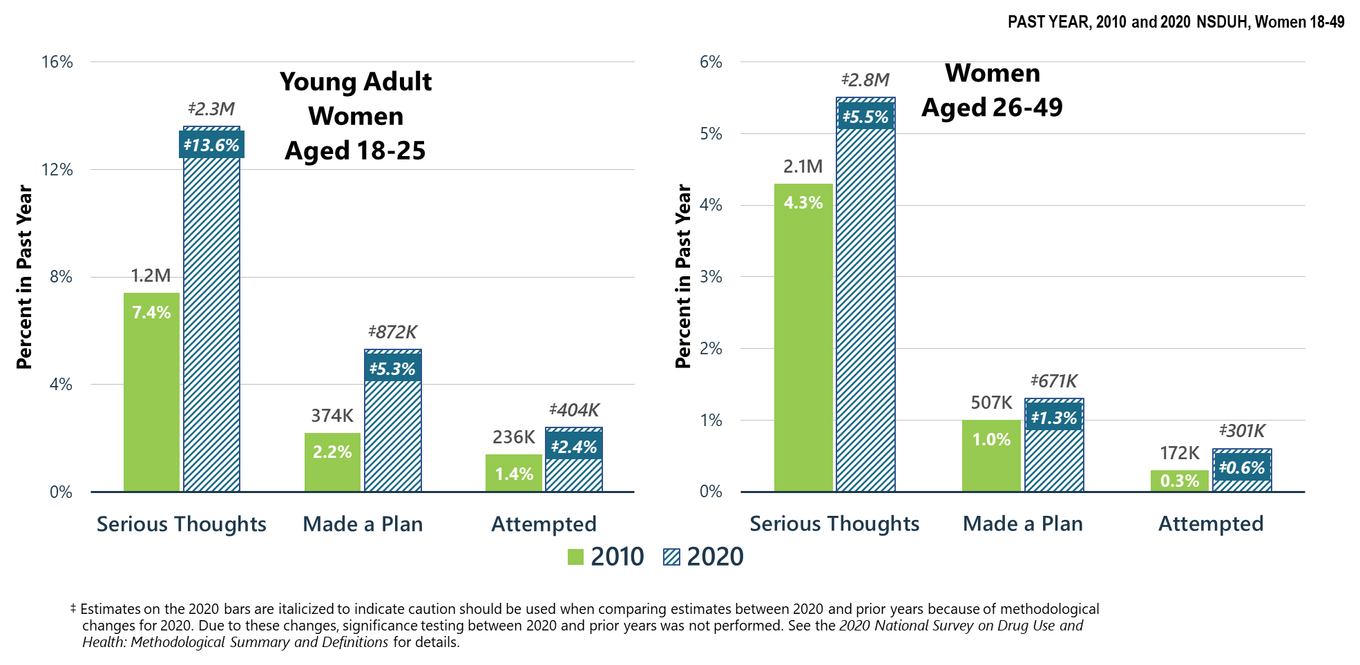
Suicidal Thoughts, Plans, and Attempts in Past Year: Among Women Aged 18-49
Notes:
The estimates in these slides have been rounded for the purposes of presentation. Any appearance of estimates not summing exactly to a known total are due to this rounding.
Some slides present the same analysis across multiple years. The underlying populations from which these estimates are derived change across years since the number of people in the United States changes across years. Thus, a change in proportions does not equal a constant change in the weighted count.
TALKING POINTS:
In 2020, serious thoughts of suicide were reported by more than 13 percent of young adult women aged 18 to 25—more than double the rate reported by women aged 26 to 49.
The percentage of young adult women aged 18 to 25 who made a suicide plan or attempted suicide was higher than for women aged 26 to 49.
Rates of planning or attempting suicide remain low—and illustrates two important points in the literature: (1) suicidal behaviors remain difficult to study due to low base rates, and (2) suicidal behaviors are underreported (e.g., Tøllefsen et al., 2012).
Tøllefsen, I. M., Hem, E., & Ekeberg, Ø. (2012). The reliability of suicide statistics: A systematic review. BMC Psychiatry, 12(1), 1-11.

Slide 49
Co-Occurring
Mental and Substance Use Disorders

Slide 50
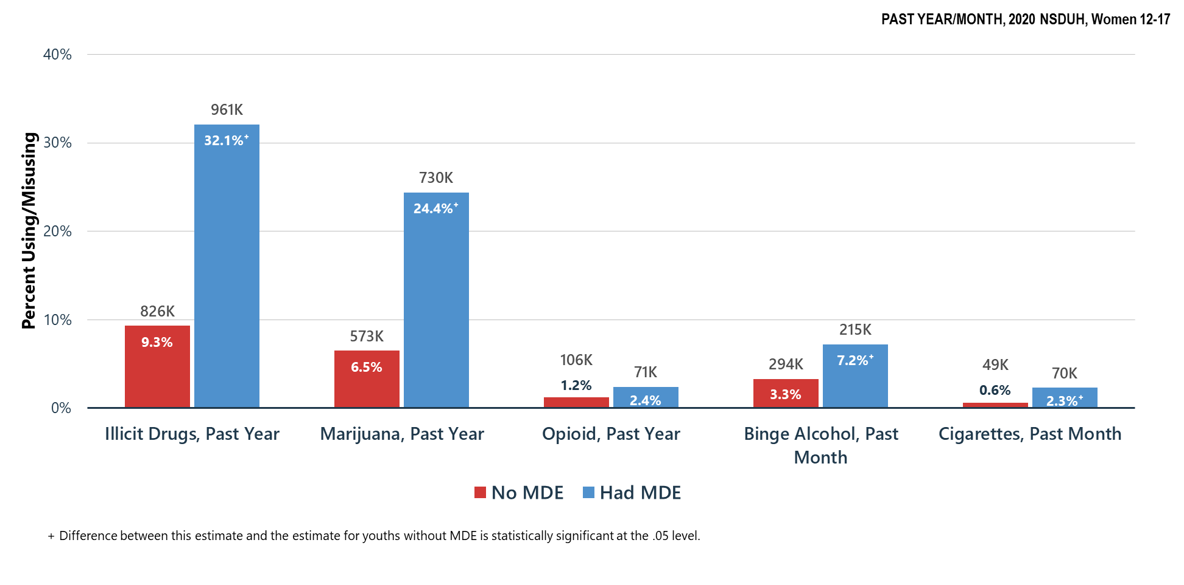
Substance Use in Past Year/Month: Among Female Youths Aged 12-17; By Past Year Major Depressive Episode (MDE) status
Notes:
The estimates in these slides have been rounded for the purposes of presentation. Any appearance of estimates not summing exactly to a known total are due to this rounding.
Some slides present the same analysis across multiple years. The underlying populations from which these estimates are derived change across years since the number of people in the United States changes across years. Thus, a change in proportions does not equal a constant change in the weighted count.
TALKING POINTS:
Youth mental health has emerged as a major concern, provided the rising rates of mental illness (including depression).
Female youths aged 12 to 17 with an MDE in the past year reported significantly higher rates of illicit drug use, marijuana use, binge drinking, and cigarette use within the past year/month. This is consistent with a recent meta-analysis that found substance use disorders commonly co-occur in individuals with major depression (Hunt et al., 2020).
Hunt, G. E., Malhi, G. S., Lai, H. M. X., & Cleary, M. (2020). Prevalence of comorbid substance use in major depressive disorder in community and clinical settings, 1990–2019: Systematic review and meta-analysis. Journal of Affective Disorders, 266, 288-304.

Slide 51
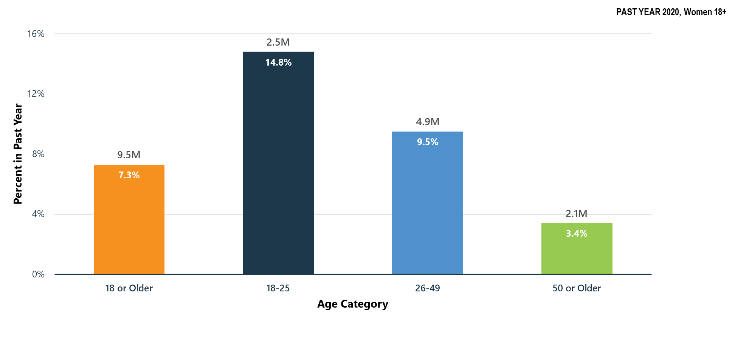
Co-Occurring Substance Use Disorder and Any Mental Illness in Past Year: Among Adult Women Aged 18+
Notes:
The estimates in these slides have been rounded for the purposes of presentation. Any appearance of estimates not summing exactly to a known total are due to this rounding.
Some slides present the same analysis across multiple years. The underlying populations from which these estimates are derived change across years since the number of people in the United States changes across years. Thus, a change in proportions does not equal a constant change in the weighted count.
TALKING POINTS:
Rates of co-occurring substance use disorder and any mental illness in the past year was highest among young adult women aged 18 to 25 and lowest among women aged 50 or older.
Declining prevalence rates of mental illness across the lifespan, such that older adults report the lowest rates of mental illness, is well established in the literature (e.g., Westerhof & Keyes, 2010, Webster et al., 2014; Thomas et al., 2016).
Westerhof, G. J., & Keyes, C. L. (2010). Mental illness and mental health: The two continua model across the lifespan. Journal of Adult Development, 17(2), 110-119.
Webster, J. D., Westerhof, G. J., & Bohlmeijer, E. T. (2014). Wisdom and mental health across the lifespan. Journals of Gerontology Series B: Psychological Sciences and Social Sciences, 69(2), 209-218.
Thomas, M. L., Kaufmann, C. N., Palmer, B. W., Depp, C. A., Martin, A. S., Glorioso, D. K., ... Jeste, D. V. (2016). Paradoxical trend for improvement in mental health with aging: A community-based study of 1,546 adults aged 21-100 years. The Journal of Clinical Psychiatry, 77(8), 8771.

Slide 52
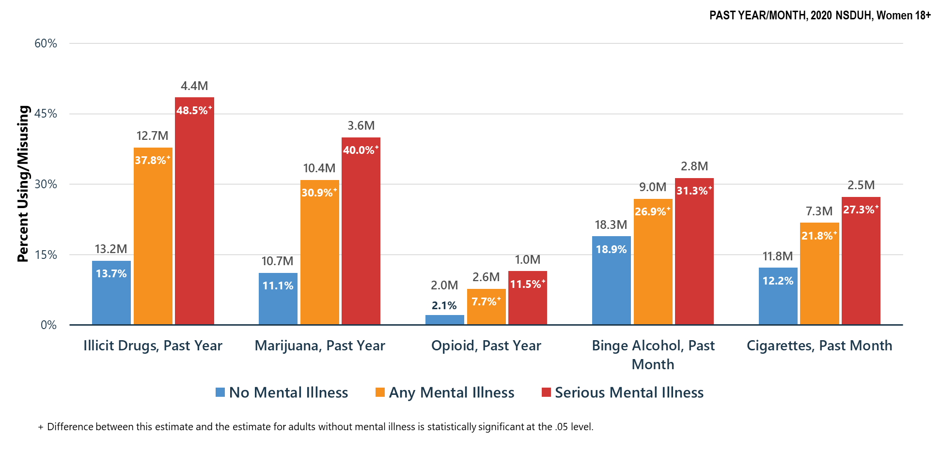
Substance Use in Past Year/Month: Among Women Aged 18+; By Mental Illness Status
Notes:
The estimates in these slides have been rounded for the purposes of presentation. Any appearance of estimates not summing exactly to a known total are due to this rounding.
Some slides present the same analysis across multiple years. The underlying populations from which these estimates are derived change across years since the number of people in the United States changes across years. Thus, a change in proportions does not equal a constant change in the weighted count.
TALKING POINTS:
Co-occurrence of mental illness and substance use is common.
Women aged 18 or older with serious mental illness or any mental illness had significantly higher rates of illicit drug, marijuana, opioid, binge alcohol, and cigarette use over the past year/month than women without mental illness.

Slide 53
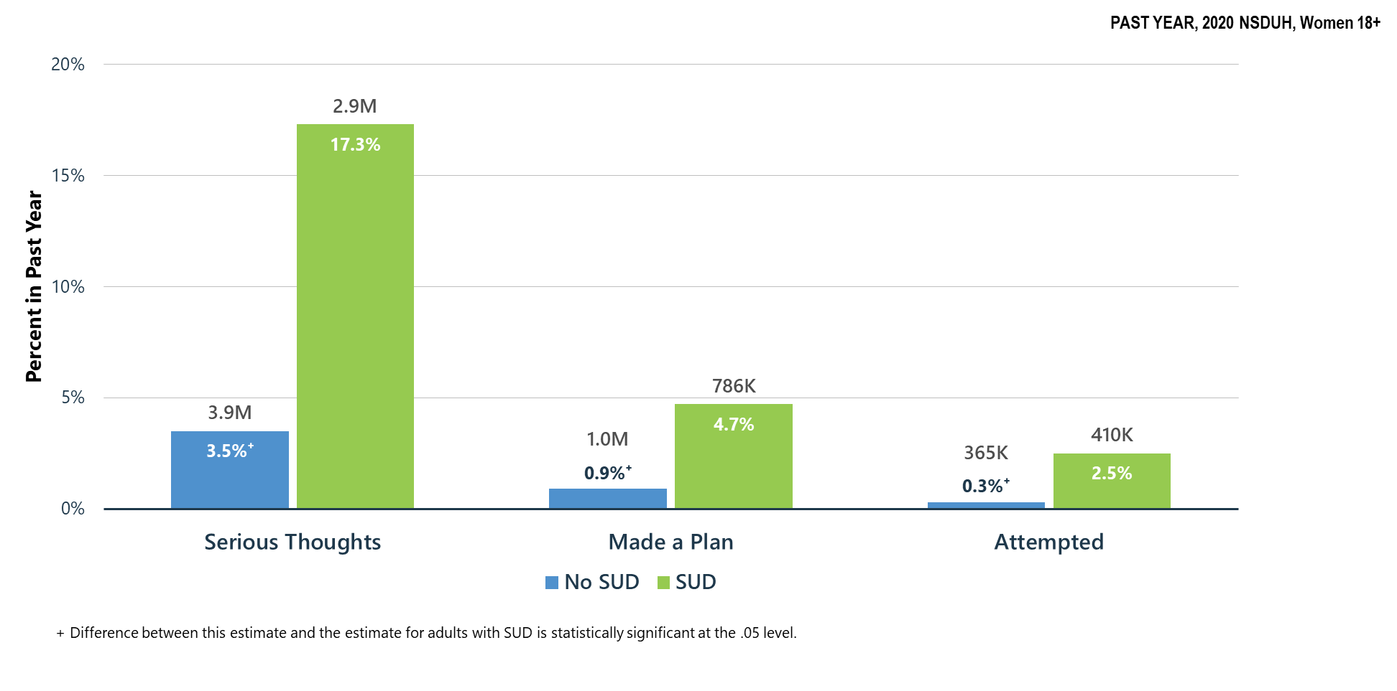
Suicidal Thoughts, Plans, and Attempts in Past Year: Among Women Aged 18+; By Substance Use Disorder (SUD) Status
Notes:
The estimates in these slides have been rounded for the purposes of presentation. Any appearance of estimates not summing exactly to a known total are due to this rounding.
Some slides present the same analysis across multiple years. The underlying populations from which these estimates are derived change across years since the number of people in the United States changes across years. Thus, a change in proportions does not equal a constant change in the weighted count.
TALKING POINTS:
Women aged 18 or older with an SUD had higher rates of serious thoughts of suicide in the past year than women who did not have an SUD.
Furthermore, women without an SUD had significantly lower rates of suicide attempts and planning.
Literature has found that substance use often co-occurs with suicidal thoughts and behaviors and is a well-established risk factor for suicide attempts and death by suicide (Esang & Ahmed, 2018).
Esang, M., & Ahmed, S. (2018). A closer look at substance use and suicide. American Journal of Psychiatry Residents' Journal, 13(6), 6-8.

Slide 54
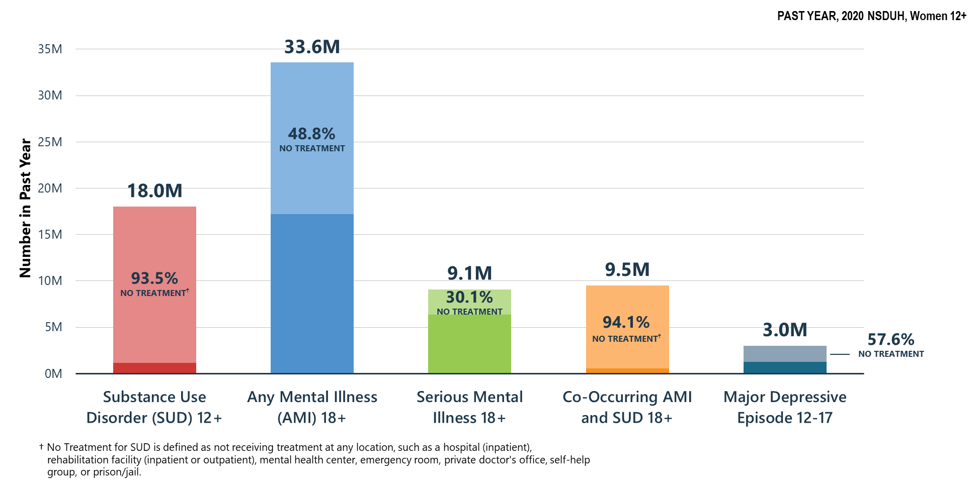
Did Not Receive Substance Use Treatment or Mental Health Services in Past Year: Among Women Aged 12+
Notes:
The estimates in these slides have been rounded for the purposes of presentation. Any appearance of estimates not summing exactly to a known total are due to this rounding.
Some slides present the same analysis across multiple years. The underlying populations from which these estimates are derived change across years since the number of people in the United States changes across years. Thus, a change in proportions does not equal a constant change in the weighted count.
TALKING POINTS:
Understanding barriers to and increasing access to SUD and mental health treatment remains a focus for providers and policymakers.
Well-established barriers to care include lack of insurance/cost, stigmatization of substance use and mental illness, and multicultural factors.
Nearly half of women aged 18 or older with AMI and over half of youths aged 12 to 17 with an MDE did not receive treatment within the past year.
Far fewer women sought help for SUD or co-occurring SUD and AMI. More than 90 percent do not receive treatment—highlighting barriers to care including stigmatization of SUD.

Slide 55
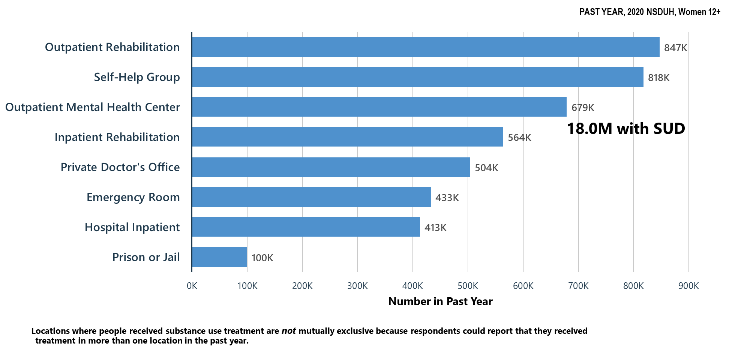
Locations Where Substance Use Treatment was Received in Past Year: Among Women Aged 12+
Notes:
The estimates in these slides have been rounded for the purposes of presentation. Any appearance of estimates not summing exactly to a known total are due to this rounding.
Some slides present the same analysis across multiple years. The underlying populations from which these estimates are derived change across years since the number of people in the United States changes across years. Thus, a change in proportions does not equal a constant change in the weighted count.
TALKING POINTS:
Among women aged 12 or older, self-help groups and outpatient rehabilitation were popular forms of treatment.
The popularity of self-help groups (e.g., Alcoholics Anonymous) is in part due to reduced fears of stigmatization (or being misunderstood) because group leaders have shared lived experiences (Moos, 2008). In addition, self-help groups are typically free.
Moos, R. H. (2008). Active ingredients of substance use‐focused self‐help groups. Addiction, 103(3), 387-396.

Slide 56
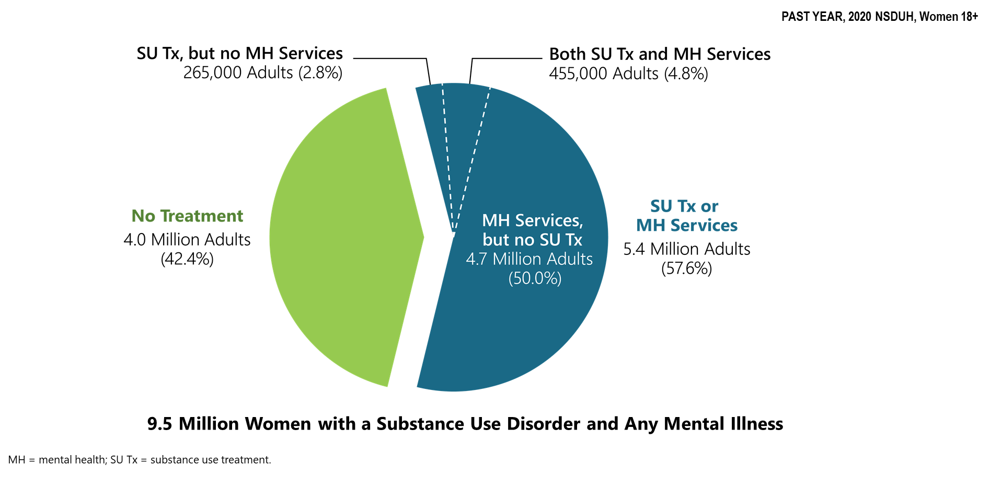
Receipt of Substance Use Treatment at a Specialty Facility and/or Mental Health Services in Past Year: Among Women Aged 18+ with Co-Occurring Substance Use Disorder (SUD) and Any Mental Illness (AMI)
Notes:
The estimates in these slides have been rounded for the purposes of presentation. Any appearance of estimates not summing exactly to a known total are due to this rounding.
Some slides present the same analysis across multiple years. The underlying populations from which these estimates are derived change across years since the number of people in the United States changes across years. Thus, a change in proportions does not equal a constant change in the weighted count.
TALKING POINTS:
Nearly half of women with a SUD and AMI did not receive treatment in the past year.
A small fraction of women with co-occurring SUD and AMI received both SUD and MH treatment.
Co-occurring SUD and AMI is particularly difficult to treat, and this treatment has poorer clinical outcomes than treatment of individuals with a single diagnosis (Najt et al., 2011). Research has shown that individuals engaged in integrated treatment for both SUD and AMI have better clinical outcomes than individuals who do not (Mangrum et al., 2006). 2020 NSDUH findings highlight the need for increased access to integrated care for SUD and MH treatment.
Najt, P., Fusar-Poli, P., & Brambilla, P. (2011). Co-occurring mental and substance abuse disorders: A review on the potential predictors and clinical outcomes. Psychiatry Research, 186(2-3), 159-164.
Mangrum, L. F., Spence, R. T., & Lopez, M. (2006). Integrated versus parallel treatment of co-occurring psychiatric and substance use disorders. Journal of Substance Abuse Treatment, 30(1), 79-84.

Slide 57
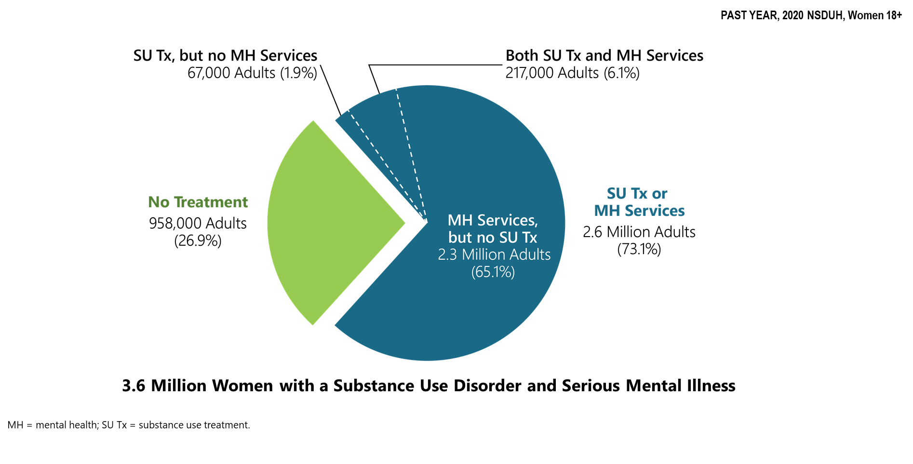
Receipt of Substance Use Treatment at a Specialty Facility and/or Mental Health Services in Past Year: Among Women Aged 18+ with Co-Occurring Substance Use Disorder (SUD) and Serious Mental Illness (SMI)
Notes:
The estimates in these slides have been rounded for the purposes of presentation. Any appearance of estimates not summing exactly to a known total are due to this rounding.
Some slides present the same analysis across multiple years. The underlying populations from which these estimates are derived change across years since the number of people in the United States changes across years. Thus, a change in proportions does not equal a constant change in the weighted count.
TALKING POINTS:
Three quarters of women with SUD and SMI received some form of SUD or MH treatment in the past year.
Most of these women received mental health services, but not SUD treatment.
These findings highlight a significant gap in treatment services, which has also been highlighted in the literature. A recent meta-analysis found there to be no high-quality evidence to support one treatment over another for individuals with co-occurring SUD and SMI (Hunt et al., 2019).
Hunt, G. E., Siegfried, N., Morley, K., Brooke‐Sumner, C., & Cleary, M. (2019). Psychosocial interventions for people with both severe mental illness and substance misuse. Cochrane Database of Systematic Reviews, 12(12).

Slide 58
Summary: Mental Health/Co-Occurring Issues in the United States in 2020
Co-occurring substance use and mental disorders are common.
Adolescents:
  Higher rates of substance use in youths who had MDE vs. youths who did not have MDE.
Adults:
  Significantly higher rates of substance use among adults with mental illness vs. adults without mental illness.
  Significantly higher rates of suicidal thoughts and behaviors than those without a substance use disorder
  Most adults with co-occurring issues do not receive treatment for both issues.

