Slide 1
2019 National Survey on Drug Use and Health: Lesbian, Gay, & Bisexual (LGB) Adults
Substance Abuse and Mental Health Services Administration
U.S. Department of Health and Human Services
September 2020

Slide 2
National Survey on Drug Use and Health (NSDUH)
NSDUH is a comprehensive household interview survey of substance use, substance use disorders, mental health, and the receipt of treatment services for these disorders in the United States.
NSDUH is collected face-to-face by field interviewers who read less sensitive questions to respondents and transition respondents to audio computer assisted self‑interviewing for sensitive items.
NSDUH covers the civilian, noninstitutionalized population, aged 12 or older:
  Includes: Households, college dorms, homeless in shelters, civilians on military bases
  Excludes: Active military, long-term hospital residents, prison populations, homeless not in shelters
Sample includes all 50 states and DC
Approximately 67,500 persons are interviewed annually
Data collected from January to December

Slide 3
How Do We Use NSDUH?
Provides a window into the state of substance use and mental health issues in the United States
Helps to guide policy directions in addressing:
  problem substances
  prevalence of mental illness
  intersection of substance use and mental health issues
  provides insights that can be studied in the context of data from other agencies to help in decision-making about what types of resources are needed and where resources should be directed

Slide 4
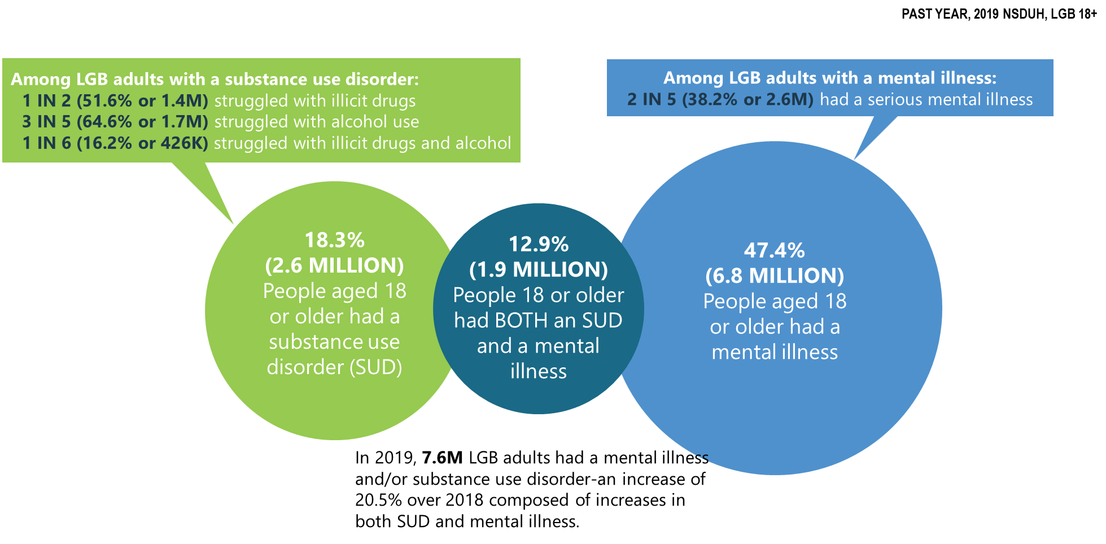
Mental Illness and Substance Use Disorders in America among LGB Adults (>18 y.o.)

Slide 5
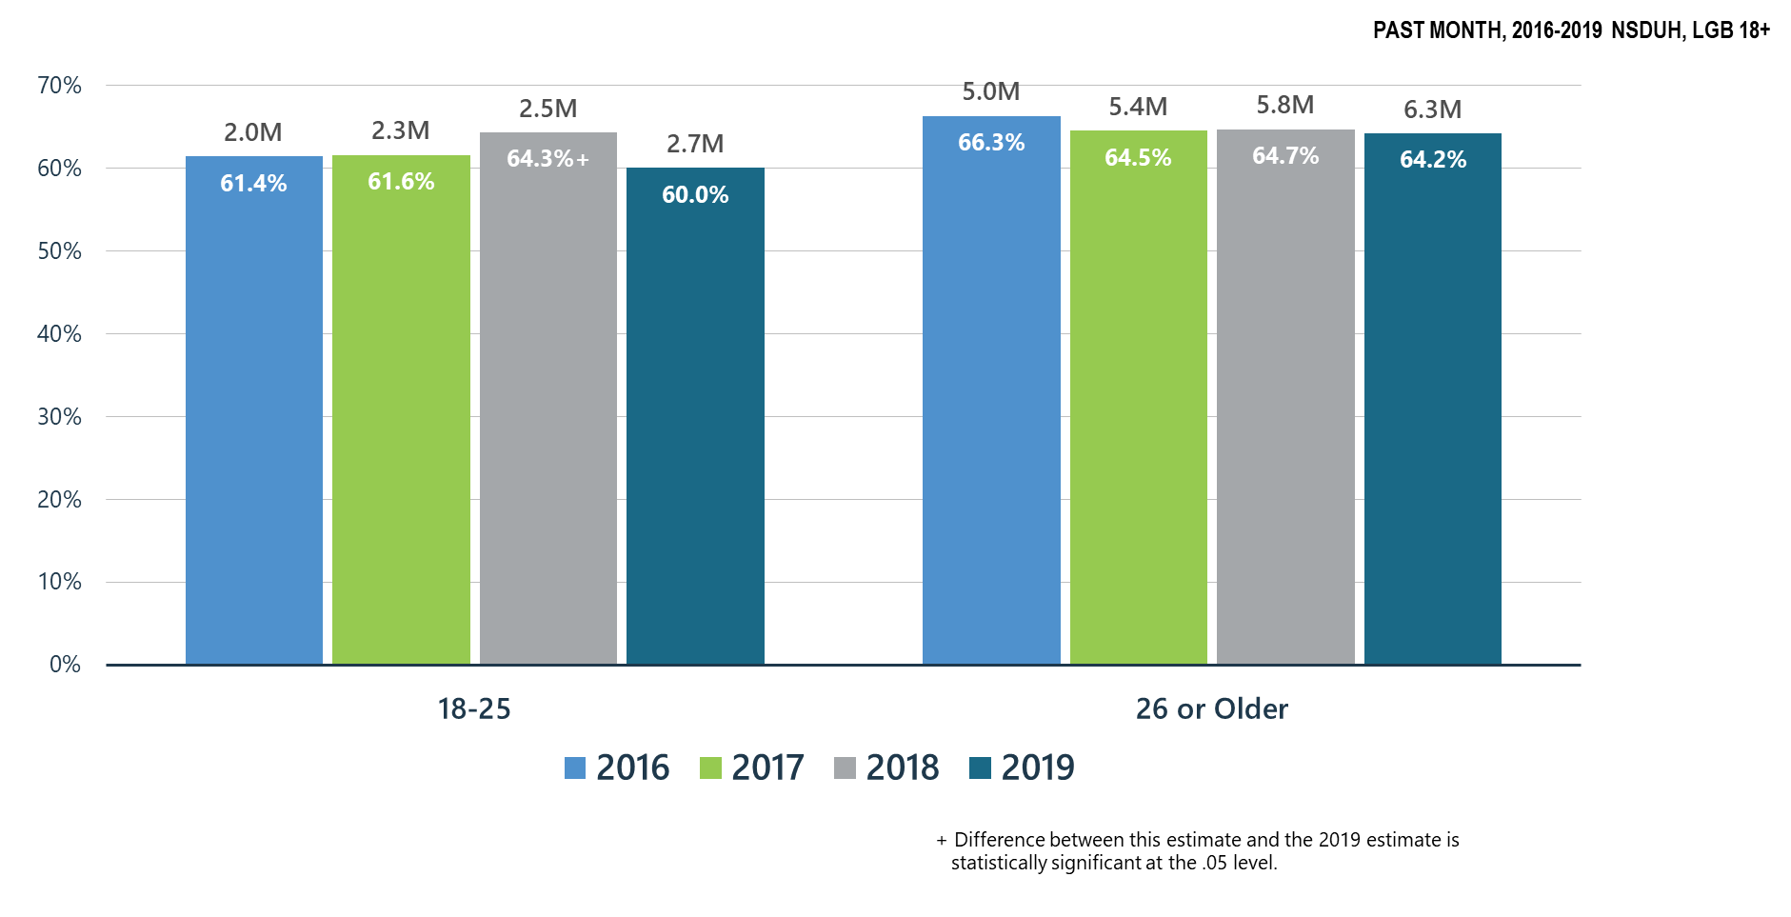
Alcohol Use among LGB Adults

Slide 6
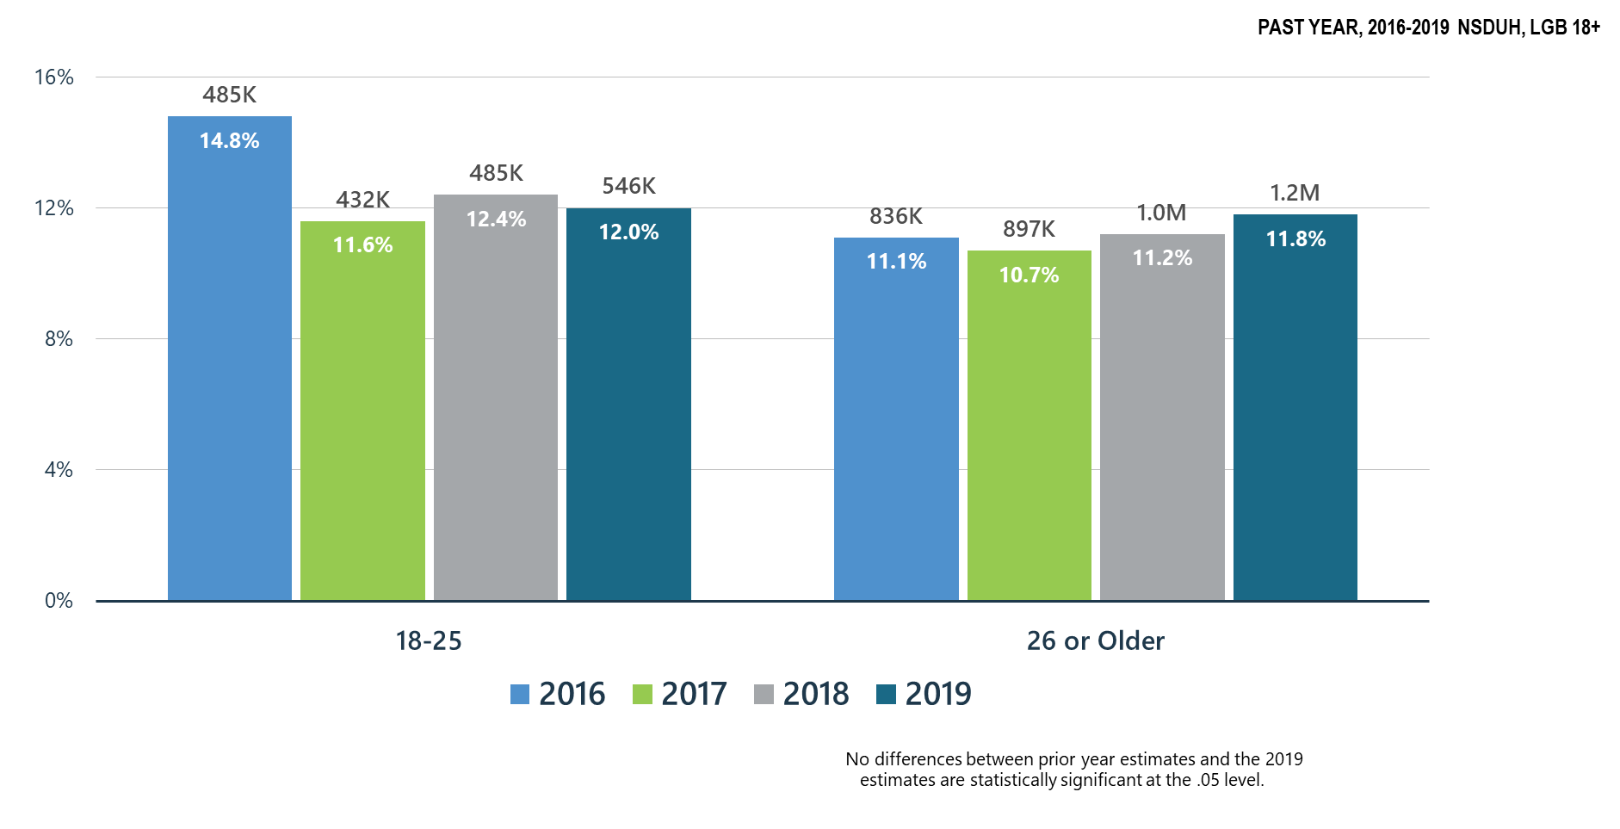
Alcohol Use Disorder among LGB Adults

Slide 7
Summary: Alcohol Use in 2019
Past month alcohol use significantly declined for LGB adults ages 18-25 when compared to 2018.
Alcohol use disorder among LGB adults remained stable in 2019.
SAMHSA will continue its prevention programs:
  SAMHSA Prevention Technology Transfer Centers produce resources and materials related to alcohol misuse prevention
  CSAP ‘Talk They Hear You’ focuses on underage drinking
  CSAP requires Partnerships for Success grantees to emphasize underage drinking prevention
  CSAT has promoted SBIRT for alcohol use in all programs including CJ, PPW, adolescent treatment, HIV and homeless programs
  CSAT has funded SBIRT training in medical residencies and other healthcare practitioner programs which screen for hazardous alcohol use and use disorders

Slide 8
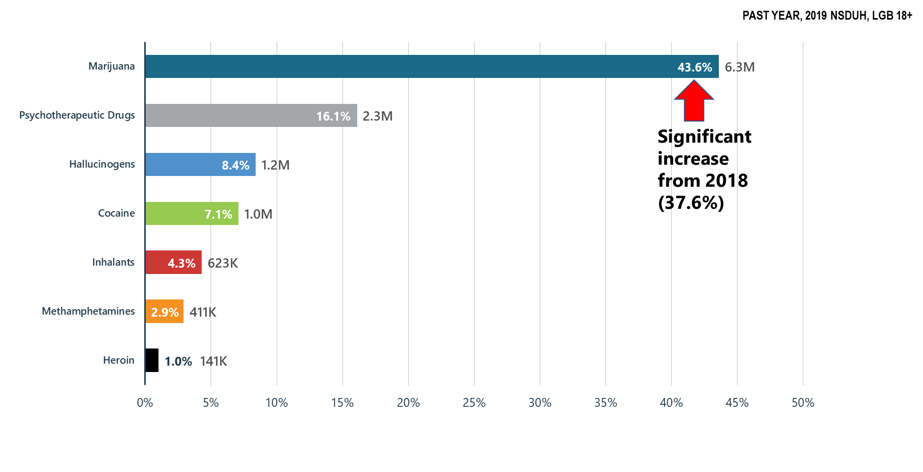
Illicit Drug Use among LGB Adults: Major Concerns: Opioids, Marijuana, Methamphetamines

Slide 9
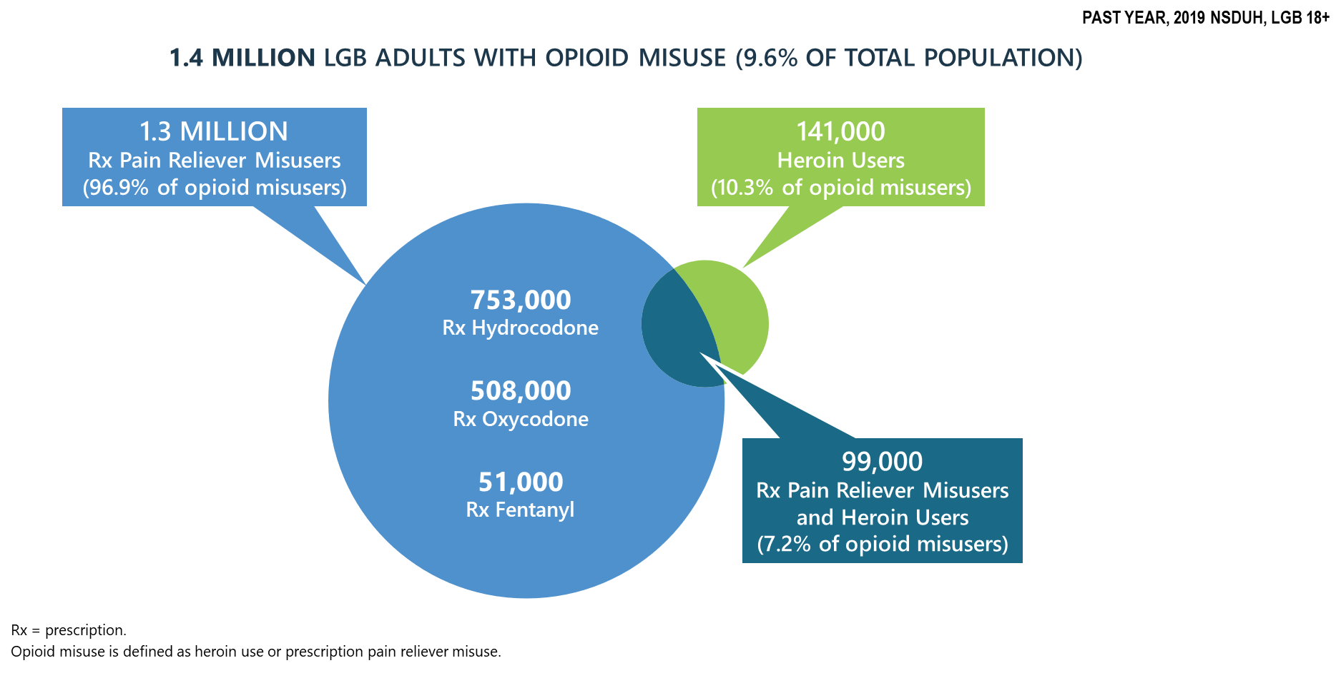
Progress on the Opioid Epidemic: Prescription Pain Reliever Misuse among LGB Adults

Slide 10
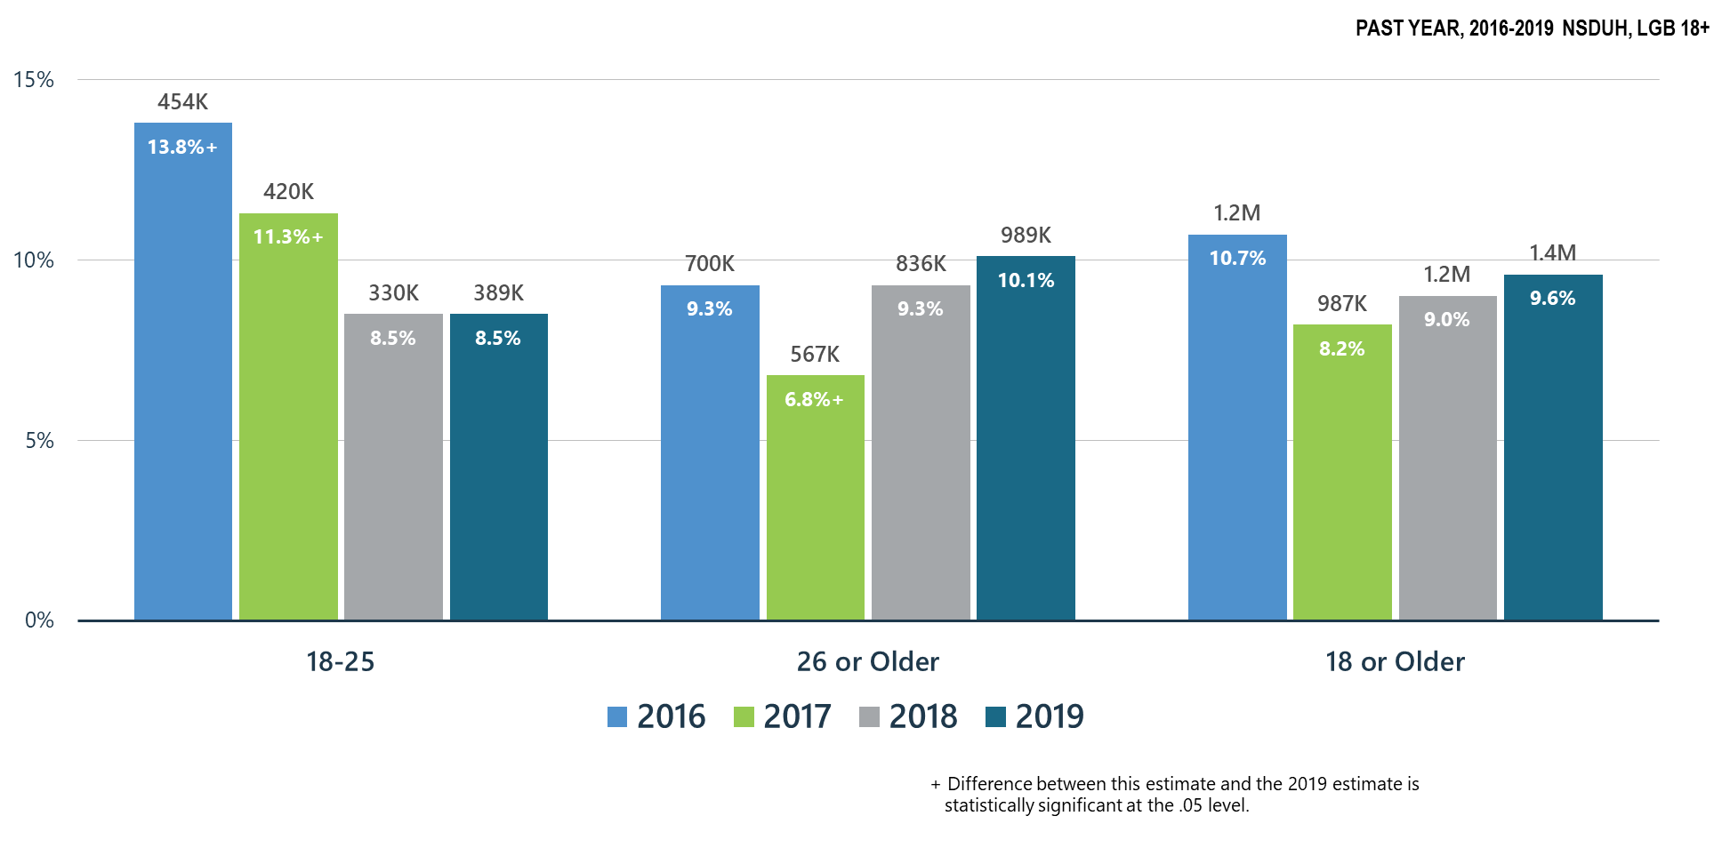
Opioid Misuse among LGB Adults

Slide 11
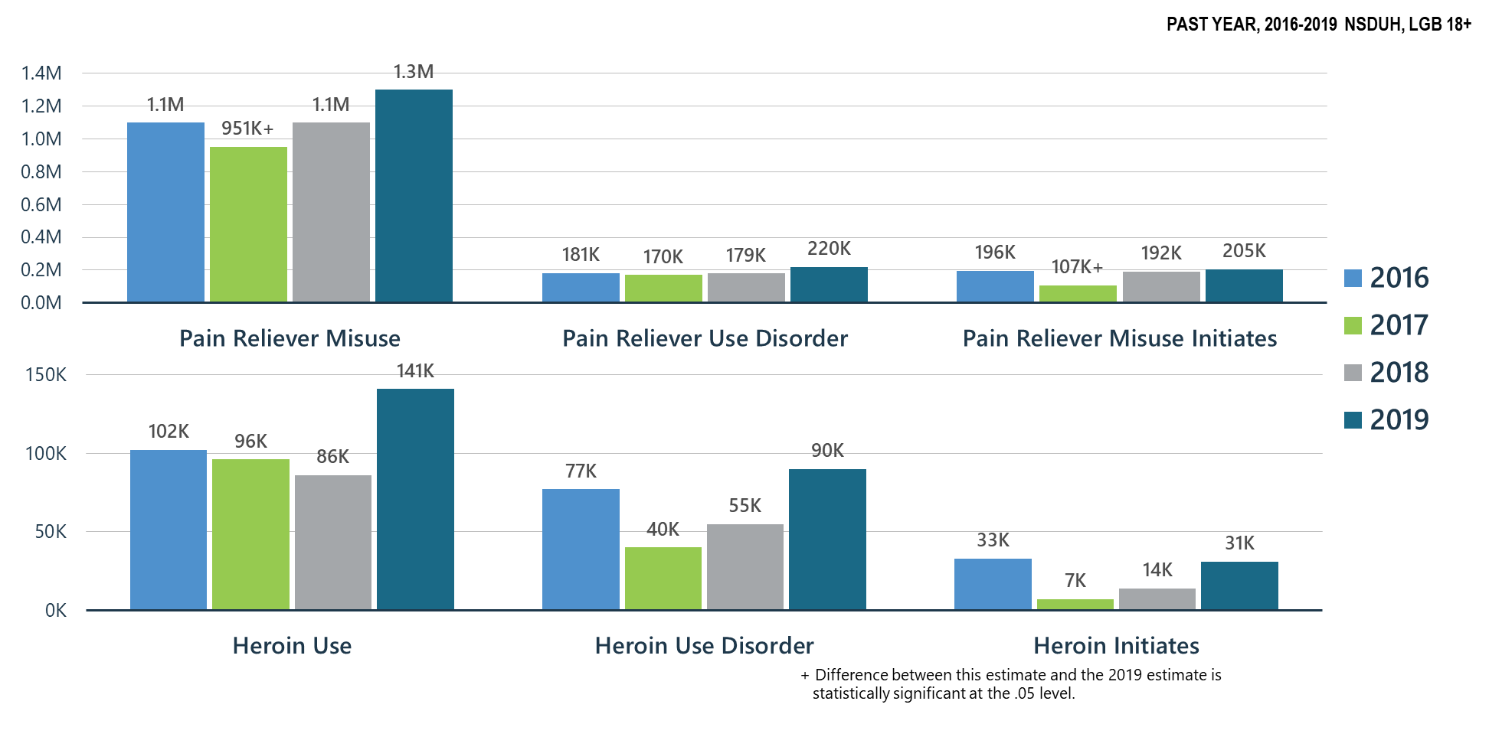
Prescription Pain Reliever Misuse and Heroin Use among LGB Adults

Slide 12
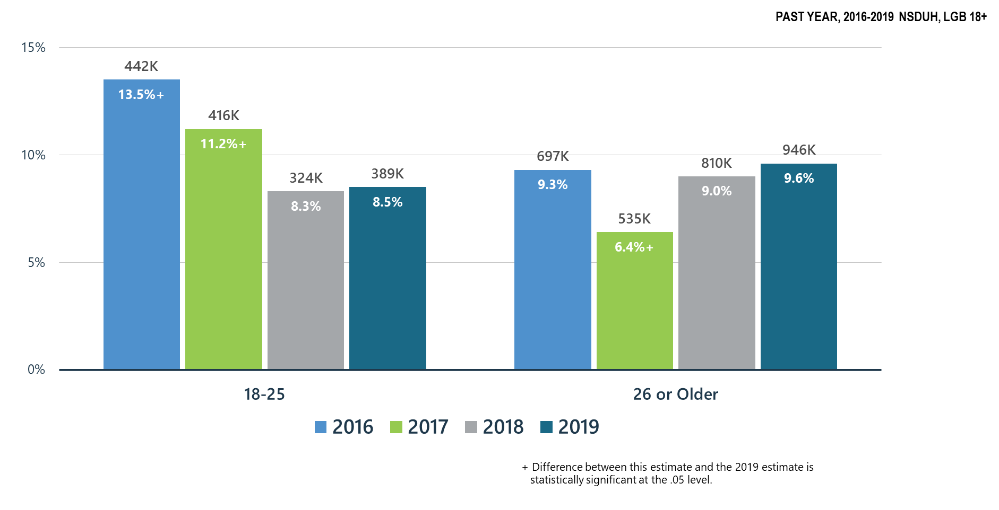
Prescription Pain Reliever Misuse among LGB Adults

Slide 13
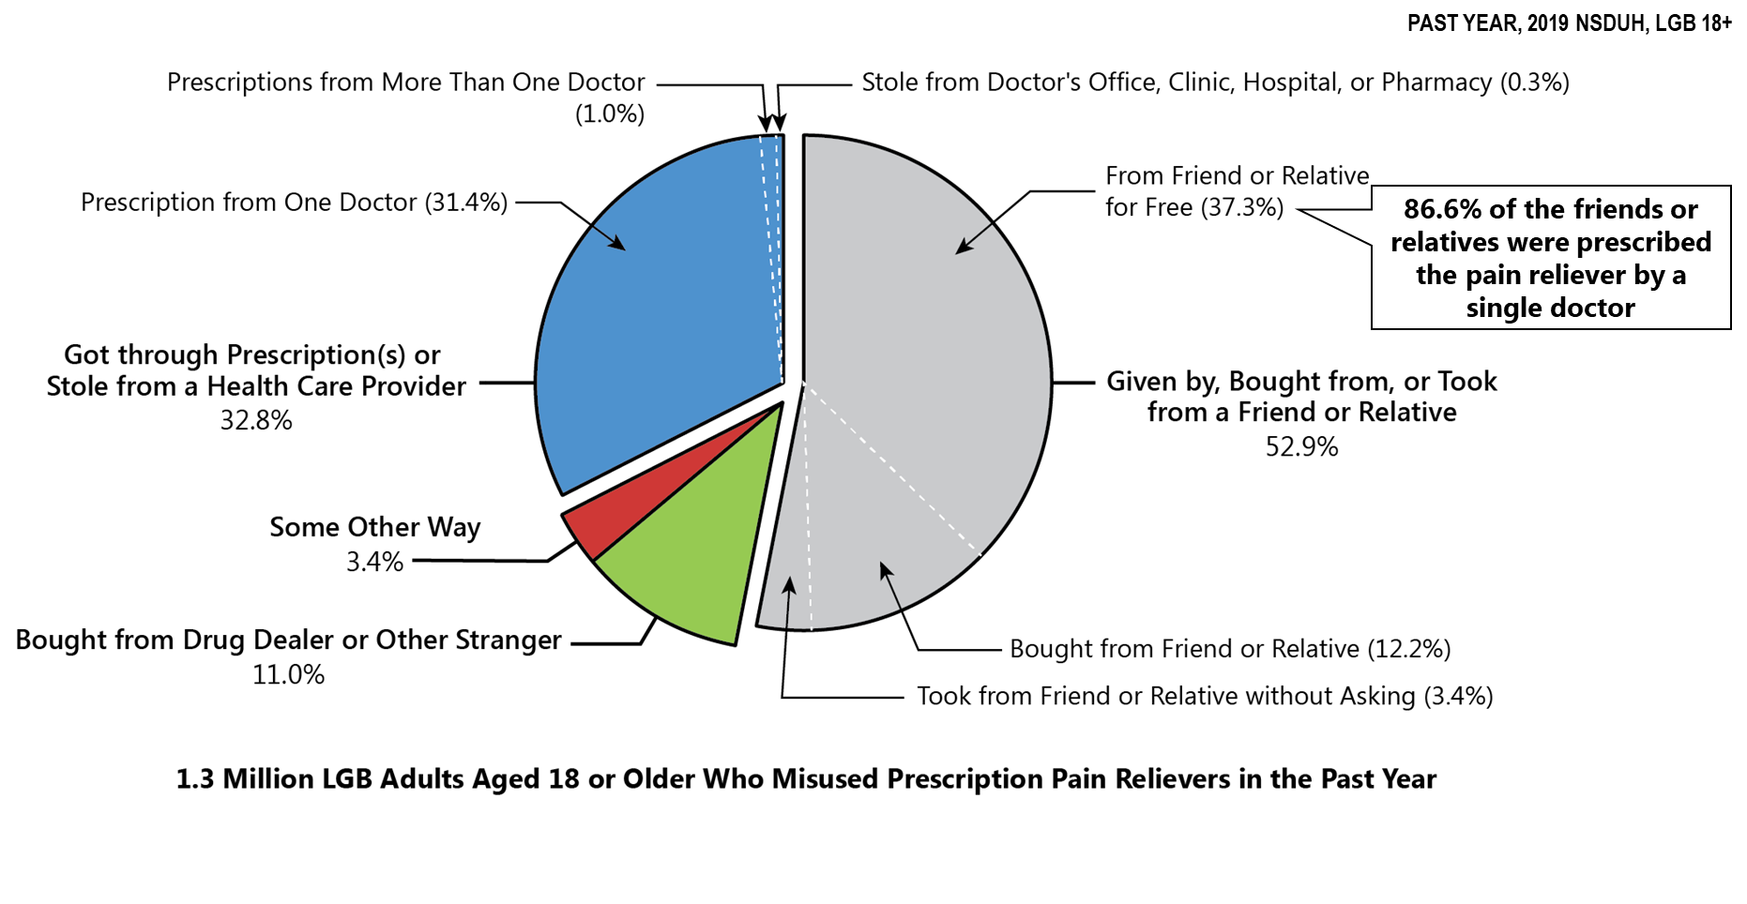
Sources Where Pain Relievers Were Obtained for Most Recent Misuse among LGB Adults Who Misused Prescription Pain Relievers

Slide 14
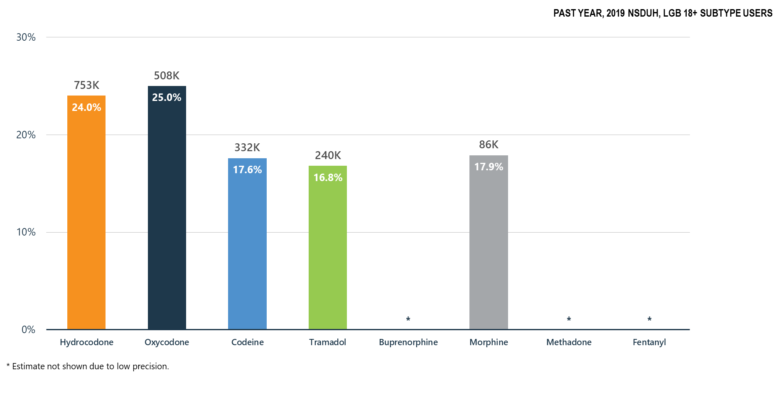
Misuse of Prescription Opioid Subtypes among LGB Adults

Slide 15
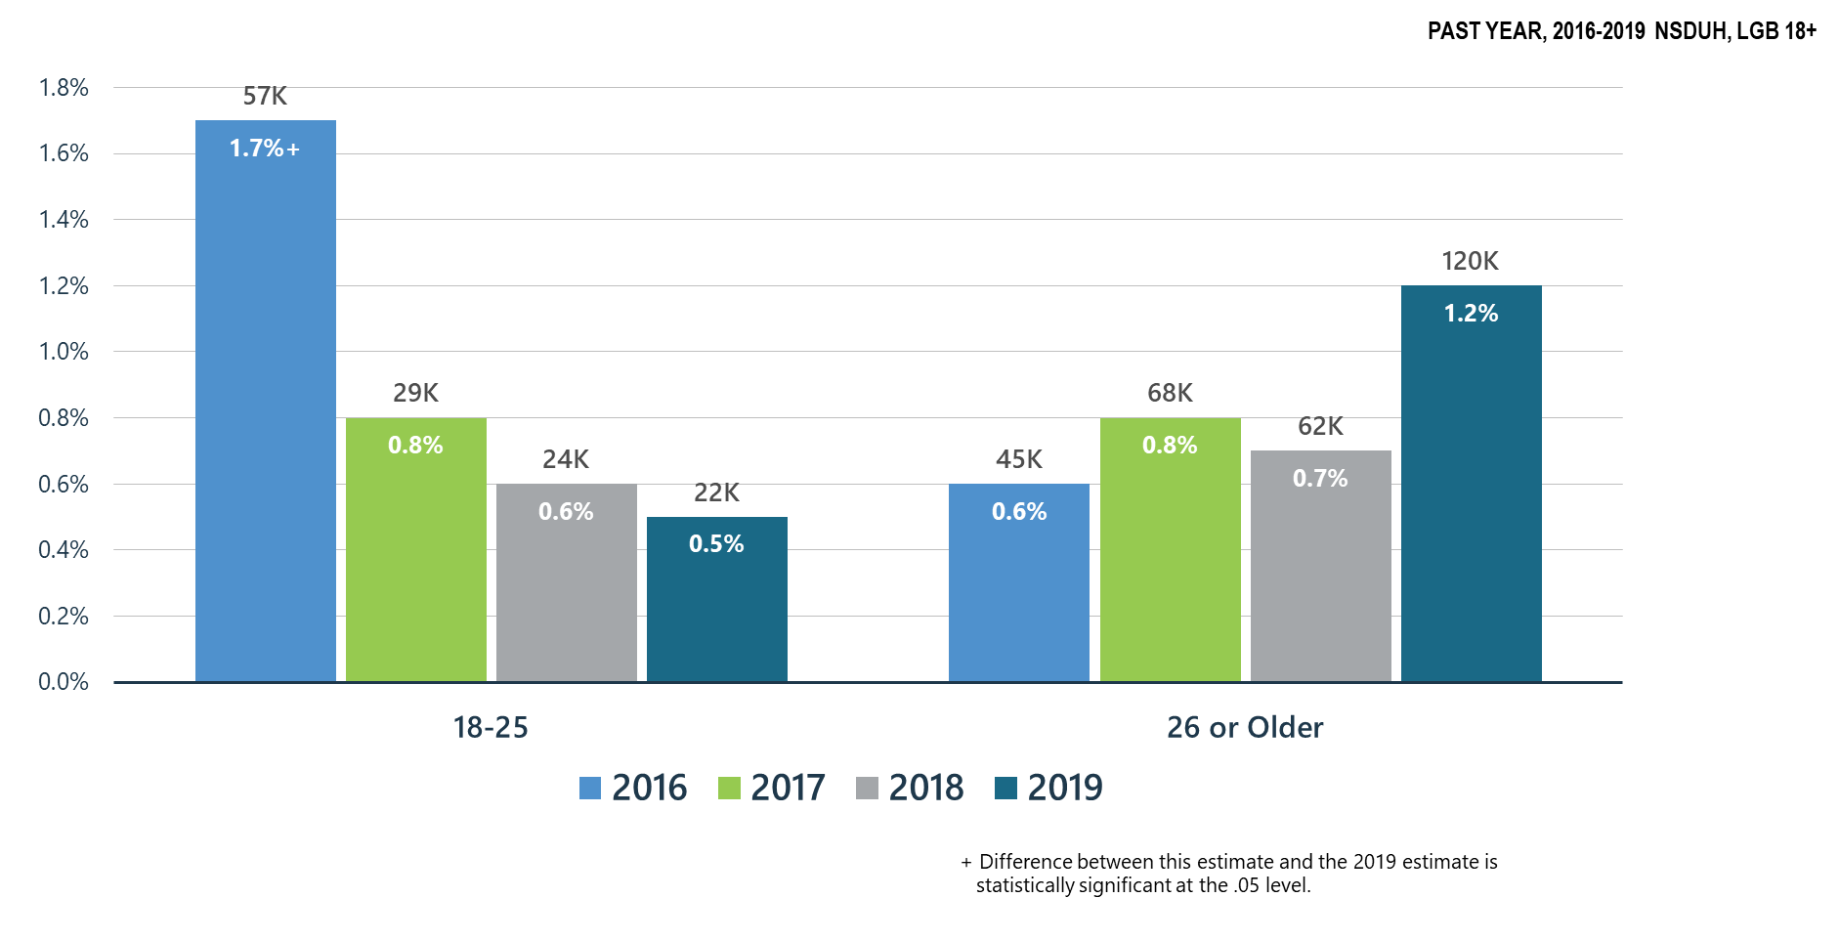
Heroin Use among LGB Adults

Slide 16
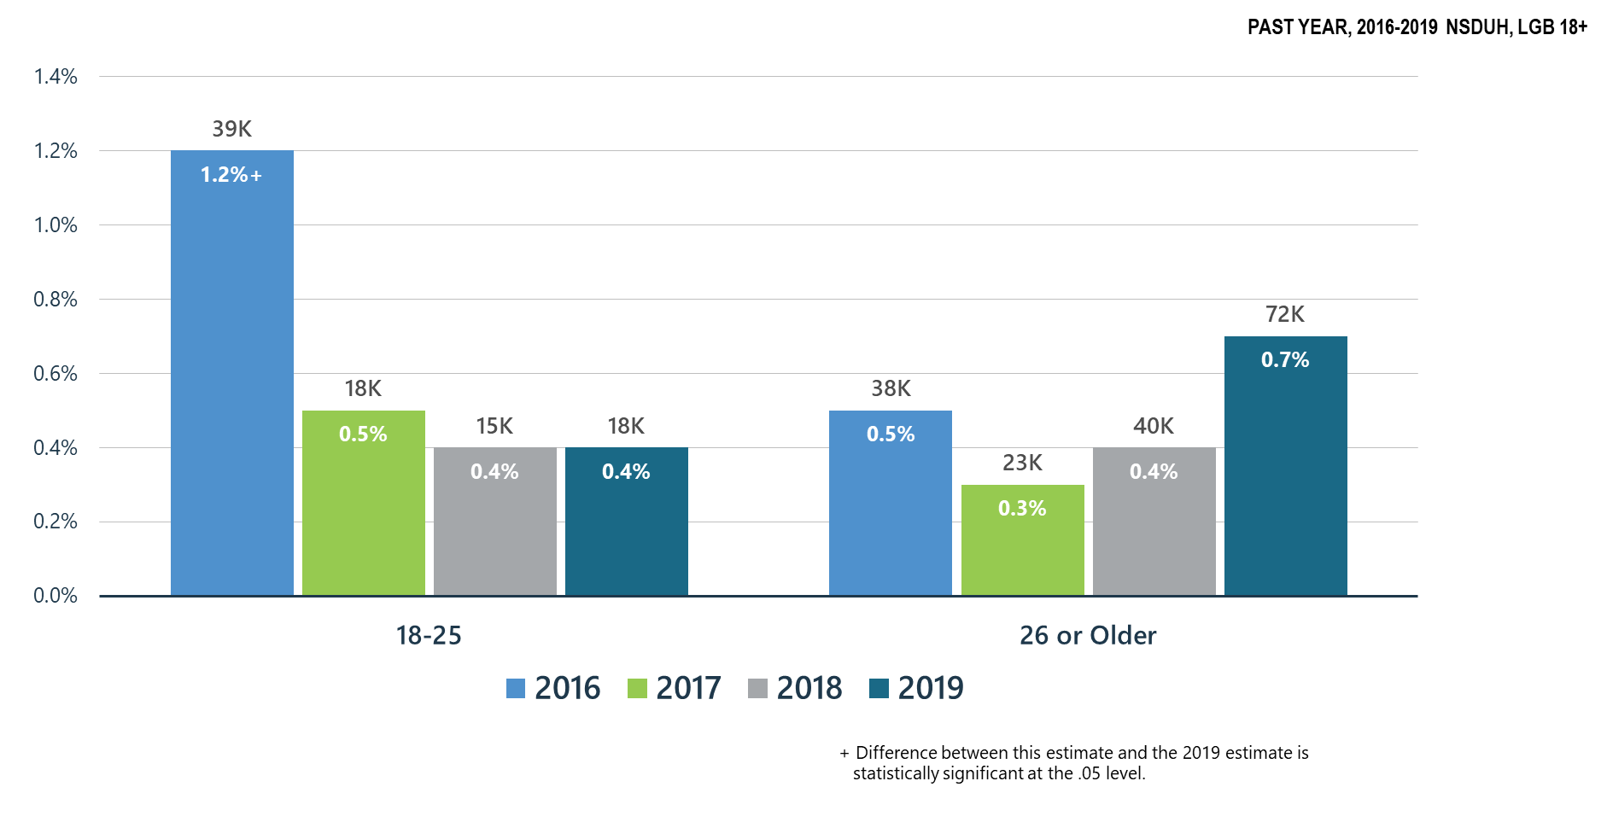
Heroin-Related Opioid Use Disorder among LGB Adults

Slide 17
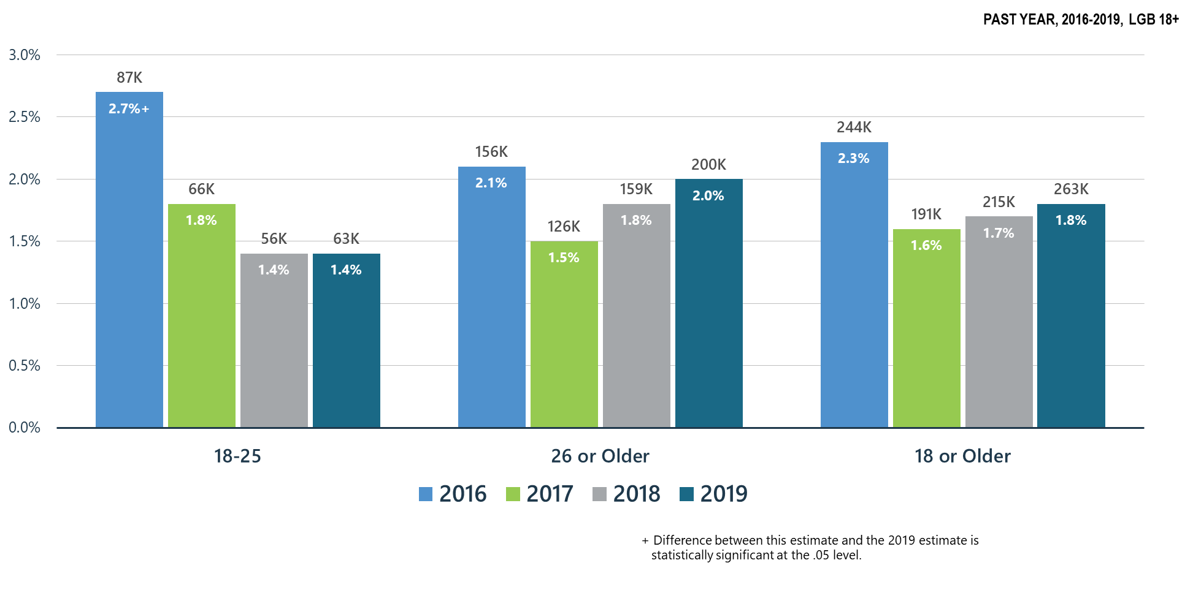
Opioid Use Disorder among LGB Adults

Slide 18
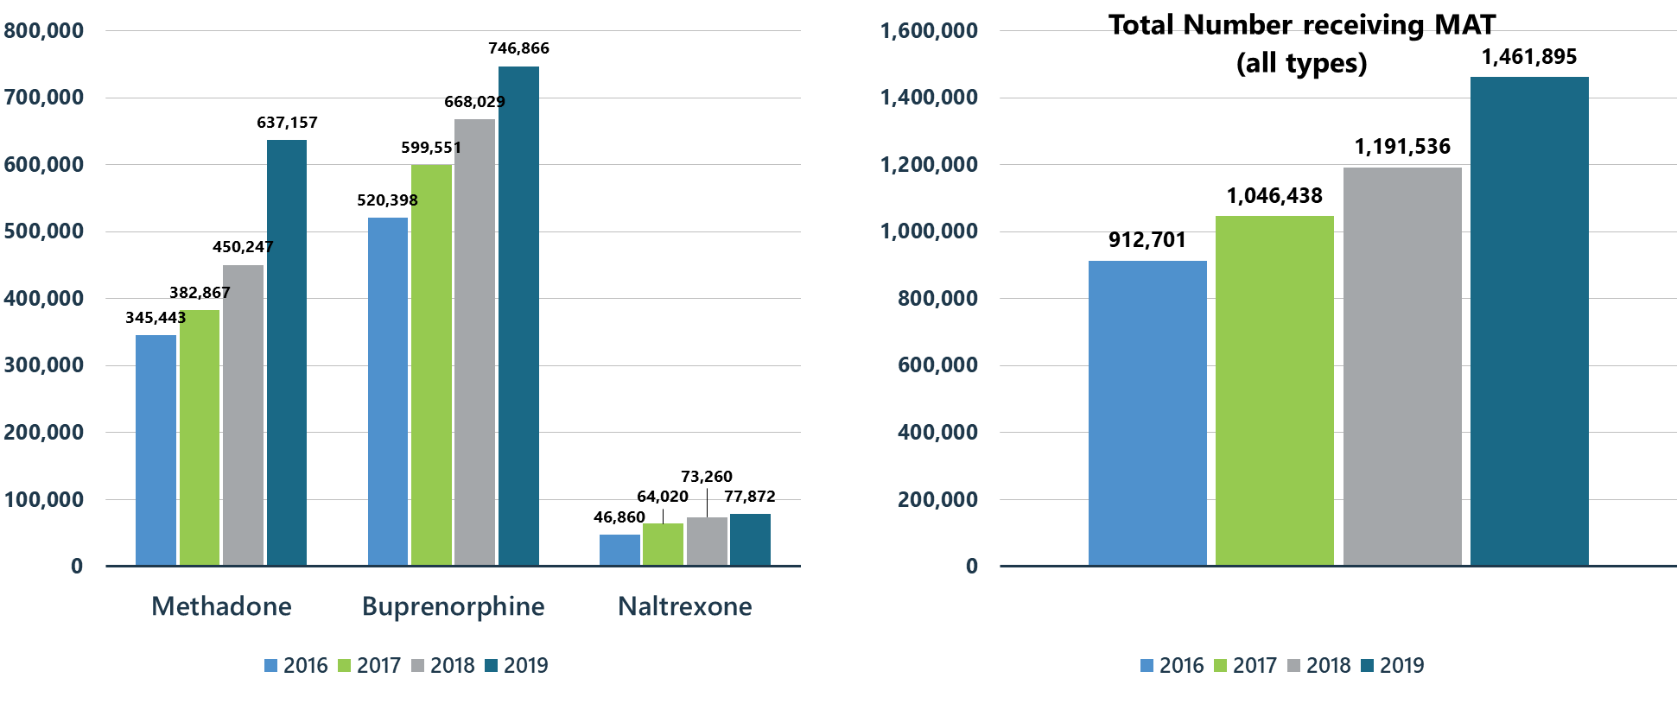
Treatment Gains: Number of Individuals Receiving Pharmacotherapy for Opioid Use Disorder (MAT)

Slide 19
Summary: Opioid Misuse in the United States
Significant decline in opioid misuse for LGB adults ages 18-25 when compared to 2016-2017, however, opioid misuse has significantly increased for LGB adults ages 26 and older when compared to 2017.
Prescription pain reliever misuse has significantly decreased in LGB adults ages 18-25 as compared to 2017.
Opioid use disorder significantly declined in LGB adults ages 18 to 25 as compared to 2016.

Slide 20
Other Illicit Substances

Slide 21
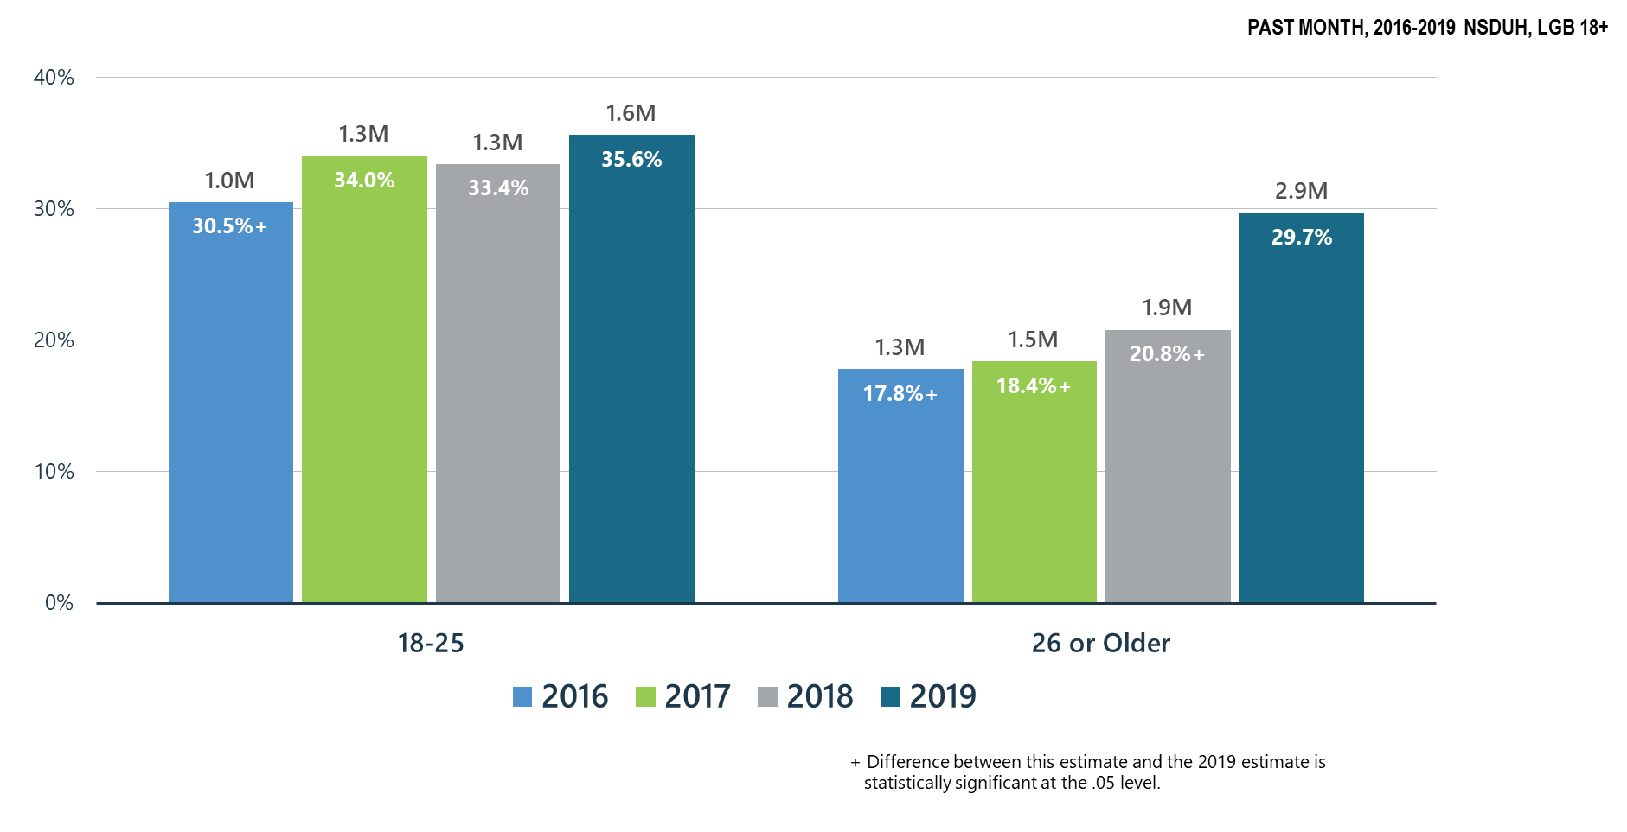
Past Month Marijuana Use for All Age Groups among LGB Adults

Slide 22
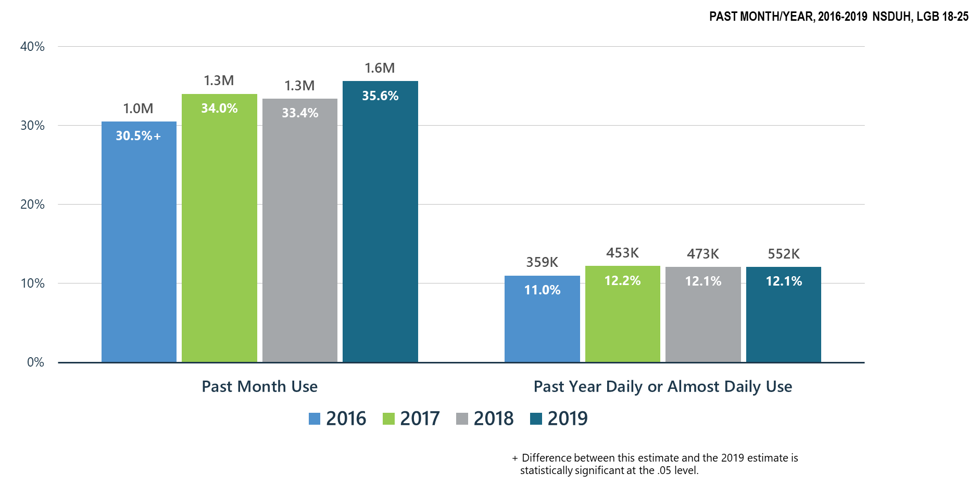
Marijuana Use among LGB Young Adults (18-25 y.o.)

Slide 23
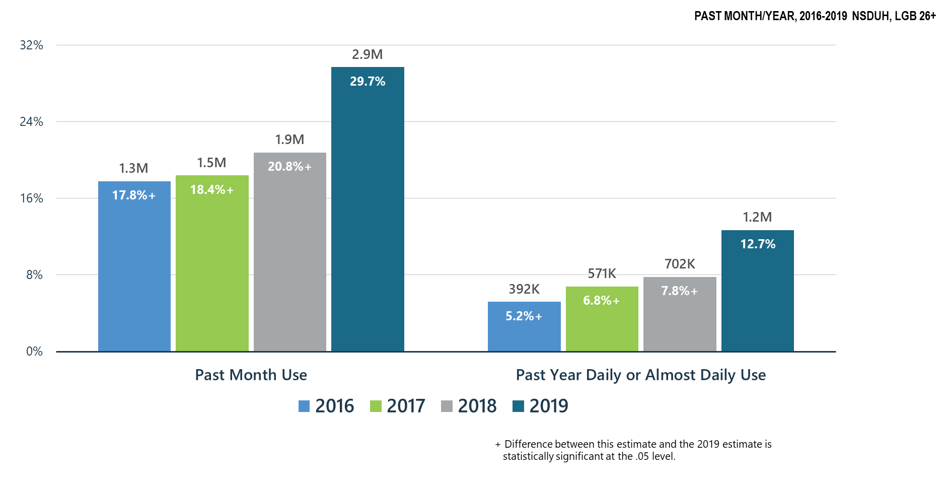
Significant Increase in Marijuana Use among LGB Adults 26+

Slide 24
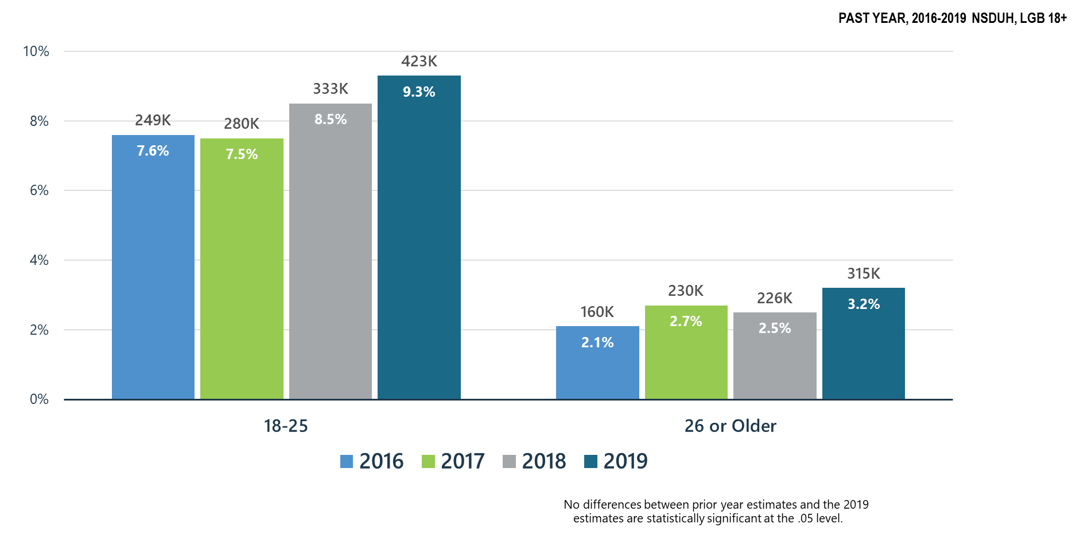
Marijuana Use Disorder among LGB Adults

Slide 25
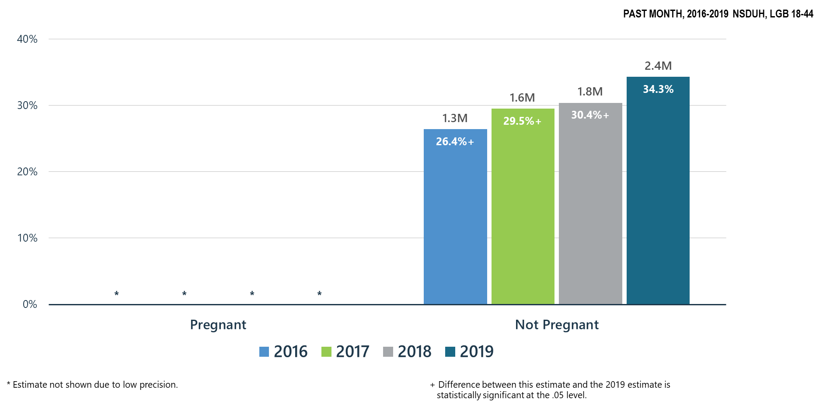
Marijuana Use among LGB Women by Pregnancy Status

Slide 26
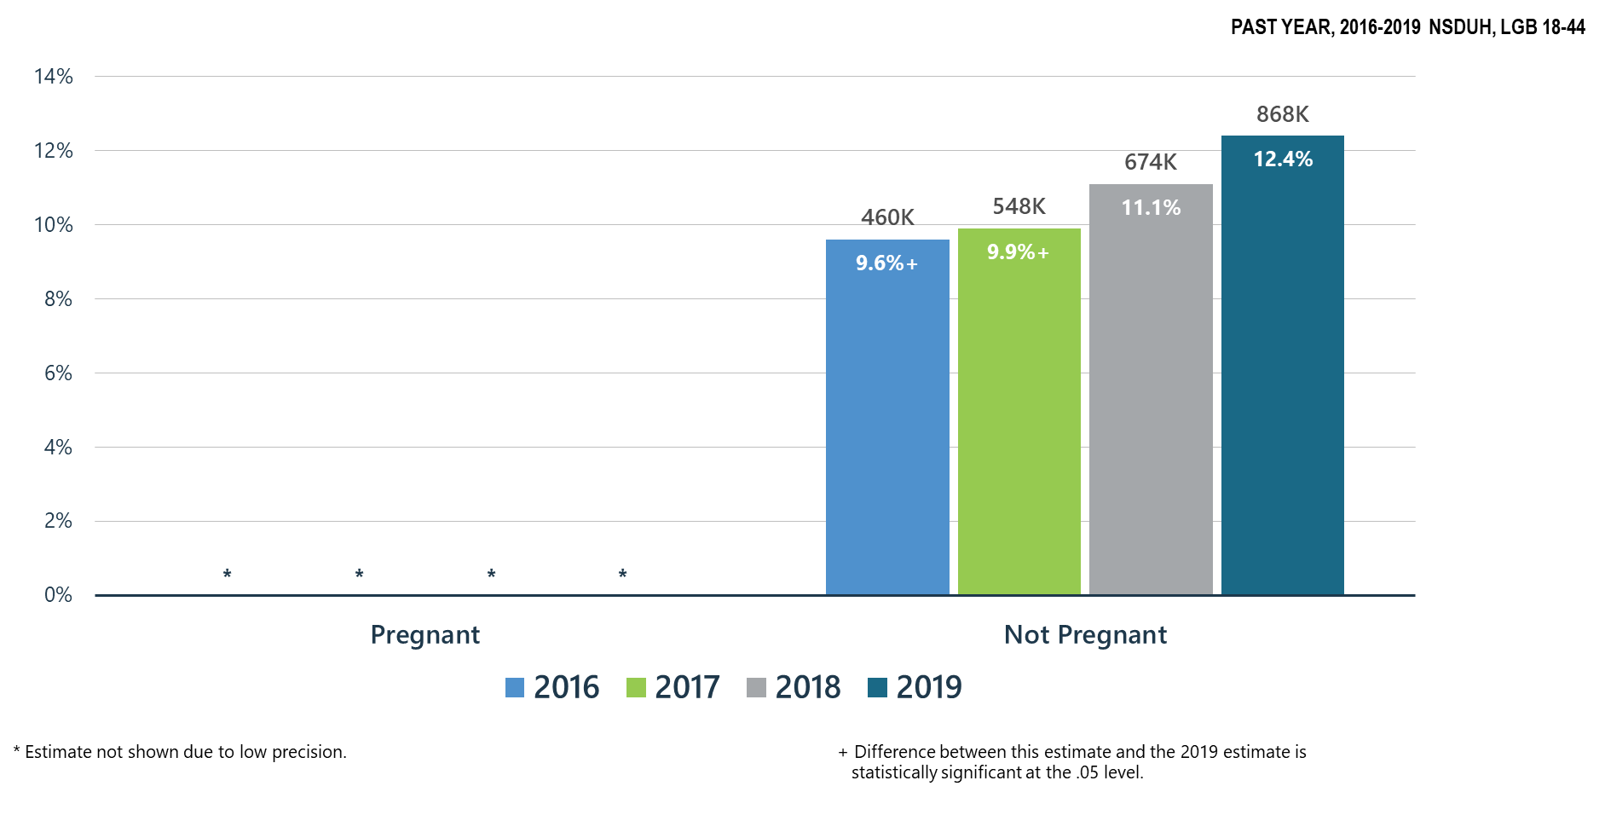
Daily or Almost Daily Marijuana Use among LGB Women by Pregnancy Status

Slide 27
Marijuana Use: Health Concerns
Past month marijuana use for LGB adults ages 18 and older has significantly increased as compared to 2016.
There were significant increases in past month and past year daily or almost daily marijuana use for LGB adults ages 26 and older.
There were significant increases in past month and daily or almost daily marijuana use for non-pregnant LGB women ages 18-44.

Slide 28
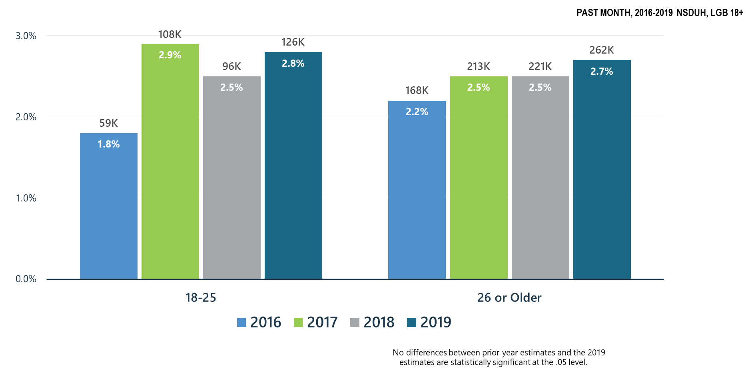
Cocaine Use among LGB Adults

Slide 29
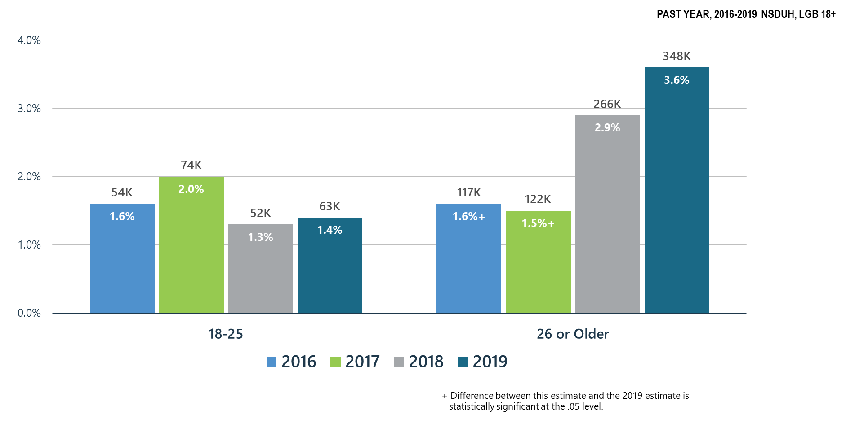
Methamphetamine Use among LGB Adults

Slide 30
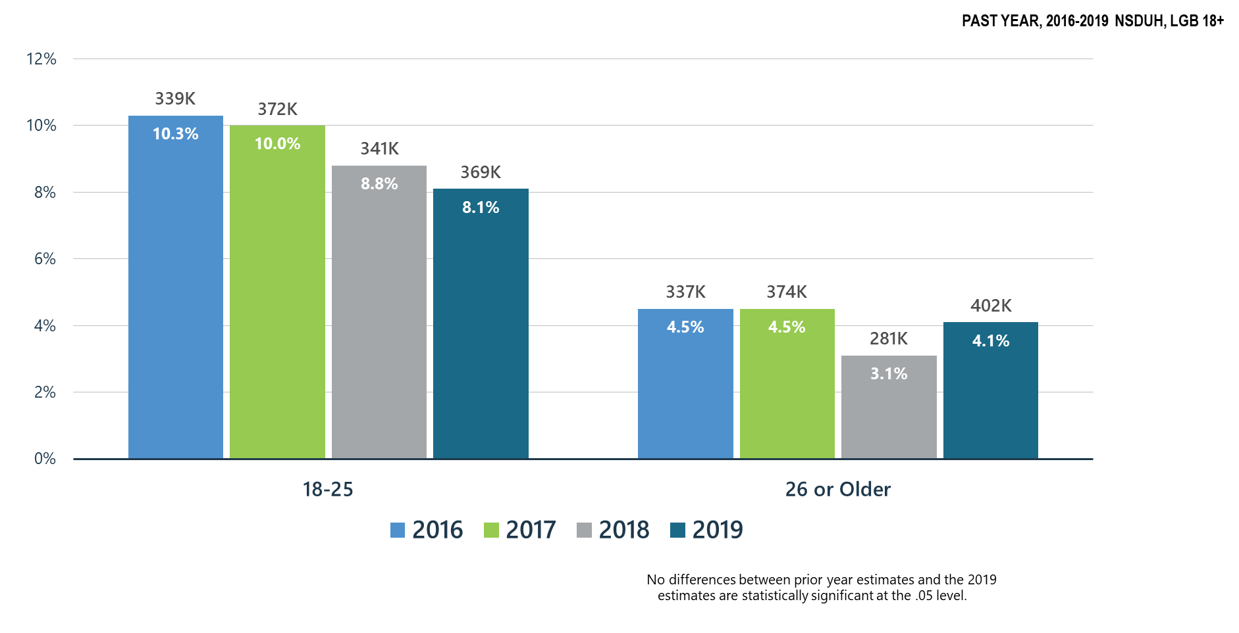
Misuse of Prescription Stimulants among LGB Adults

Slide 31
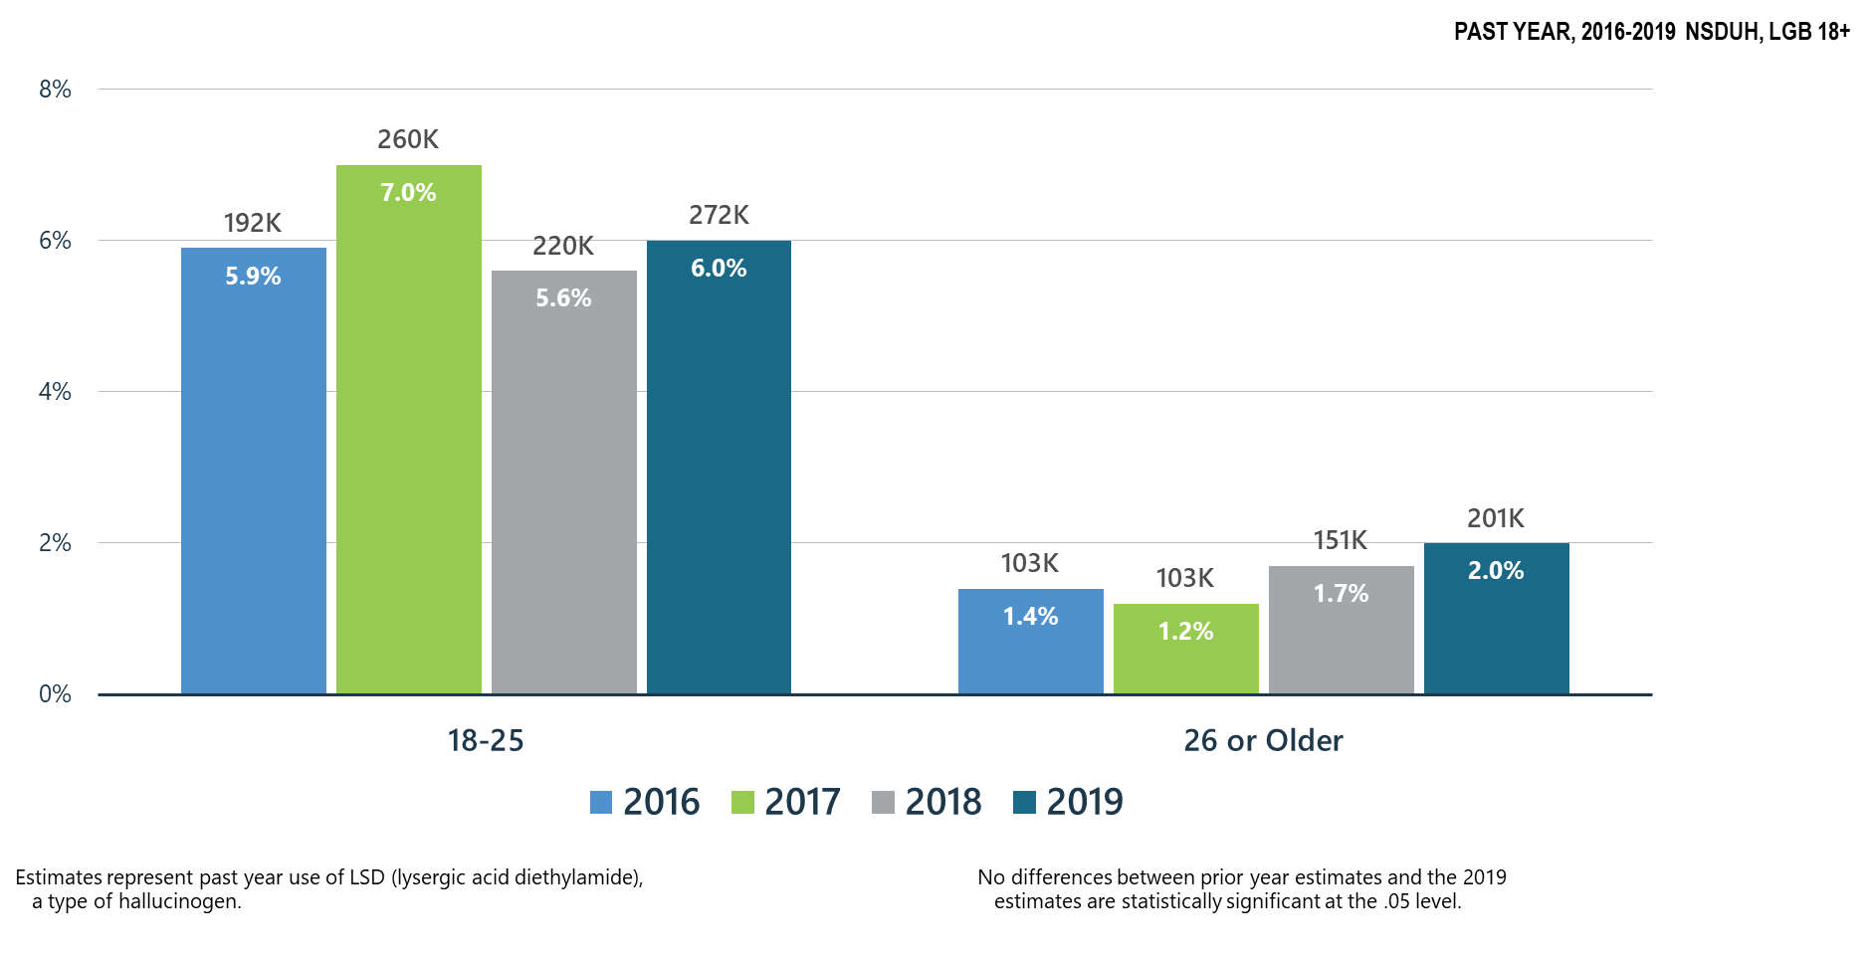
LSD Use among LGB Adults for All Age Groups

Slide 32
Summary: Other Substance Use in the United States in 2019 Compared to Past Years
In 2019 there were significant increases in methamphetamine use among LGB adults ages 26 and older as compared to 2016 and 2017.
There was a slight decrease in misuse of prescription stimulants among LGB adults ages 18-25, but a slight increase for ages 26 and older.
Past year LSD misuse slightly increased for all ages for LGB adults as compared to 2018.

Slide 33
Polysubstance Use and Mental Illness

Slide 34
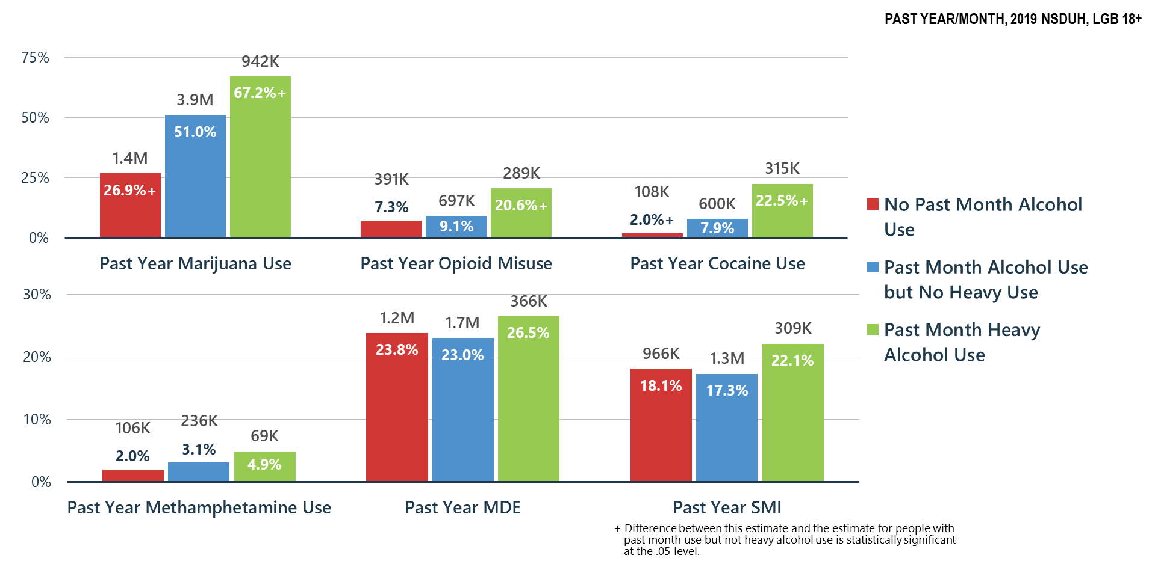
Alcohol Use Related to Other Substance Use, MDE and SMI among LGB Adults

Slide 35
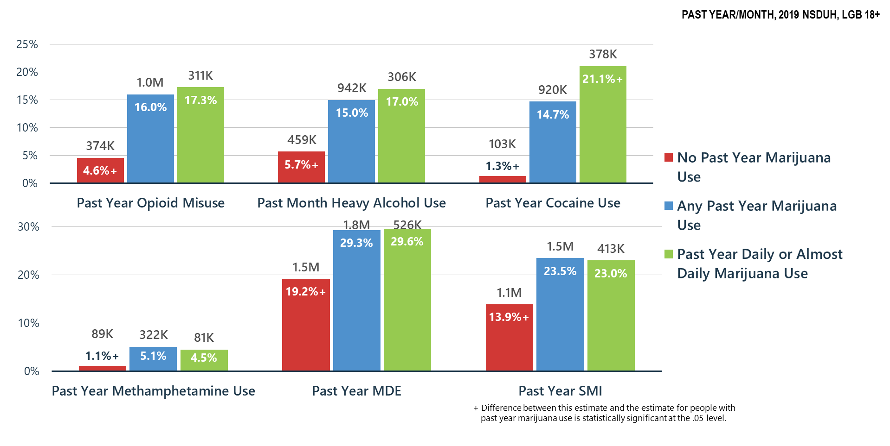
Marijuana Use Related to Other Substance Use, MDE and SMI among LGB Adults

Slide 36
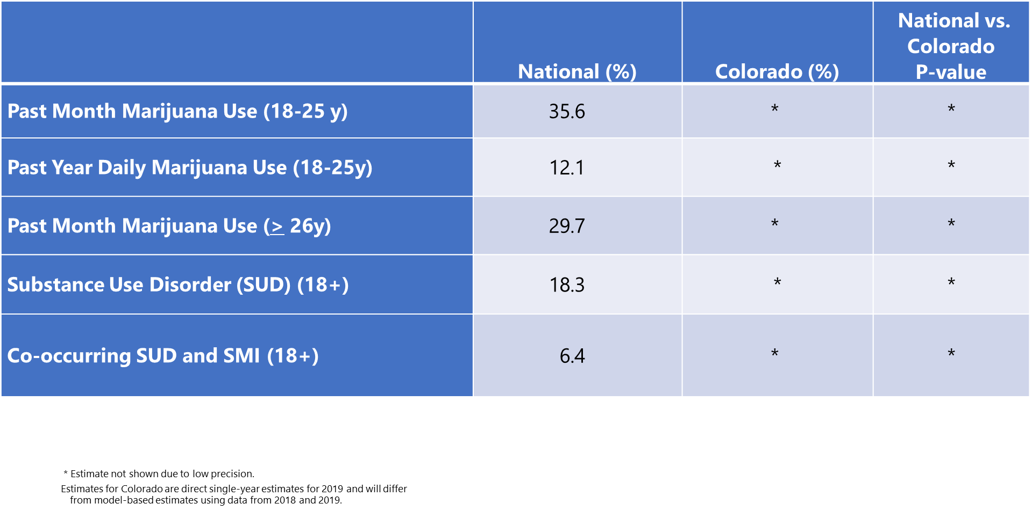
Comparison of Rates of Mental/Substance Use Disorders Associated with Marijuana Use among LGB Adults: National vs. Colorado Data from the National Survey on Drug Use and Health (2019)

Slide 37
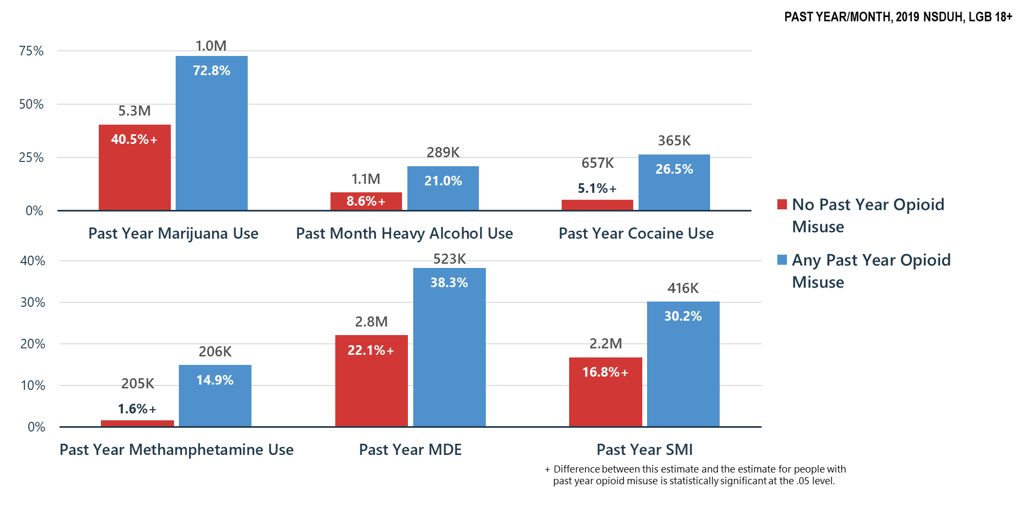
Opioid Misuse Related to Other Substance Use, MDE and SMI among LGB Adults

Slide 38
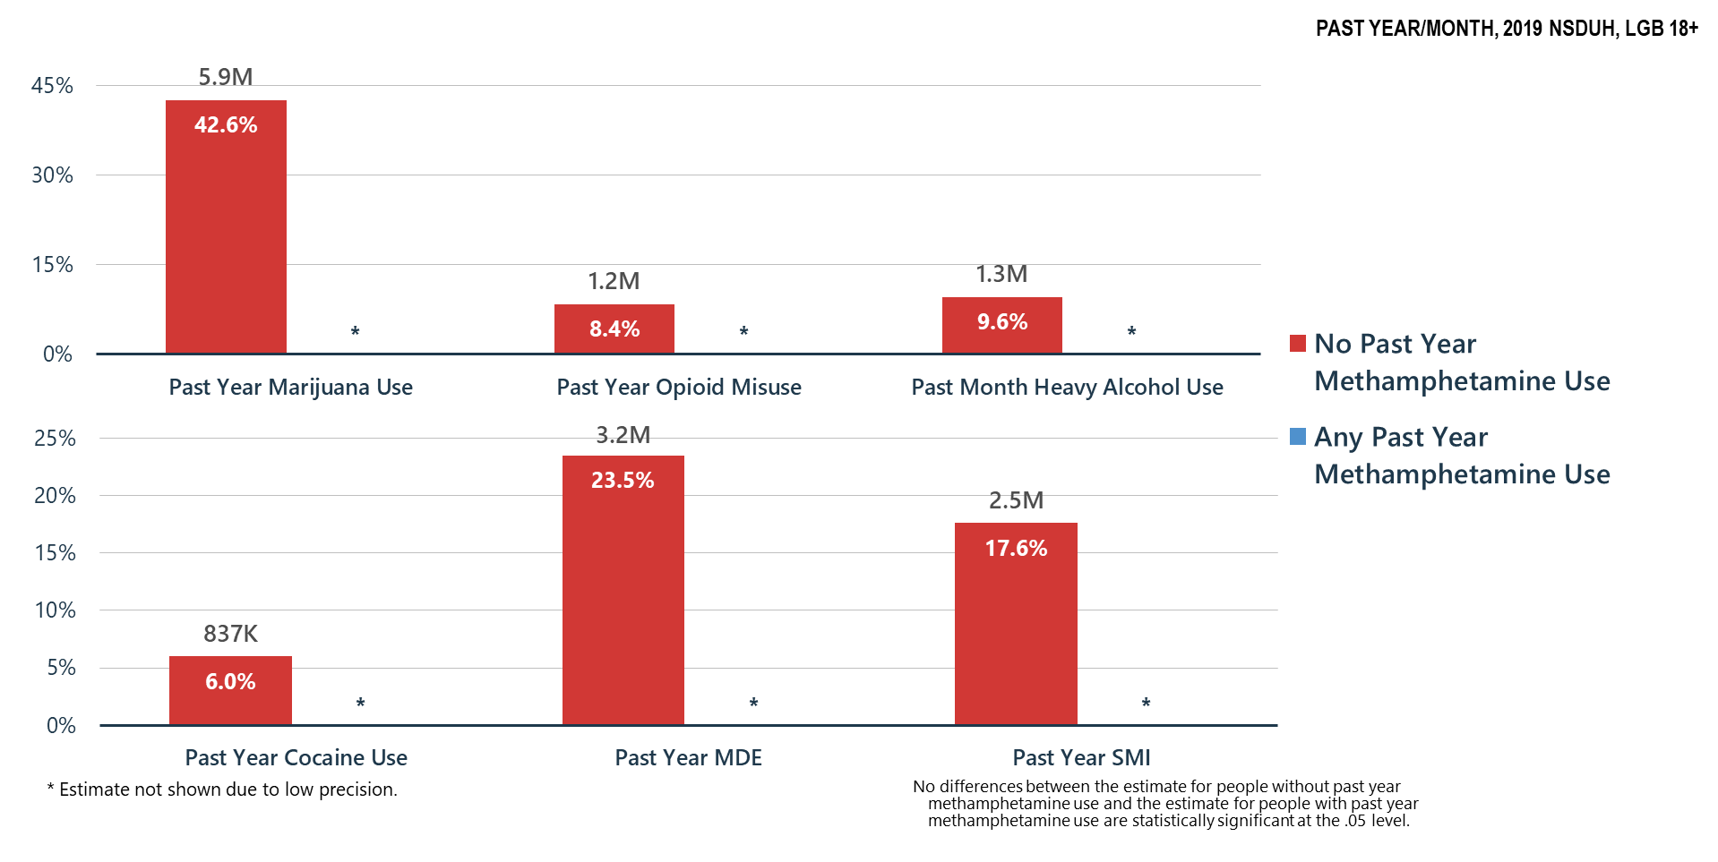
Methamphetamine Use Related to Other Substance Use, MDE and SMI among LGB Adults

Slide 39
Summary
Polysubstance use is common—if a person is having problems with one substance, they are likely using and may be having problems with other substances
Treatment providers must screen for and treat all substance use disorders and problem substance use
Association of substance misuse and mental illness is clear—we must all do a better job of helping Americans understand these relationships and risks

Slide 40
Mental Health

Slide 41
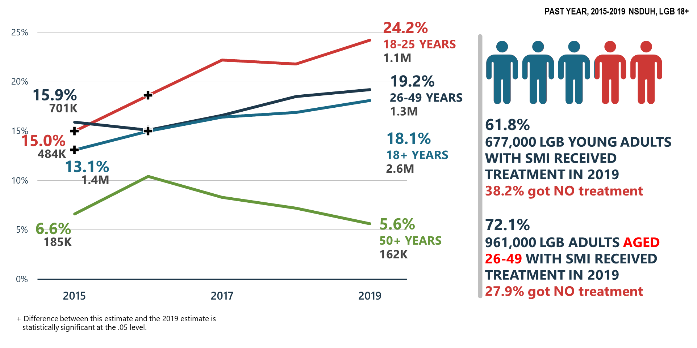
Serious Mental Illness (SMI) among LGB Adults

Slide 42
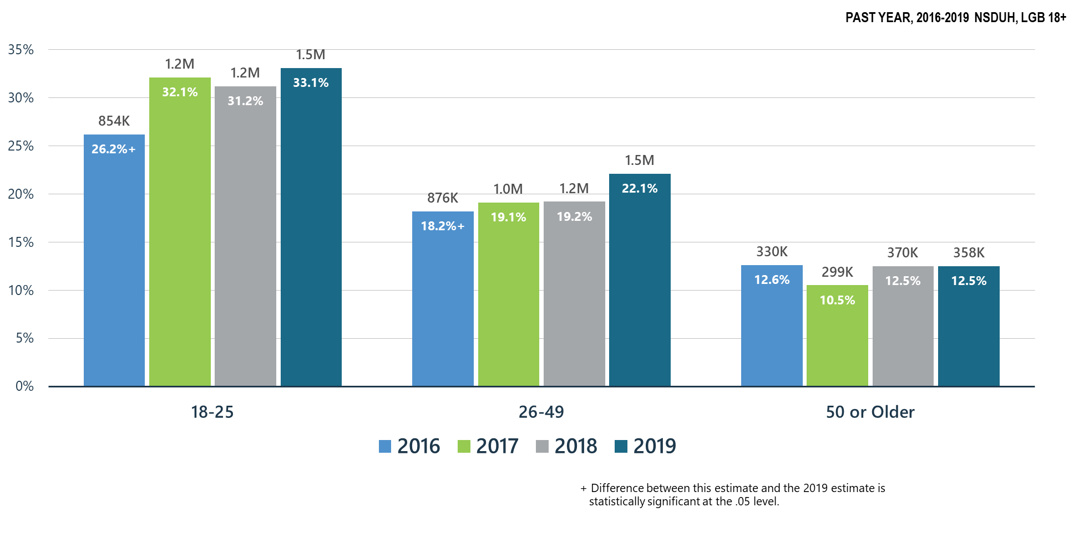
Major Depressive Episodes among LGB Adults

Slide 43
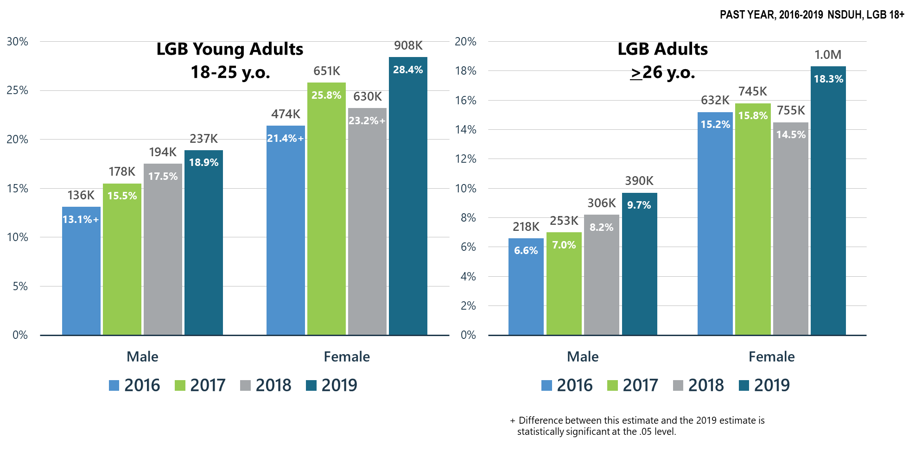
Major Depressive Episodes with Severe Impairment among LGB Adults

Slide 44
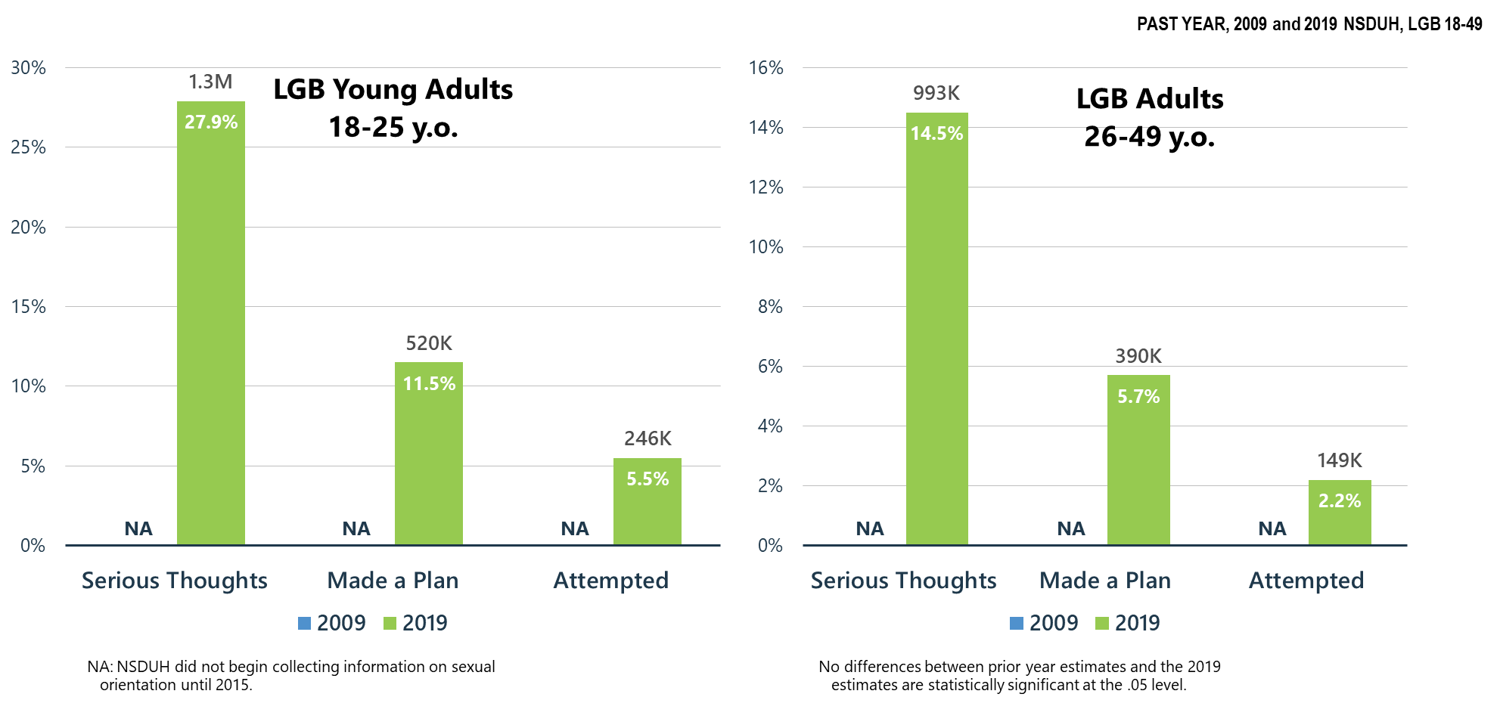
Suicidal Thoughts, Plans, and Attempts for LGB Young Adults (18-25 y.o.) and LGB Adults (26-49 y.o.)

Slide 45
Co-Occurring
Mental and Substance Use Disorders

Slide 46
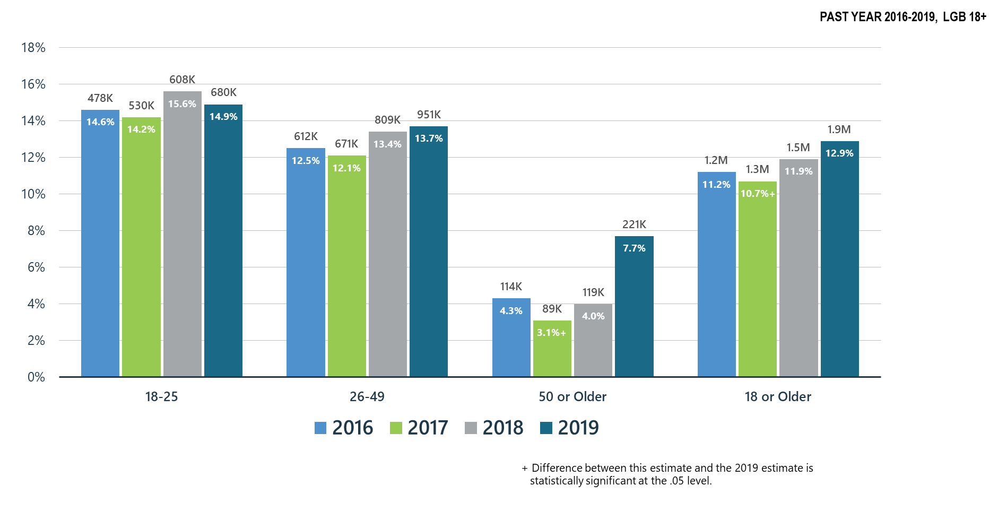
Co-Occurring Substance Use Disorder and Any Mental Illness in LGB Adults

Slide 47
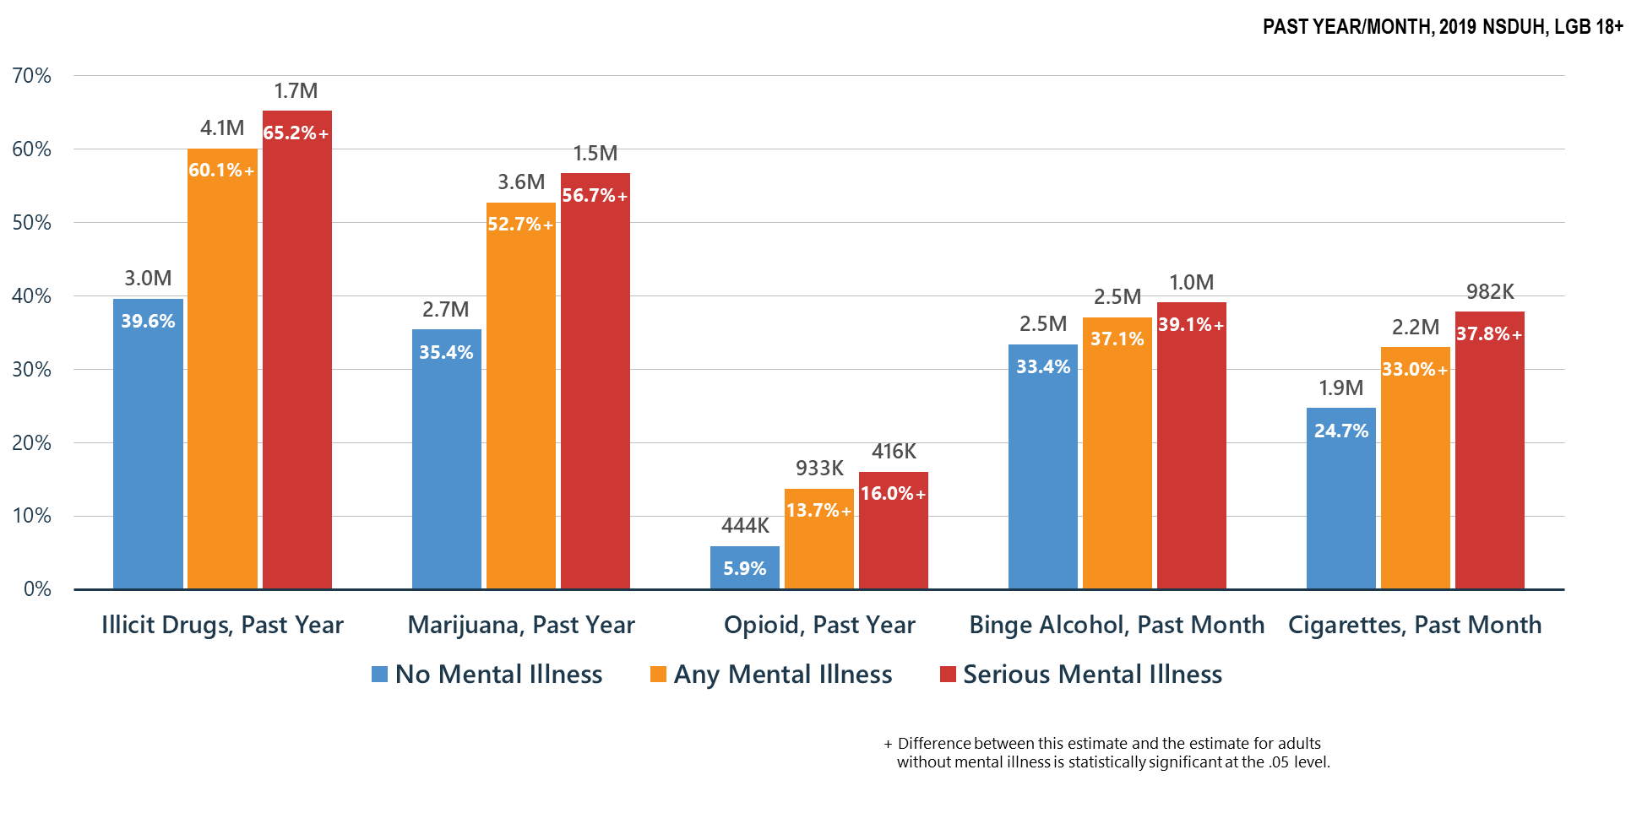
Co-Occurring Issues: Substance Use and Mental Illness among LGB Adults

Slide 48
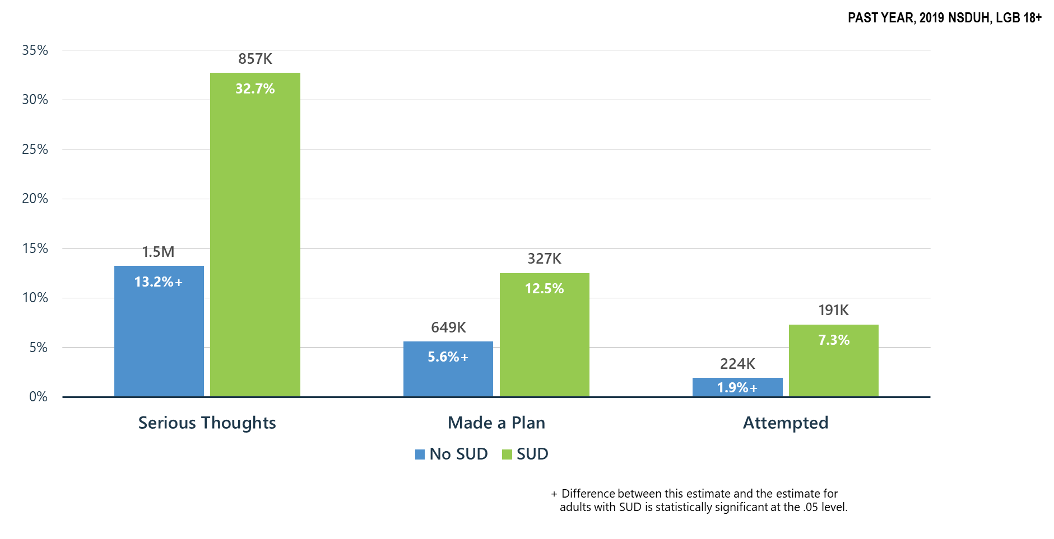
Substance Use Disorder (SUD) is Associated with Suicidal Thoughts, Plans, and Attempts among LGB Adults >18 y.o.

Slide 49
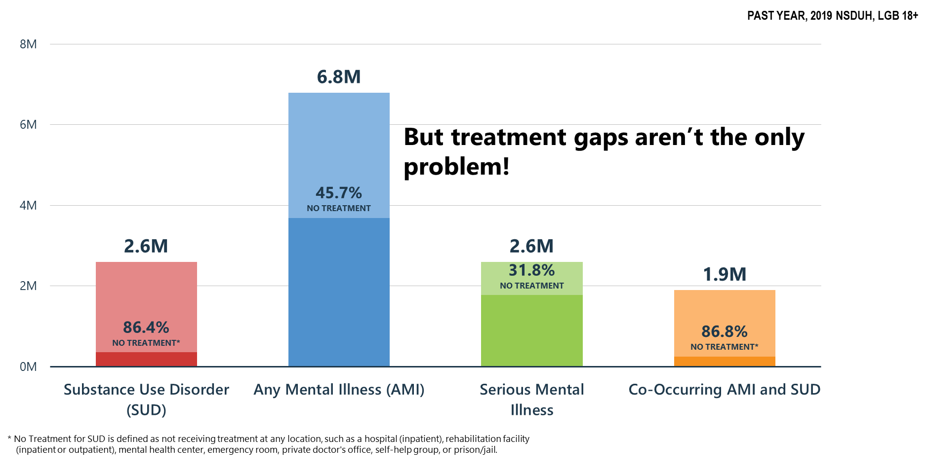
Mental and Substance Use Disorders among LGB Adults: High Prevalence/Huge Treatment Gaps

Slide 50
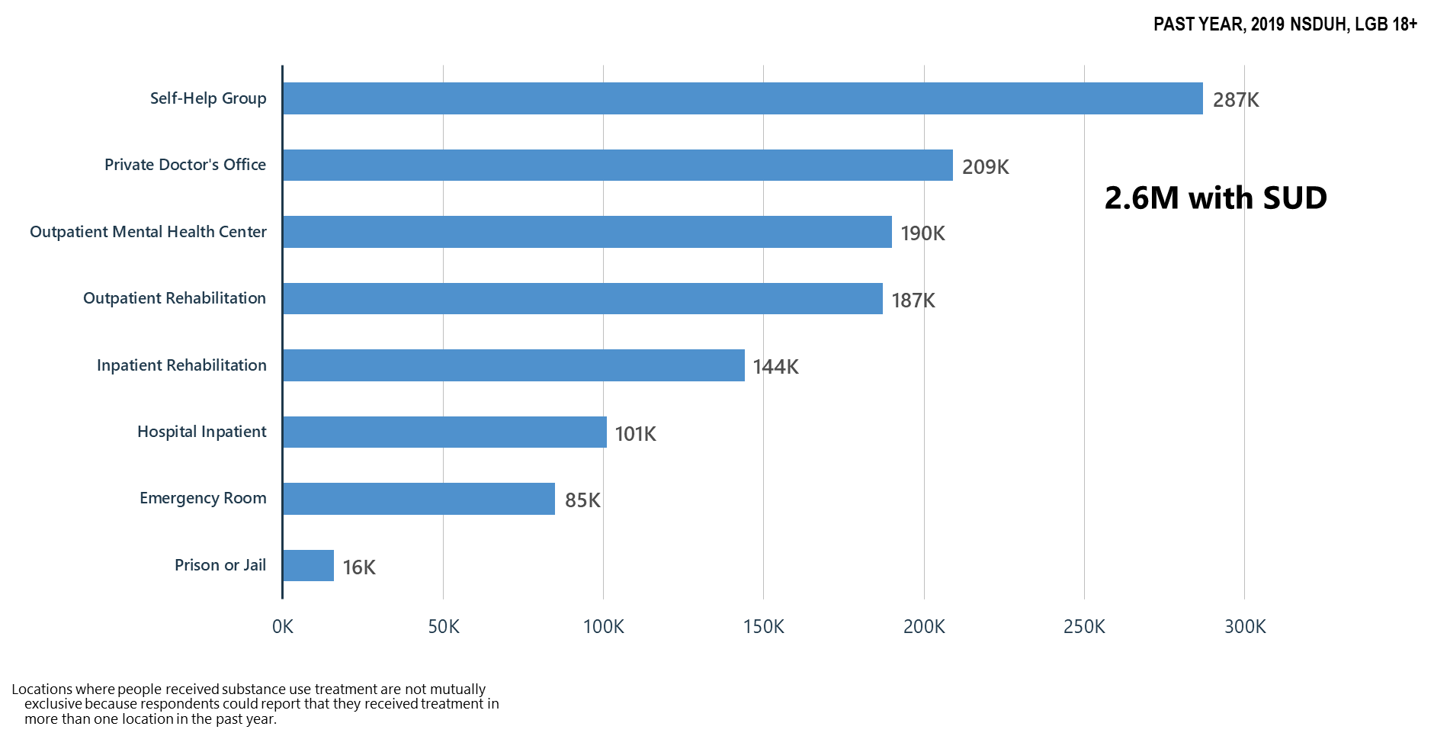
Locations Where Substance Use Treatment was Received among LGB Adults

Slide 51
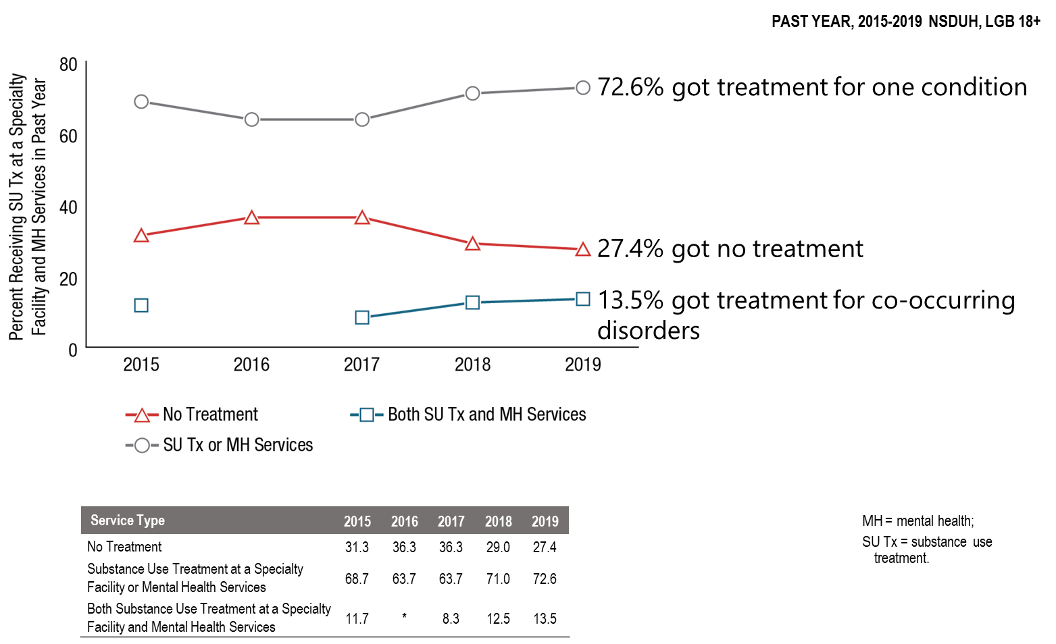
Receipt of Substance Use Treatment at a Specialty Facility and Mental Health Services in the Past Year among LGB Adults Aged 18 or Older with Past Year Substance Use Disorder and Serious Mental Illness: 2015-2019

Slide 52
Summary: Mental Health/Co-Occurring Issues in the United States in 2019
Serious mental illness among the LGB population ages 18-25 and 26-49 has significantly increased as compared to 2016.
Major depressive episodes with severe impairment among LGB young adult men ages 18-25 significantly increased as compared to 2016 and major depressive episodes with severe impairment significantly increased among LBG young women ages 18-25 as compared to 2018.
There were huge treatment gaps for treatment of mental and substance use disorders in the LGB population.
Substance use disorder significantly increased suicidality among the LGB population ages 18 and older.
Self-help groups ranked higher than outpatient rehabilitation facilities for the locations where substance use treatment was received.

Slide 53
What Can We Do Now?
SAMHSA must use its resources to benefit as many as possible:
Community based treatment and recovery services
Build on the Certified Community Behavioral Health Clinic model
  Crisis intervention services/suicide prevention resources
  Integrated mental health, substance use, general medical services
  Children’s mental health services-linkages with schools
Keep telemedicine/telehealth in place including use of telephone where audio/visual is not possible and pay for these services at same rate as face-to-face—no reduction in reimbursement because it is telemedicine
Continue and expand as possible technical assistance and training to behavioral health providers—clinicians and peers

Slide 54
It’s Up to Us Now
Let’s work as hard as we can to make decision-makers understand mental health and substance use needs in America—pre and post-COVID-19
Let’s keep the virus in mind in planning and implementing our services so that we can safely deliver care, but we cannot ignore the overall health needs of the American people—that is not an option
Let’s work to meet the mental health/substance use needs of our people:
  Restore our systems—mental health and substance use disorder services are ‘essential services’
  Expand our treatment and community recovery support systems permanently
  Every American life is precious and every American death—regardless of the cause is a terrible loss

