Slide 1
2019 National Survey on Drug Use and Health: Veteran Adults
Substance Abuse and Mental Health Services Administration
U.S. Department of Health and Human Services
September 2020

Slide 2
National Survey on Drug Use and Health (NSDUH)
NSDUH is a comprehensive household interview survey of substance use, substance use disorders, mental health, and the receipt of treatment services for these disorders in the United States.
NSDUH is collected face-to-face by field interviewers who read less sensitive questions to respondents and transition respondents to audio computer assisted self‑interviewing for sensitive items.
NSDUH covers the civilian, noninstitutionalized population, aged 12 or older:
  Includes: Households, college dorms, homeless in shelters, civilians on military bases
  Excludes: Active military, long-term hospital residents, prison populations, homeless not in shelters
Sample includes all 50 states and DC
Approximately 67,500 persons are interviewed annually
Data collected from January to December

Slide 3
How Do We Use NSDUH?
Provides a window into the state of substance use and mental health issues in the United States
Helps to guide policy directions in addressing:
  problem substances
  prevalence of mental illness
  intersection of substance use and mental health issues
  provides insights that can be studied in the context of data from other agencies to help in decision-making about what types of resources are needed and where resources should be directed

Slide 4
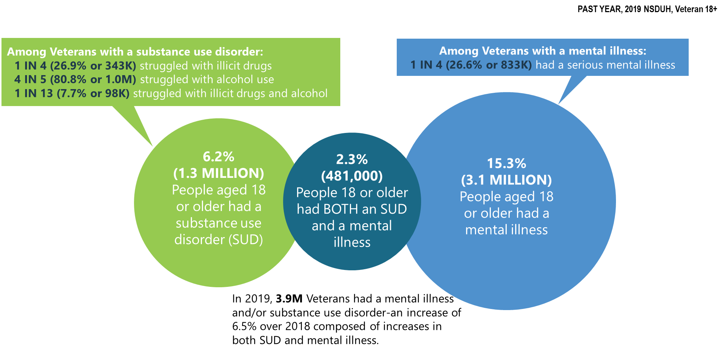
Mental Illness and Substance Use Disorders in America among Veterans (>18 y.o.)

Slide 5
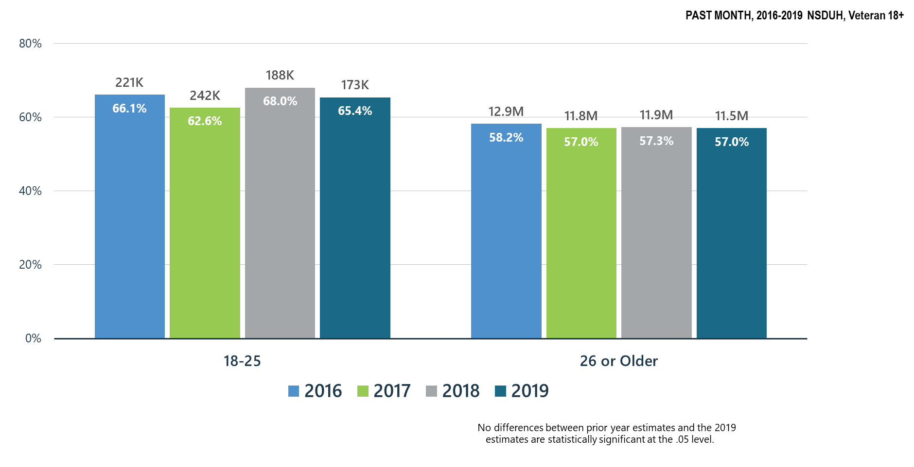
Alcohol Use among Veterans

Slide 6
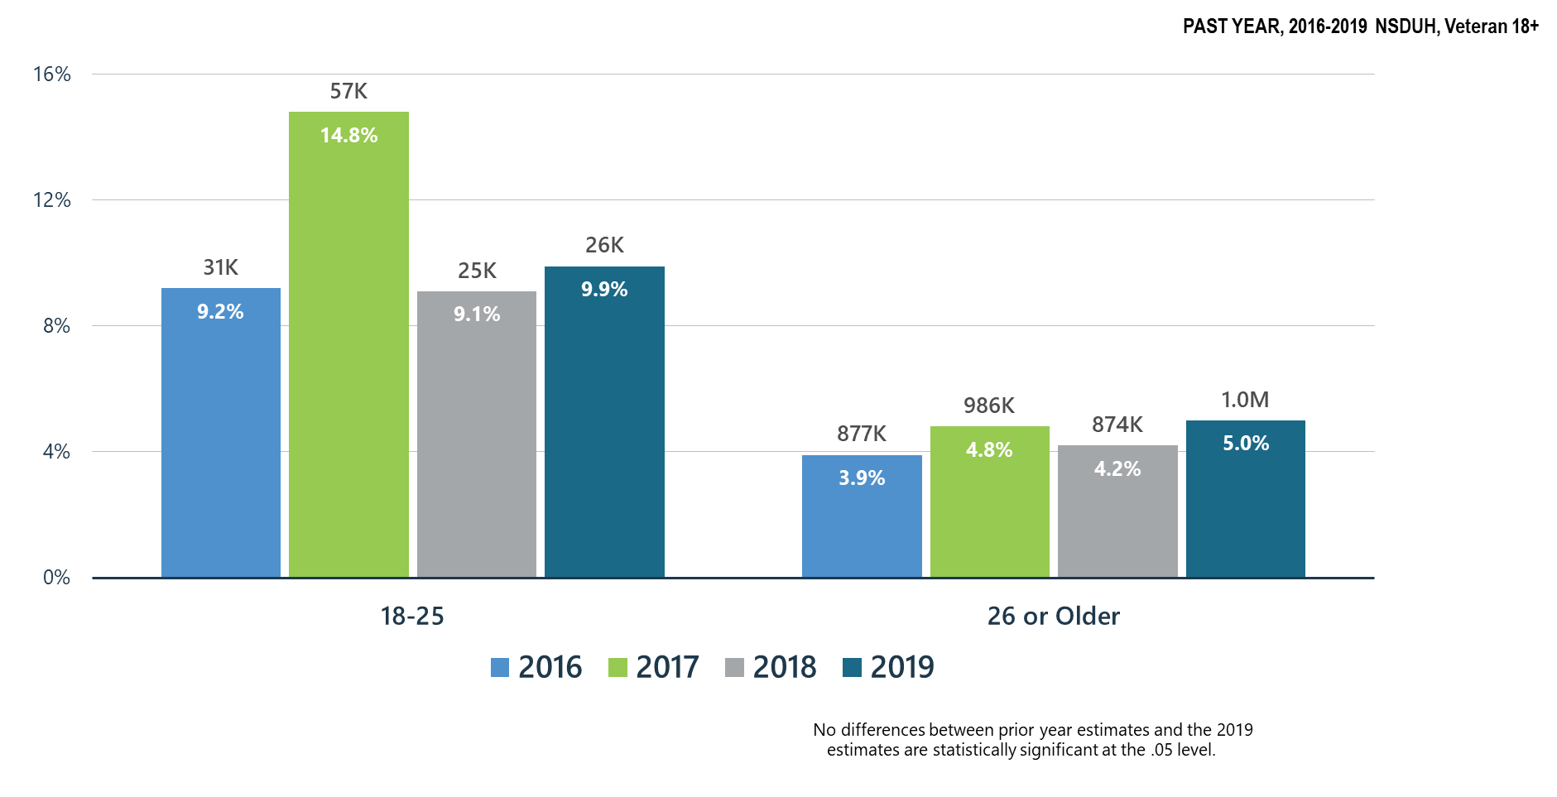
Alcohol Use Disorder among Veterans

Slide 7
Summary: Alcohol Use in 2019
Past month alcohol use and past year alcohol use disorder remained stable in veterans of all age groups during 2018-2019.
While alcohol use among veterans declined slightly from 2018, alcohol use disorder increased slightly in 2019.
SAMHSA will continue its prevention programs:
  SAMHSA Prevention Technology Transfer Centers produce resources and materials related to alcohol misuse prevention
  CSAP ‘Talk They Hear You’ focuses on underage drinking
  CSAP requires Partnerships for Success grantees to emphasize underage drinking prevention
  CSAT has promoted SBIRT for alcohol use in all programs including CJ, PPW, adolescent treatment, HIV and homeless programs
  CSAT has funded SBIRT training in medical residencies and other healthcare practitioner programs which screen for hazardous alcohol use and use disorders

Slide 8
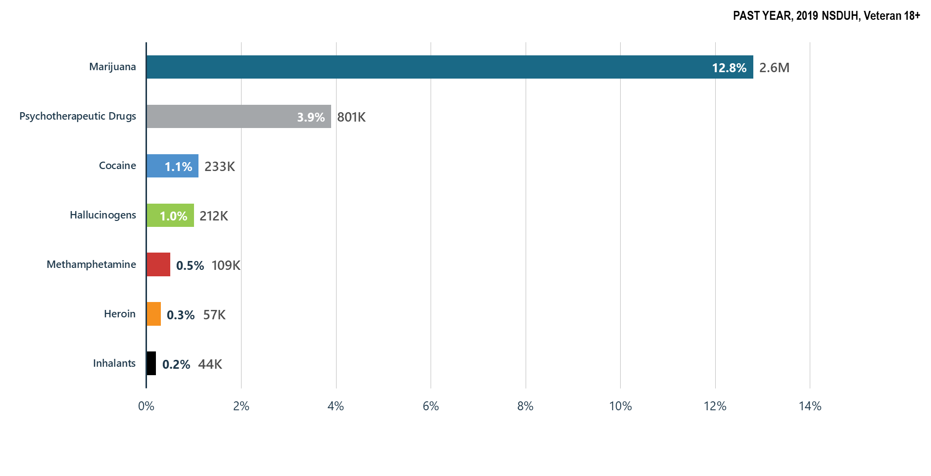
Illicit Drug Use among Veterans

Slide 9
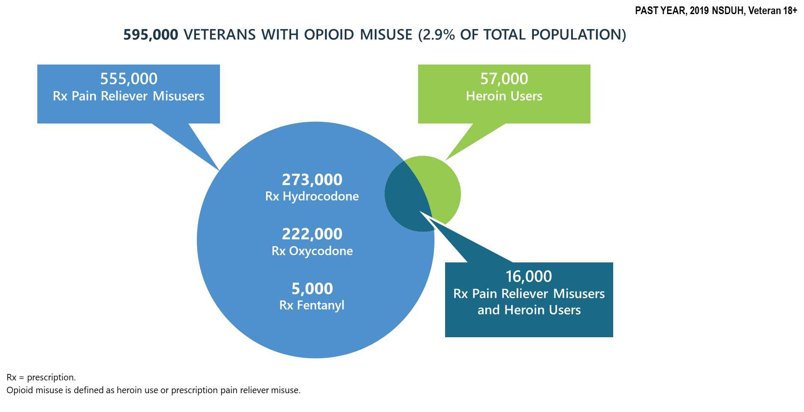
Progress on the Opioid Epidemic: Prescription Pain Reliever Misuse among Veterans

Slide 10
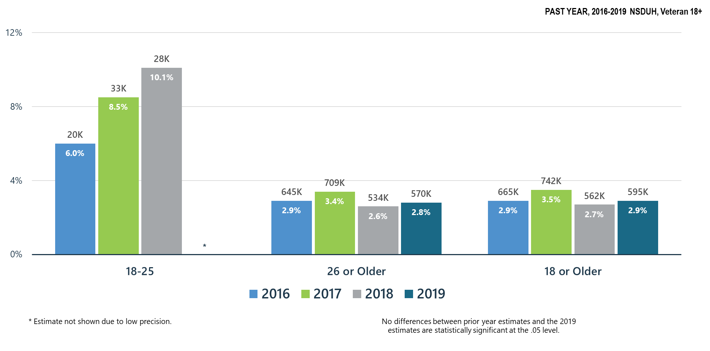
Opioid Misuse among Veterans

Slide 11
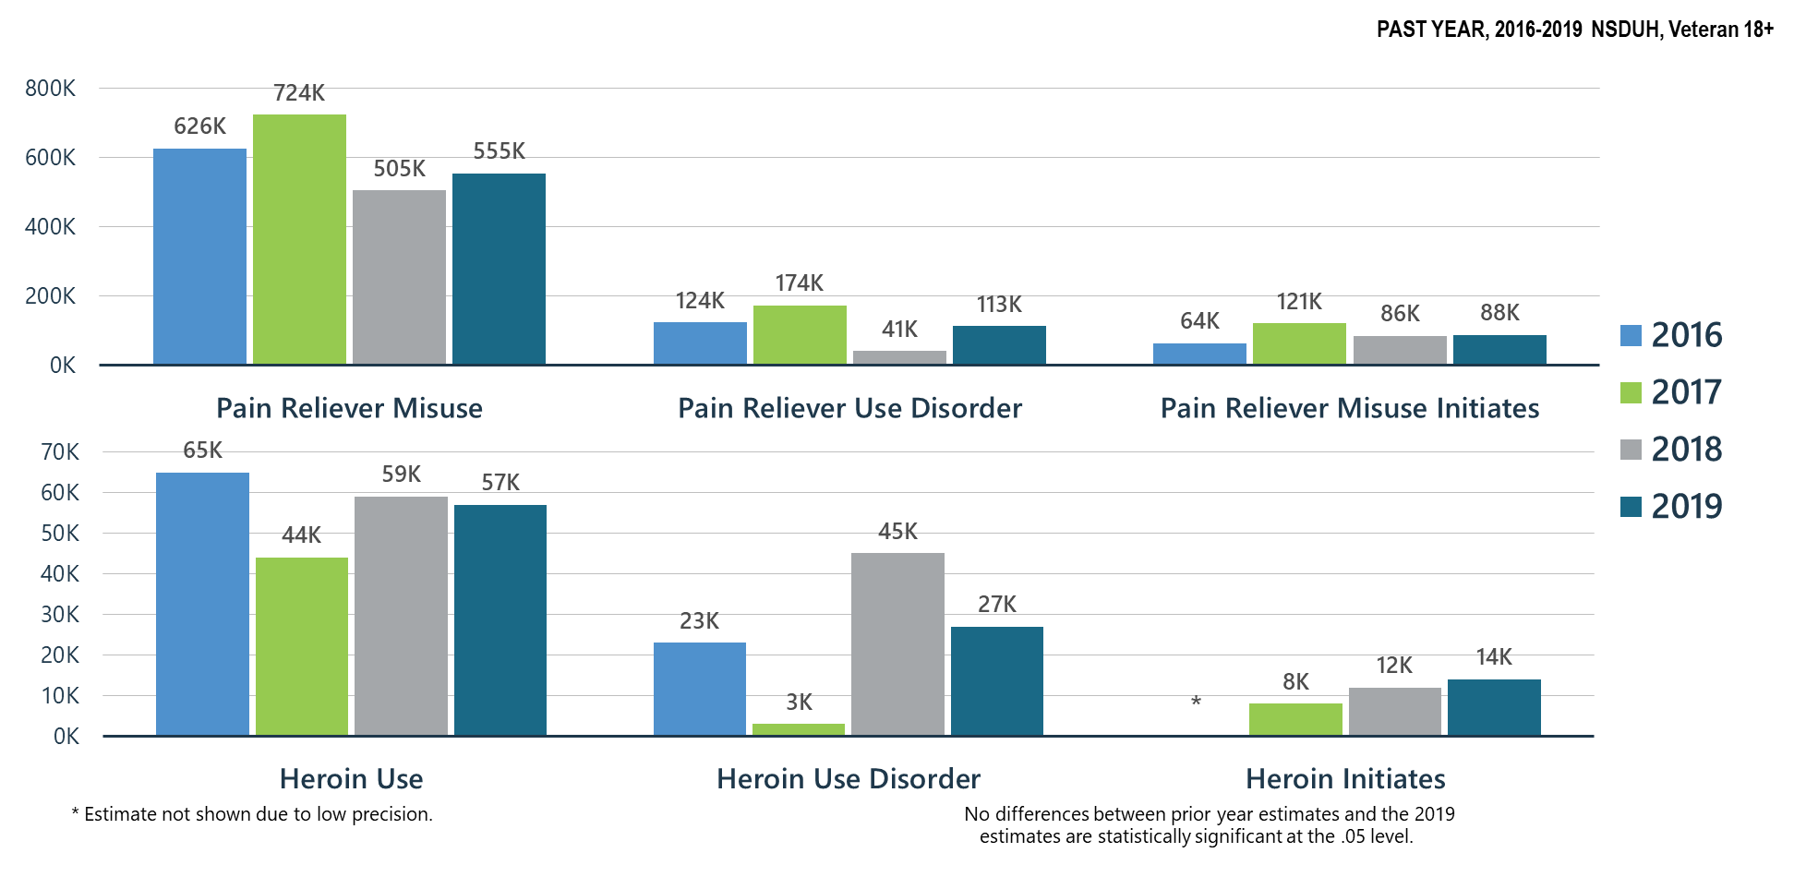
Prescription Pain Reliever Misuse and Heroin Use among Veterans

Slide 12
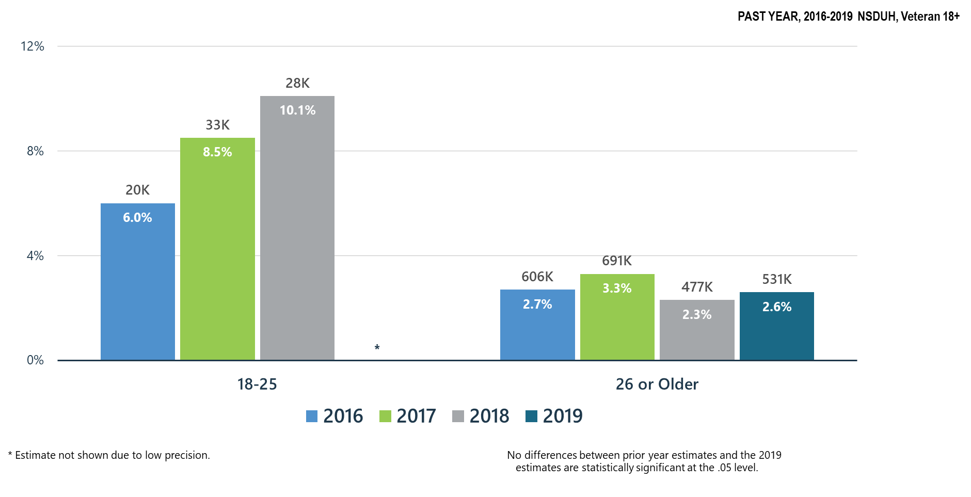
Prescription Pain Reliever Misuse among Veterans

Slide 13
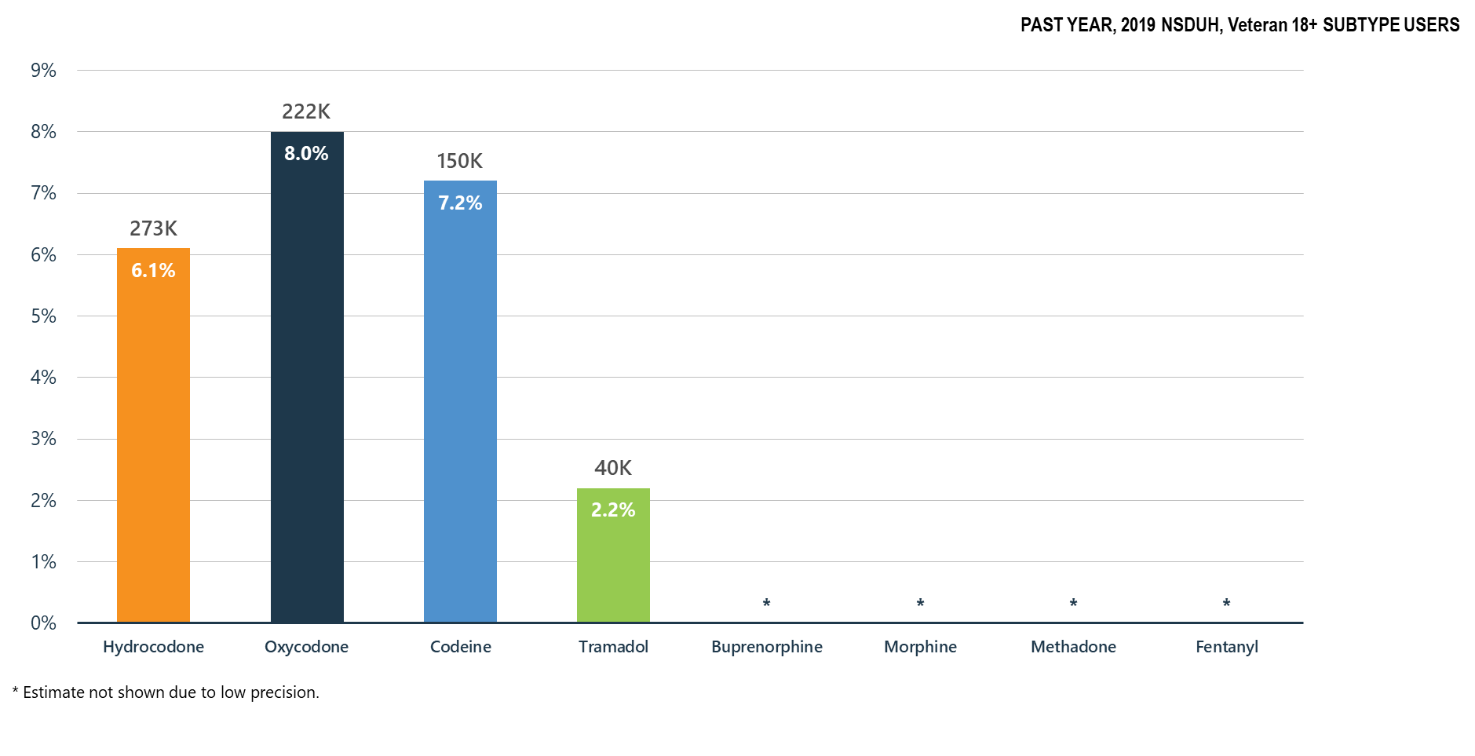
Misuse of Prescription Opioid Subtypes among Veterans

Slide 14
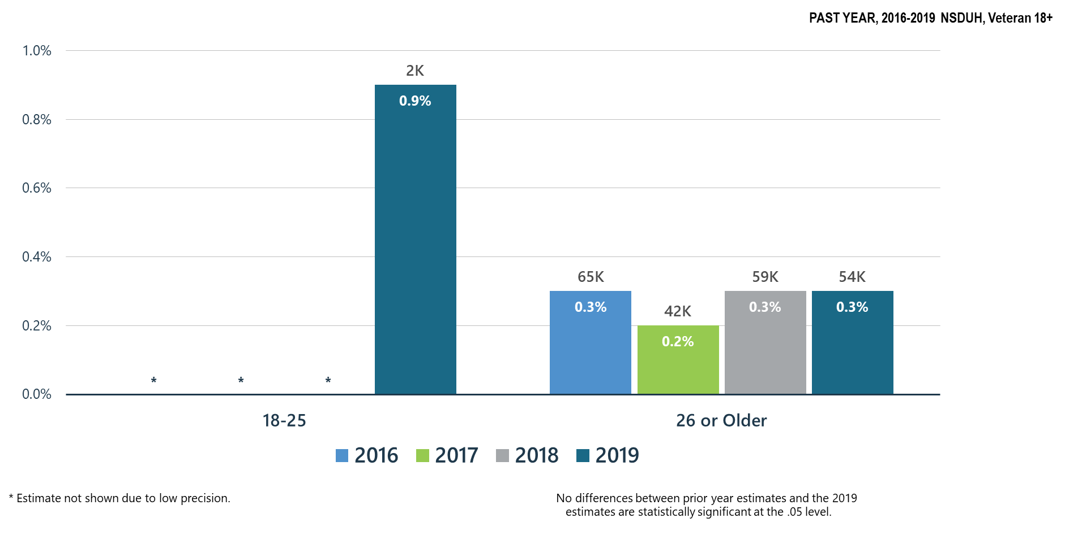
Heroin Use among Veterans

Slide 15
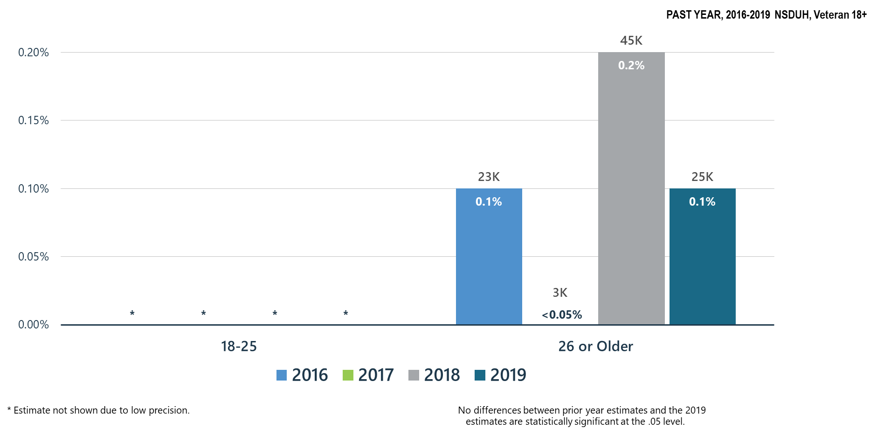
Heroin-Related Opioid Use Disorder among Veterans

Slide 16
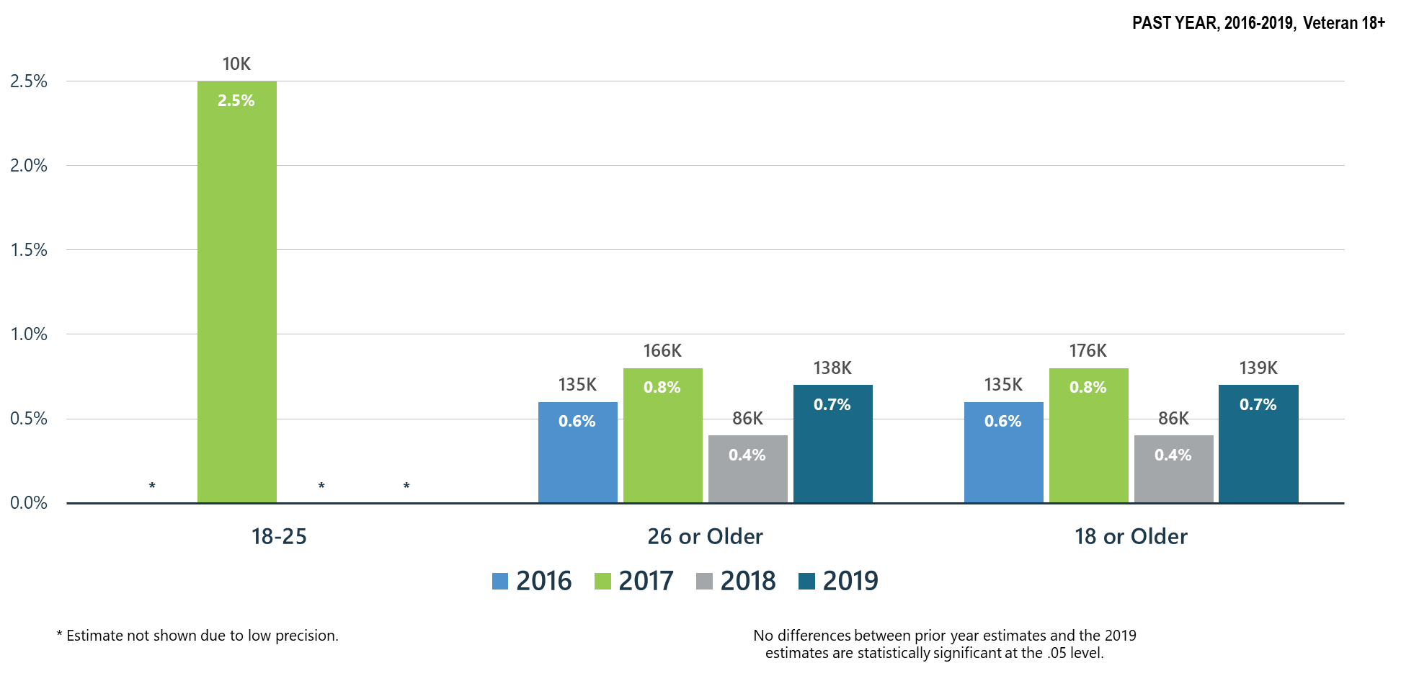
Opioid Use Disorder among Veterans

Slide 17
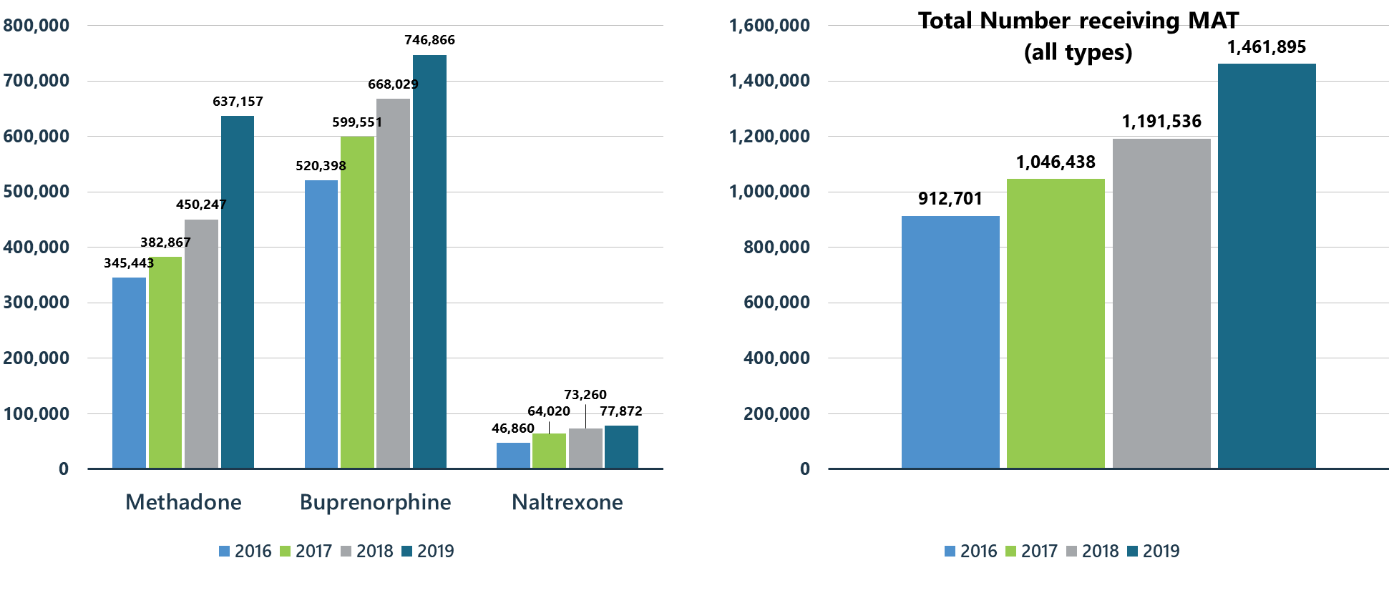
Treatment Gains: Number of Individuals Receiving Pharmacotherapy for Opioid Use Disorder (MAT)

Slide 18
Summary: Opioid Misuse in the United States in 2019 Compared to 2018
Oxycodone is the opioid with the highest percentage of veterans acknowledging misuse of the medication.
Heroin use among veterans 26 years older and older remains stable.
There were slight increases in opioid use disorder when compared to 2018.
Heroin initiates among veterans also slightly increased.

Slide 19
Other Illicit Substances

Slide 20
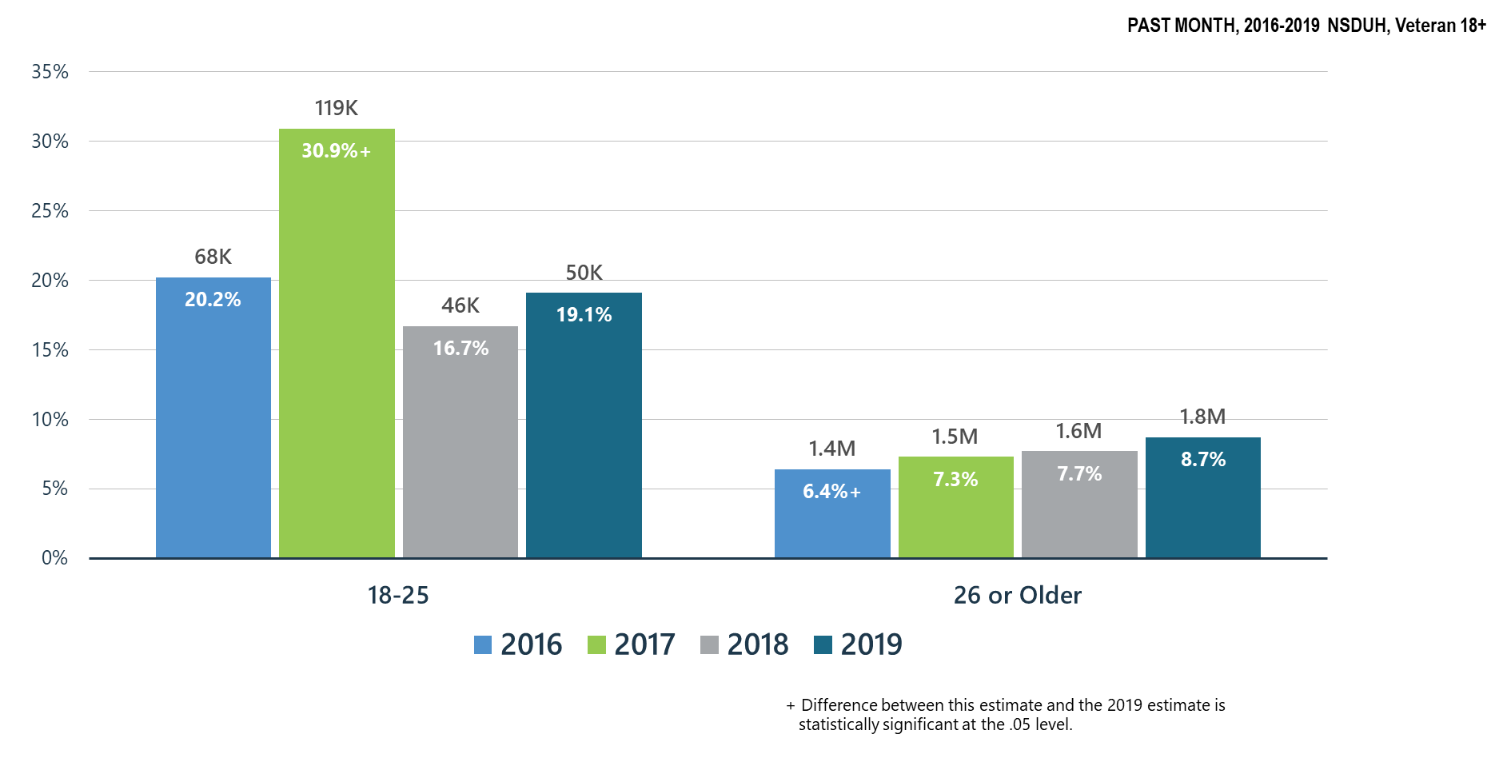
Past Month Marijuana Use for All Age Groups among Veterans

Slide 21
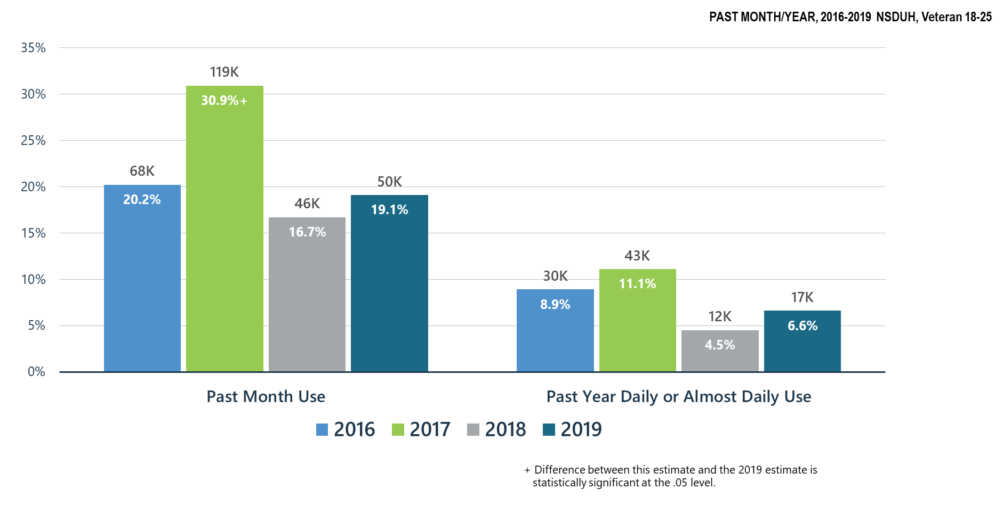
Marijuana Use among Veteran Young Adults (18-25 y.o.)

Slide 22
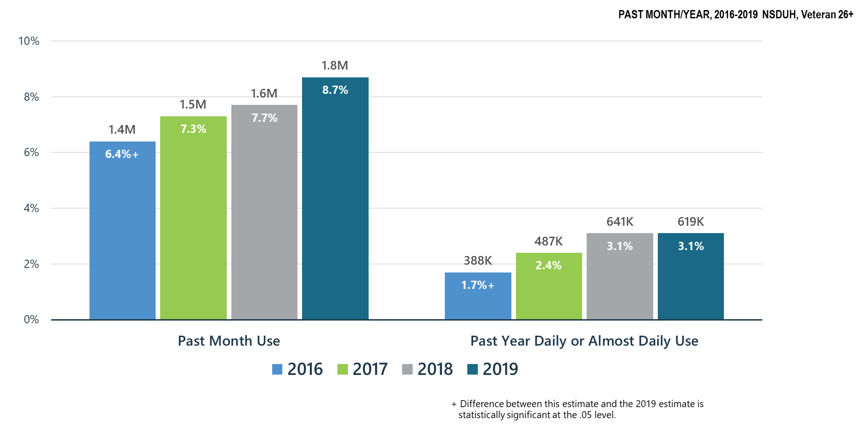
Marijuana Use among Veteran Adults 26+

Slide 23
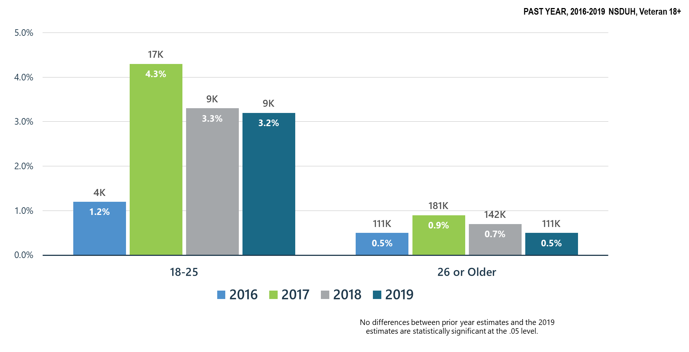
Marijuana Use Disorder among Veterans

Slide 24
Marijuana Use: Health Concerns
While past month marijuana significantly decreased for veterans ages 18-25 when compared to 2017, past month marijuana use for veterans ages 26 and older continues to increase.
Past month marijuana use and past year daily or almost daily use of marijuana for veterans ages 26 and older has significantly increased as compared to 2016.
Marijuana use disorder for veterans ages 26 and older continues to slightly decline.

Slide 25
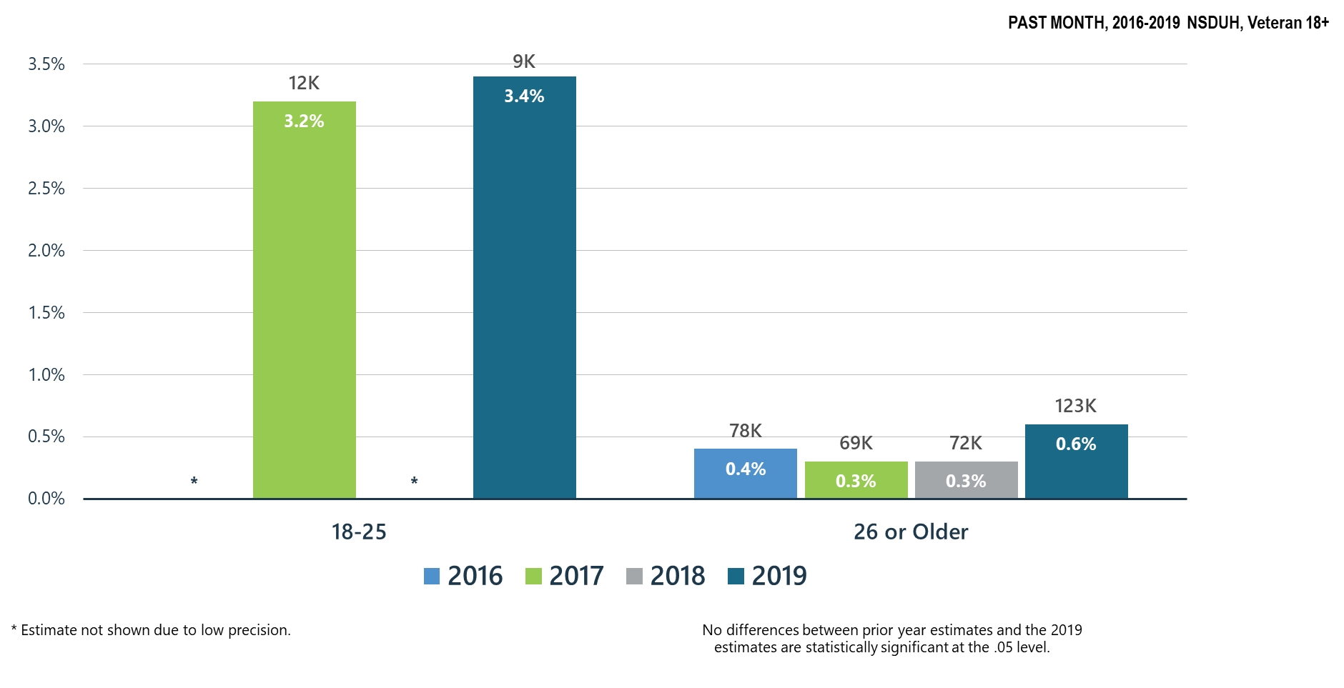
Cocaine Use among Veterans

Slide 26
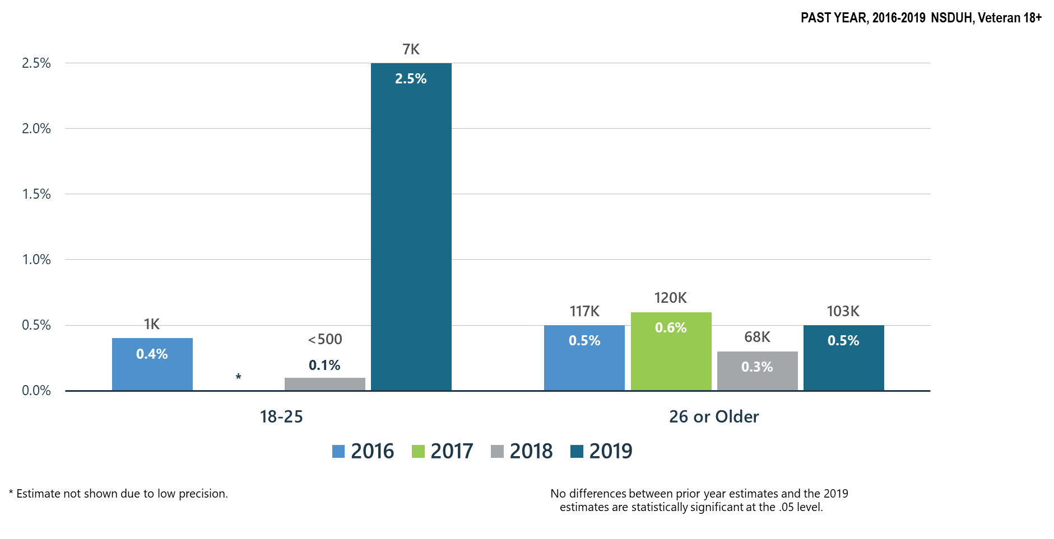
Methamphetamine Use among Veterans

Slide 27
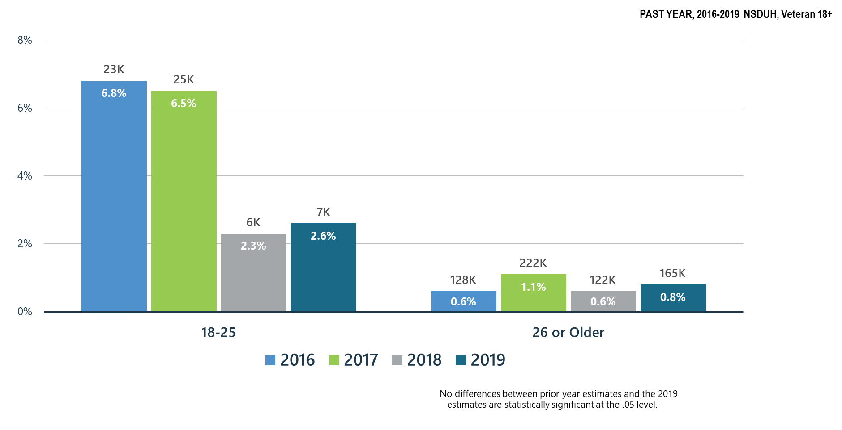
Misuse of Prescription Stimulants among Veterans

Slide 28
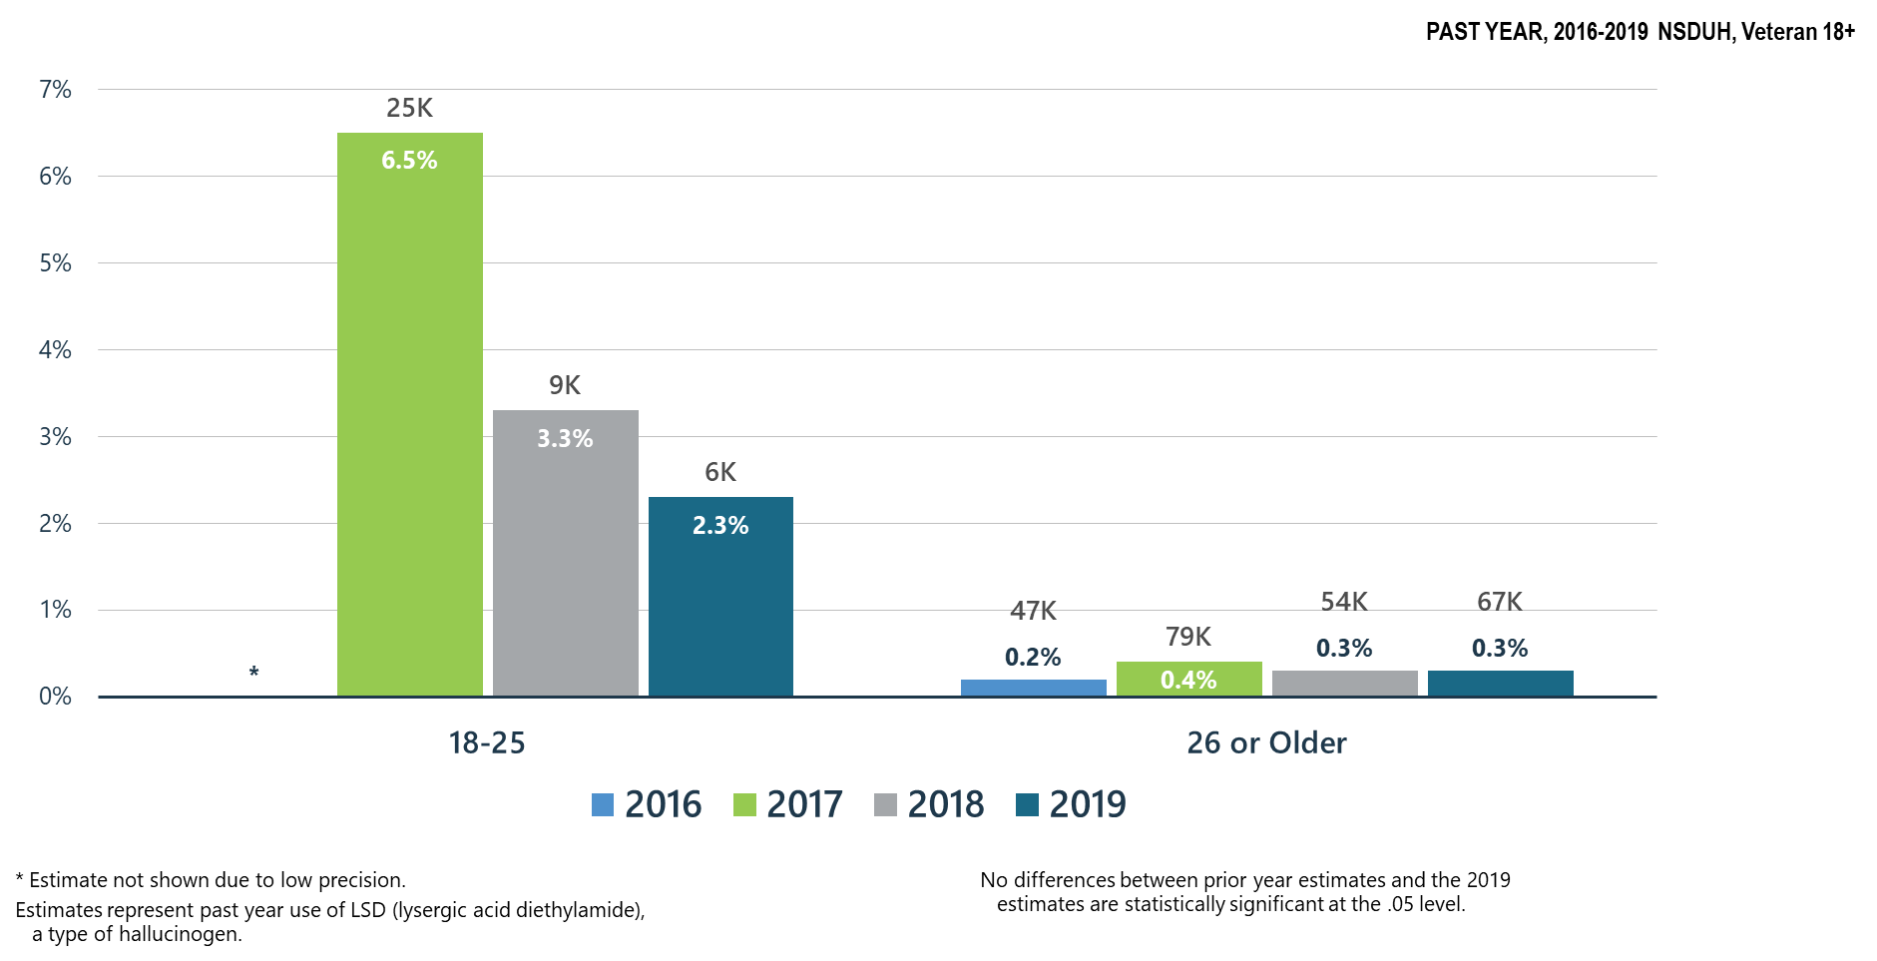
LSD Use among Veterans for All Age Groups

Slide 29
Summary: Other Substance Use in the United States in 2019 Compared to 2018
Misuse of prescription stimulants among veterans of all ages has slightly increased when compared to 2018.
Methamphetamine misuse and cocaine misuse among veterans has also slightly increased.
LSD misuse has slightly decreased for veterans ages 18-25 and remained stable in veterans ages 26 and older.

Slide 30
Polysubstance Use and Mental Illness

Slide 31
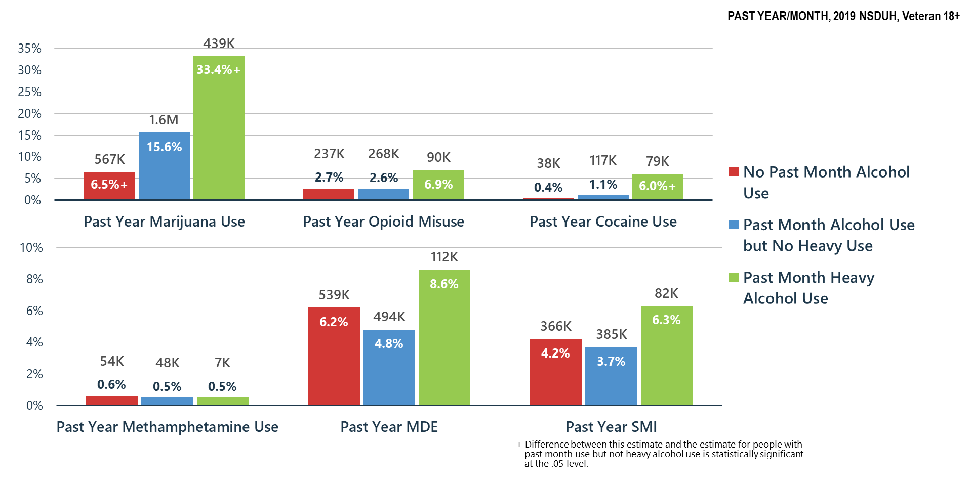
Alcohol Use Related to Other Substance Use, MDE and SMI among Veterans

Slide 32
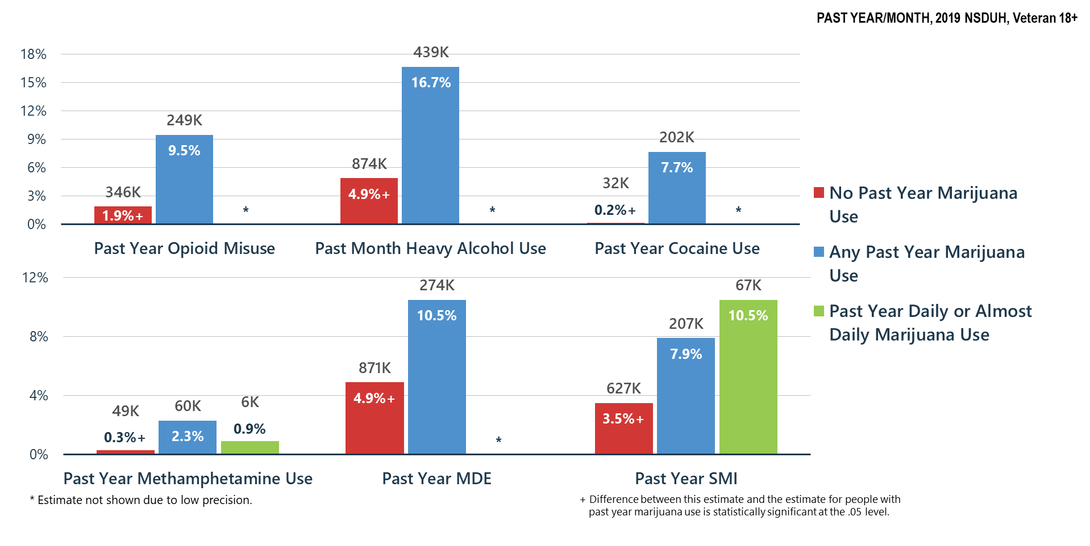
Marijuana Use Related to Other Substance Use, MDE and SMI among Veterans

Slide 33
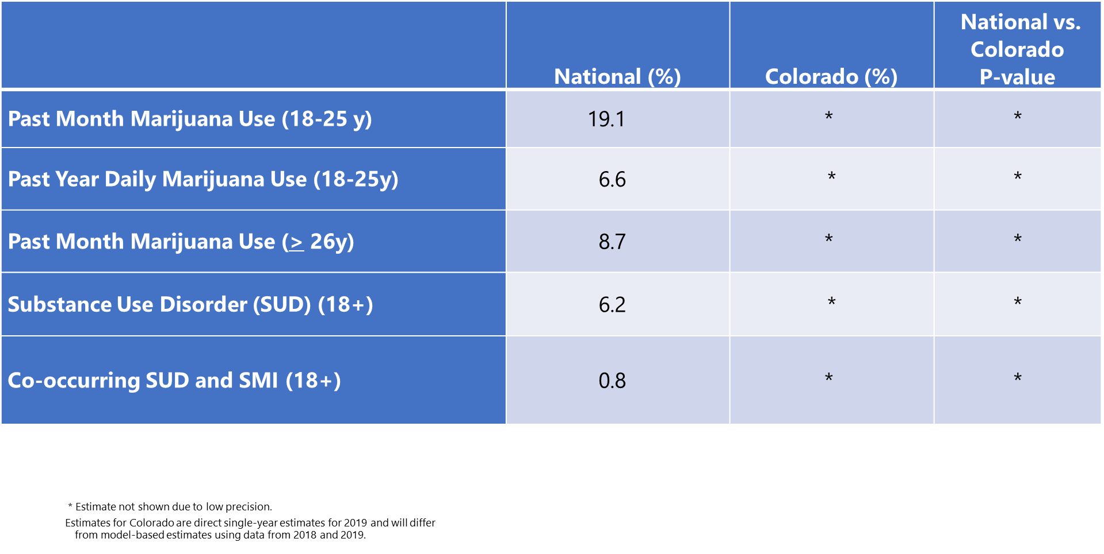
Comparison of Rates of Mental/Substance Use Disorders Associated with Marijuana Use among Veterans: National vs. Colorado Data from the National Survey on Drug Use and Health (2019)

Slide 34
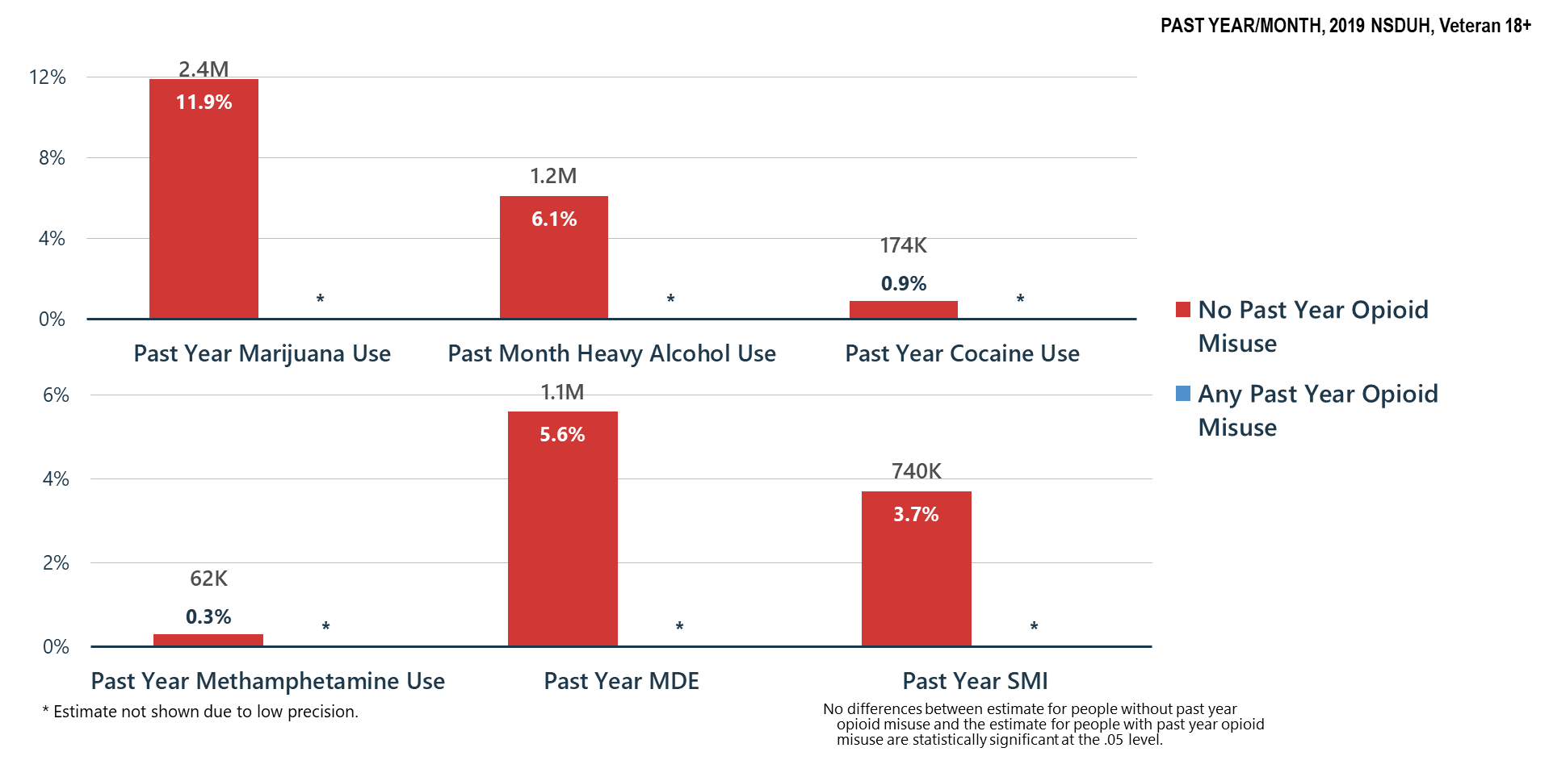
Opioid Misuse Related to Other Substance Use, MDE and SMI among Veterans

Slide 35
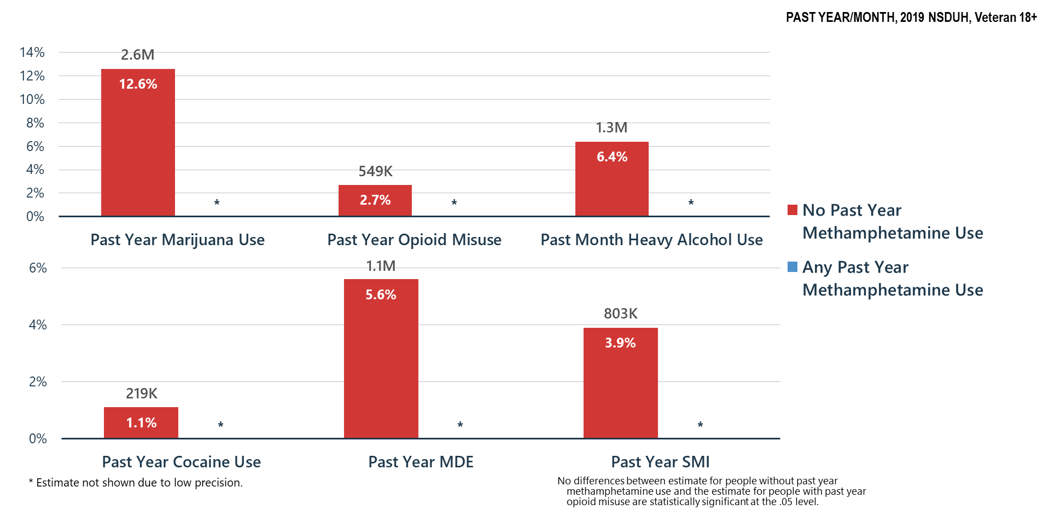
Methamphetamine Use Related to Other Substance Use, MDE and SMI among Veterans

Slide 36
Summary
Polysubstance use is common—if a person is having problems with one substance, they are likely using and may be having problems with other substances
Treatment providers must screen for and treat all substance use disorders and problem substance use
Association of substance misuse and mental illness is clear—we must all do a better job of helping Americans understand these relationships and risks

Slide 37
Mental Health

Slide 38
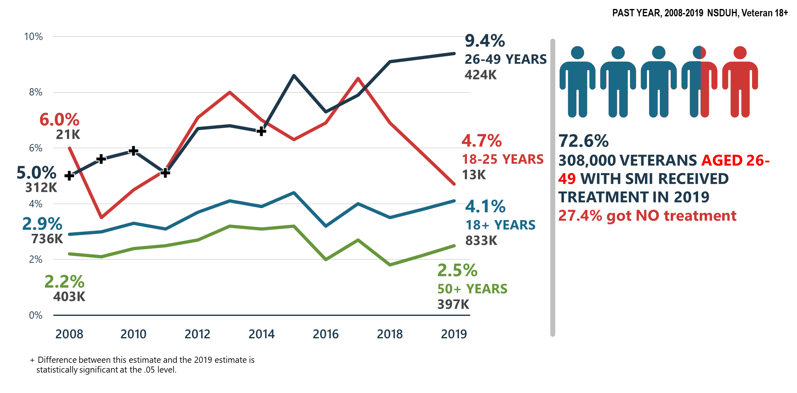
Serious Mental Illness (SMI) among Veterans

Slide 39
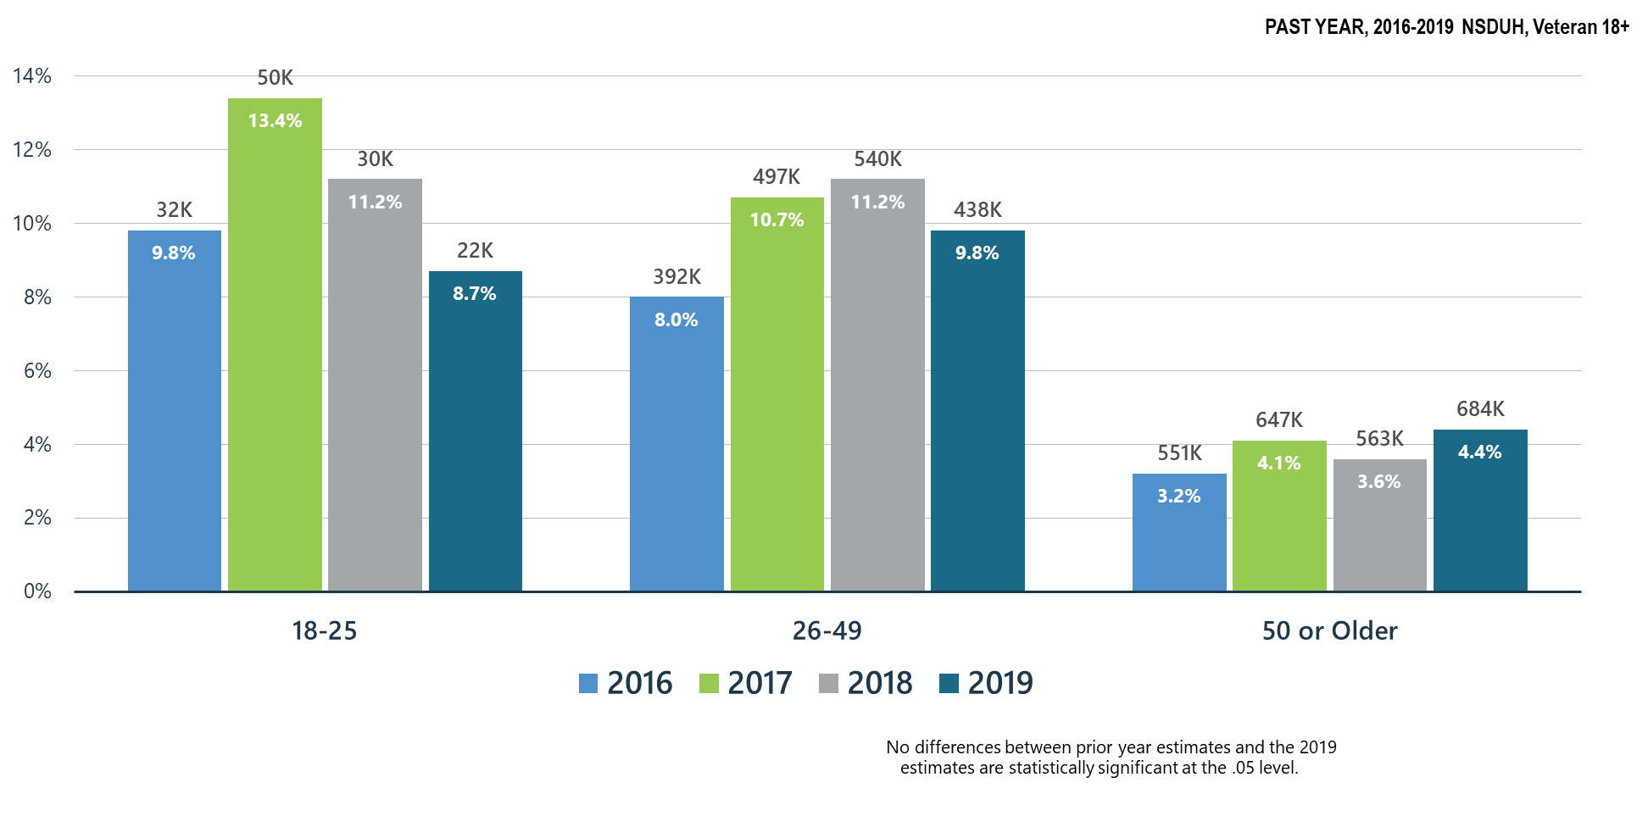
Major Depressive Episodes among Veterans

Slide 40
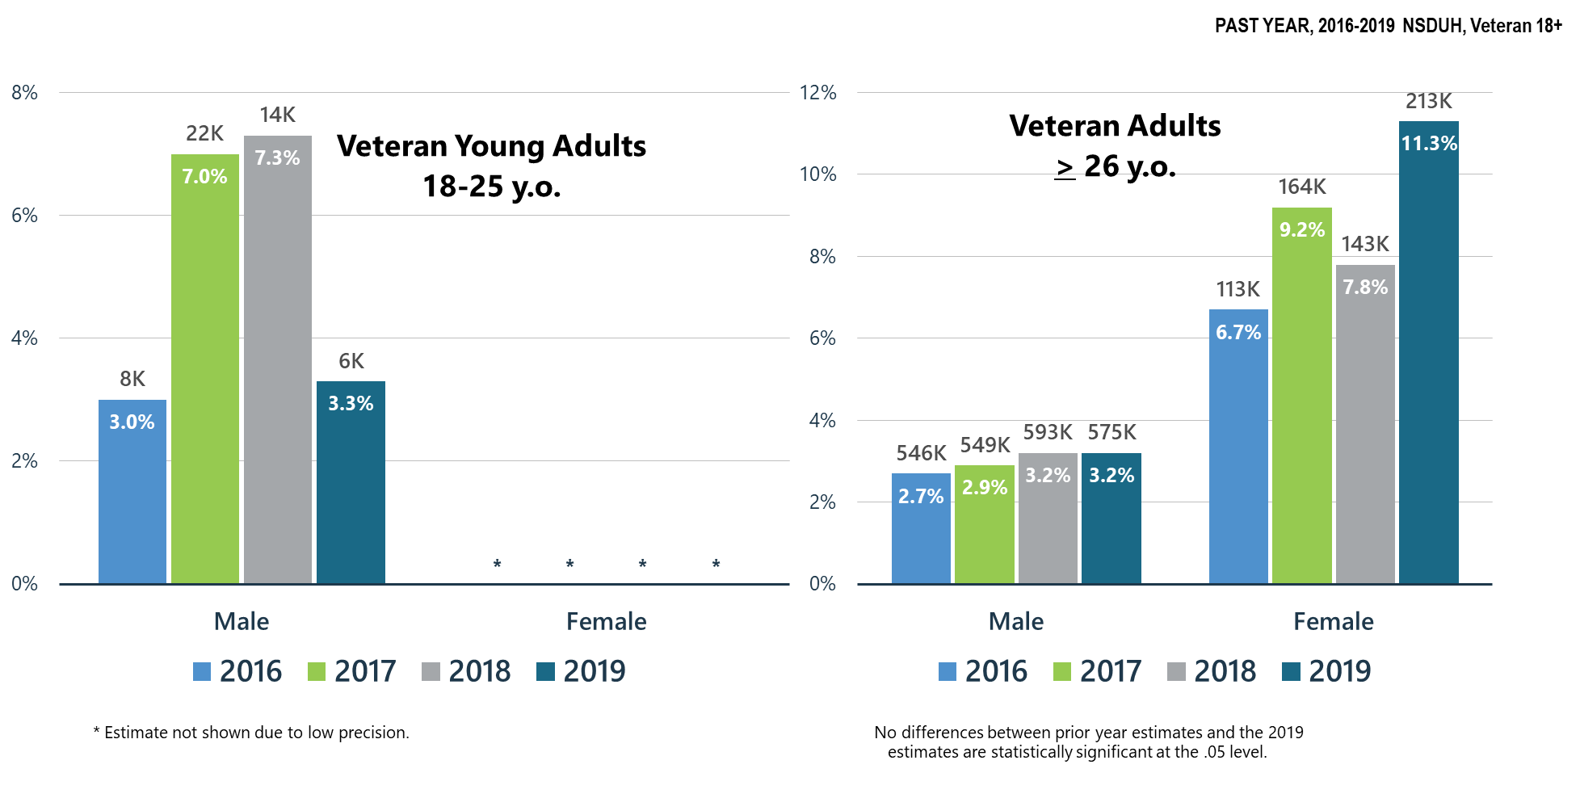
Major Depressive Episodes with Severe Impairment among Veteran Adults

Slide 41
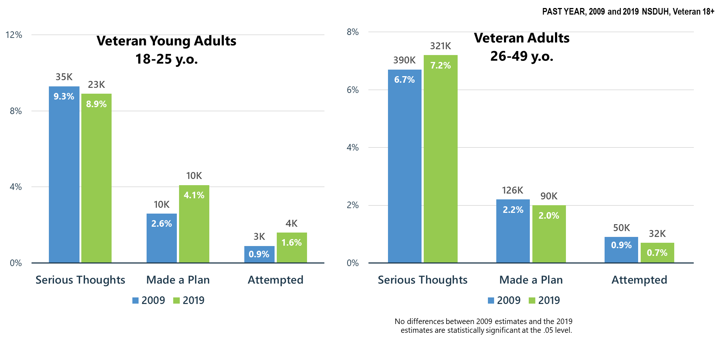
Suicidal Thoughts, Plans, and Attempts among Veteran Young Adults (18-25 y.o.) and Veteran Adults (26-49 y.o.)

Slide 42
Co-Occurring
Mental and Substance Use Disorders

Slide 43
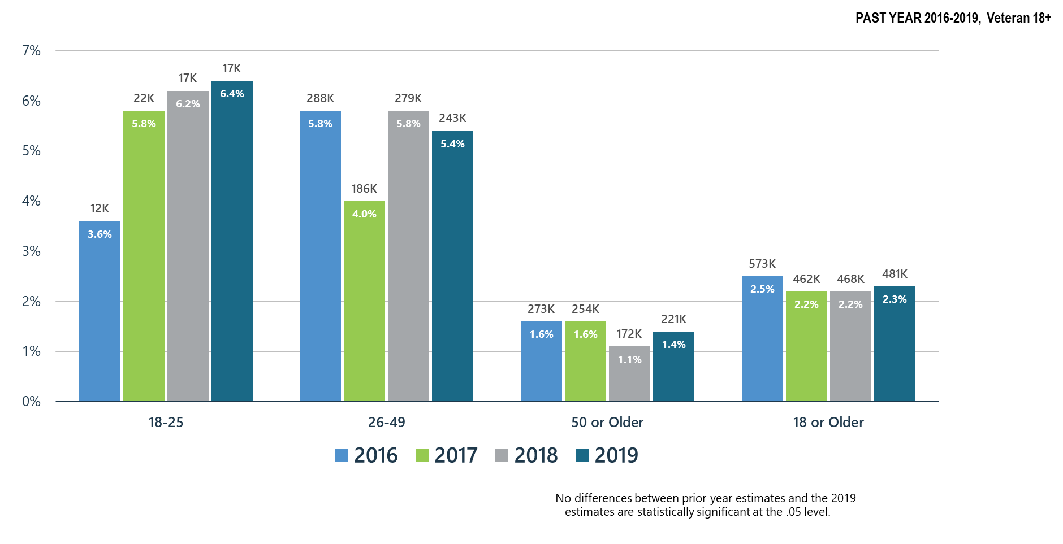
Co-Occurring Substance Use Disorder and Any Mental Illness in Veteran Adults

Slide 44
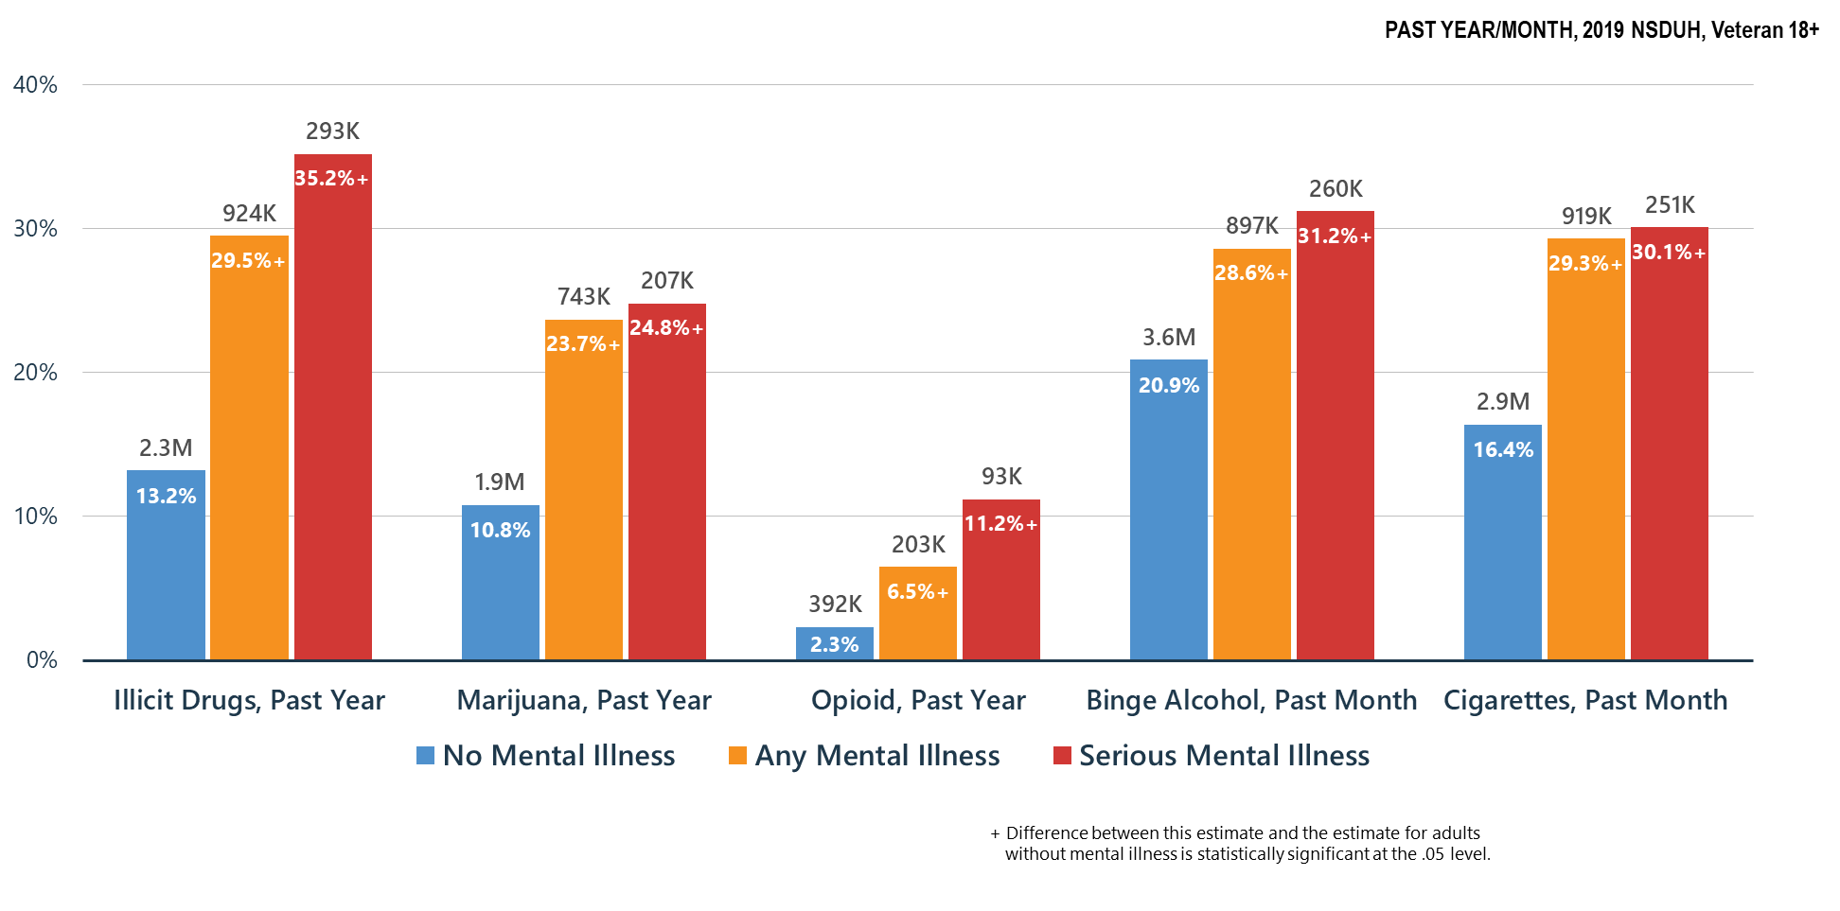
Co-Occurring Issues: Substance Use and Mental Illness among Veteran Adults

Slide 45
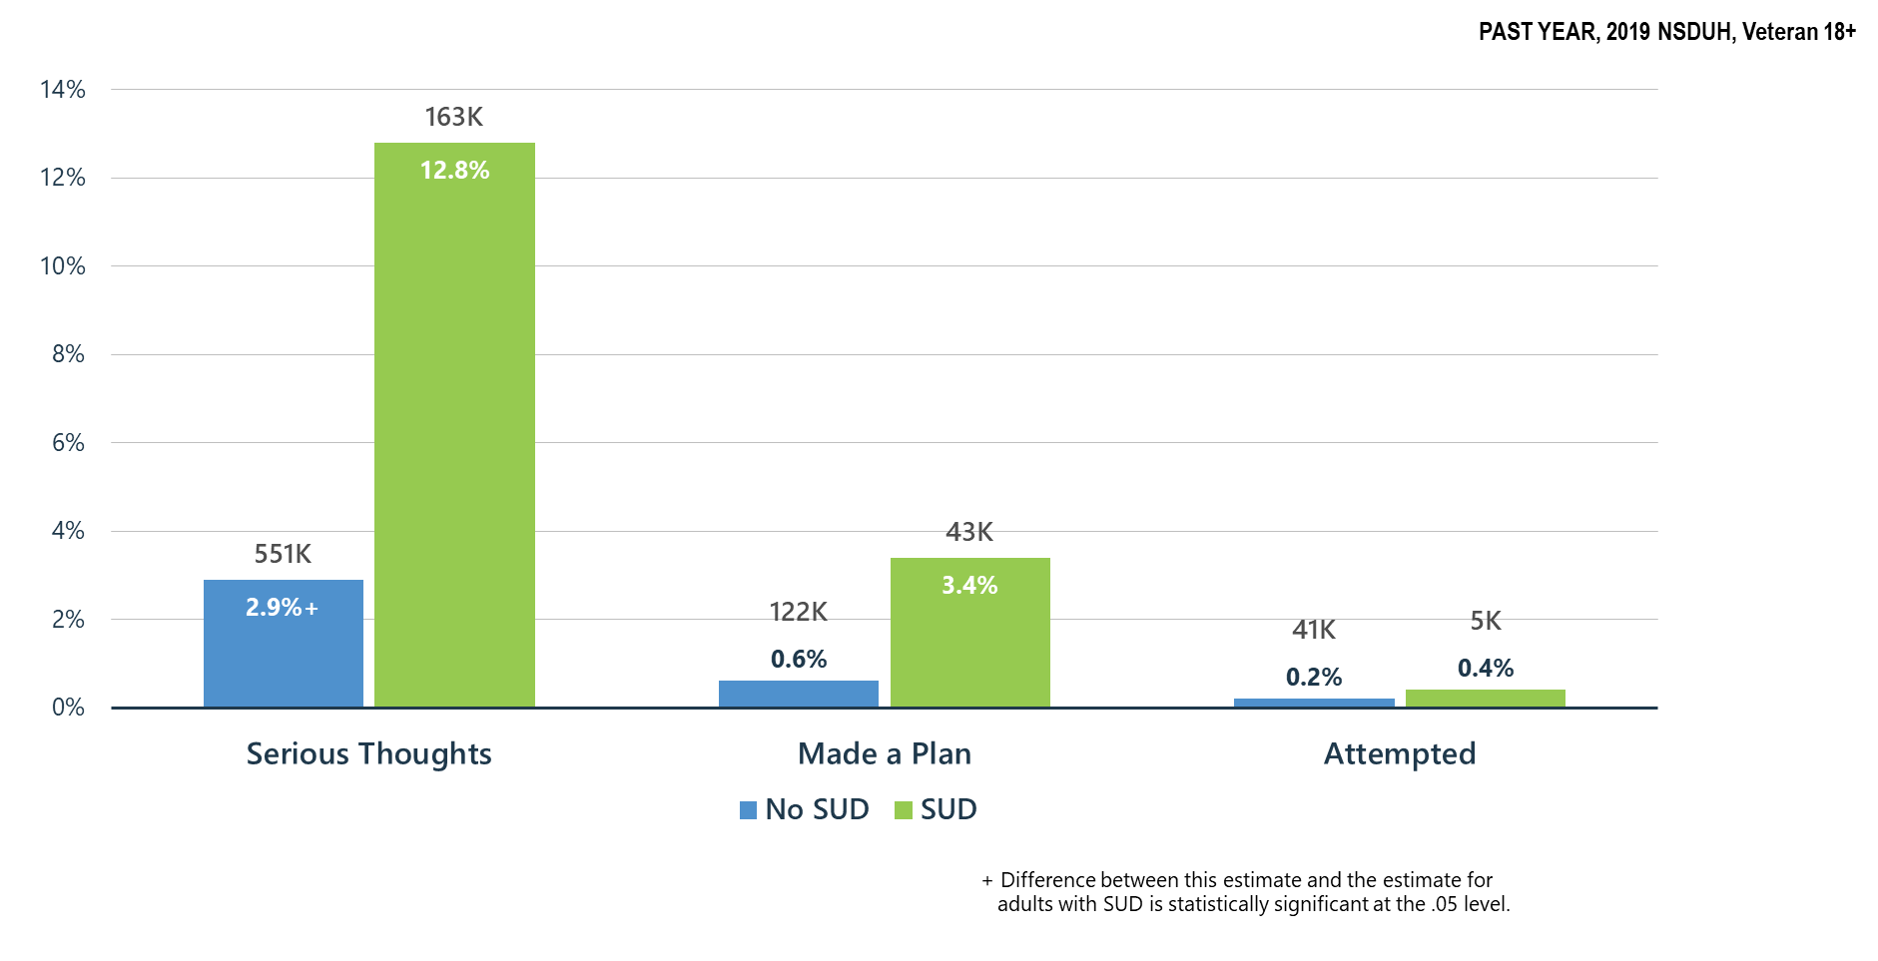
Substance Use Disorder (SUD) is Associated with Suicidal Thoughts, Plans, and Attempts among Veterans

Slide 46
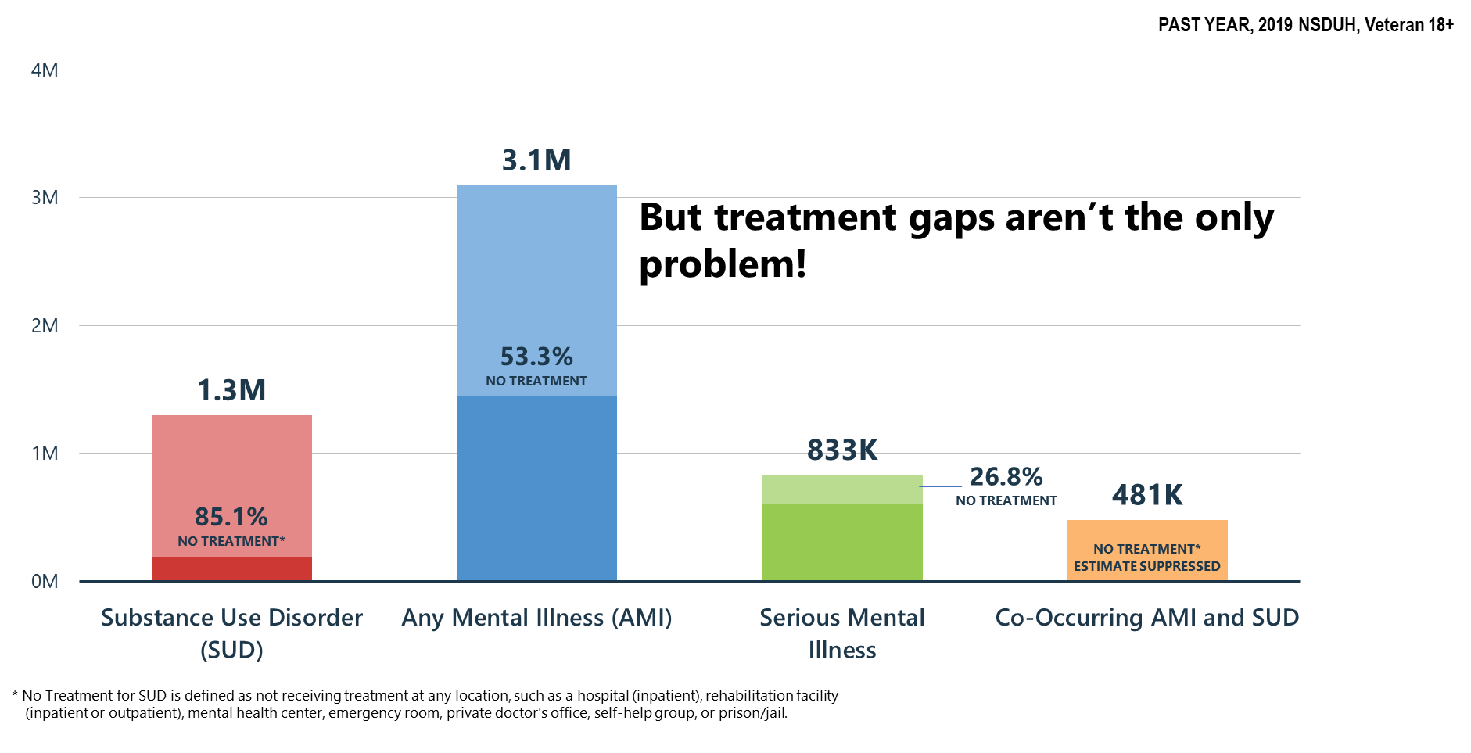
Mental and Substance Use Disorders among Veterans: High Prevalence/Huge Treatment Gaps

Slide 47
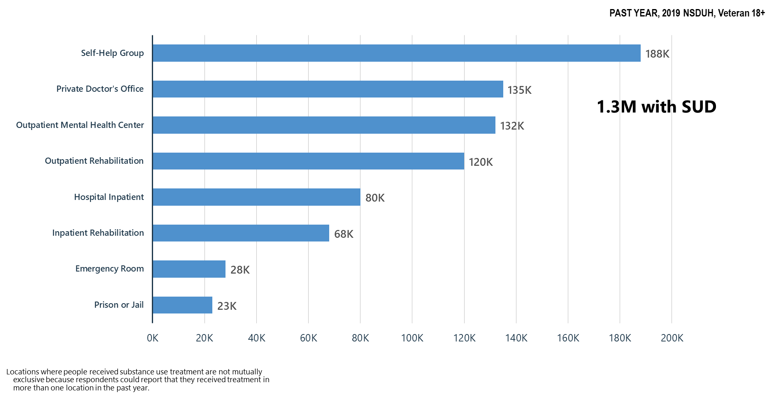
Locations Where Substance Use Treatment was Received among Veterans

Slide 48
Summary: Mental Health/Co-Occurring Issues in the United States in 2019
Serious mental illness among veterans ages 26-49 has increased when compared to 2014 but is decreasing among veterans ages 18 - 25.
Suicidal thoughts and behaviors remain stable in veterans ages 18-49 between 2009 and 2019.
Major depressive episodes with severe impairment is increasing for veterans ages 26 and older, especially for women.
Substance use disorder significantly increased suicidality among veterans ages 18 and older.
Self-help groups ranked higher than outpatient rehabilitation facilities for the locations where substance use treatment was received.

Slide 49
What Can We Do Now?
SAMHSA must use its resources to benefit as many as possible:
Community based treatment and recovery services
Build on the Certified Community Behavioral Health Clinic model
  Crisis intervention services/suicide prevention resources
  Integrated mental health, substance use, general medical services
  Children’s mental health services-linkages with schools
Keep telemedicine/telehealth in place including use of telephone where audio/visual is not possible and pay for these services at same rate as face-to-face—no reduction in reimbursement because it is telemedicine
Continue and expand as possible technical assistance and training to behavioral health providers—clinicians and peers

Slide 50
It’s Up to Us Now
Let’s work as hard as we can to make decision-makers understand mental health and substance use needs in America—pre and post-COVID-19
Let’s keep the virus in mind in planning and implementing our services so that we can safely deliver care, but we cannot ignore the overall health needs of the American people—that is not an option
Let’s work to meet the mental health/substance use needs of our people:
  Restore our systems—mental health and substance use disorder services are ‘essential services’
  Expand our treatment and community recovery support systems permanently
  Every American life is precious and every American death—regardless of the cause is a terrible loss

