Slide 1
2019 National Survey on Drug Use and Health: Women
Substance Abuse and Mental Health Services Administration
U.S. Department of Health and Human Services
September 2020

Slide 2
National Survey on Drug Use and Health (NSDUH)
NSDUH is a comprehensive household interview survey of substance use, substance use disorders, mental health, and the receipt of treatment services for these disorders in the United States.
NSDUH is collected face-to-face by field interviewers who read less sensitive questions to respondents and transition respondents to audio computer assisted self‑interviewing for sensitive items.
NSDUH covers the civilian, noninstitutionalized population, aged 12 or older:
  Includes: Households, college dorms, homeless in shelters, civilians on military bases
  Excludes: Active military, long-term hospital residents, prison populations, homeless not in shelters
Sample includes all 50 states and DC
Approximately 67,500 persons are interviewed annually
Data collected from January to December

Slide 3
How Do We Use NSDUH?
Provides a window into the state of substance use and mental health issues in the United States
Helps to guide policy directions in addressing:
  problem substances
  prevalence of mental illness
  intersection of substance use and mental health issues
  provides insights that can be studied in the context of data from other agencies to help in decision-making about what types of resources are needed and where resources should be directed

Slide 4
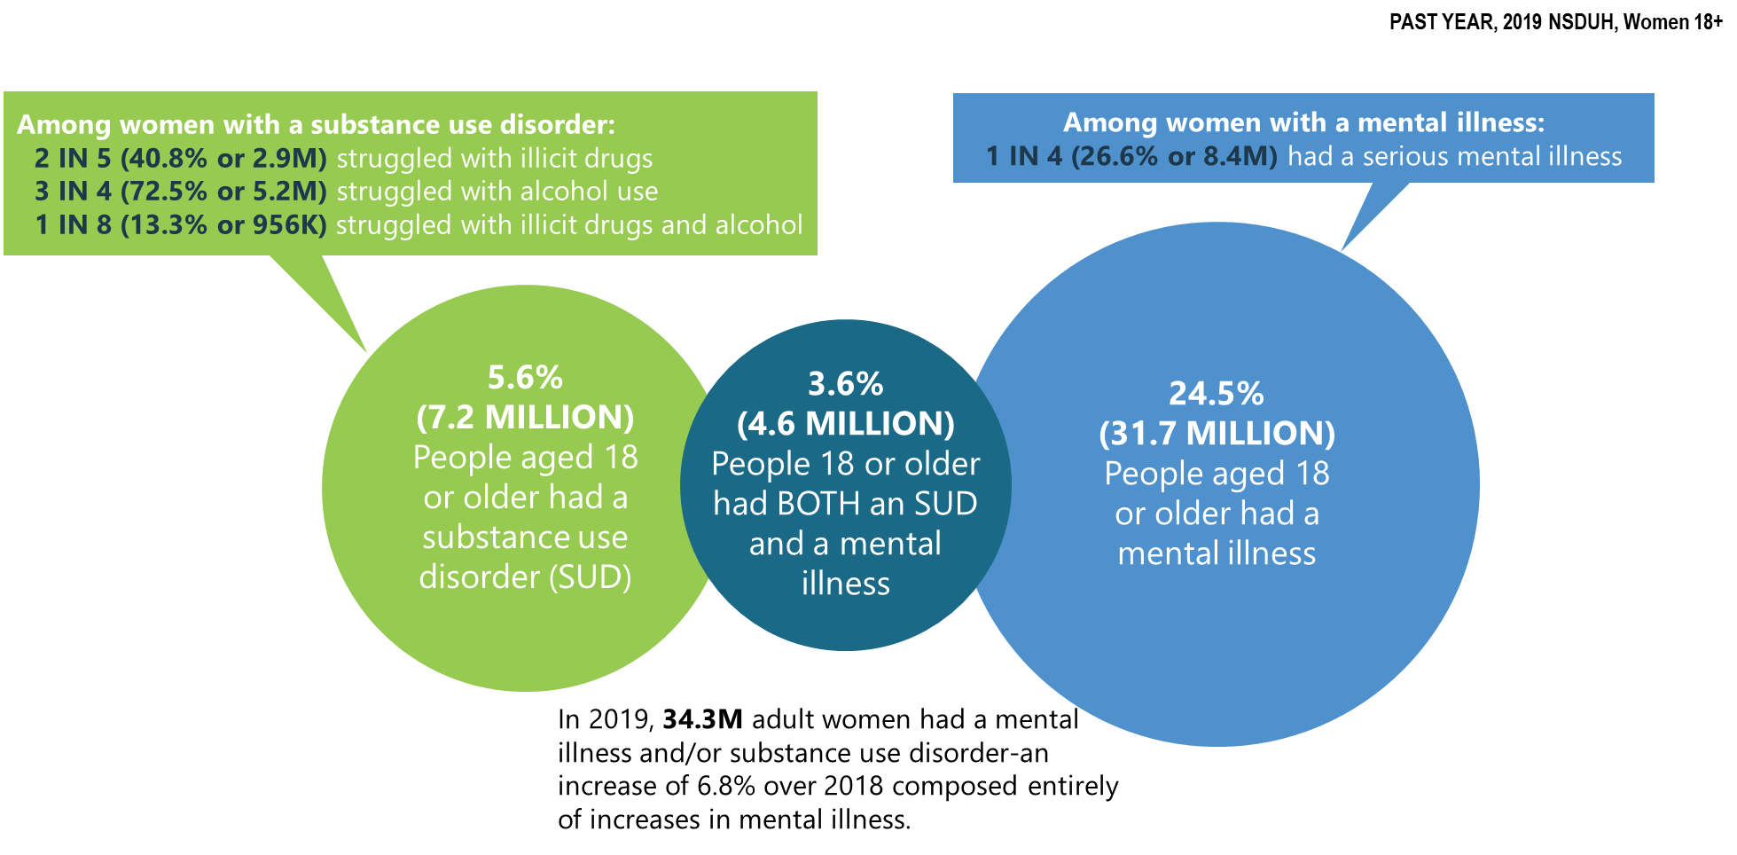
Mental Illness and Substance Use Disorders in America among Women (>18 y.o.)

Slide 5
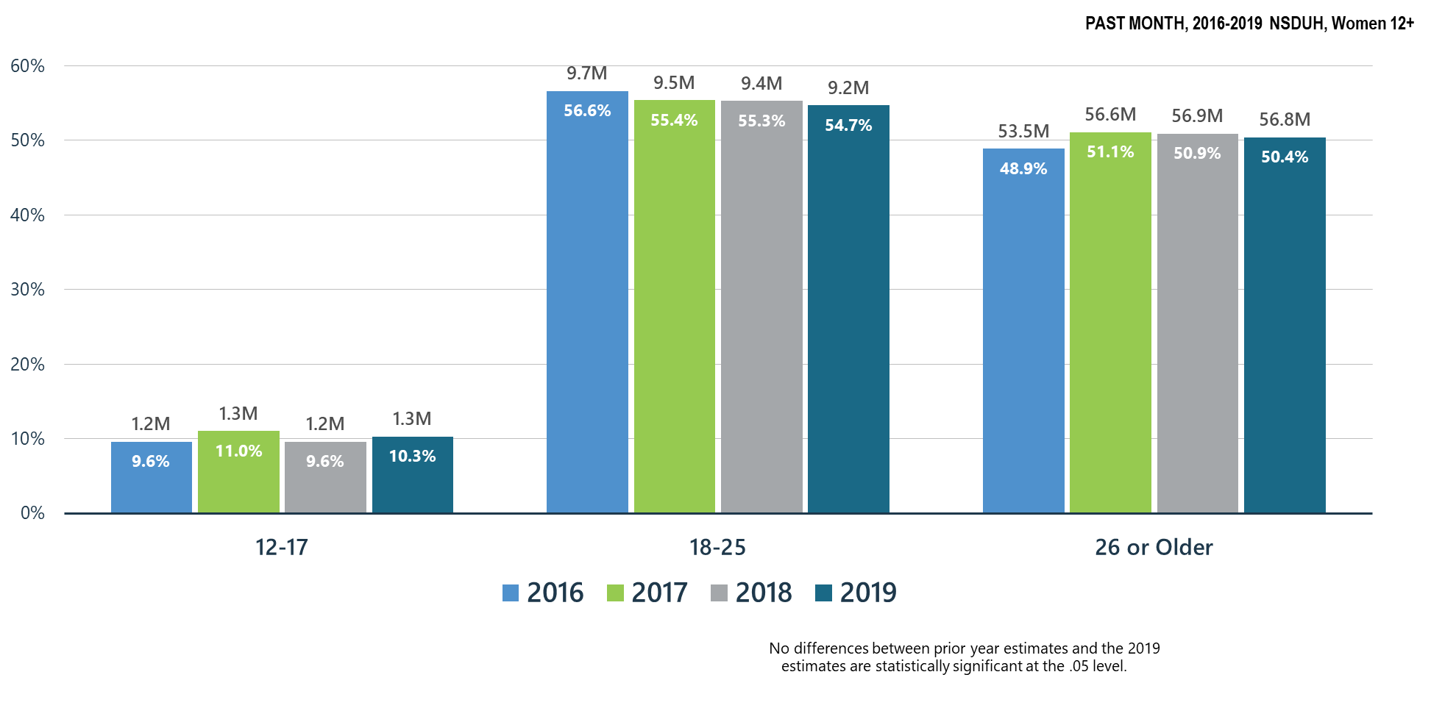
Alcohol Use among Women

Slide 6
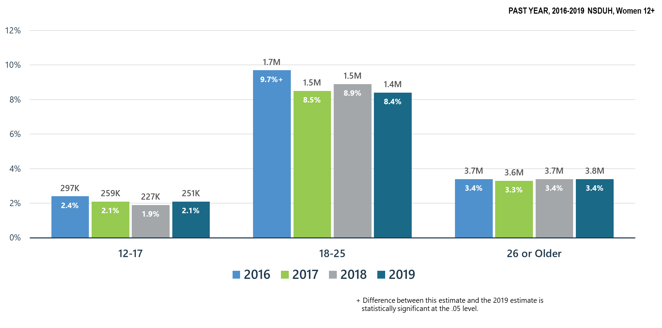
Alcohol Use Disorder among Women

Slide 7
Summary: Alcohol Use in 2019
Past month alcohol use remained stable in all age groups for women during 2018-2019
Alcohol Use Disorder declined significantly in young women ages 18-25 from 2016 to 2019.
SAMHSA will continue its prevention programs:
  SAMHSA Prevention Technology Transfer Centers produce resources and materials related to alcohol misuse prevention
  CSAP ‘Talk They Hear You’ focuses on underage drinking
  CSAP requires Partnerships for Success grantees to emphasize underage drinking prevention
  CSAT has promoted SBIRT for alcohol use in all programs including CJ, PPW, adolescent treatment, HIV and homeless programs
  CSAT has funded SBIRT training in medical residencies and other healthcare practitioner programs which screen for hazardous alcohol use and use disorders

Slide 8
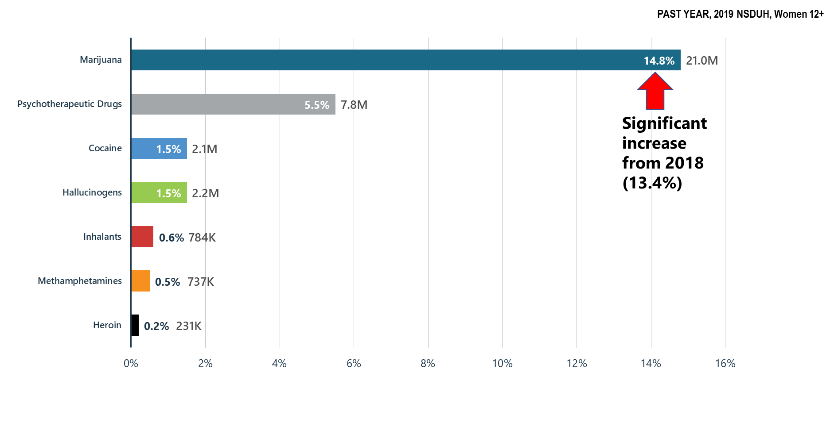
Illicit Drug Use among Women: Major Concerns: Opioids, Marijuana, Methamphetamines

Slide 9
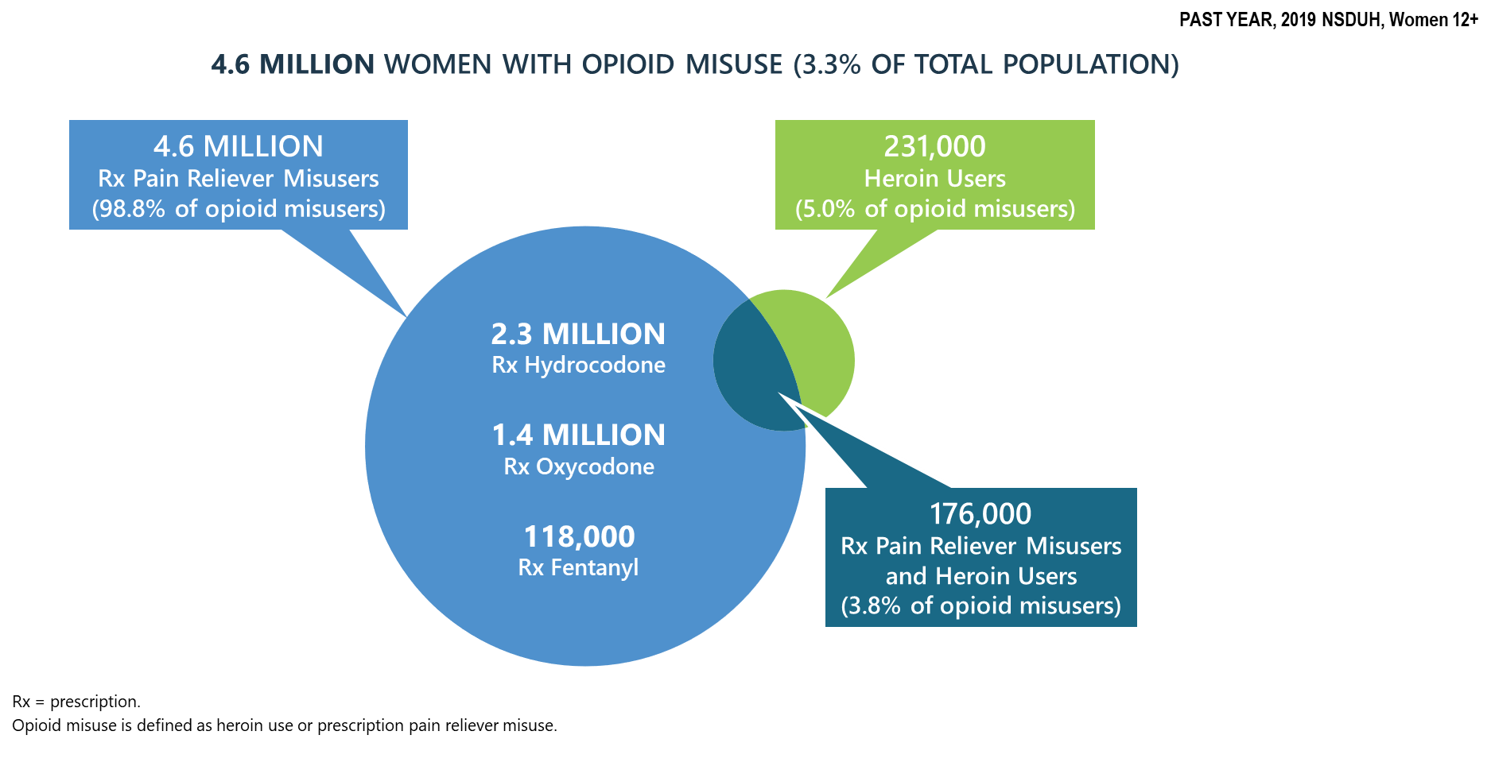
Progress on the Opioid Epidemic: Prescription Pain Reliever Misuse among Women

Slide 10
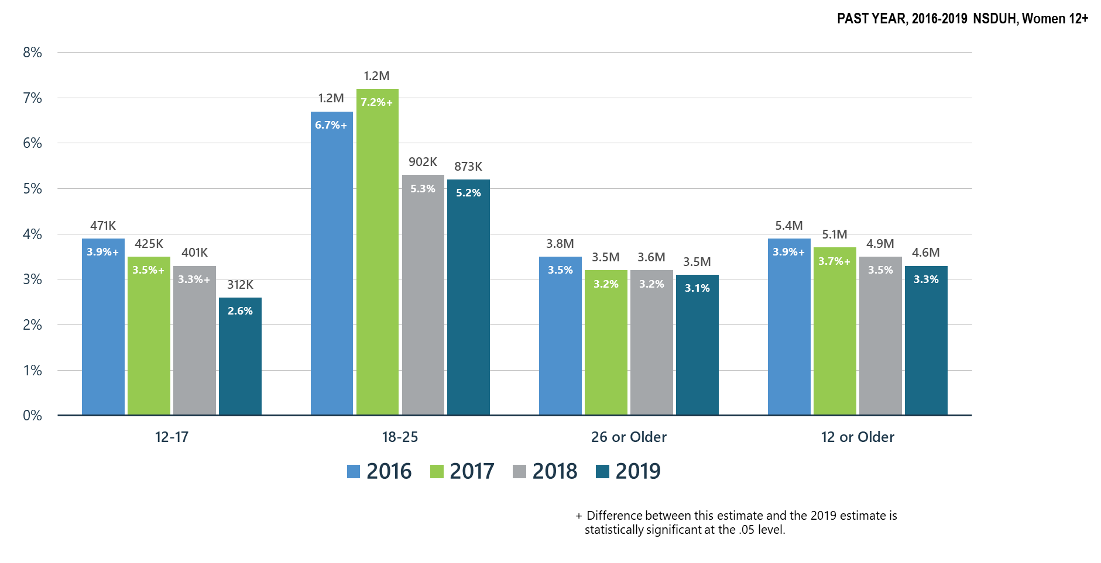
Opioid Misuse among Women

Slide 11
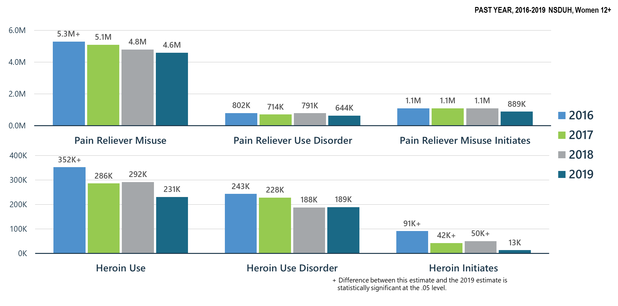
Prescription Pain Reliever Misuse and Heroin Use among Women

Slide 12
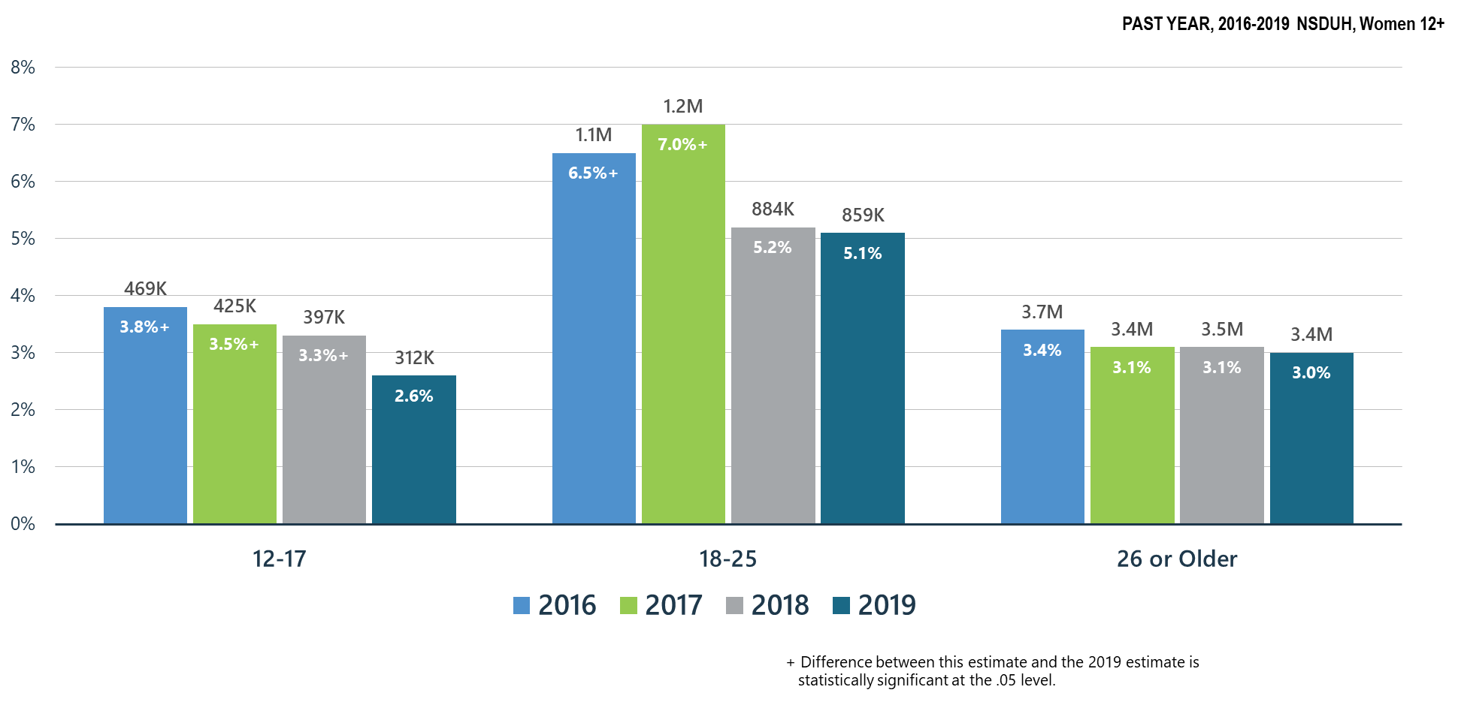
Prescription Pain Reliever Misuse among Women

Slide 13
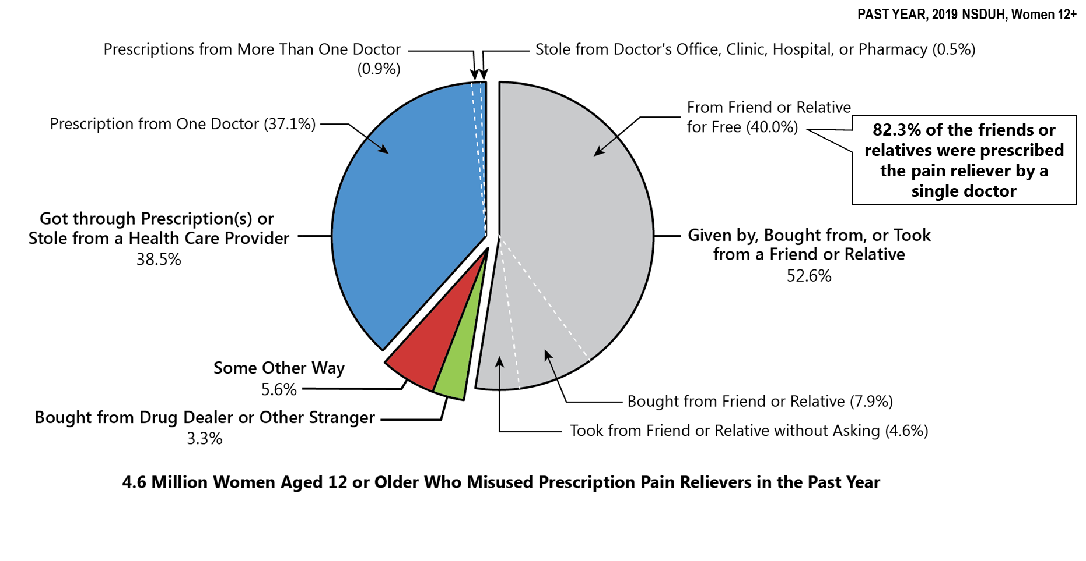
Sources Where Pain Relievers Were Obtained for Most Recent Misuse among Women Who Misused Prescription Pain Relievers

Slide 14
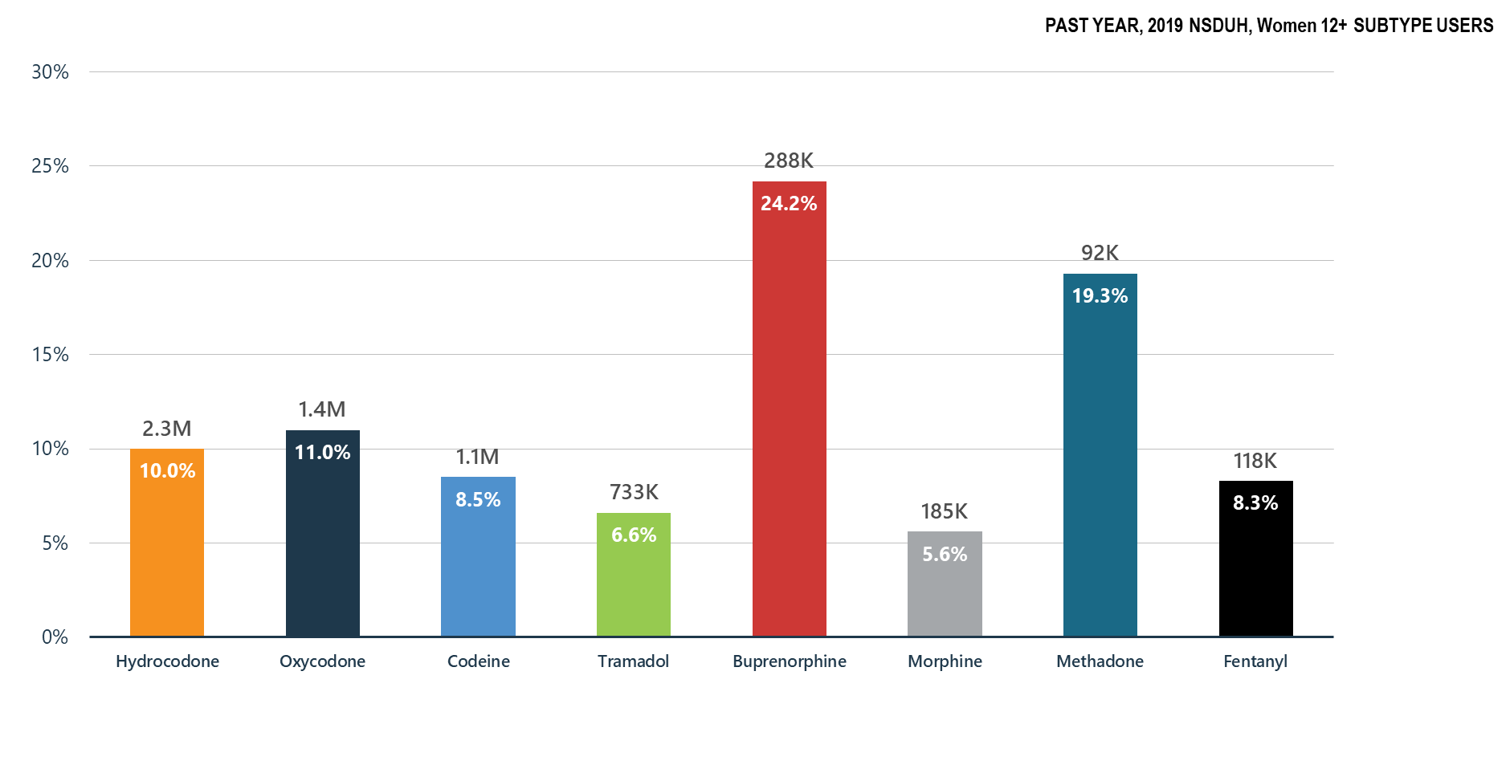
Misuse of Prescription Opioid Subtypes among Women

Slide 15
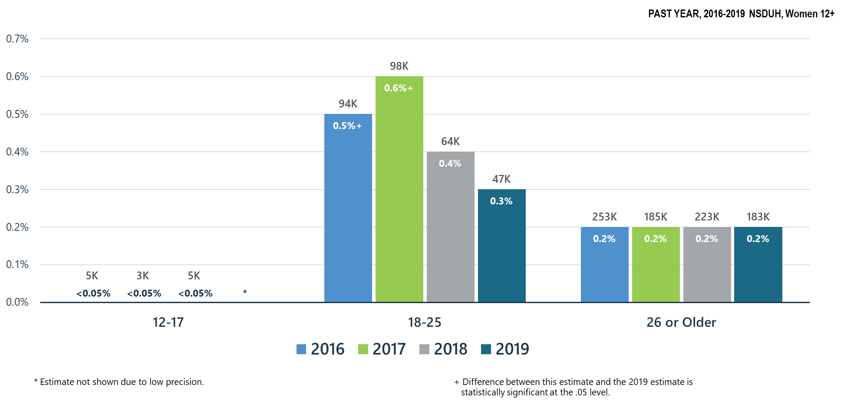
Heroin Use among Women: Continuing to Decline in 18-25 y.o.

Slide 16
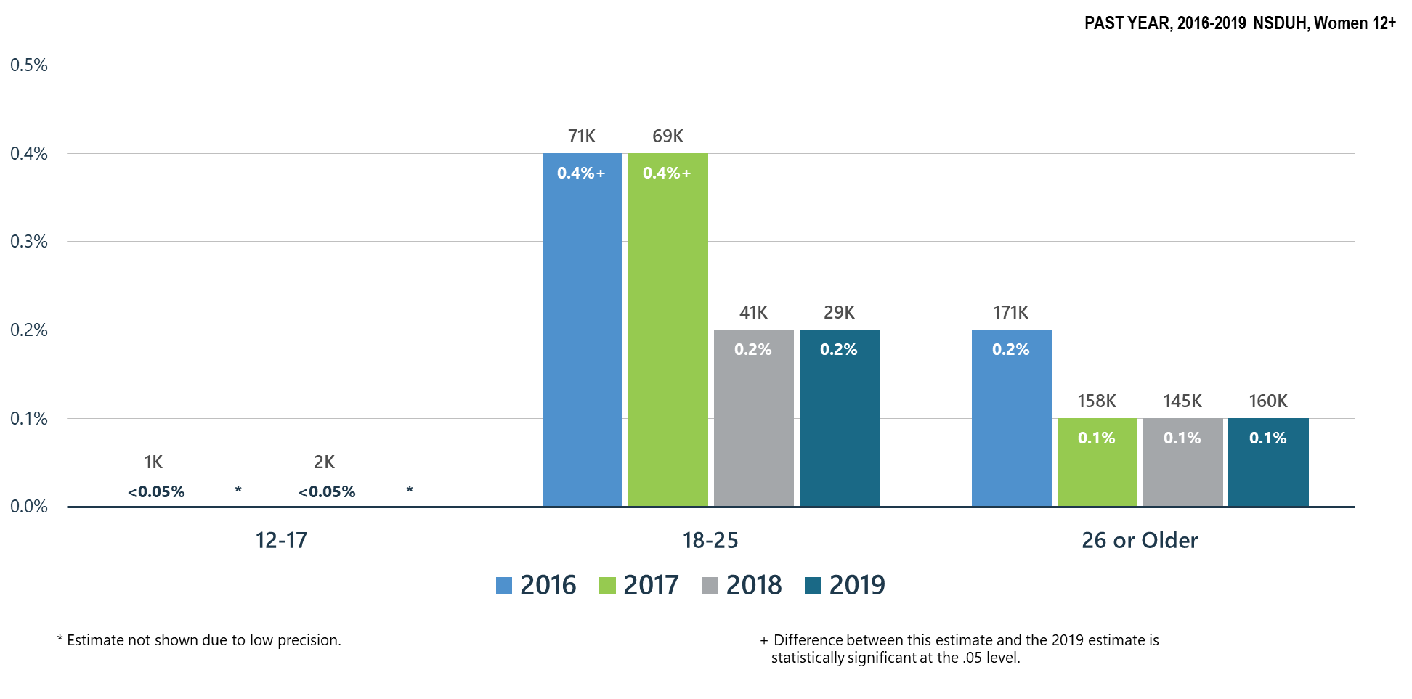
Heroin-Related Opioid Use Disorder among Women

Slide 17
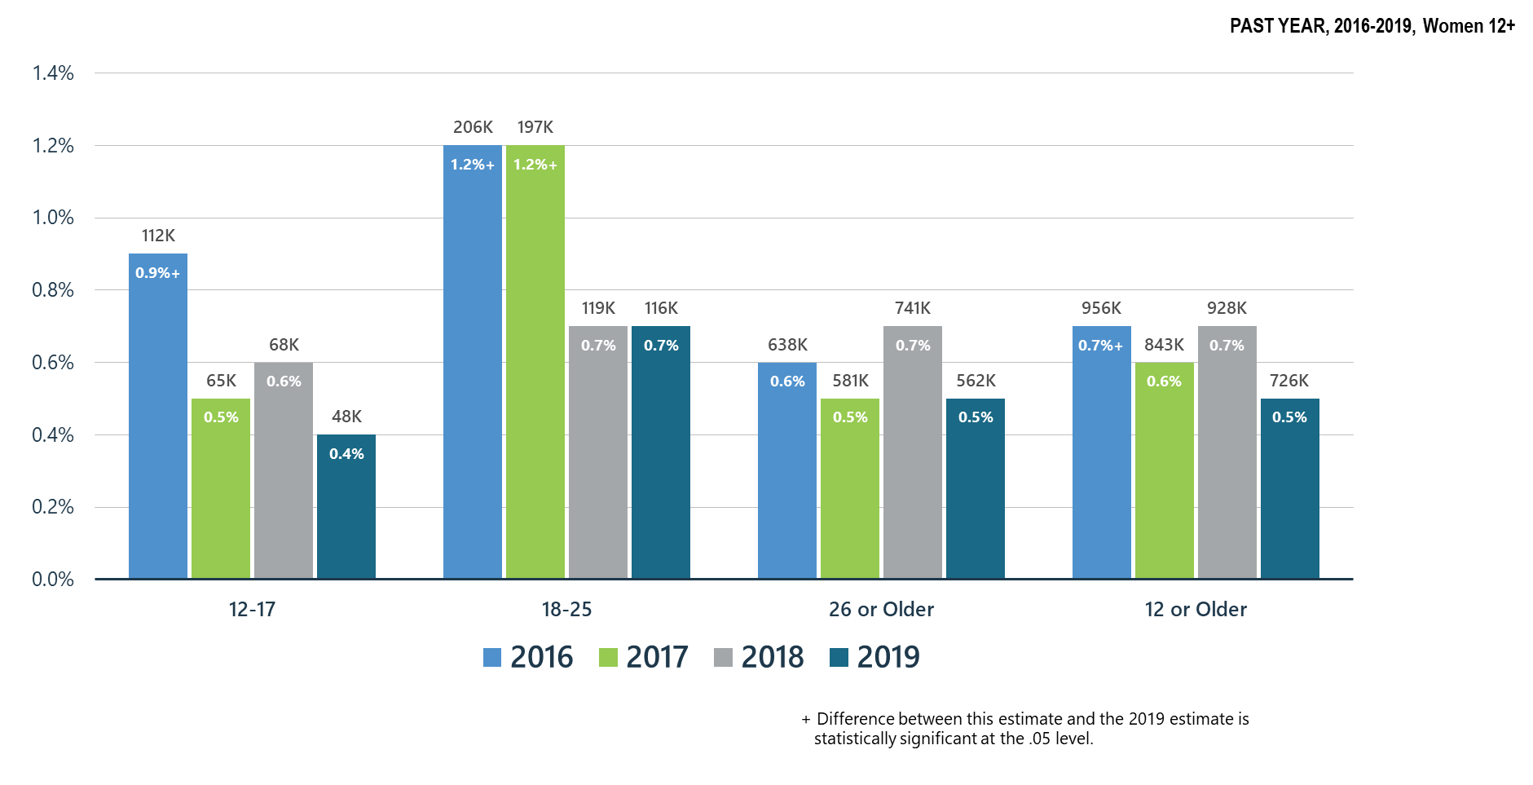
Opioid Use Disorder among Women

Slide 18
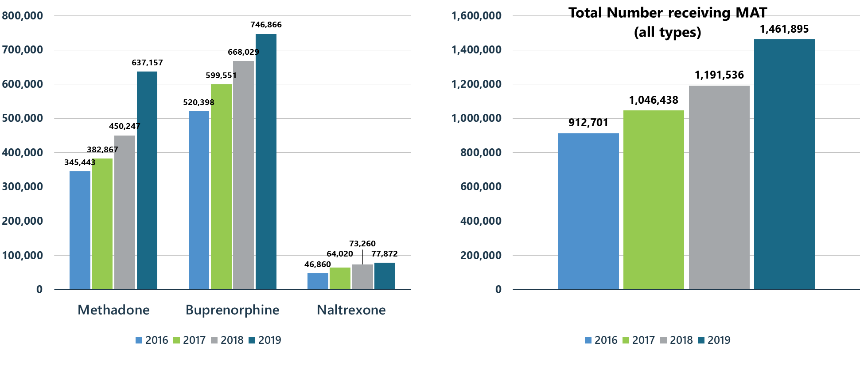
Treatment Gains: Number of Individuals Receiving Pharmacotherapy for Opioid Use Disorder (MAT)

Slide 19
Summary: Opioid Misuse in the United States in 2019
Opioid misuse has significantly decreased as compared to 2016-2017 for women ages 12-25.
Heroin use continues to decline among women ages 18-25.
Buprenorphine continues to be the opioid with the highest percentage of women acknowledging misuse of the medication.

Slide 20
Other Illicit Substances

Slide 21
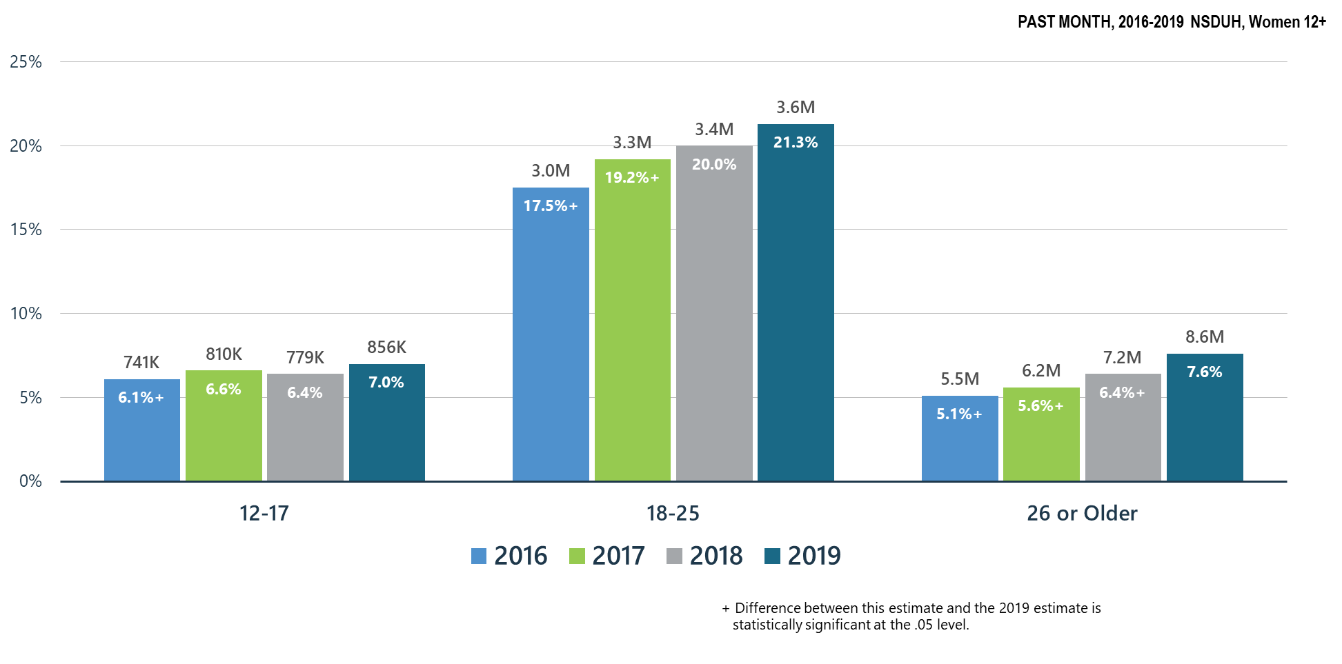
Past Month Marijuana Use for All Age Groups among Women

Slide 22
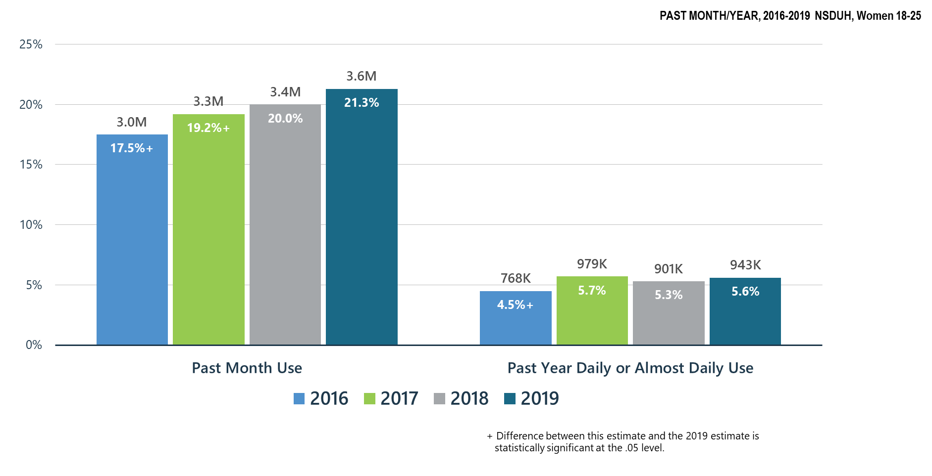
Marijuana Use among Young Women (18-25 y.o.)

Slide 23
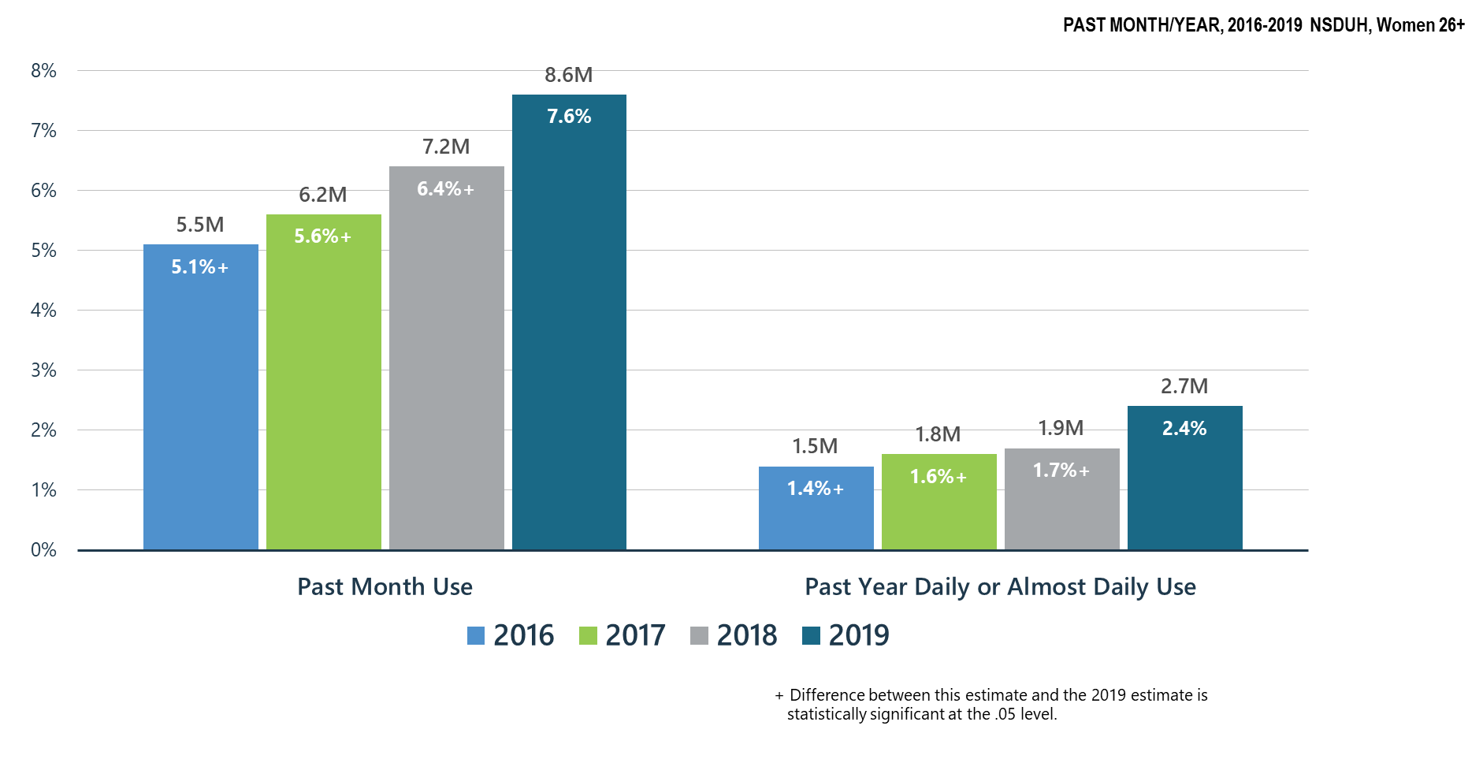
Significant Increase in Marijuana Use among Adult Women 26+

Slide 24
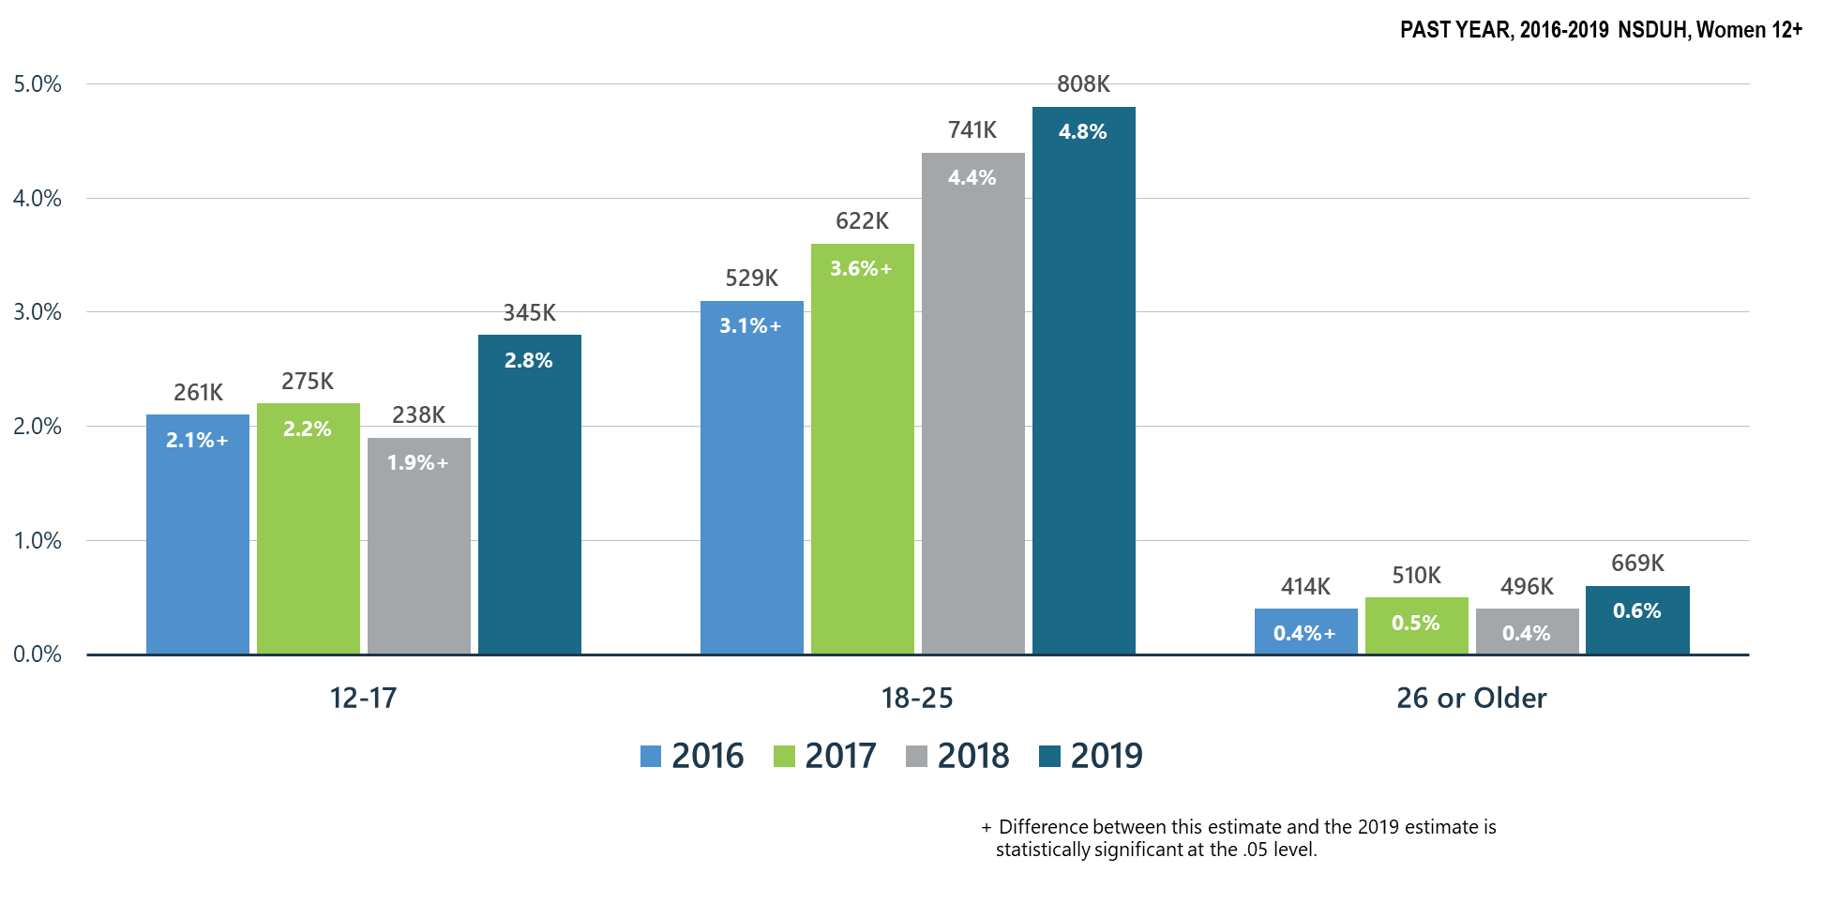
Marijuana Use Disorder among Women: Significant Increase for 12-17 y.o.

Slide 25
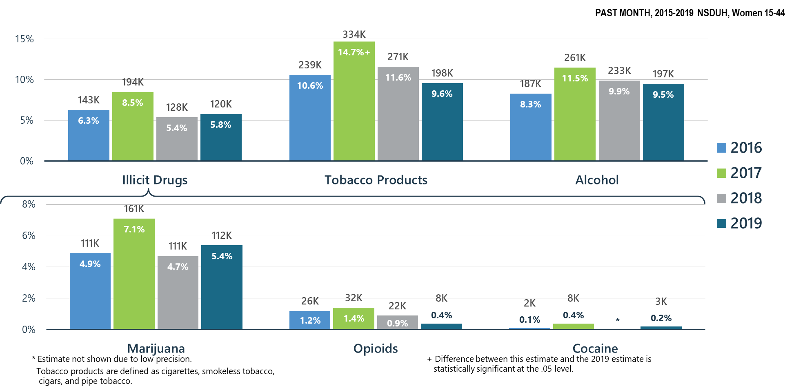
Past Month Substance Use among Pregnant Women

Slide 26
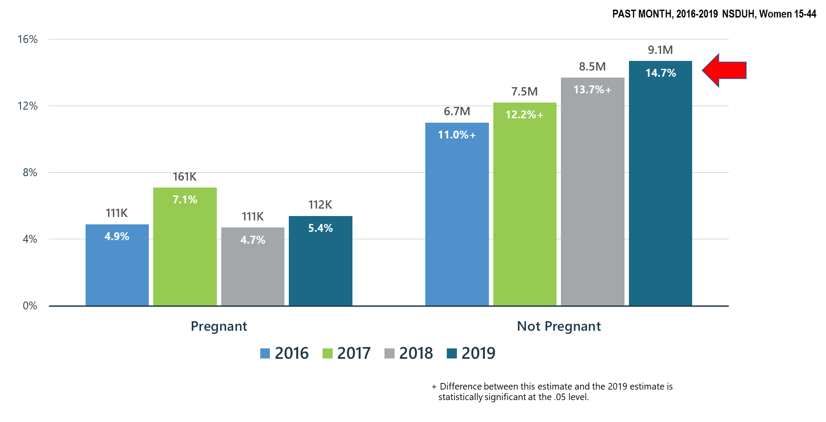
Marijuana Use among Women by Pregnancy Status

Slide 27
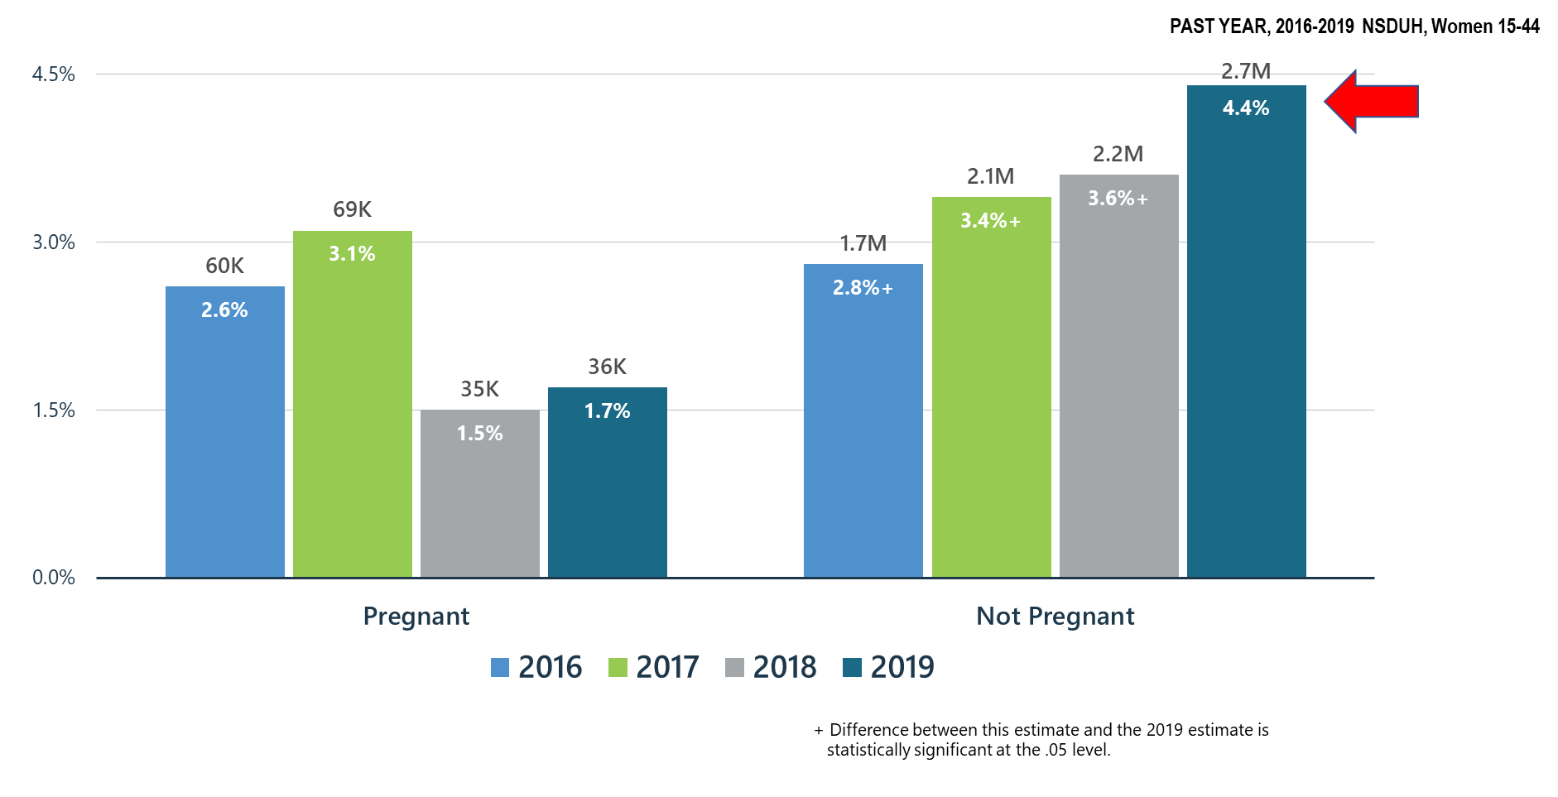
Daily or Almost Daily Marijuana Use among Women by Pregnancy Status

Slide 28
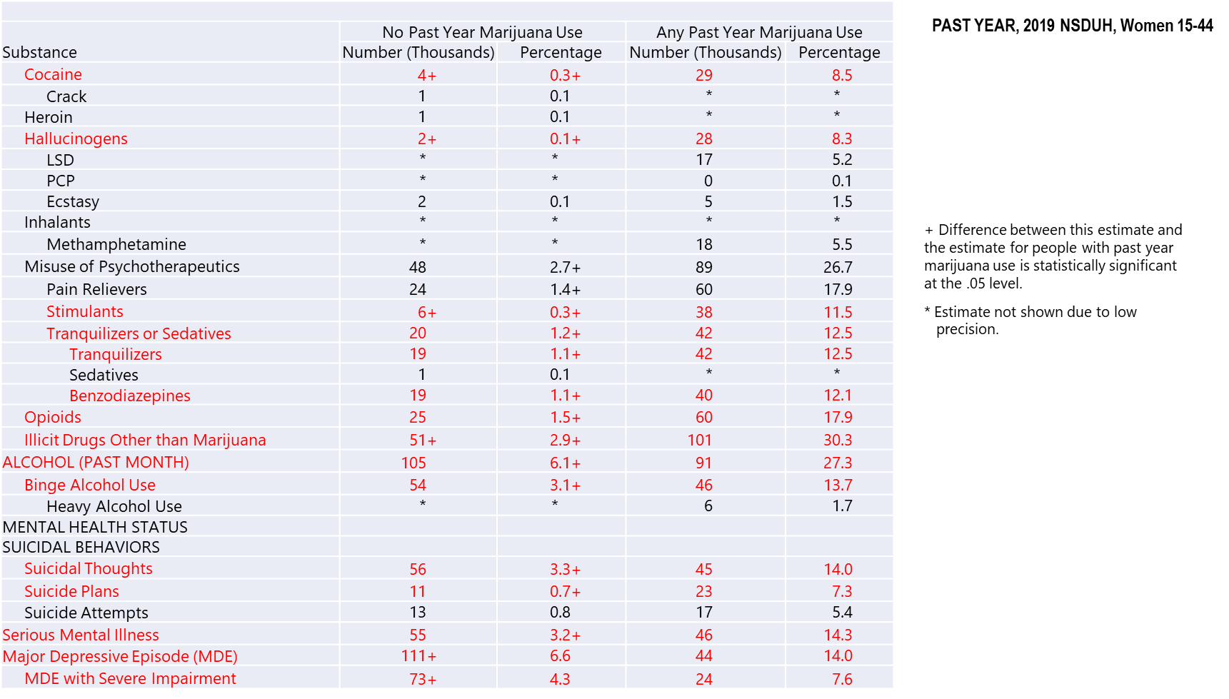
Past Year Substance Use and Mental Health Issues among Pregnant Women Aged 15 to 44 by Marijuana Use Status

Slide 29
Marijuana Use: Health Concerns
Past month marijuana use has significantly increased across all age groups for women as compared to 2016.
There were significant increases in marijuana use among adult women ages 26 and older.
Marijuana use disorder among young women ages 12-17 significantly increased.
There were slight increases in past month marijuana use and daily or almost daily marijuana use in women that were pregnant. There were significant increases in both categories for women that were not pregnant as compared to 2018.

Slide 30
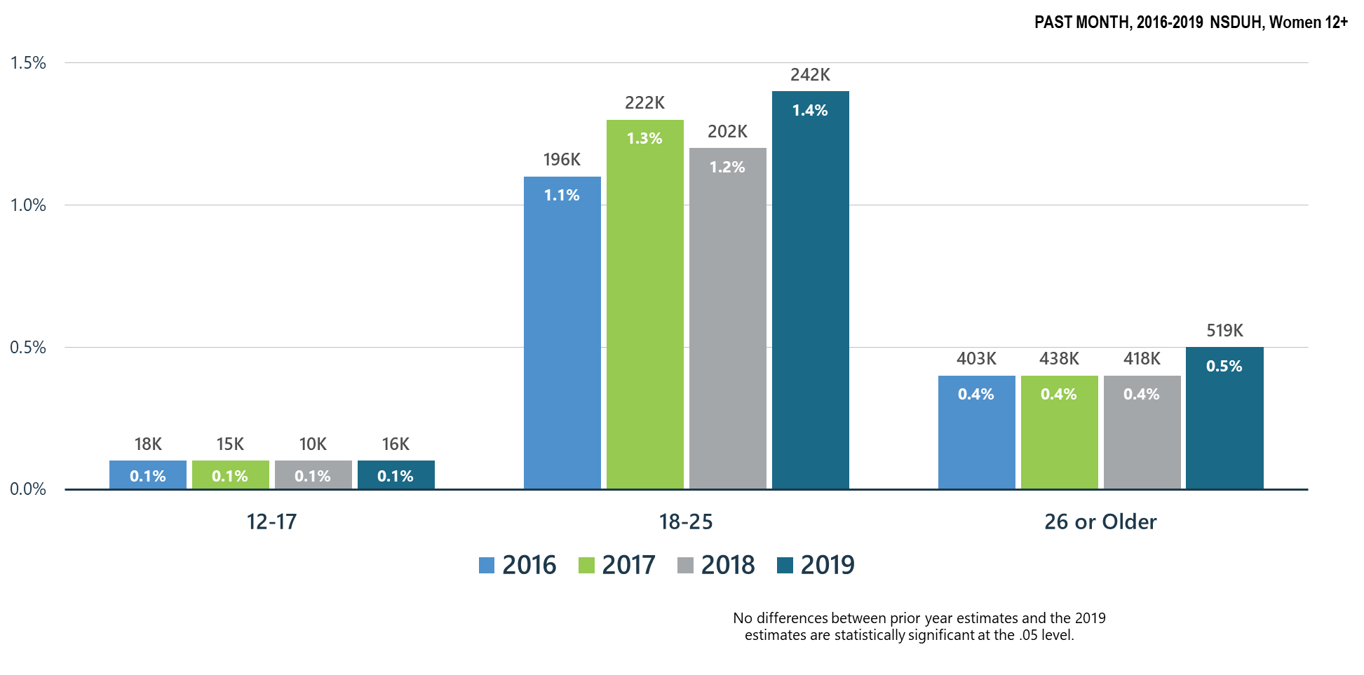
Cocaine Use among Women

Slide 31
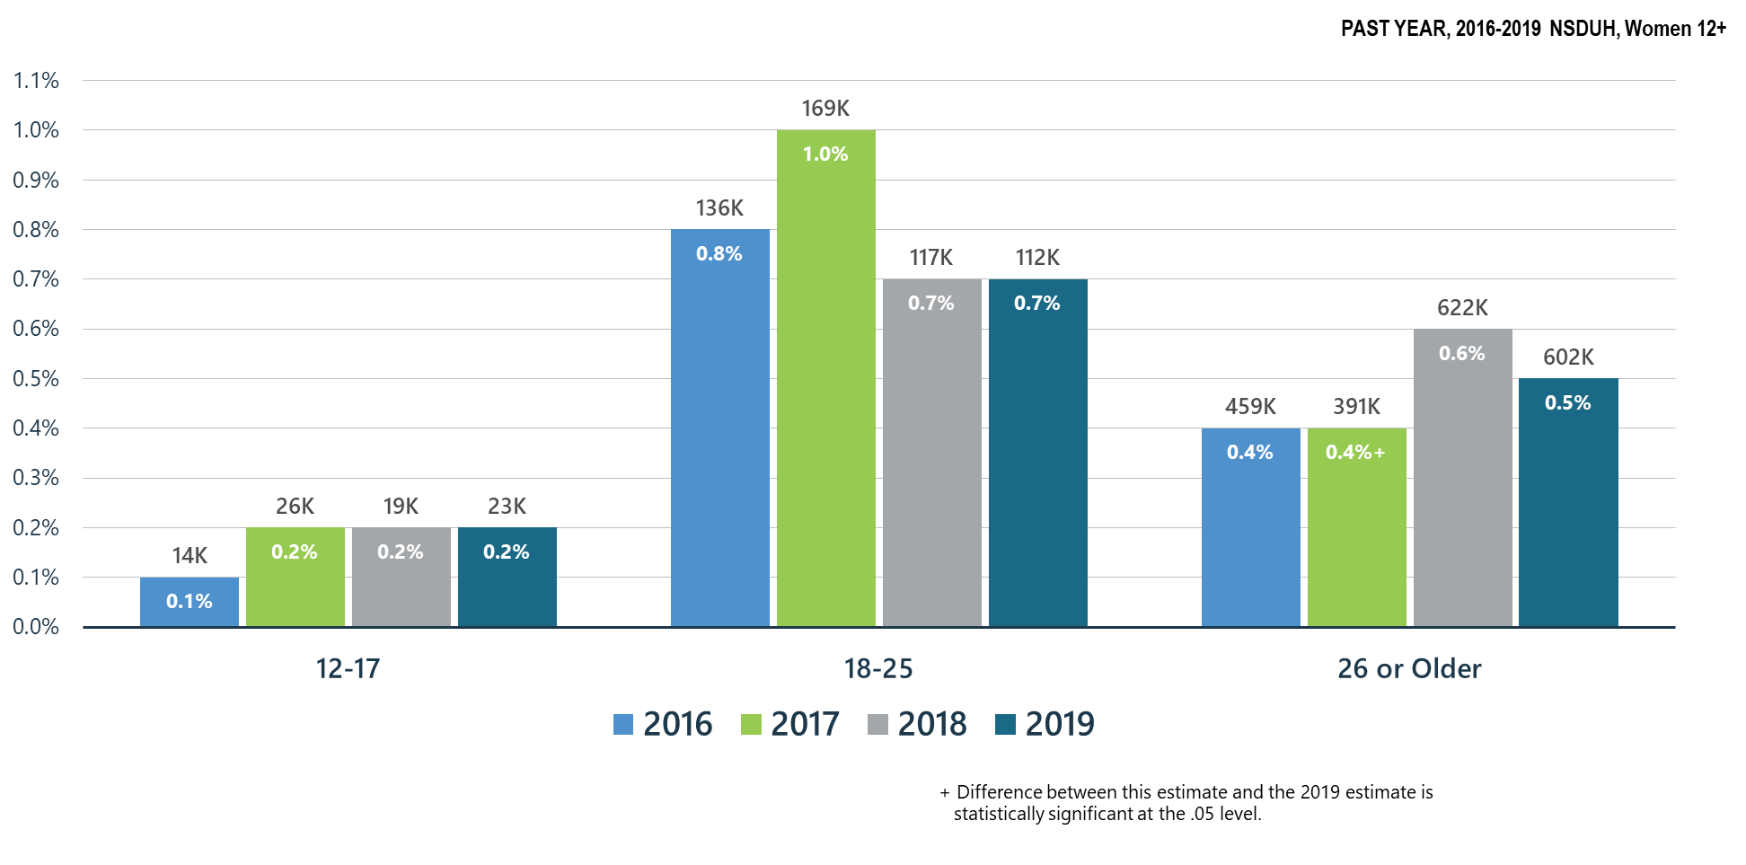
Methamphetamine Use among Women

Slide 32
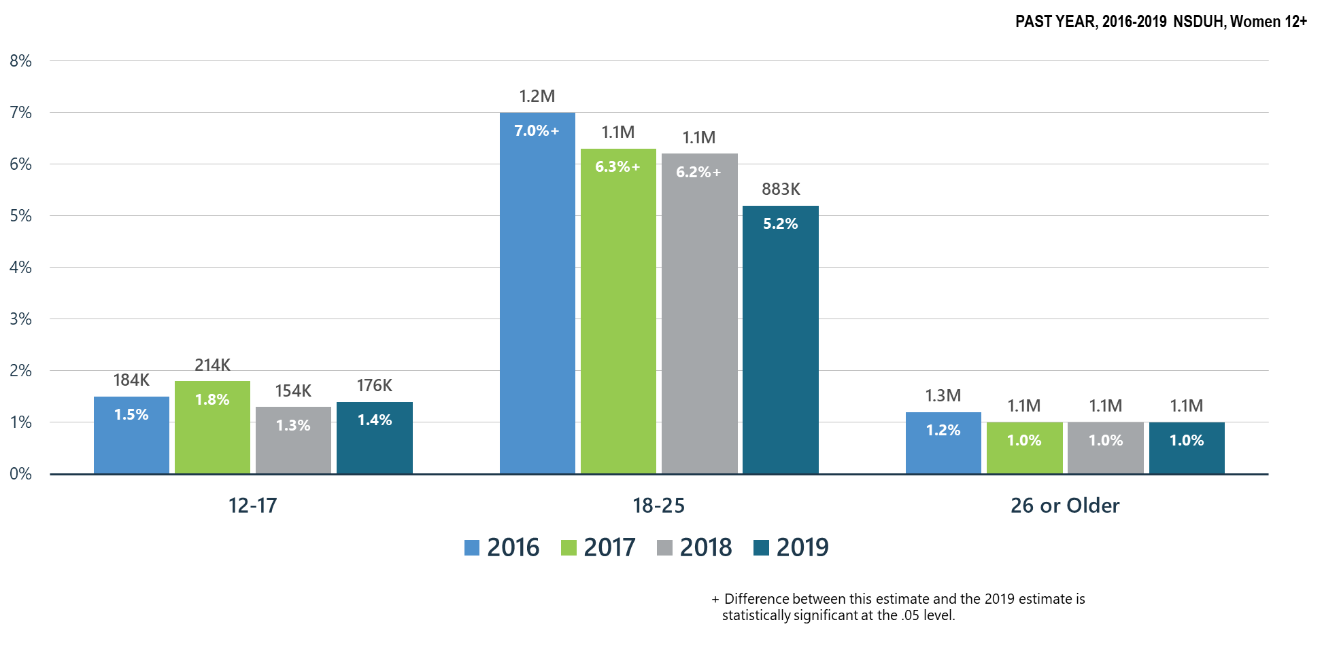
Misuse of Prescription Stimulants among Women

Slide 33
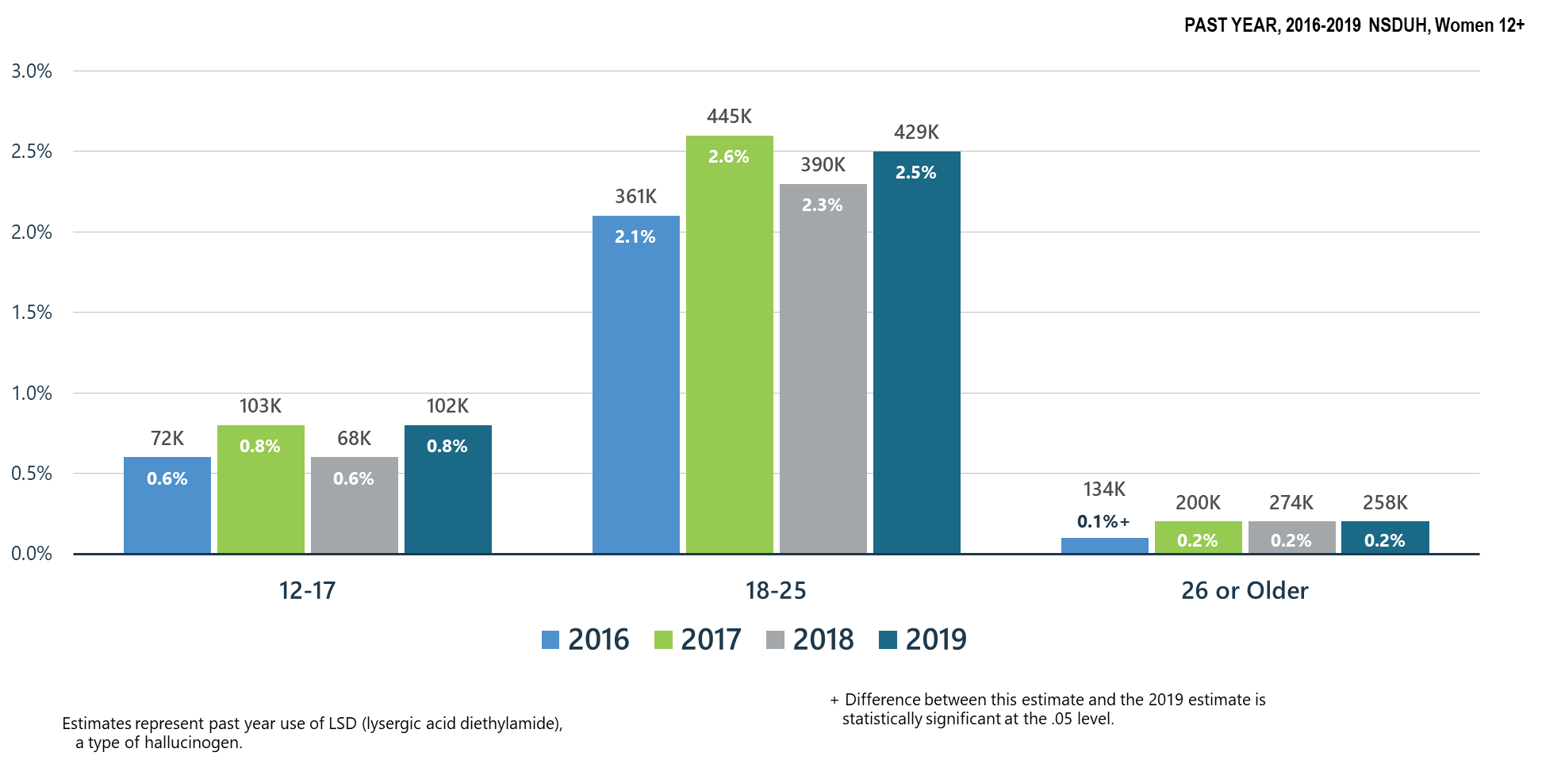
LSD Use among Women for All Age Groups

Slide 34
Summary: Other Substance Use in the United States in 2019 Compared to 2018
Cocaine use in women of all ages remained stable.
Methamphetamine use in women ages 26 or older significantly increases as compared to 2017.
Misuse of prescription stimulants by women ages 18-25 significantly decreased when compared to 2016-2018.
LSD use among women significantly increased for women ages 26 or older when compared to 2016.

Slide 35
Polysubstance Use and Mental Illness

Slide 36
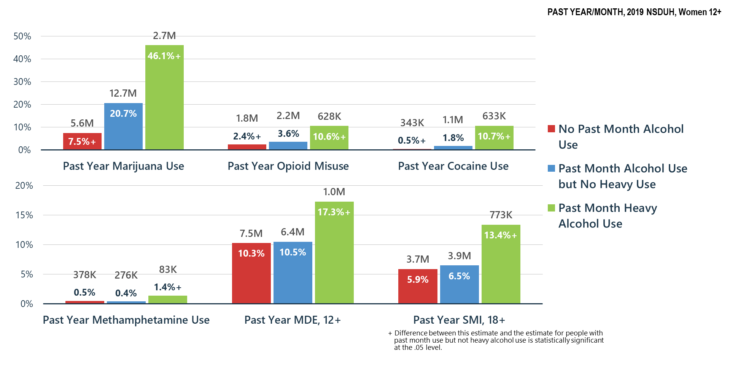
Alcohol Use Related to Other Substance Use, MDE and SMI among Women

Slide 37
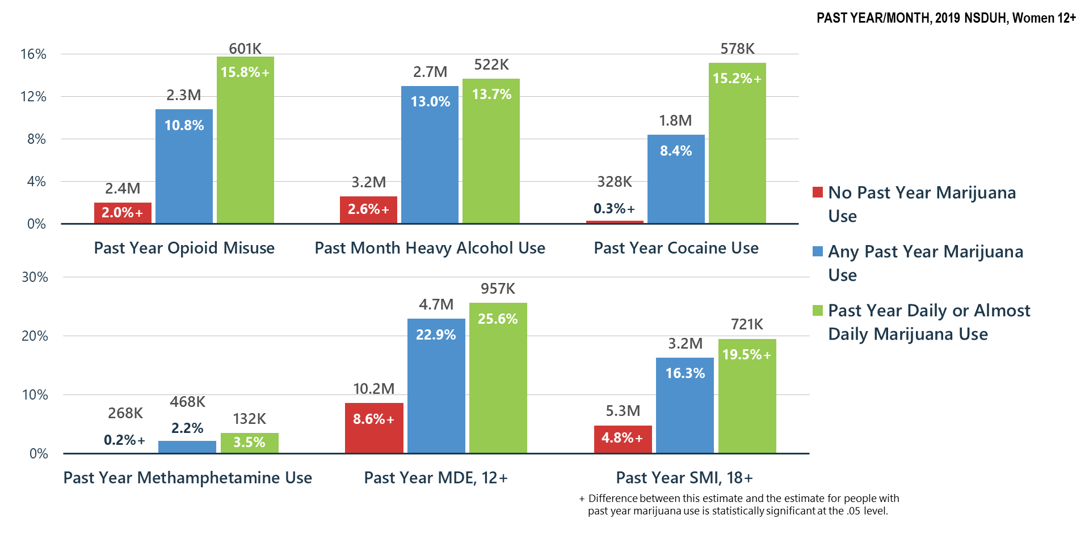
Marijuana Use Related to Other Substance Use, MDE and SMI among Women

Slide 38
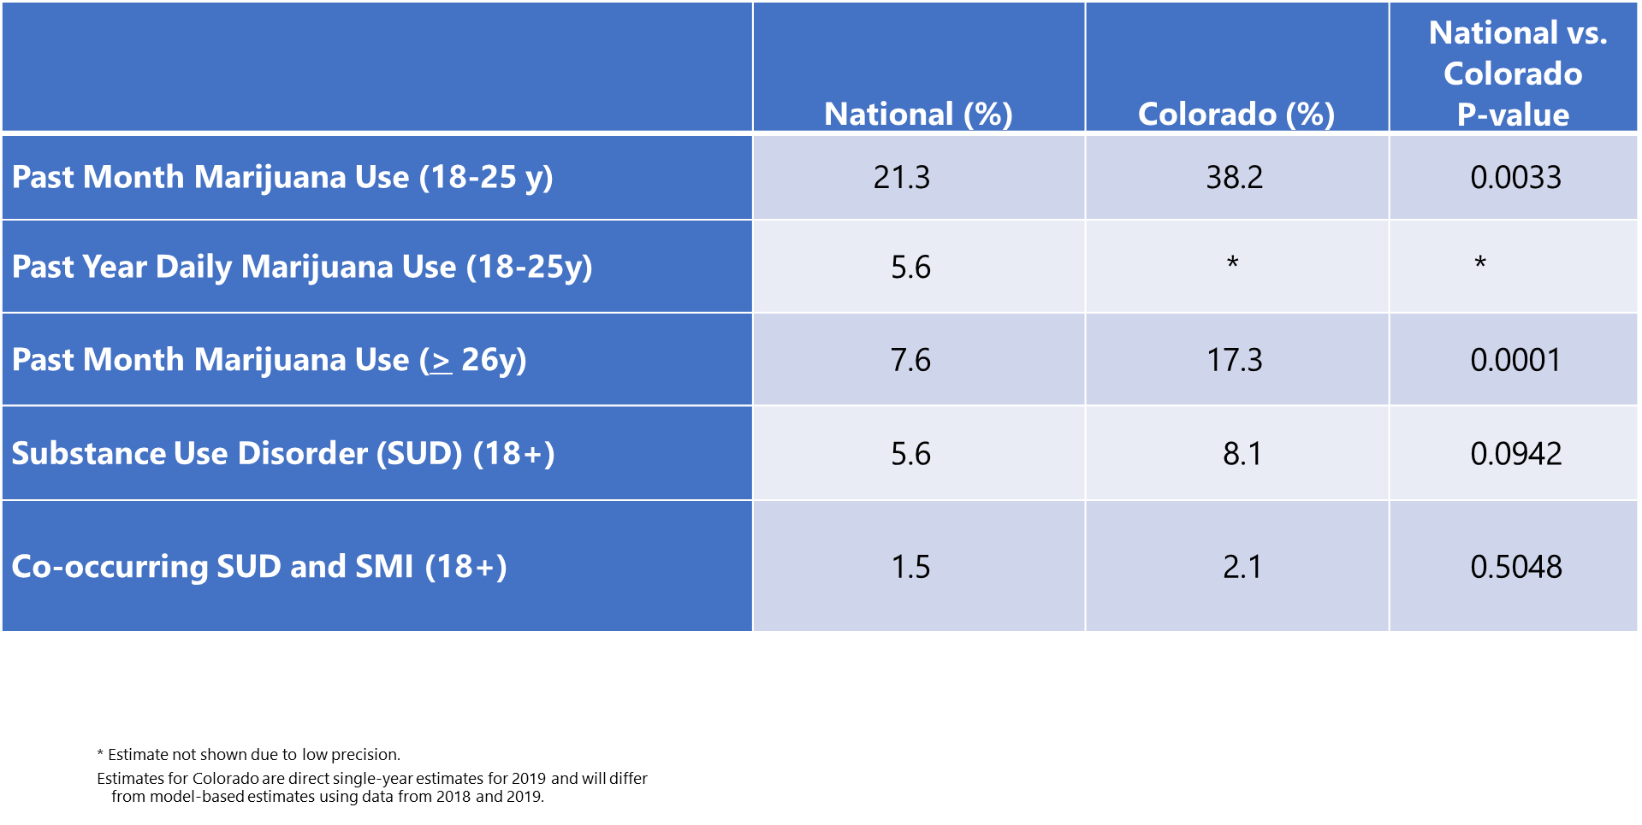
Comparison of Rates of Mental/Substance Use Disorders Associated with Marijuana Use among Women: National vs. Colorado Data from the National Survey on Drug Use and Health (2019)

Slide 39
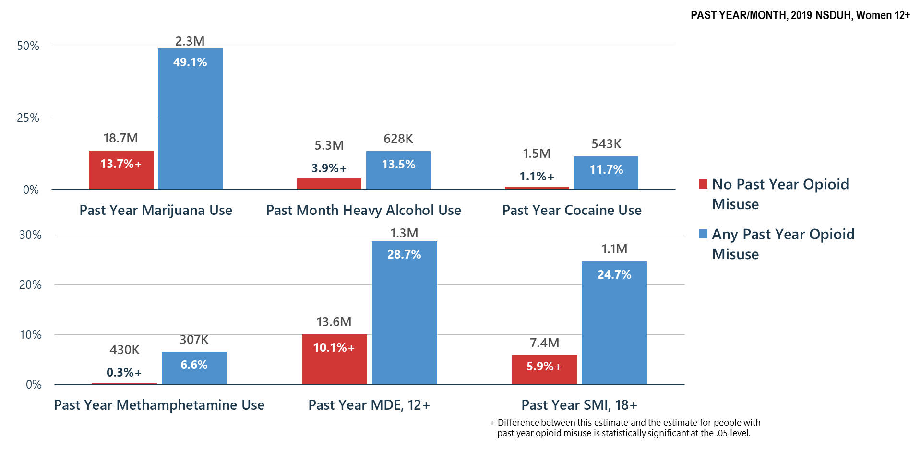
Opioid Misuse Related to Other Substance Use, MDE and SMI among Women

Slide 40
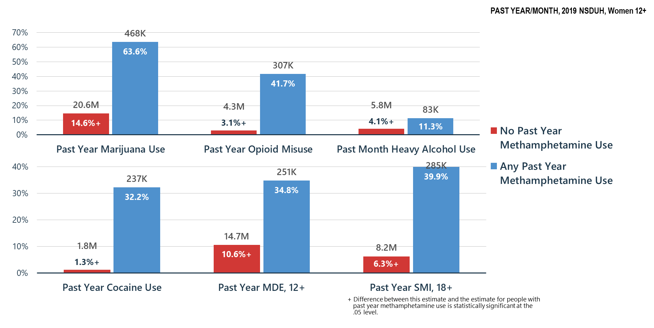
Methamphetamine Use Related to Other Substance Use, MDE and SMI among Women

Slide 41
Summary
Polysubstance use is common—if a person is having problems with one substance, they are likely using and may be having problems with other substances
Treatment providers must screen for and treat all substance use disorders and problem substance use
Association of substance misuse and mental illness is clear—we must all do a better job of helping Americans understand these relationships and risks

Slide 42
Mental Health

Slide 43
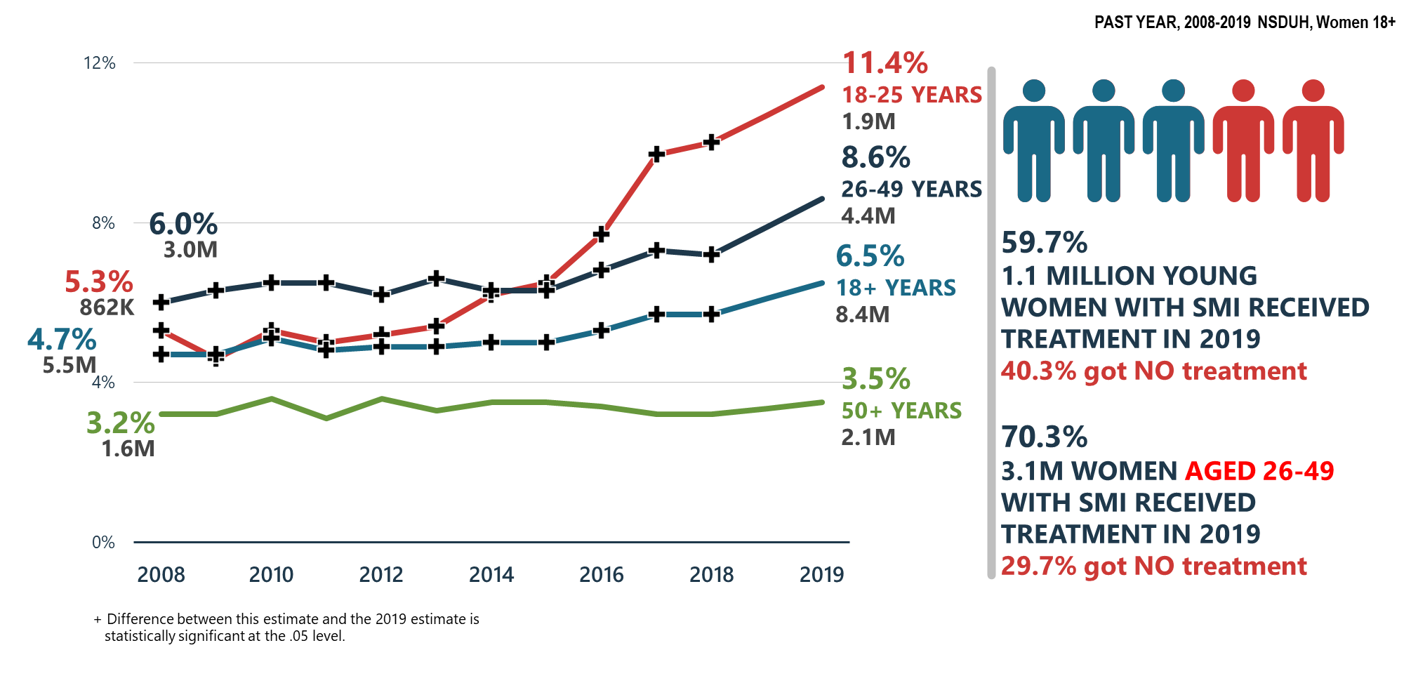
Serious Mental Illness (SMI) among Women Increasing

Slide 44
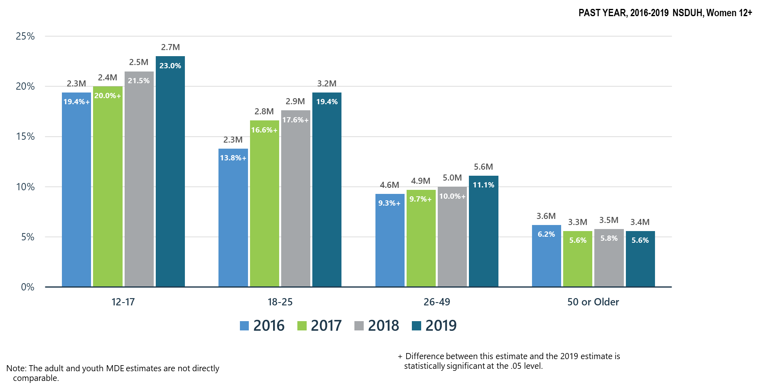
Major Depressive Episodes among Women Increased for Those Under Age 50

Slide 45
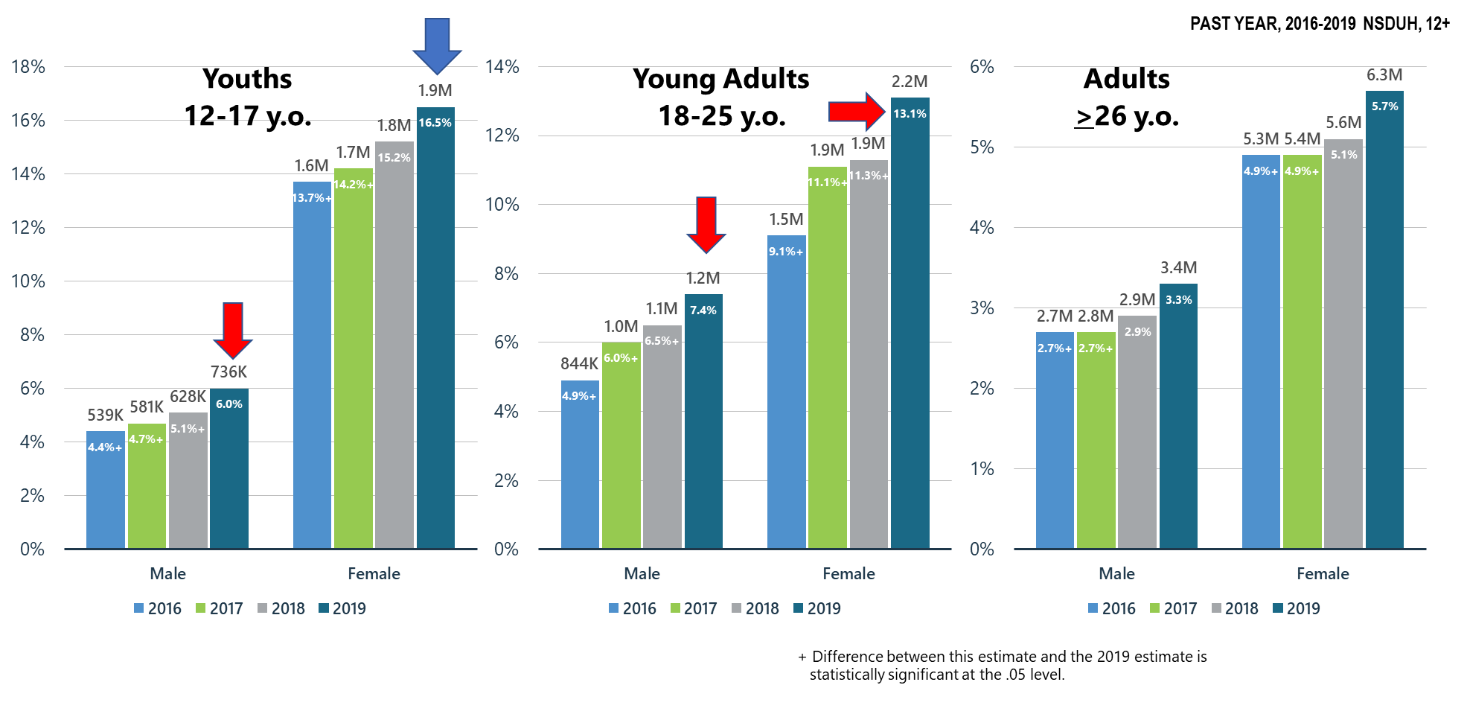
Major Depressive Episodes with Severe Impairment

Slide 46
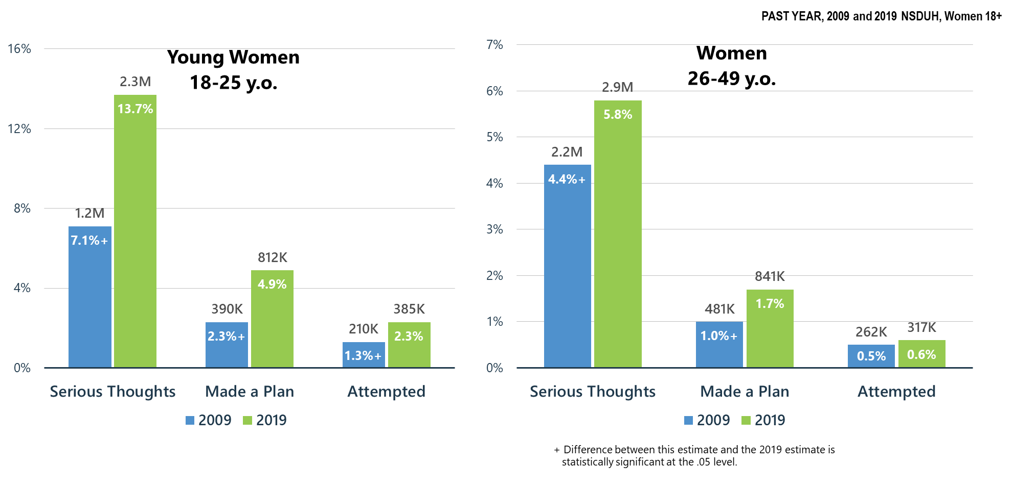
Suicidal Thoughts, Plans, and Attempts Increase for Young Women (18-25 y.o.) and Women (26-49 y.o.)

Slide 47
Co-Occurring
Mental and Substance Use Disorders

Slide 48
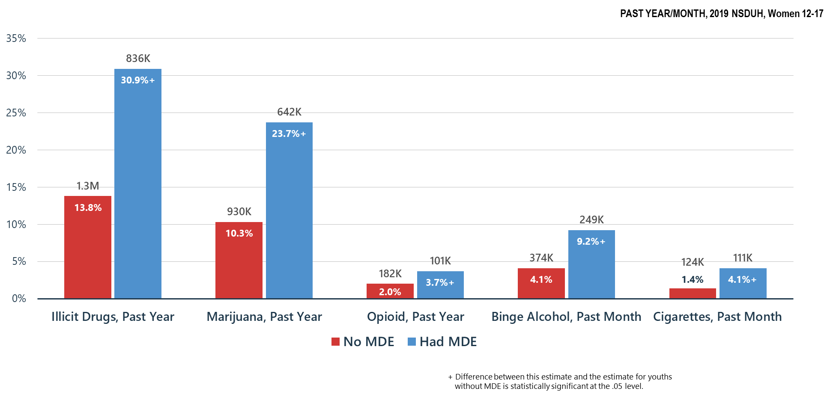
Substance Use among Adolescent Females (12-17 y.o.) by Past Year Major Depressive Episode (MDE) status

Slide 49
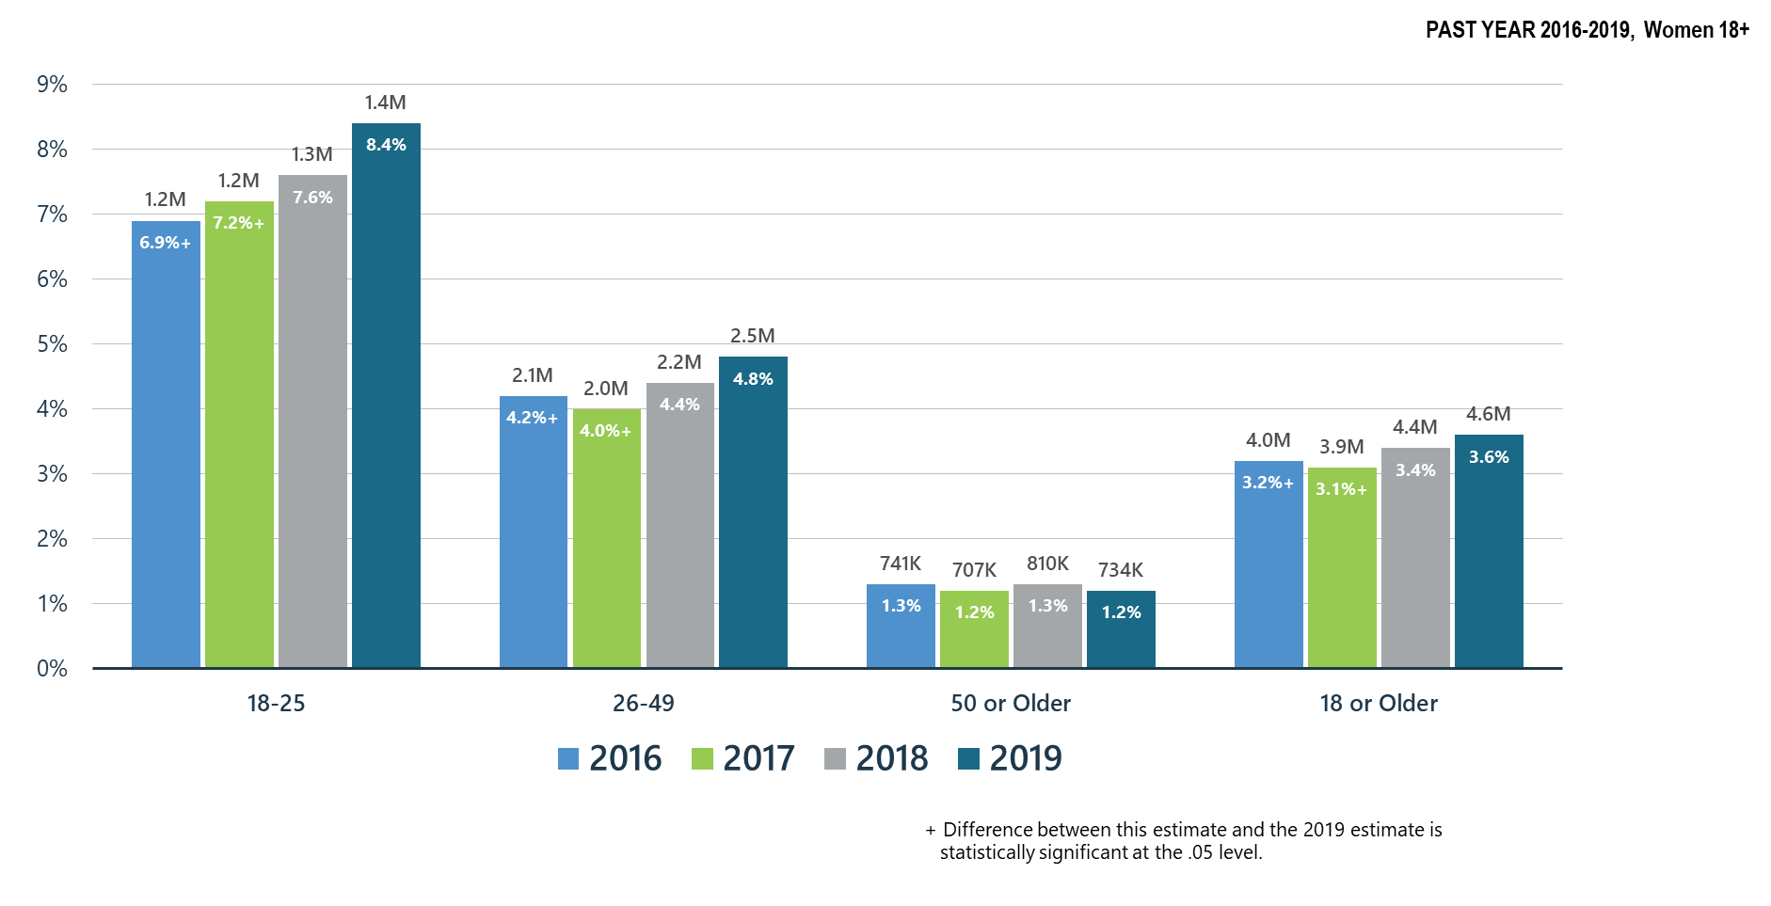
Co-Occurring Substance Use Disorder and Any Mental Illness in Adult Women

Slide 50
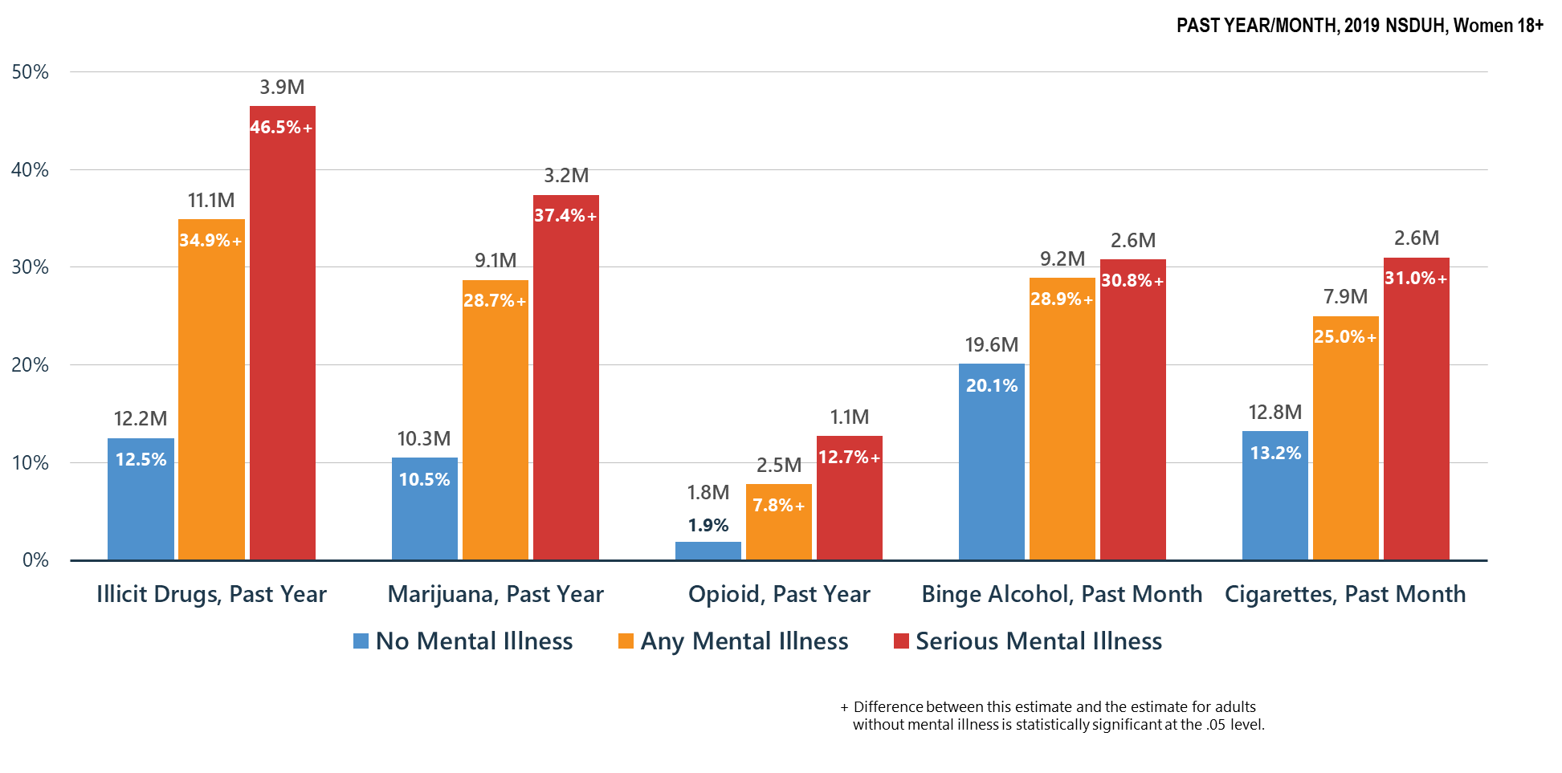
Co-Occurring Issues: Substance Use and Mental Illness among Adult Women

Slide 51
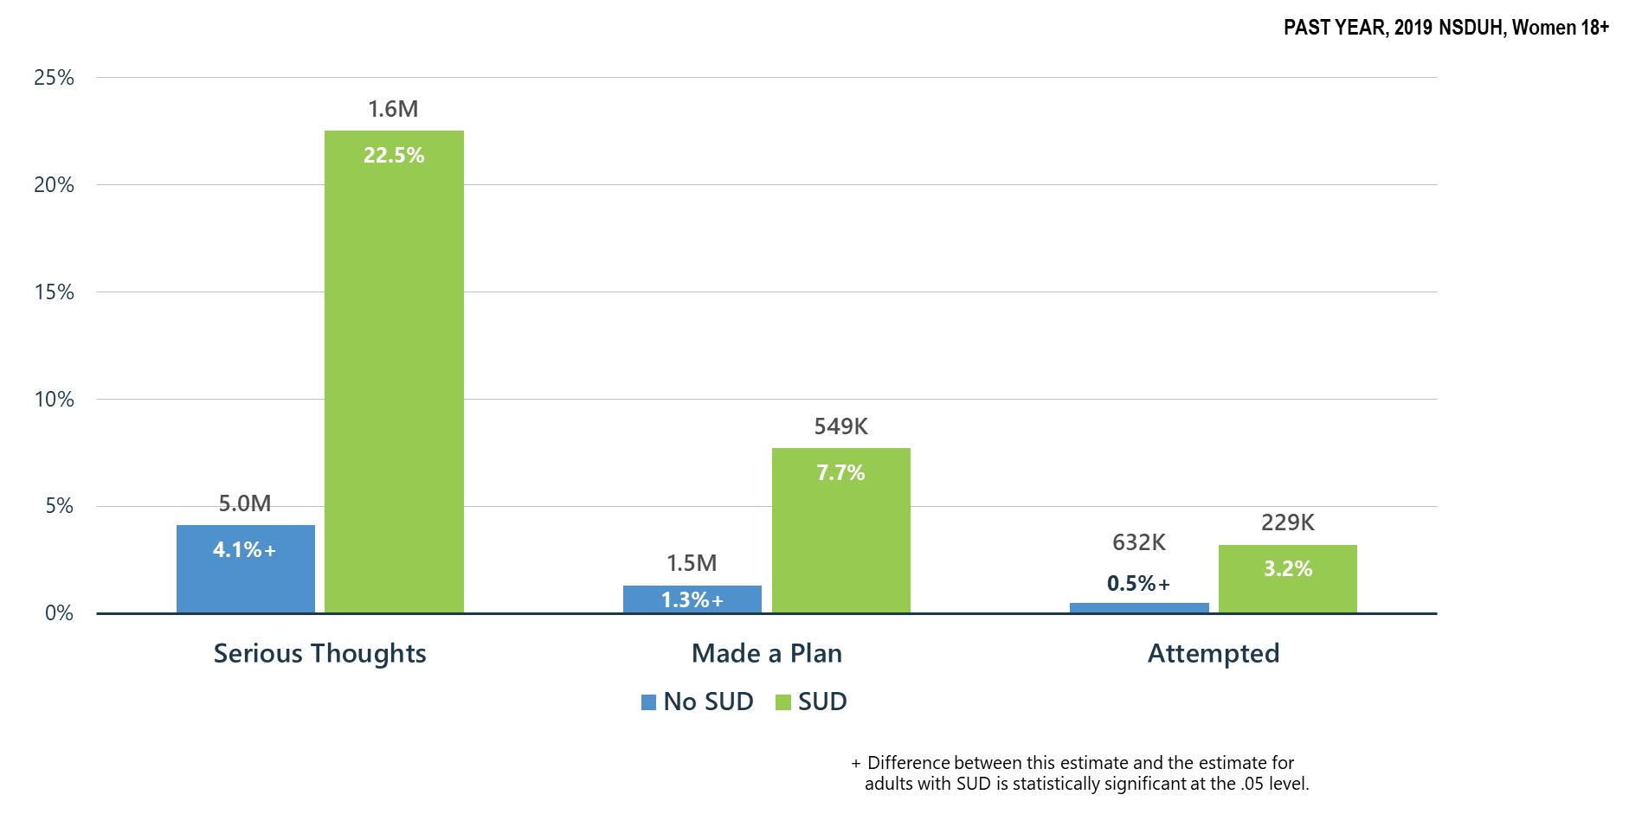
Substance Use Disorder (SUD) is Associated with Suicidal Thoughts, Plans, and Attempts among Adult Women >18 y.o.

Slide 52
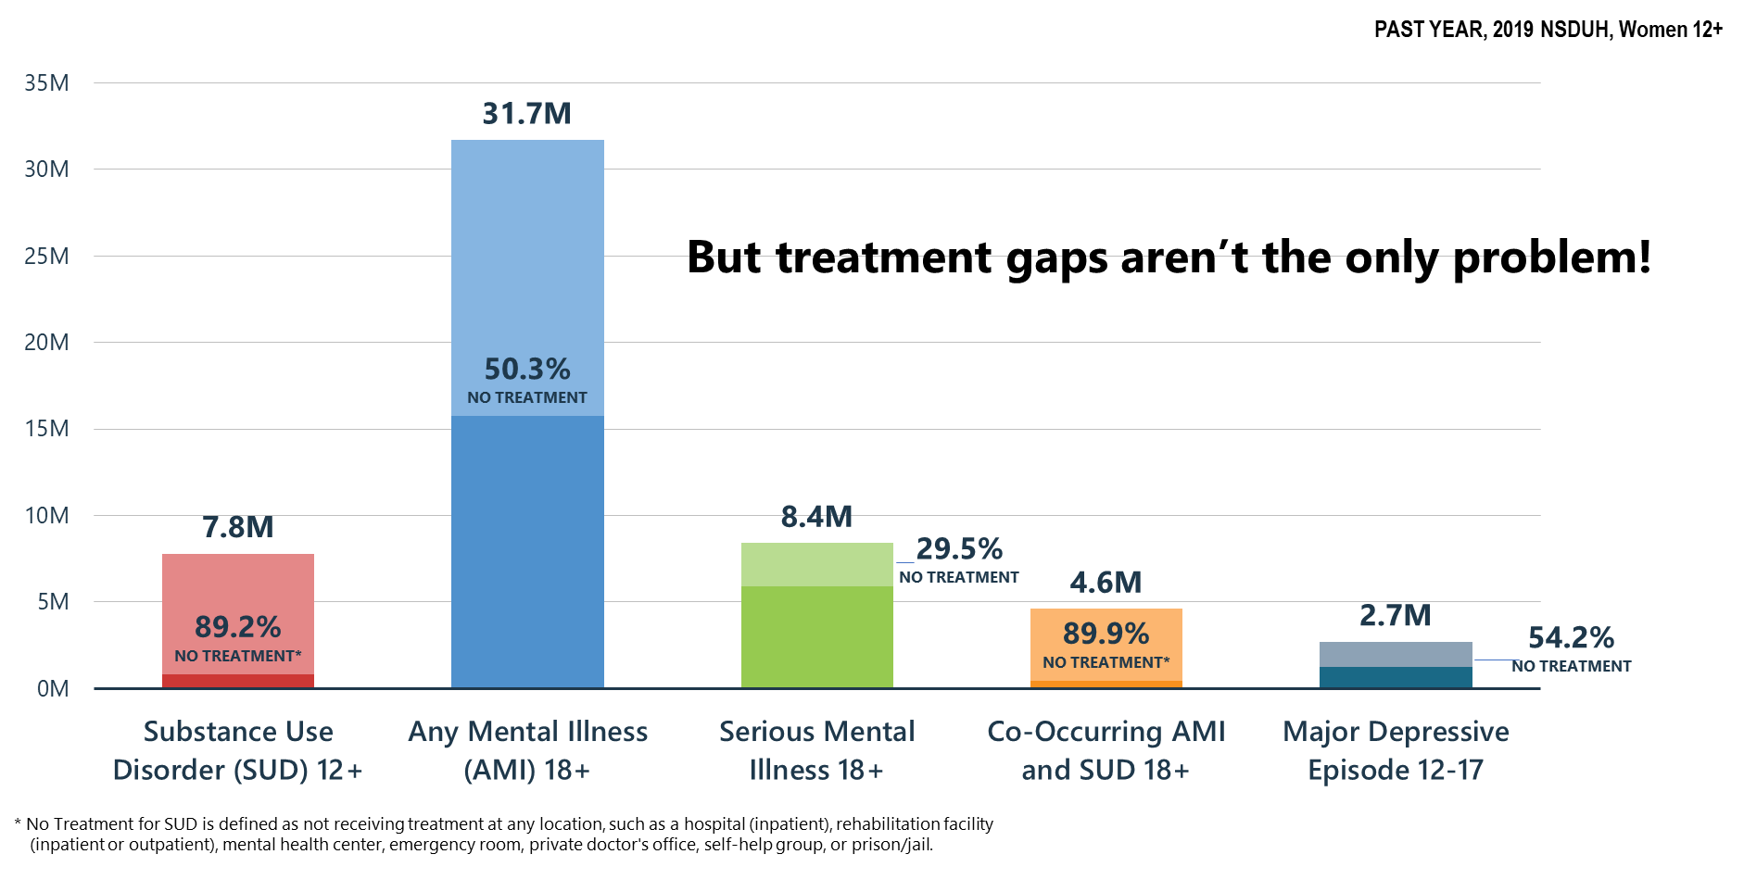
Mental and Substance Use Disorders among Women: High Prevalence/Huge Treatment Gaps

Slide 53
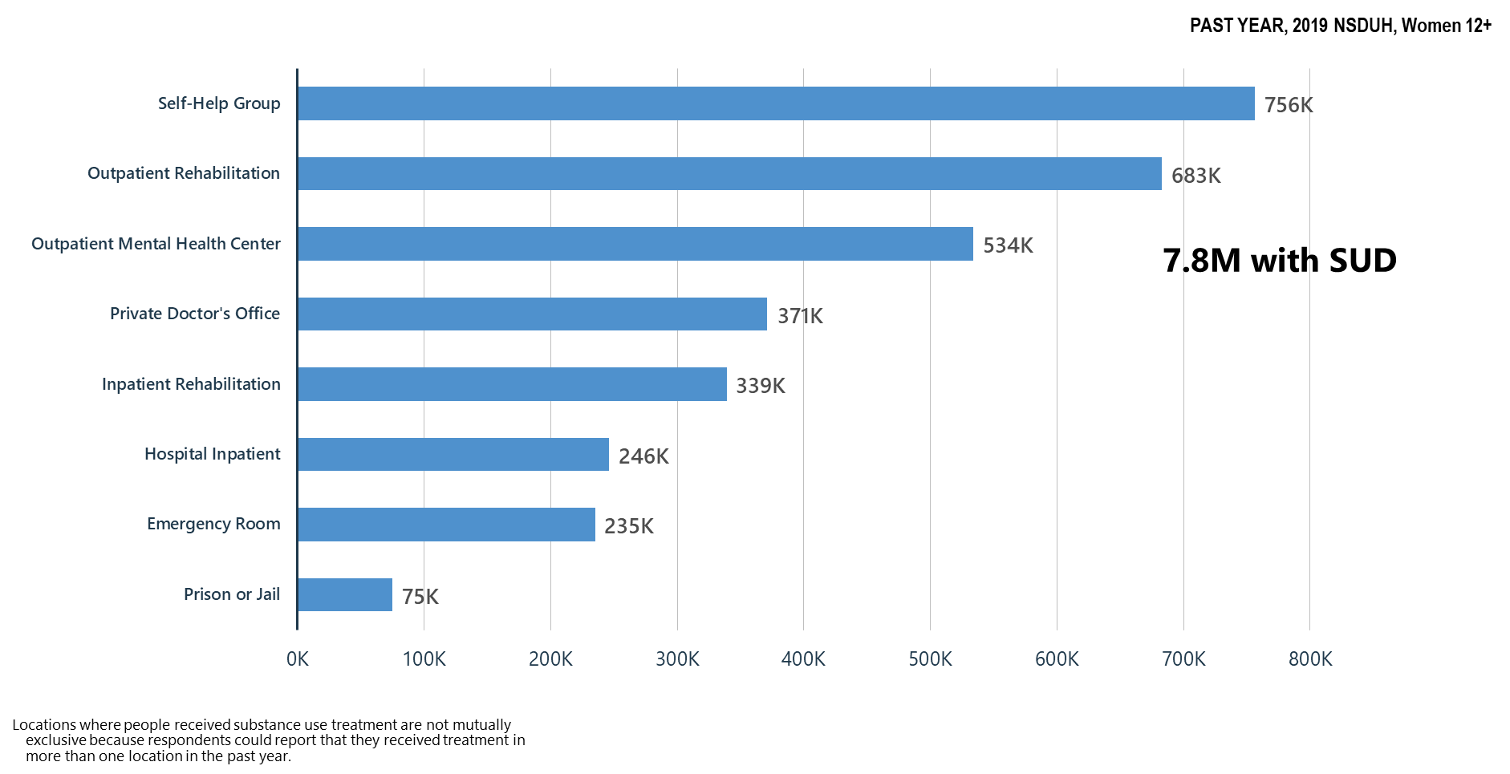
Locations Where Substance Use Treatment was Received among Women

Slide 54
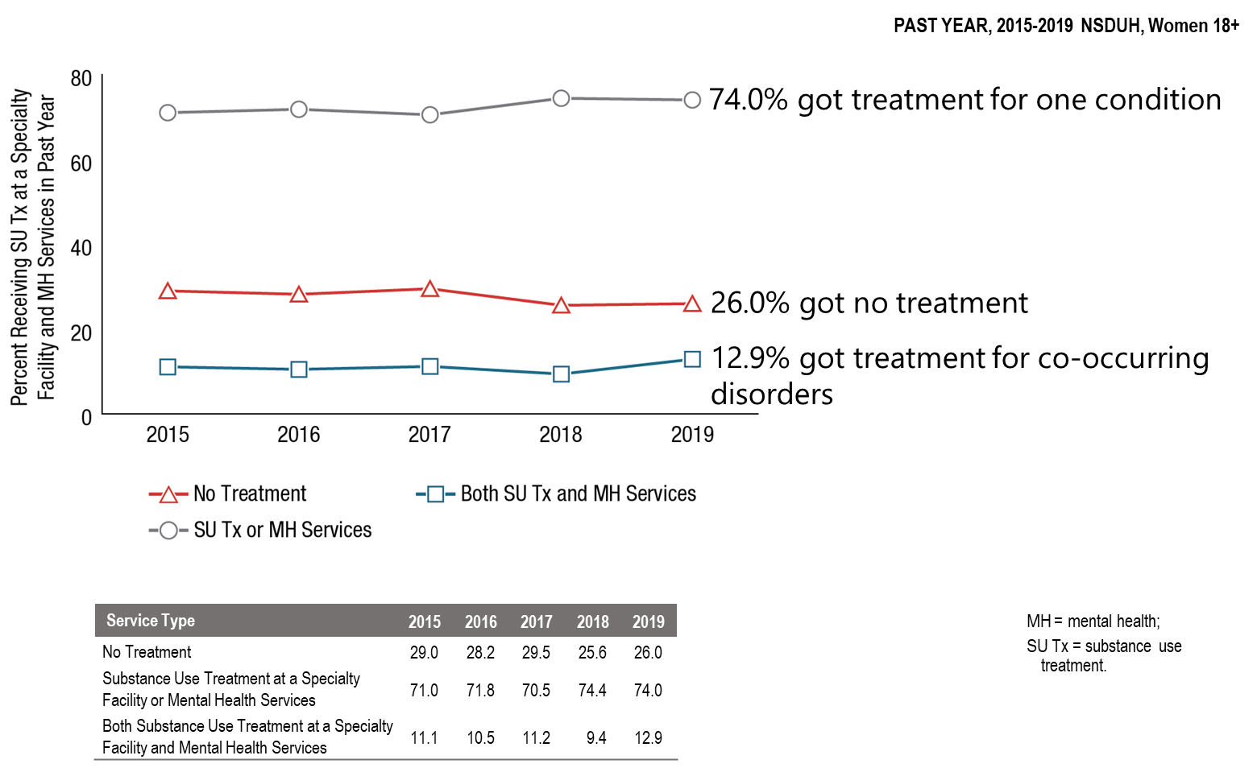
Receipt of Substance Use Treatment at a Specialty Facility and Mental Health Services in the Past Year among Adult Women Aged 18 or Older with Past Year Substance Use Disorder and Serious Mental Illness: 2015-2019

Slide 55
Summary: Mental Health/Co-Occurring Issues in the United States in 2019
Serious mental illness among women is increasing.
Suicidal thoughts and behaviors have increased in women ages 18-49 between 2009 and 2019
Substance use disorder significantly increased suicidality among women ages 18 and older.
Self-help groups ranked higher than outpatient rehabilitation facilities for the locations where substance use treatment was received.

Slide 56
What Can We Do Now?
SAMHSA must use its resources to benefit as many as possible:
Community based treatment and recovery services
Build on the Certified Community Behavioral Health Clinic model
  Crisis intervention services/suicide prevention resources
  Integrated mental health, substance use, general medical services
  Children’s mental health services-linkages with schools
Keep telemedicine/telehealth in place including use of telephone where audio/visual is not possible and pay for these services at same rate as face-to-face—no reduction in reimbursement because it is telemedicine
Continue and expand as possible technical assistance and training to behavioral health providers—clinicians and peers

Slide 57
It’s Up to Us Now
Let’s work as hard as we can to make decision-makers understand mental health and substance use needs in America—pre and post-COVID-19
Let’s keep the virus in mind in planning and implementing our services so that we can safely deliver care, but we cannot ignore the overall health needs of the American people—that is not an option
Let’s work to meet the mental health/substance use needs of our people:
  Restore our systems—mental health and substance use disorder services are ‘essential services’
  Expand our treatment and community recovery support systems permanently
  Every American life is precious and every American death—regardless of the cause is a terrible loss

