Slide 1
2019 National Survey on Drug Use and Health: African Americans
Substance Abuse and Mental Health Services Administration
U.S. Department of Health and Human Services
September 2020

Slide 2
National Survey on Drug Use and Health (NSDUH)
NSDUH is a comprehensive household interview survey of substance use, substance use disorders, mental health, and the receipt of treatment services for these disorders in the United States.
NSDUH is collected face-to-face by field interviewers who read less sensitive questions to respondents and transition respondents to audio computer assisted self‑interviewing for sensitive items.
NSDUH covers the civilian, noninstitutionalized population, aged 12 or older:
  Includes: Households, college dorms, homeless in shelters, civilians on military bases
  Excludes: Active military, long-term hospital residents, prison populations, homeless not in shelters
Sample includes all 50 states and DC
Approximately 67,500 persons are interviewed annually
Data collected from January to December

Slide 3
How Do We Use NSDUH?
Provides a window into the state of substance use and mental health issues in the United States
Helps to guide policy directions in addressing:
  problem substances
  prevalence of mental illness
  intersection of substance use and mental health issues
  provides insights that can be studied in the context of data from other agencies to help in decision-making about what types of resources are needed and where resources should be directed

Slide 4
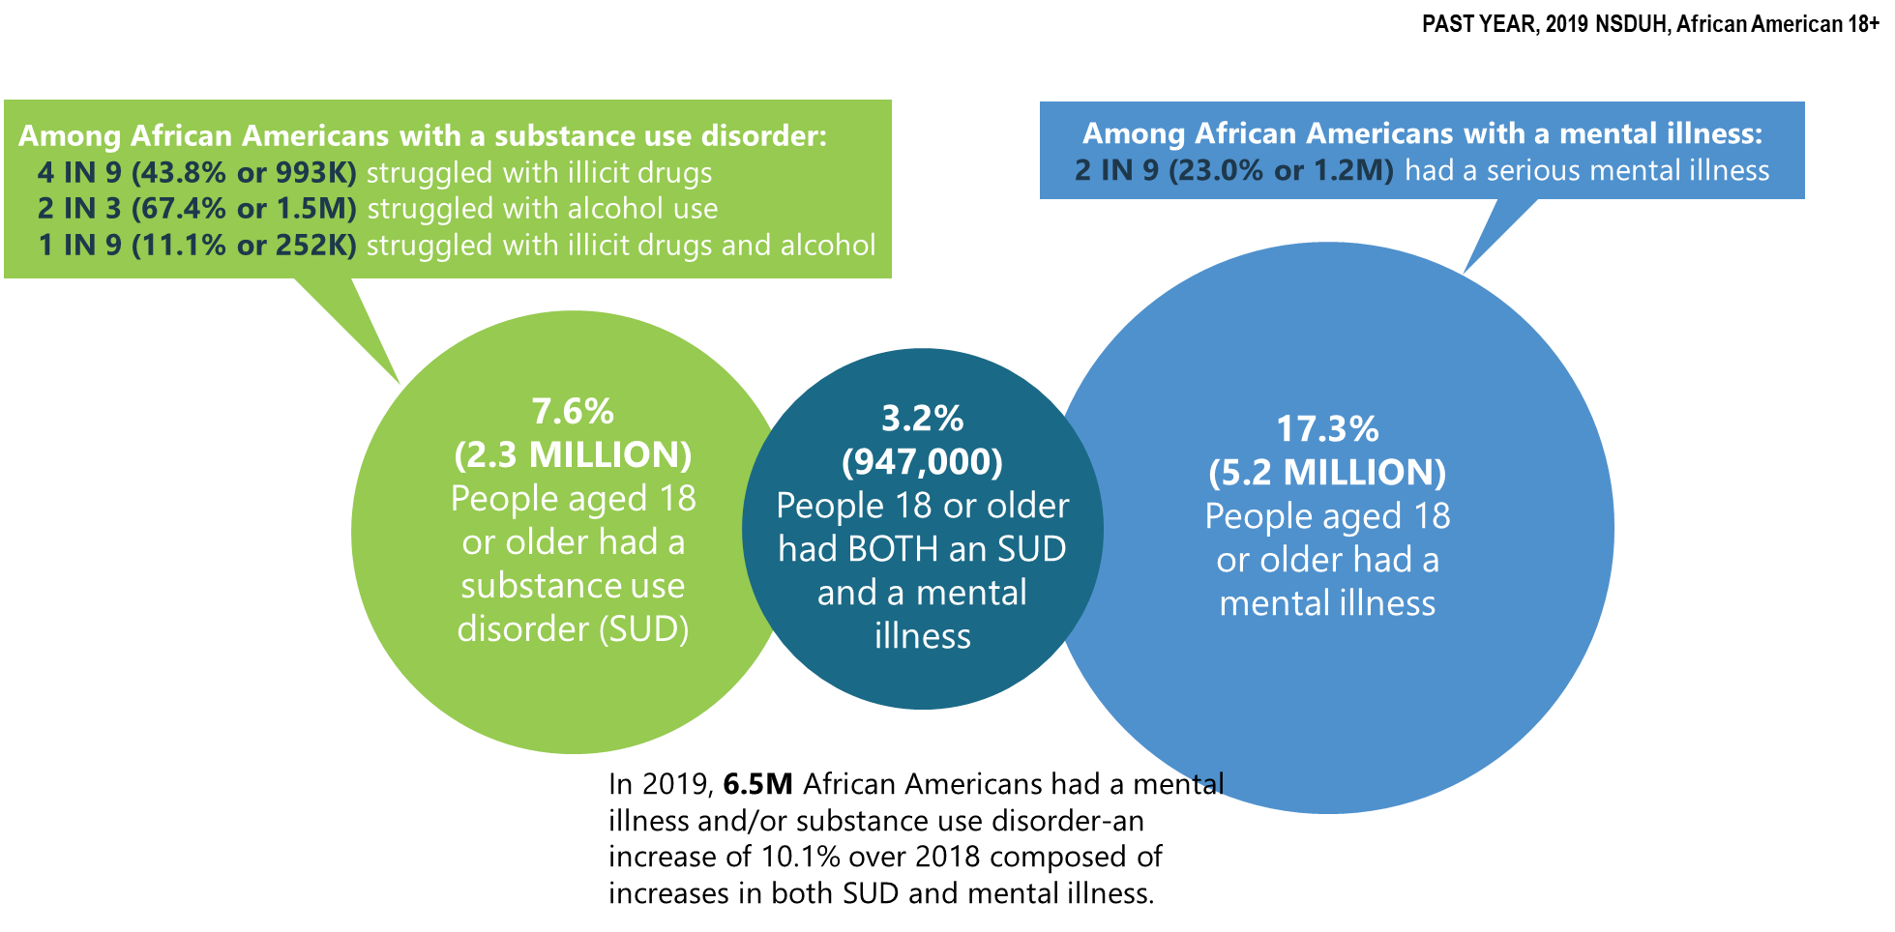
Mental Illness and Substance Use Disorders in America among African American Adults (>18 y.o.)

Slide 5
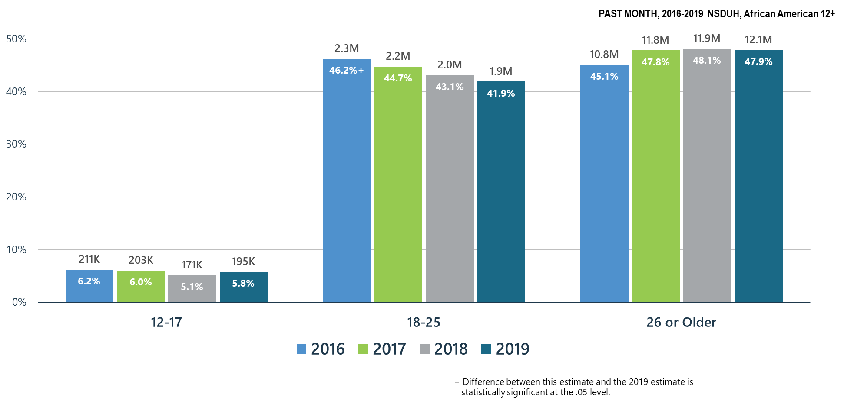
Alcohol Use among African Americans

Slide 6
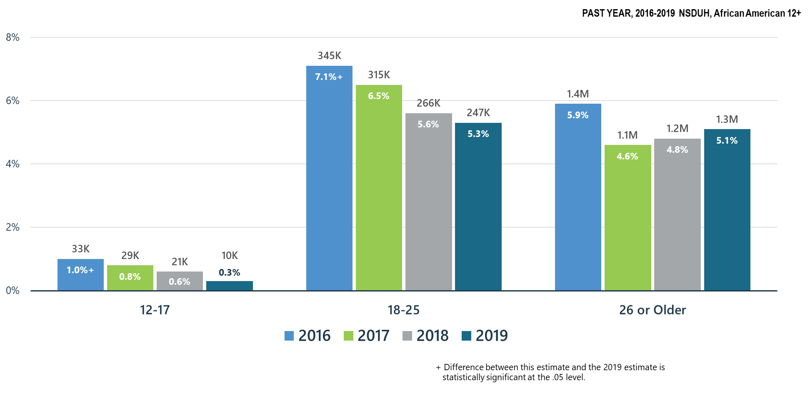
Alcohol Use Disorder among African Americans

Slide 7
Summary: Alcohol Use in 2019
Past month alcohol use remained stable in all age groups of the African American population during 2018-2019. There was a significant decrease in past month alcohol use from 2016 among African Americans ages 18-25.
There have been significant decreases in alcohol use disorder among African Americans ages 12-17 and ages 18-25 since 2016.
SAMHSA will continue its prevention programs:
  SAMHSA Prevention Technology Transfer Centers produce resources and materials related to alcohol misuse prevention
  CSAP ‘Talk They Hear You’ focuses on underage drinking
  CSAP requires Partnerships for Success grantees to emphasize underage drinking prevention
  CSAT has promoted SBIRT for alcohol use in all programs including CJ, PPW, adolescent treatment, HIV and homeless programs
  CSAT has funded SBIRT training in medical residencies and other healthcare practitioner programs which screen for hazardous alcohol use and use disorders

Slide 8
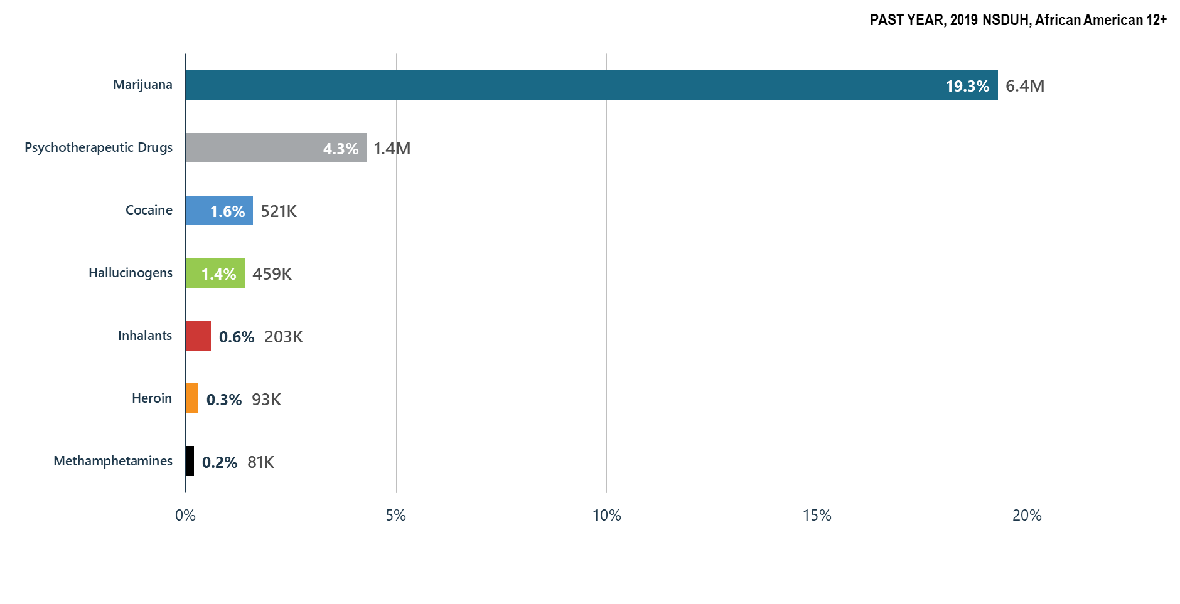
Illicit Drug Use among African Americans: Major Concerns: Opioids, Marijuana, Methamphetamines

Slide 9
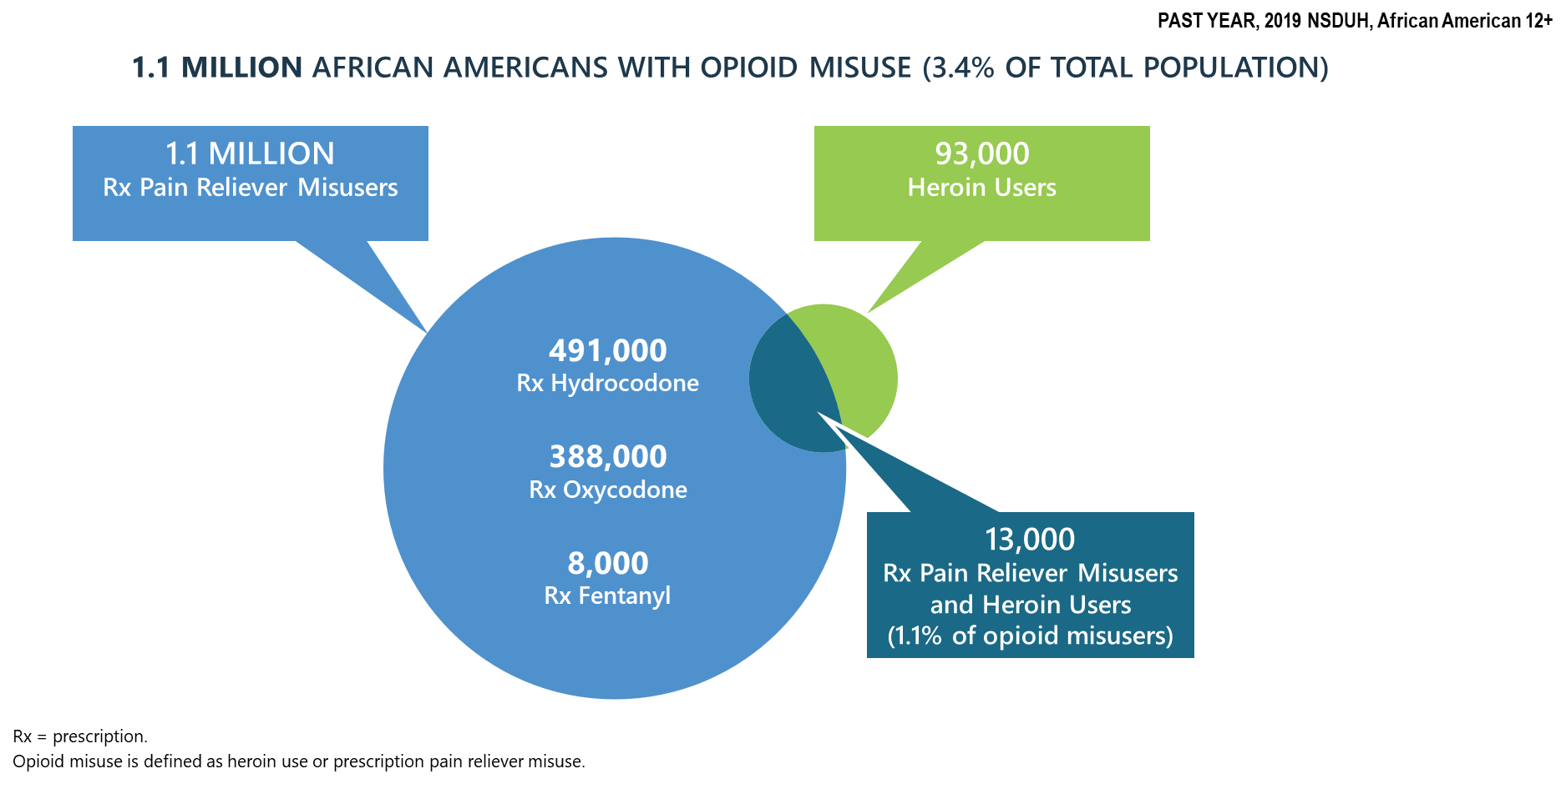
Progress on the Opioid Epidemic: Prescription Pain Reliever Misuse among African Americans

Slide 10
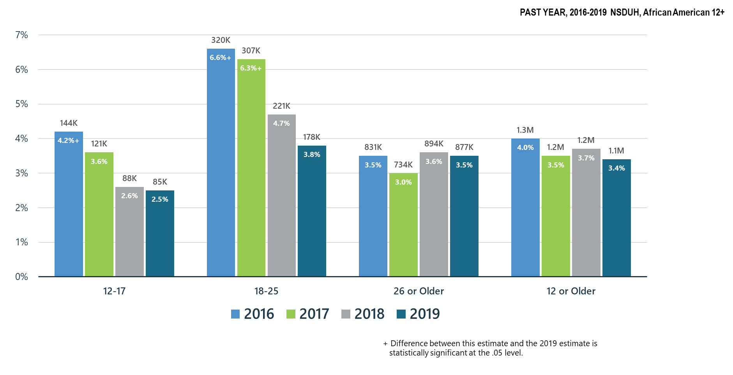
Opioid Misuse among African Americans

Slide 11
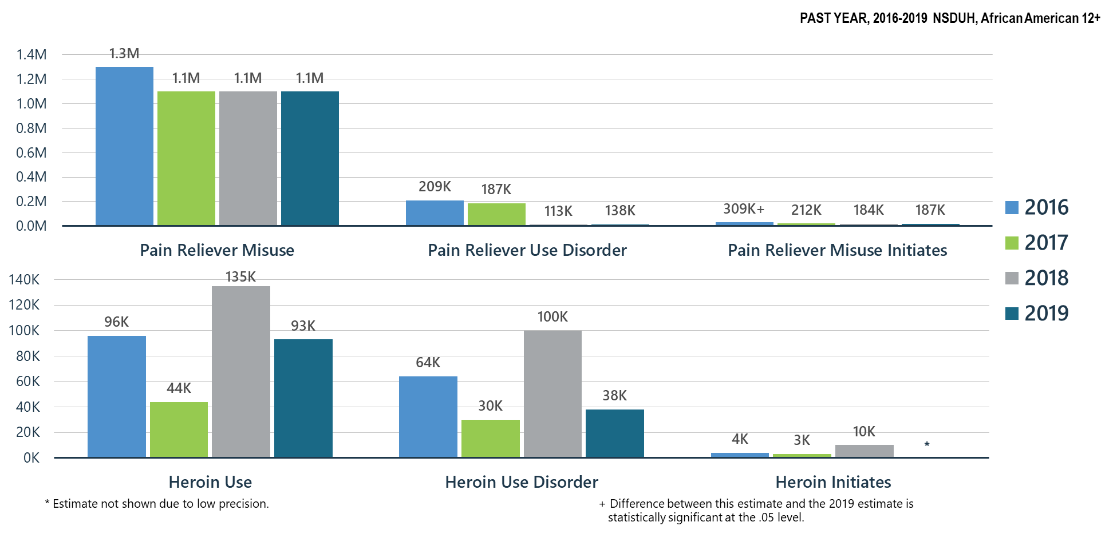
Prescription Pain Reliever Misuse and Heroin Use among African Americans

Slide 12
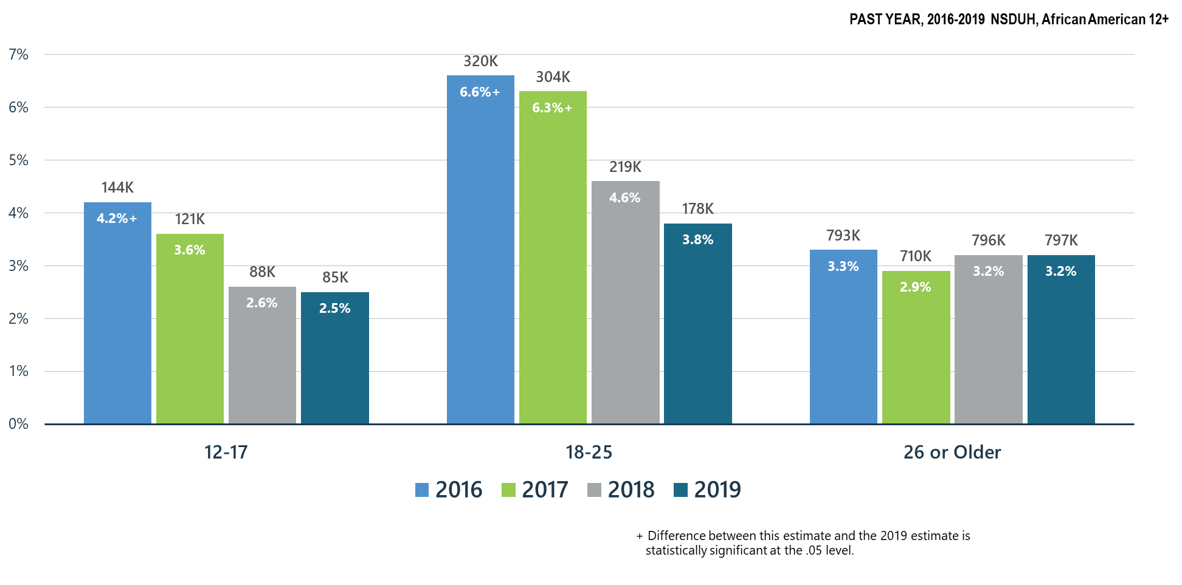
Prescription Pain Reliever Misuse among African Americans

Slide 13
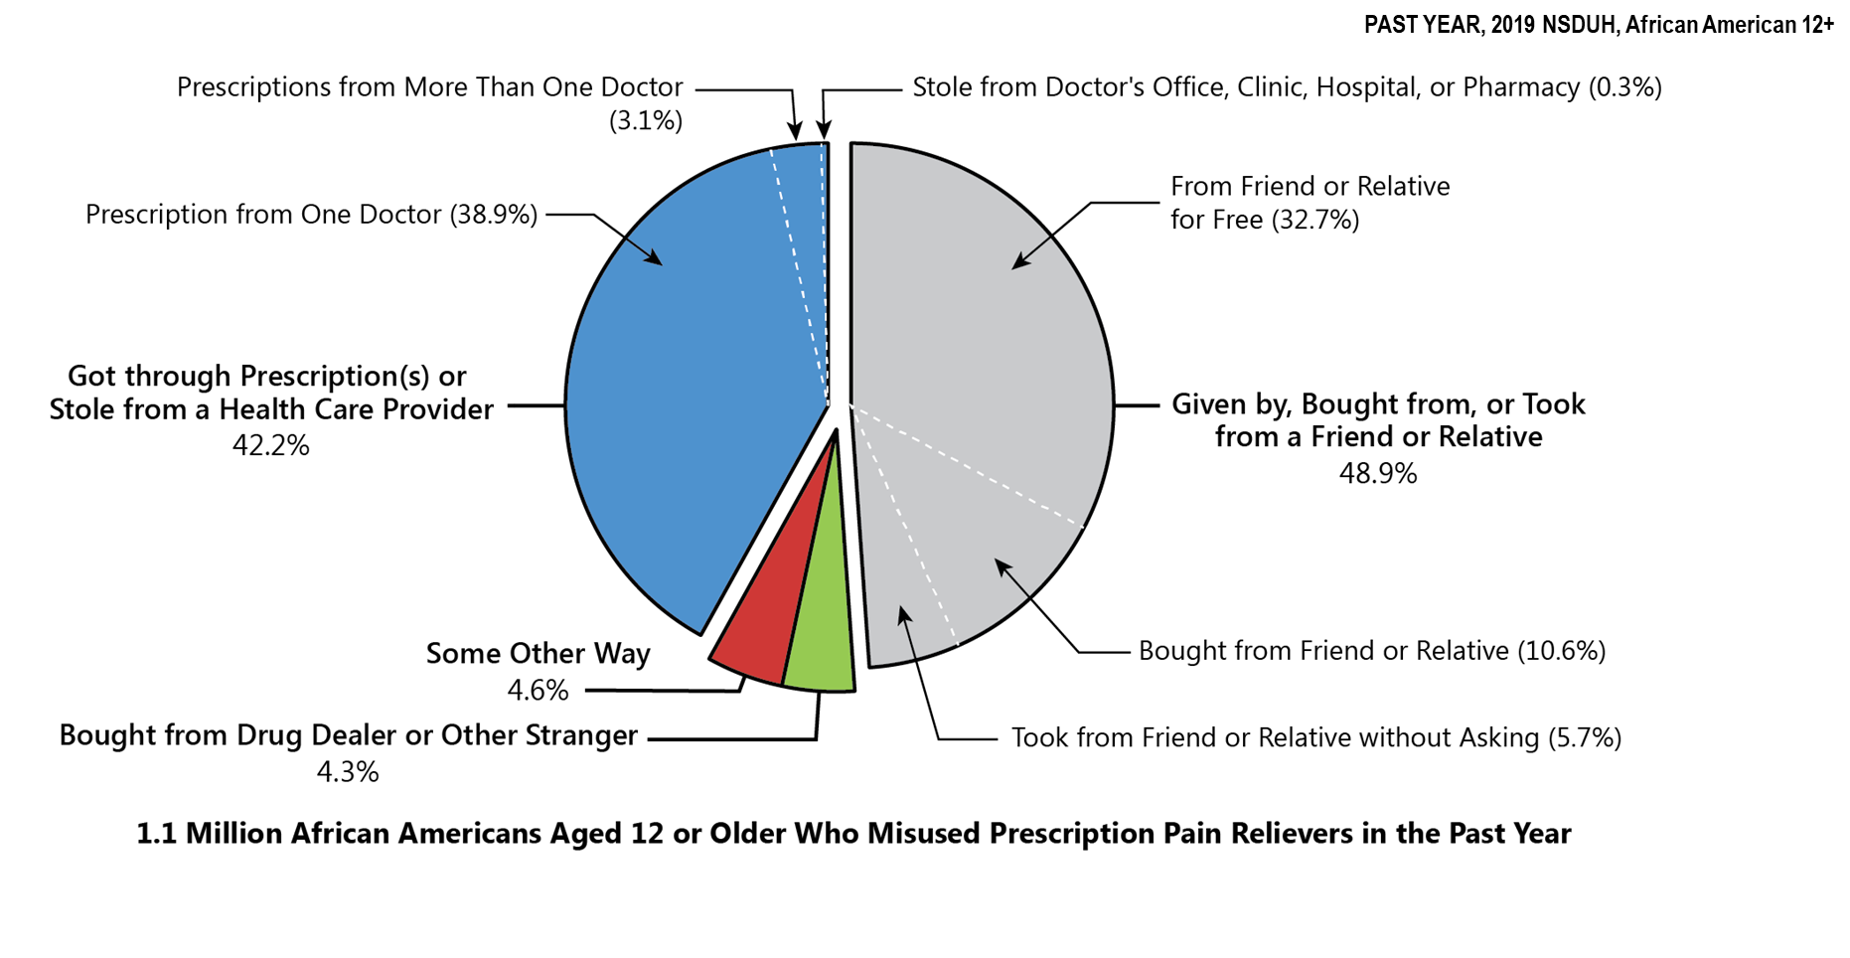
Sources Where Pain Relievers Were Obtained for Most Recent Misuse among African Americans Who Misused Prescription Pain Relievers

Slide 14
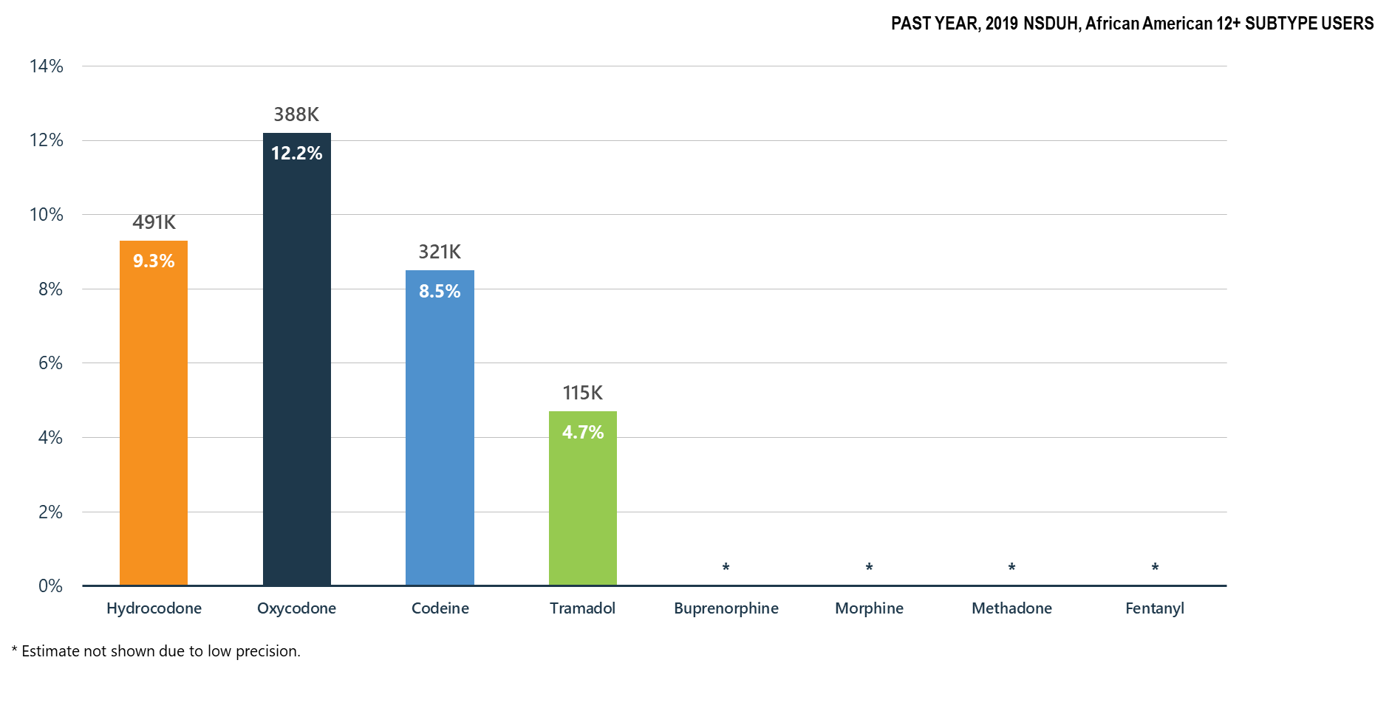
Misuse of Prescription Opioid Subtypes among African Americans

Slide 15
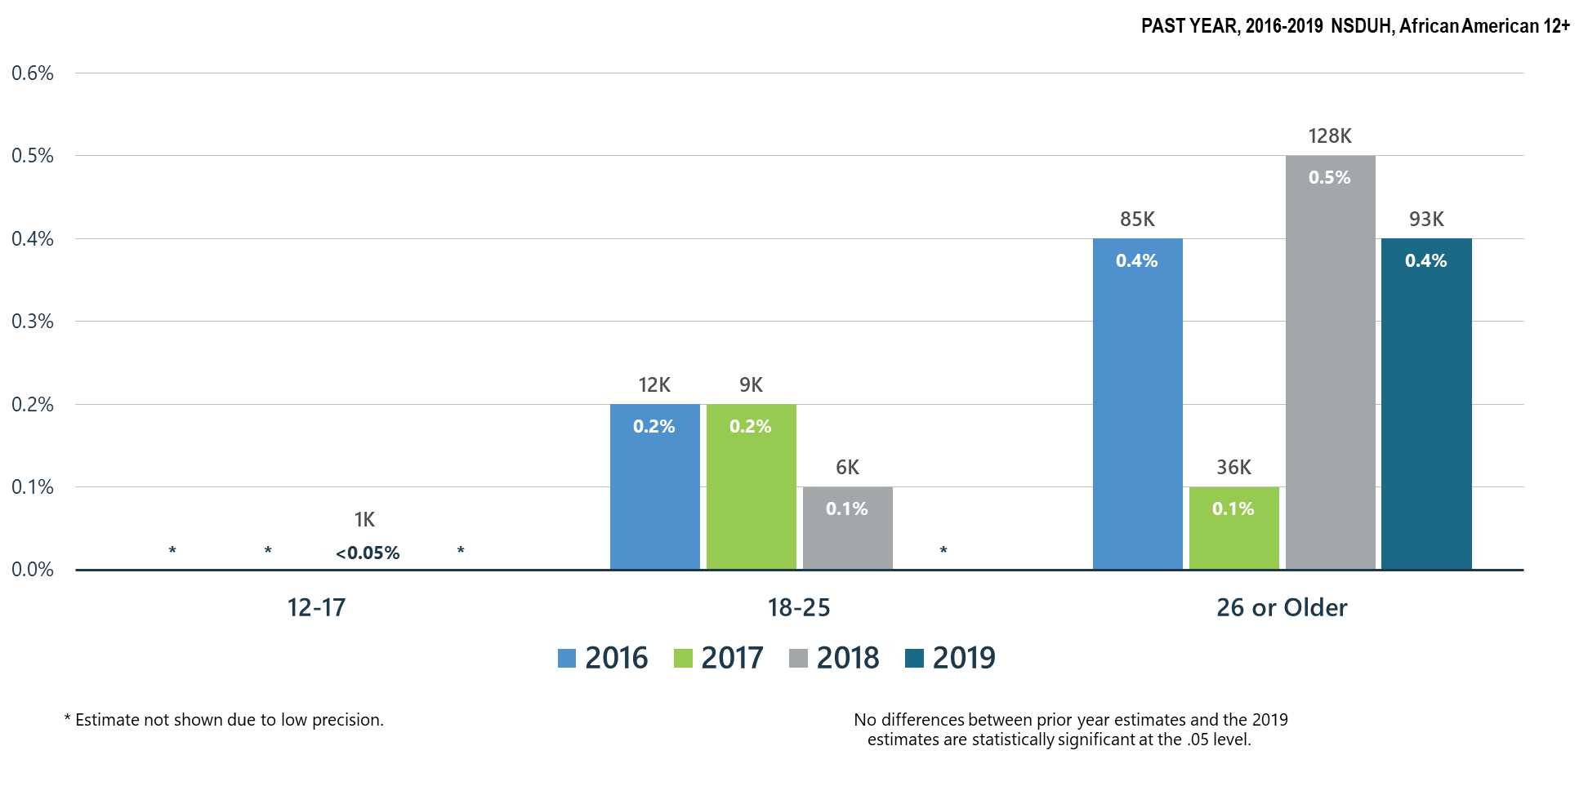
Heroin Use among African Americans

Slide 16
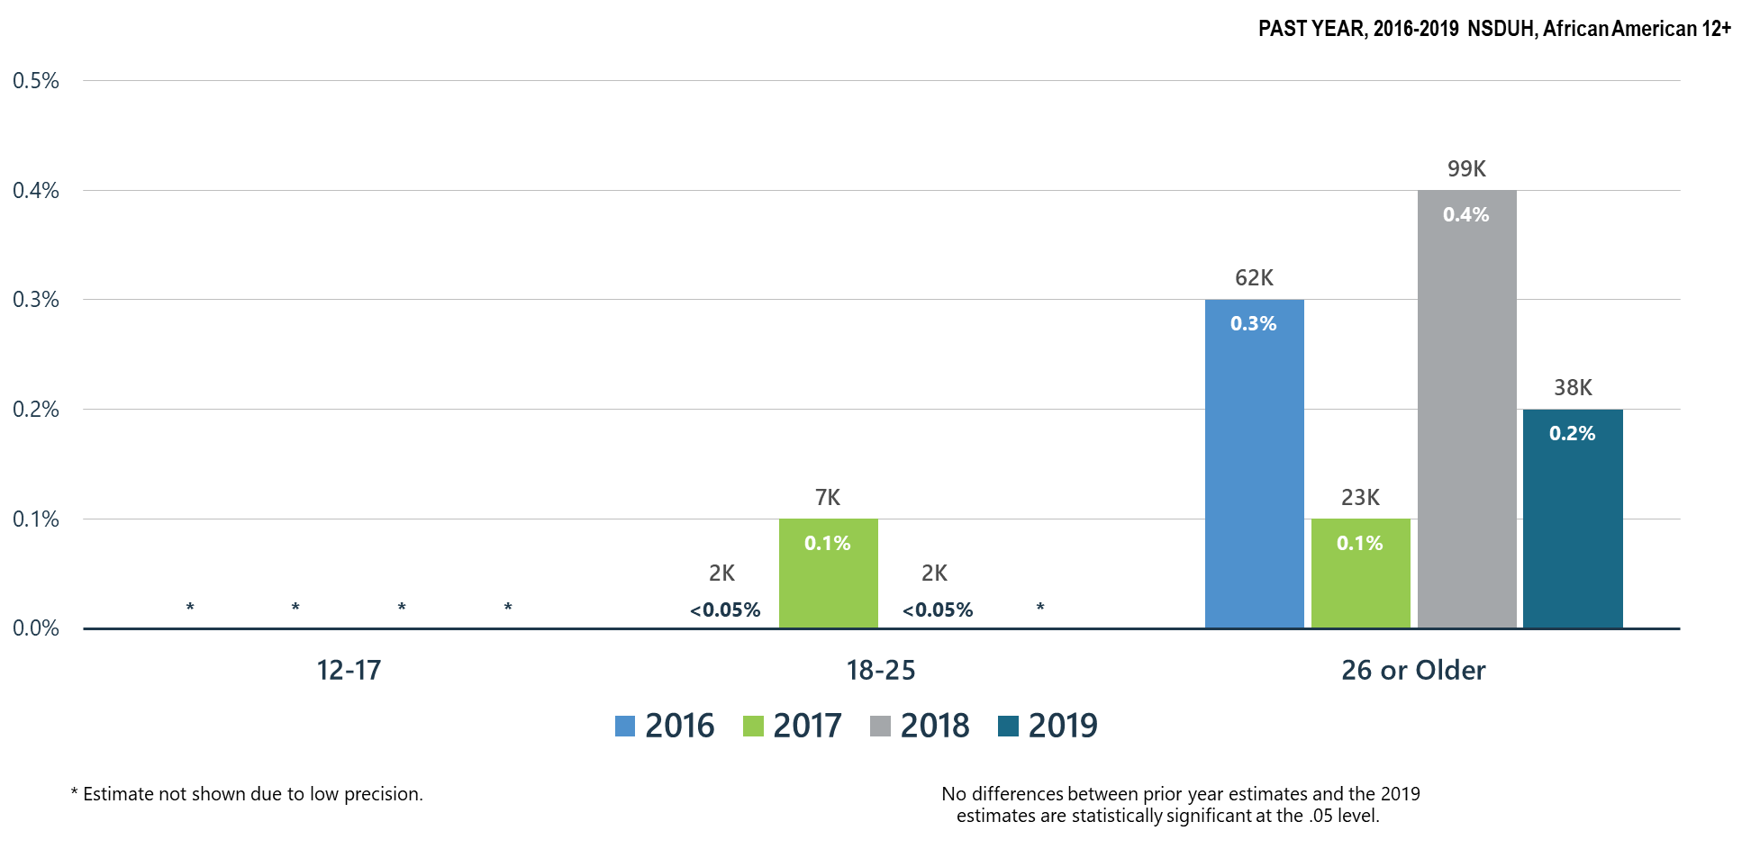
Heroin-Related Opioid Use Disorder among African Americans

Slide 17
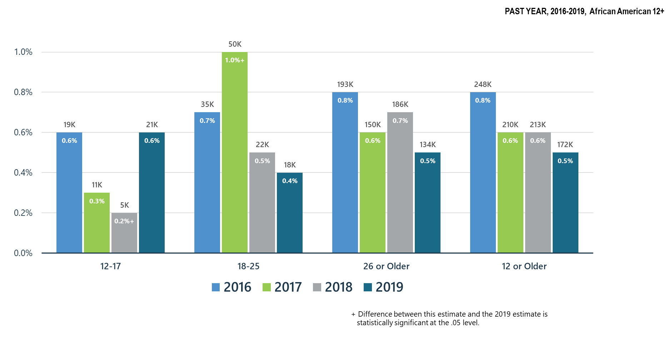
Opioid Use Disorder among African Americans

Slide 18
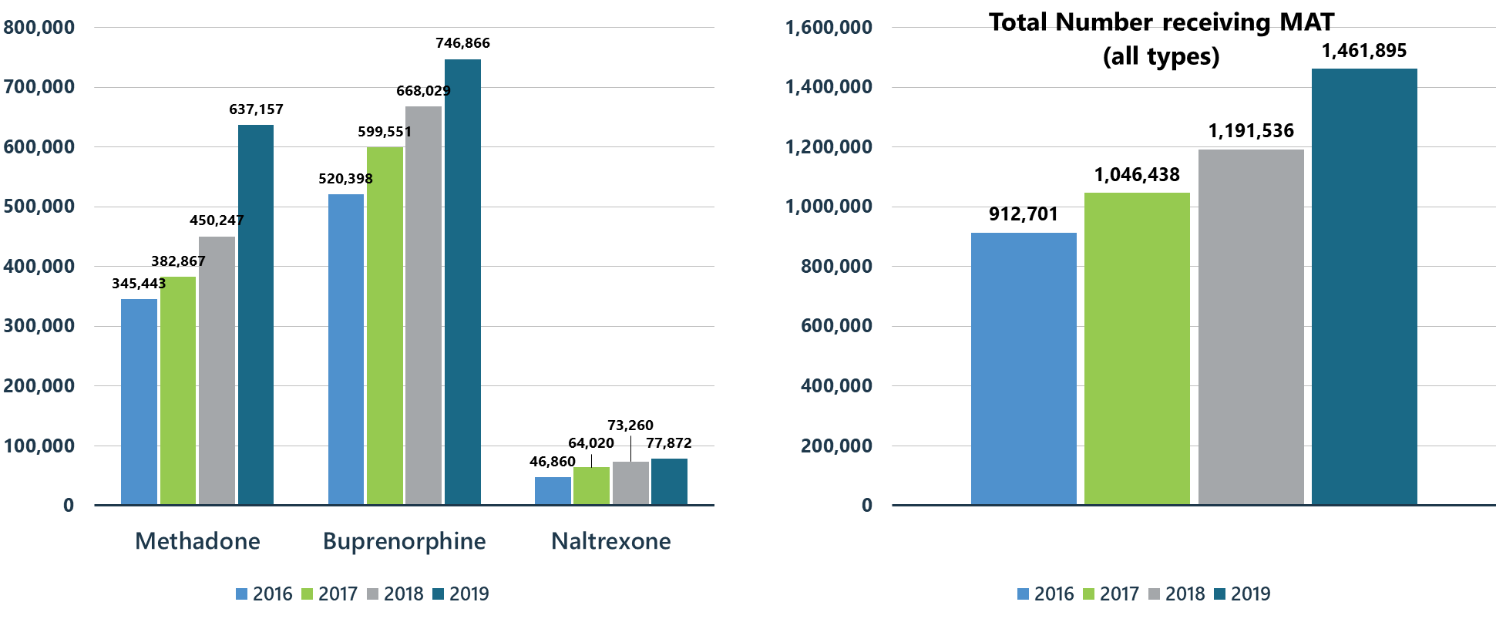
Treatment Gains: Number of Individuals Receiving Pharmacotherapy for Opioid Use Disorder (MAT)

Slide 19
Summary: Opioid Misuse in the United States in 2019
Opioid misuse continues to decrease in African Americans across all age groups. There are significant decreases for ages 12-17 and 18-25 since 2016.
Prescription pain reliever misuse significantly decreased in African Americans ages 12-25 since 2017 and remains stable in ages 26 and older.
Heroin-related opioid use disorder slightly decreased for African Americans ages 26 and older.
Despite much progress, opioid use disorder significantly increased in African Americans ages 12-17.

Slide 20
Other Illicit Substances

Slide 21
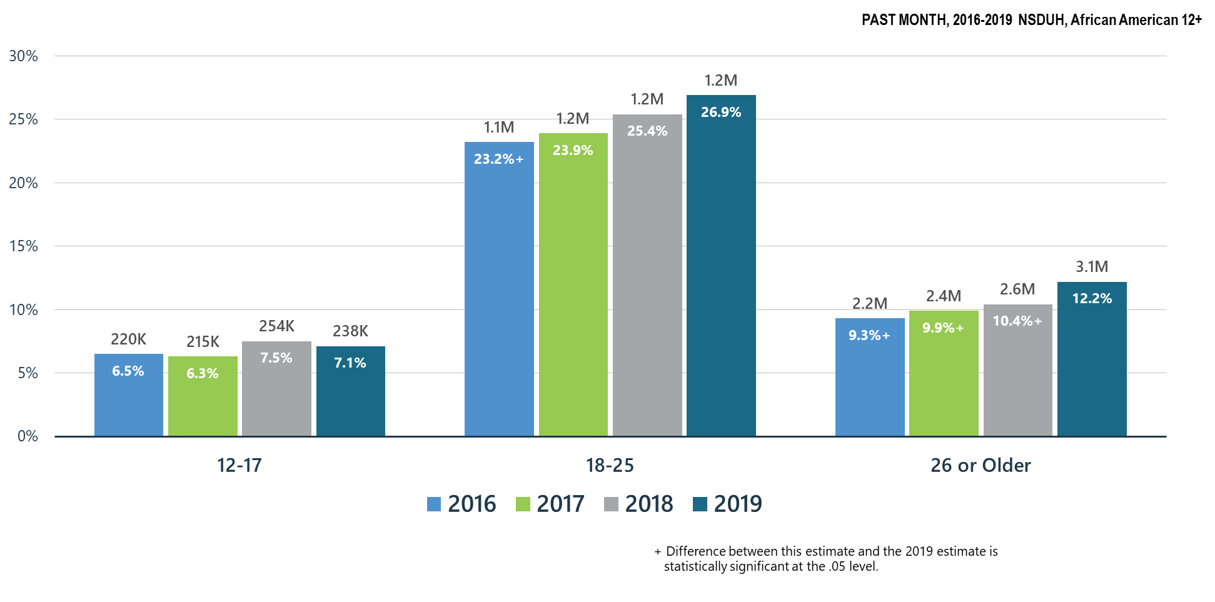
Past Month Marijuana Use for All Age Groups among African Americans

Slide 22
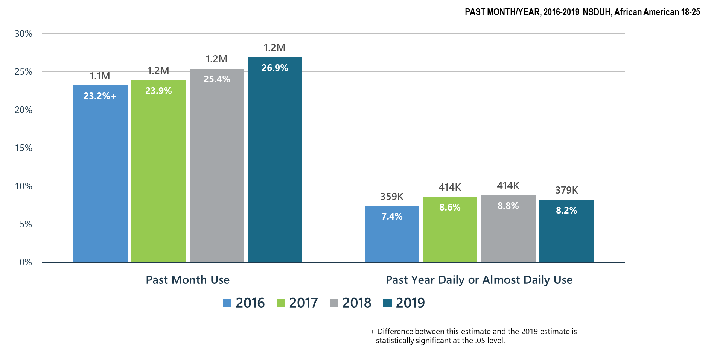
Marijuana Use among African American Young Adults (18-25 y.o.)

Slide 23
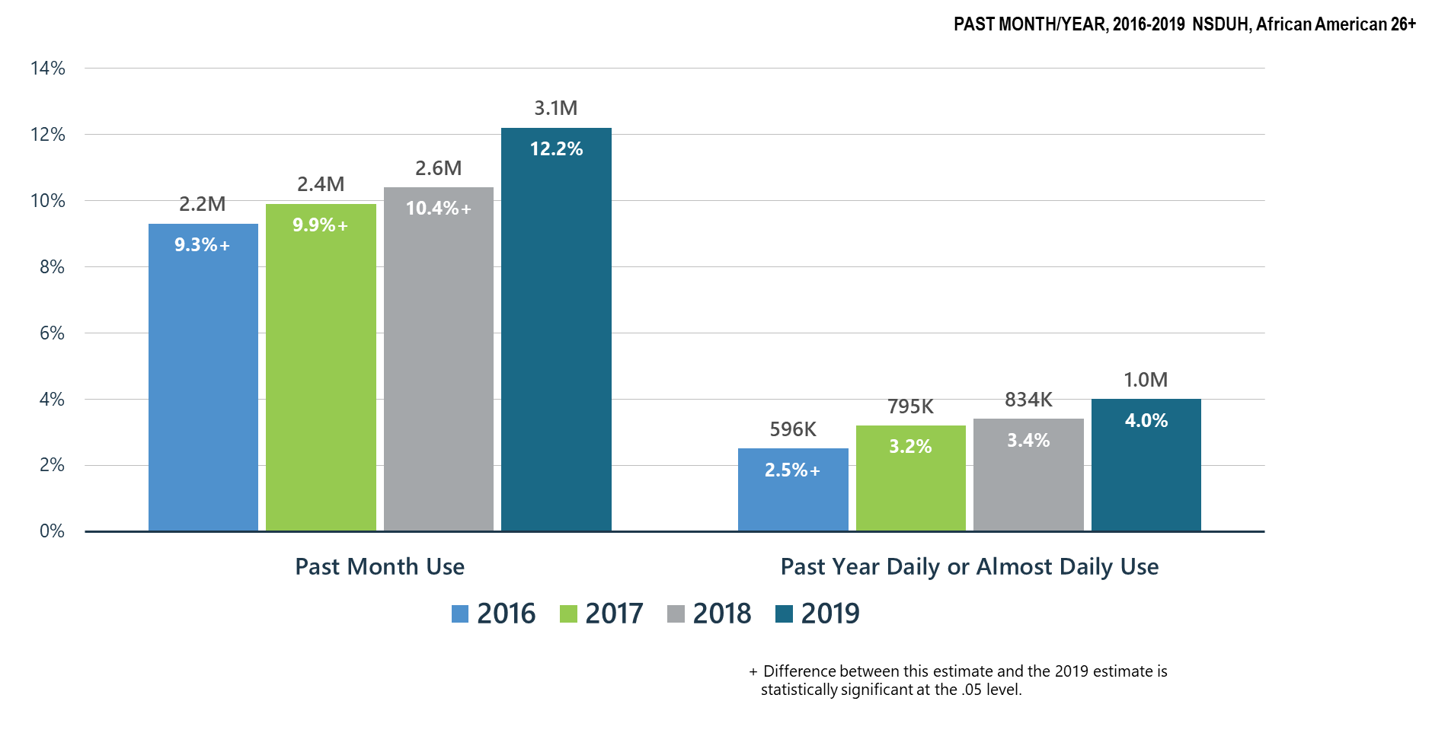
Significant Increase in Marijuana Use among African American Adults 26+

Slide 24
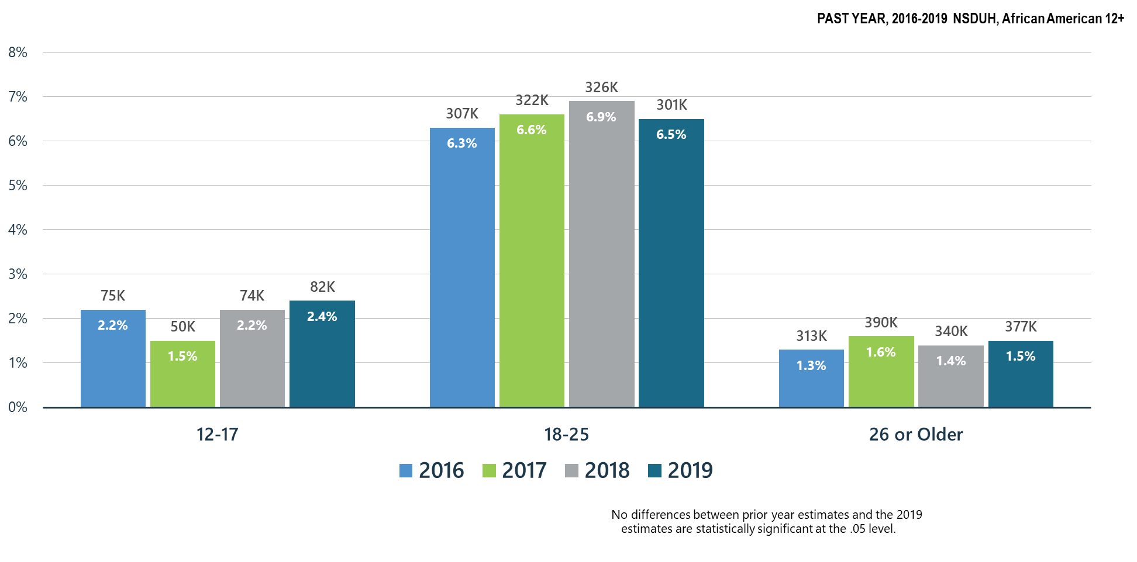
Marijuana Use Disorder among African Americans

Slide 25
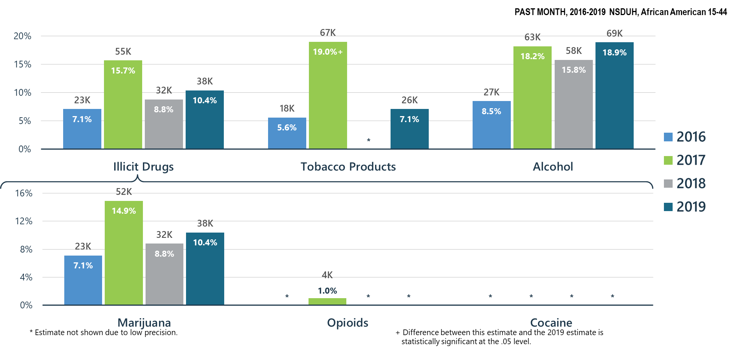
Past Month Substance Use among African American Pregnant Women

Slide 26
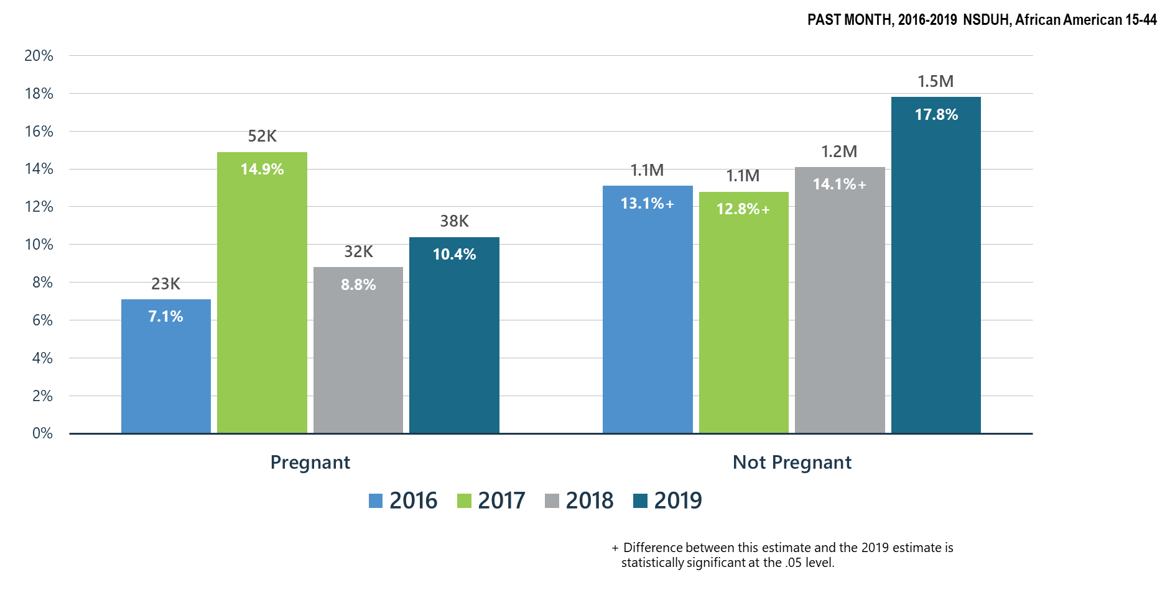
Marijuana Use among African American Women by Pregnancy Status

Slide 27
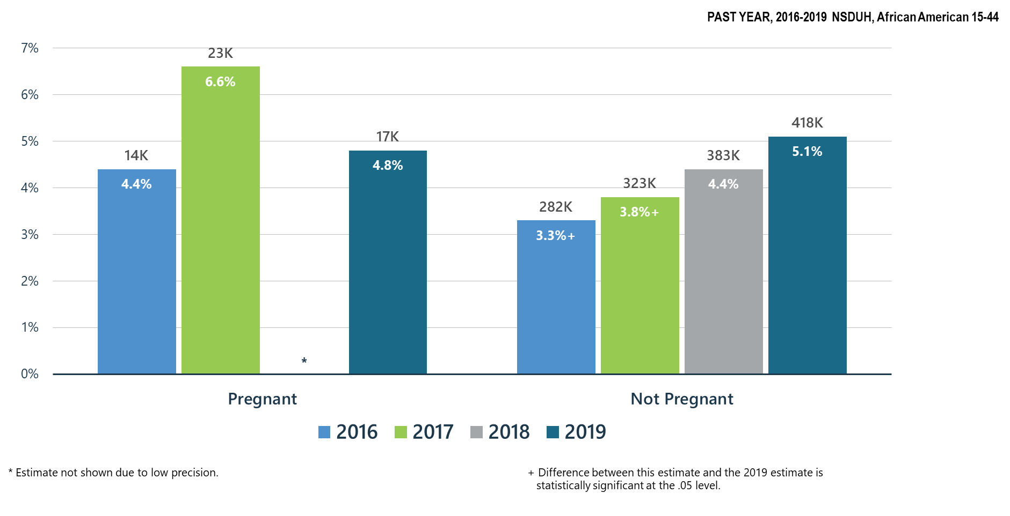
Daily or Almost Daily Marijuana Use among African American Women by Pregnancy Status

Slide 28
Marijuana Use: Health Concerns
There were significant increases in past month marijuana use and daily/almost daily marijuana use for African Americans ages 26 and older compared to 2016.
Past month substance use for illicit drugs, tobacco products, alcohol, and marijuana in pregnant women have all slightly increased since 2018.
Daily or almost daily marijuana use among African American women has slightly increased in pregnant women, and significantly increased since 2017 in women aged 15-44 that are not pregnant.

Slide 29
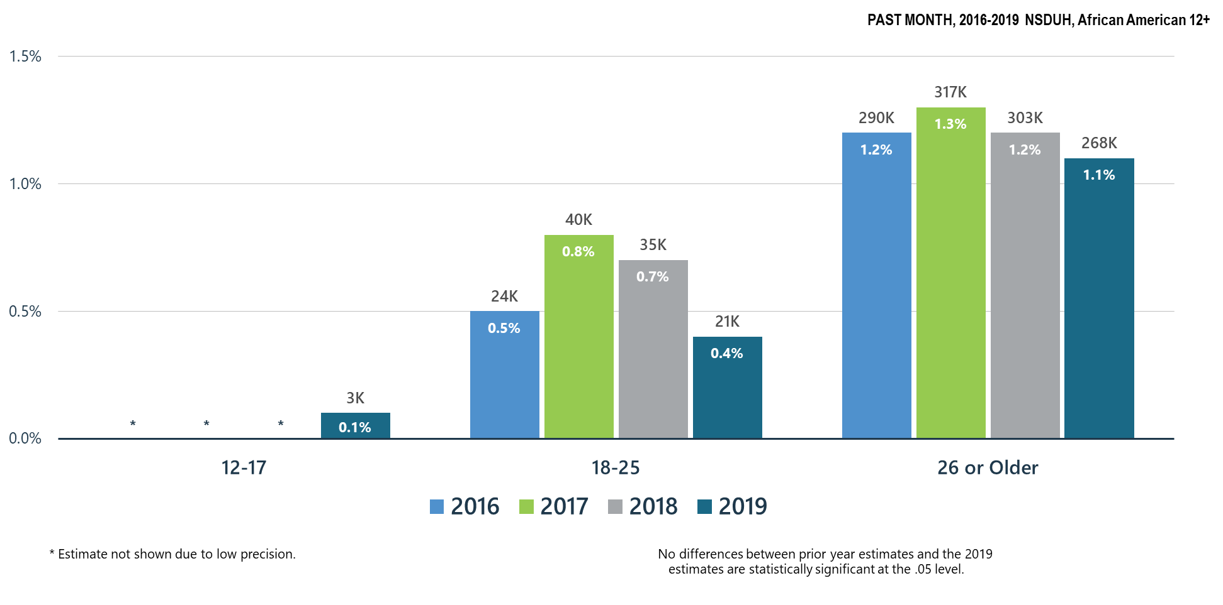
Cocaine Use among African Americans

Slide 30
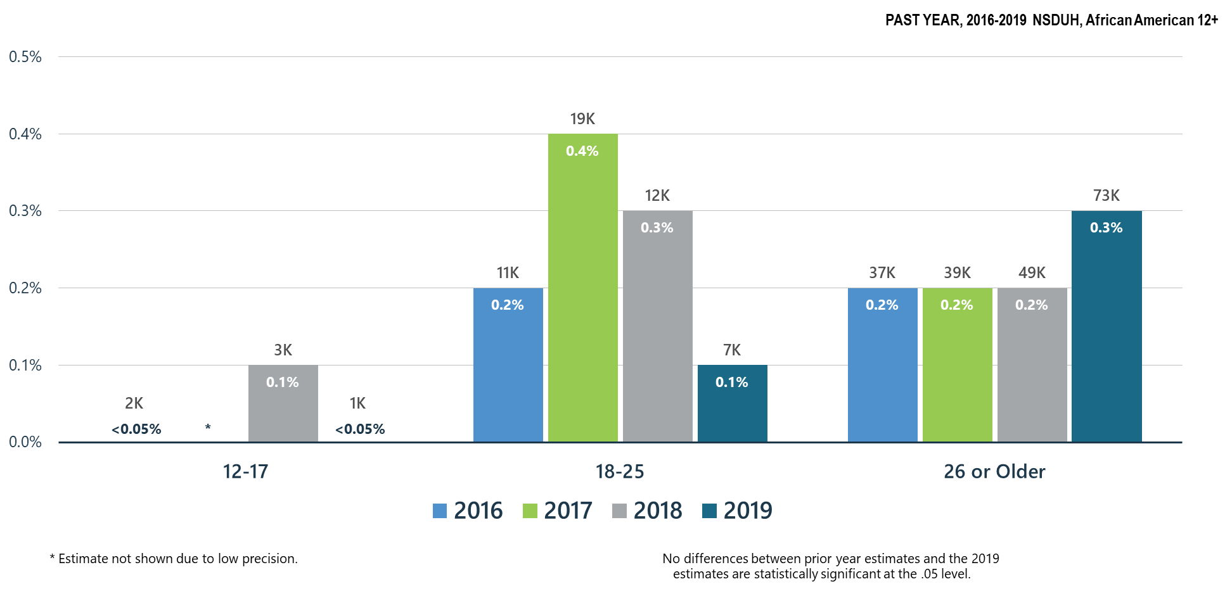
Methamphetamine Use among African Americans

Slide 31
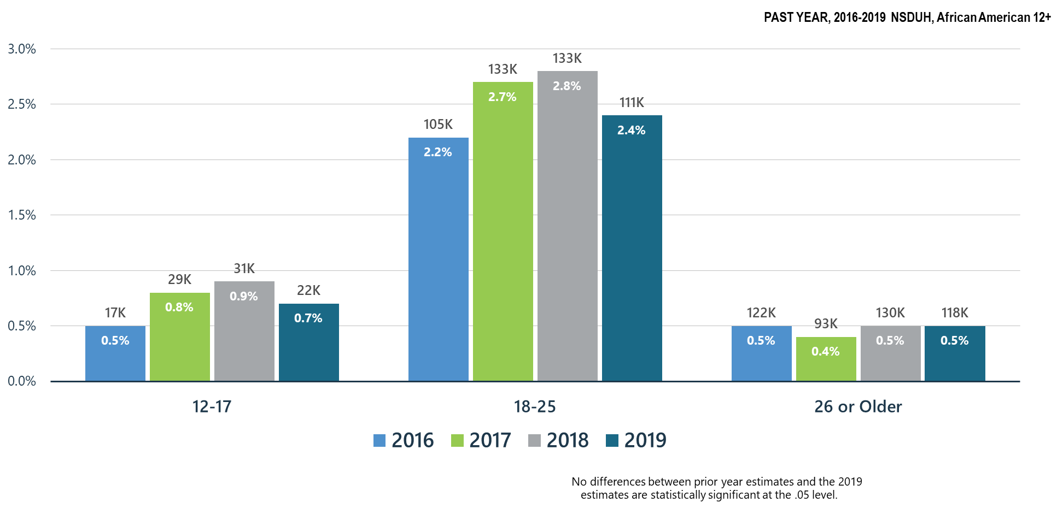
Misuse of Prescription Stimulants among African Americans

Slide 32
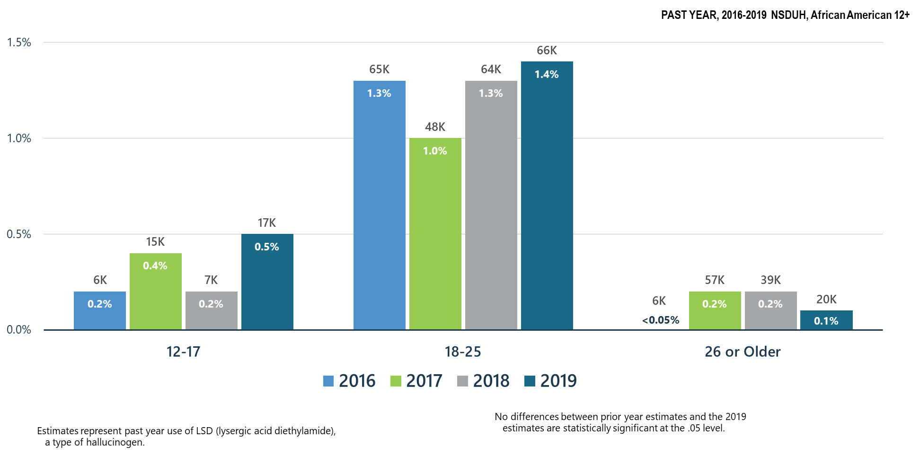
LSD Use among African Americans for All Age Groups

Slide 33
Summary: Other Substance Use in the United States in 2019 Compared to 2018
There were no significant changes in cocaine and methamphetamine use across all ages in the African American population.
Misuse of prescription simulants in African Americans has slightly decreased in ages 12-17 and 18-25 and remained stable for ages 26 and older.
LSD use for African Americans ages 12-17 and 18-25 has slightly increased.

Slide 34
Polysubstance Use and Mental Illness

Slide 35
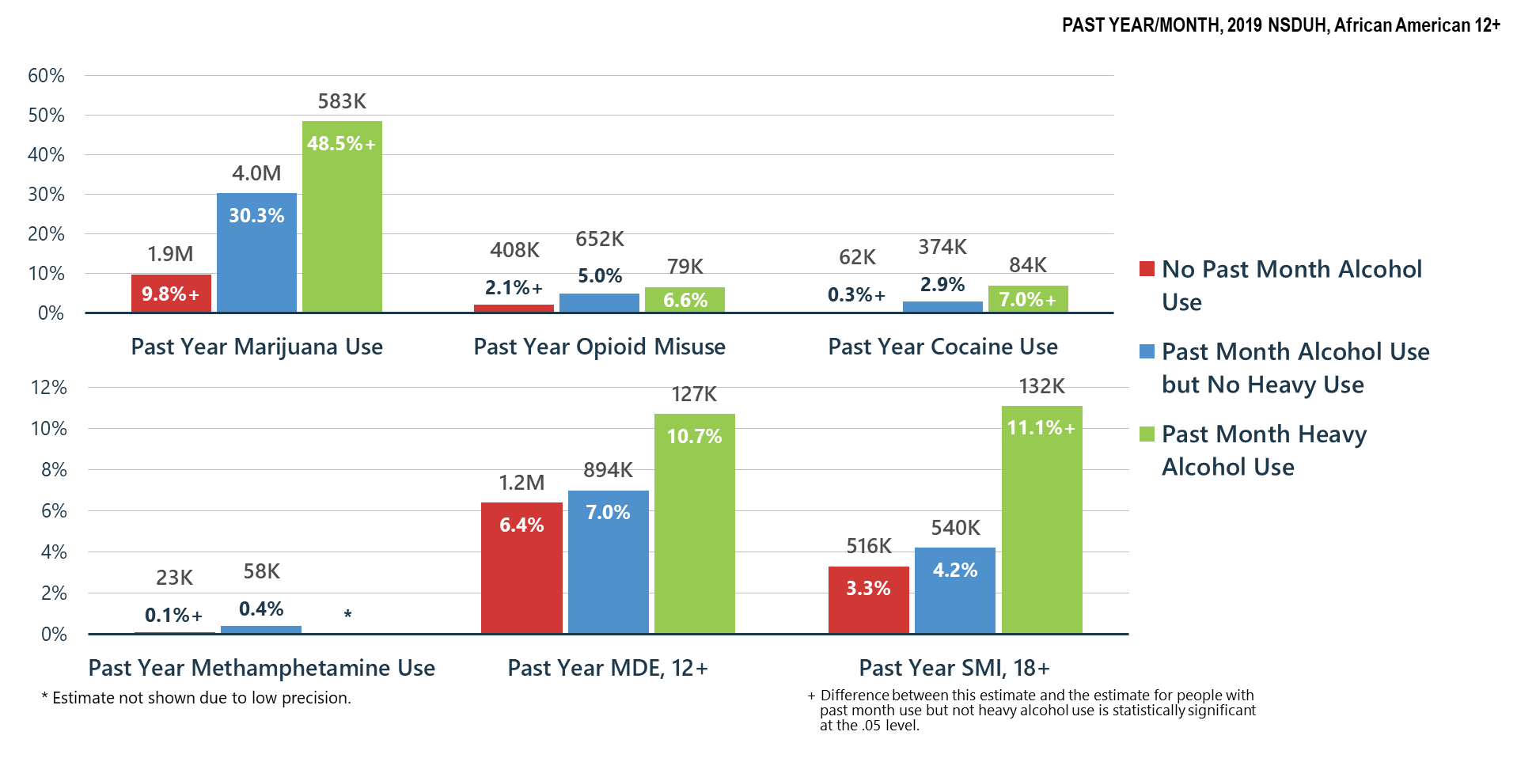
Alcohol Use Related to Other Substance Use, MDE and SMI among African Americans

Slide 36
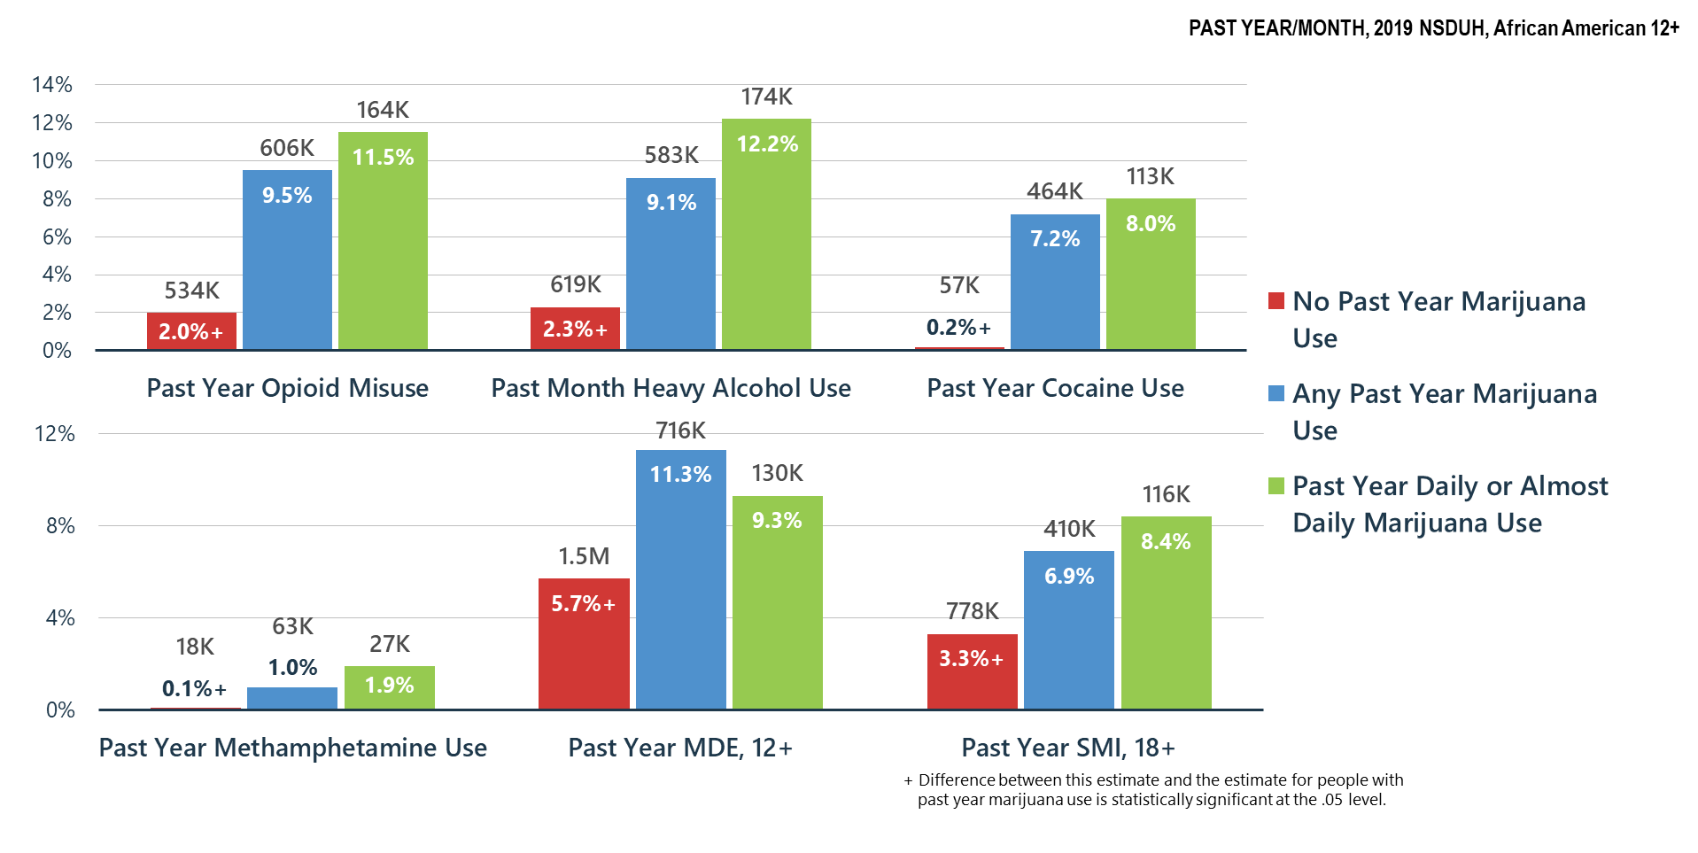
Marijuana Use Related to Other Substance Use, MDE and SMI among African Americans

Slide 37
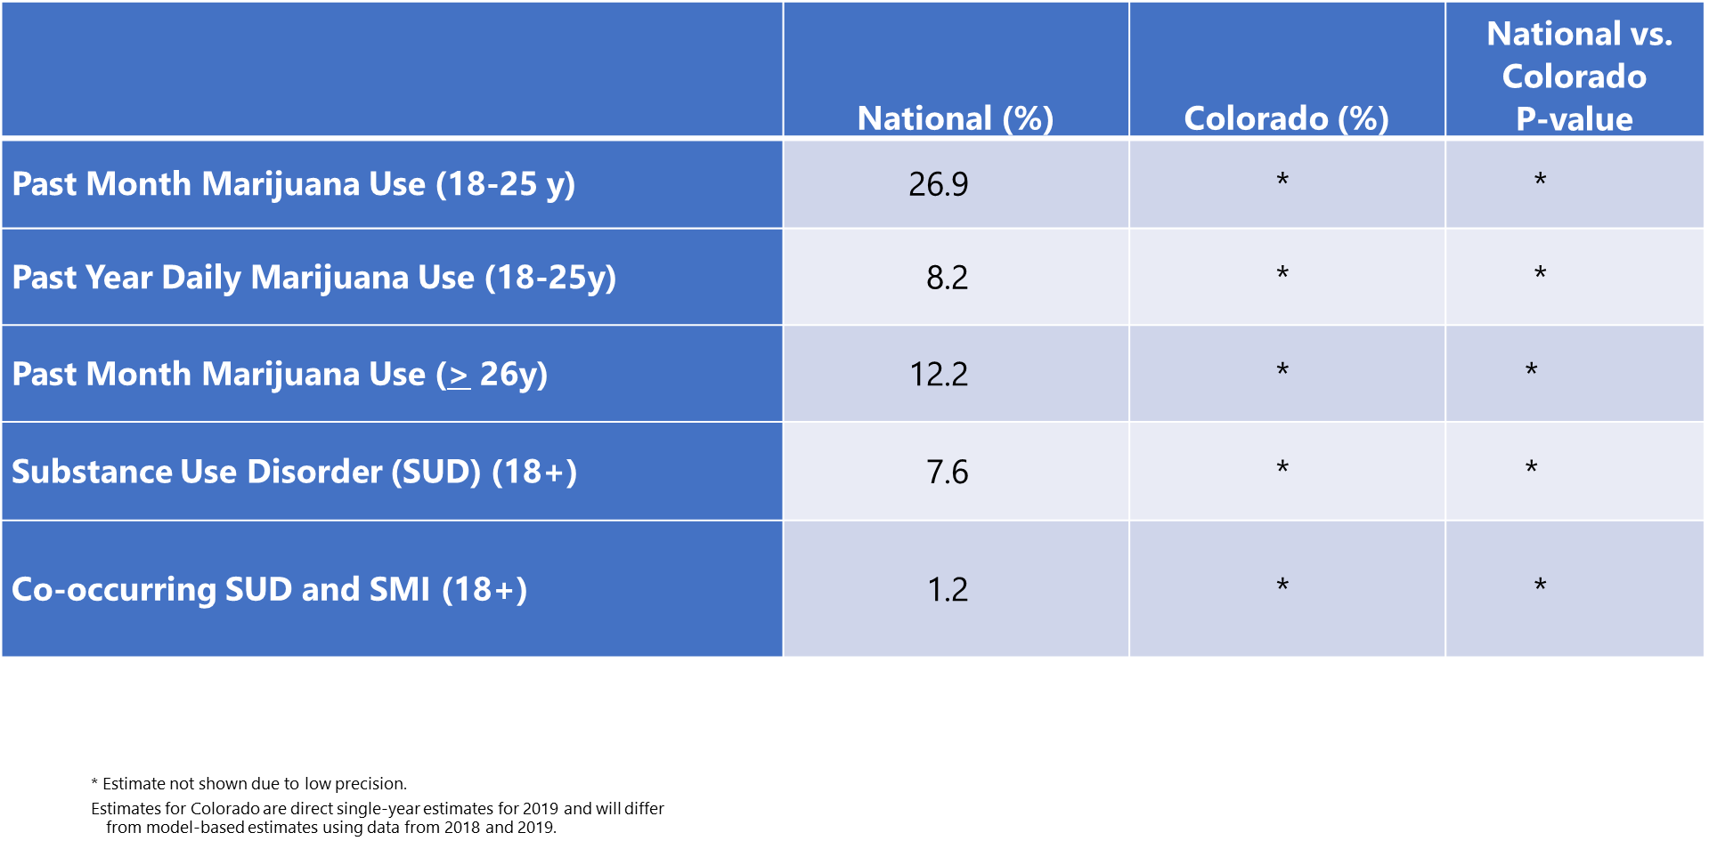
Comparison of Rates of Mental/Substance Use Disorders Associated with Marijuana Use among African Americans: National vs. Colorado Data from the National Survey on Drug Use and Health (2019)

Slide 38
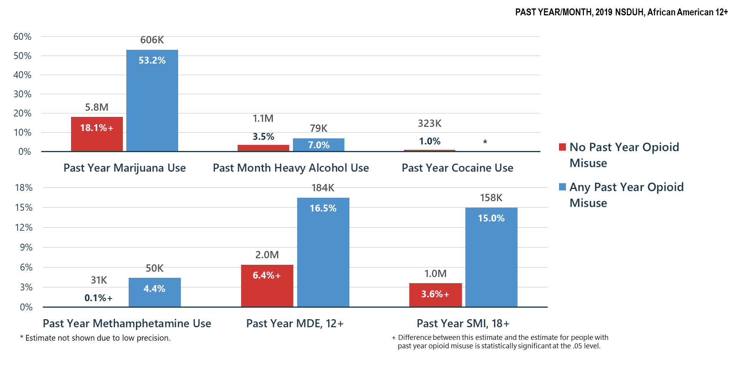
Opioid Misuse Related to Other Substance Use, MDE and SMI among African Americans

Slide 39
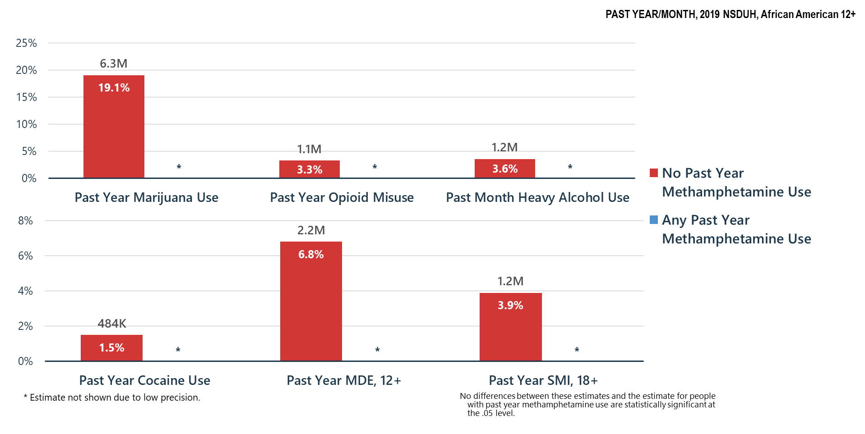
Methamphetamine Use Related to Other Substance Use, MDE and SMI among African Americans

Slide 40
Summary
Polysubstance use is common—if a person is having problems with one substance, they are likely using and may be having problems with other substances
Treatment providers must screen for and treat all substance use disorders and problem substance use
Association of substance misuse and mental illness is clear—we must all do a better job of helping Americans understand these relationships and risks

Slide 41
Mental Health

Slide 42
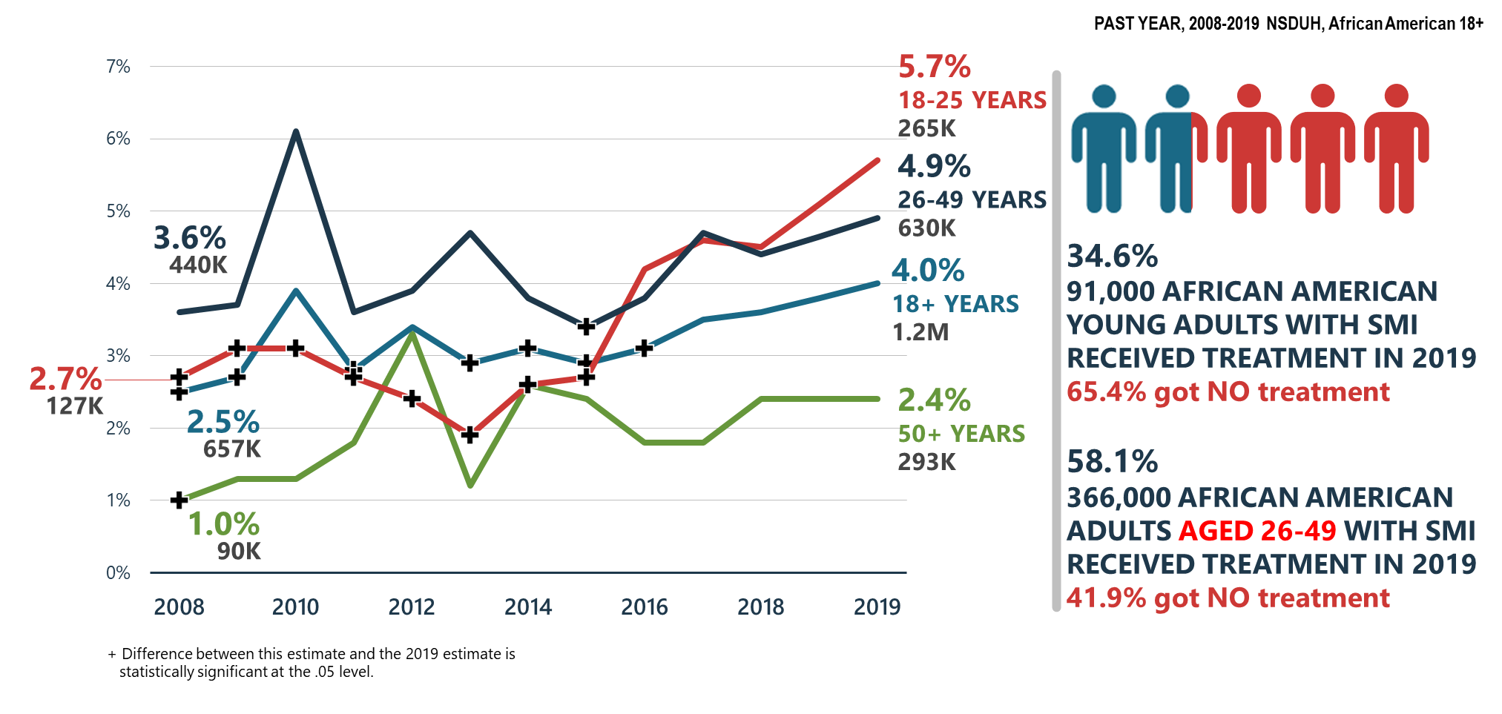
Serious Mental Illness (SMI) among African Americans

Slide 43
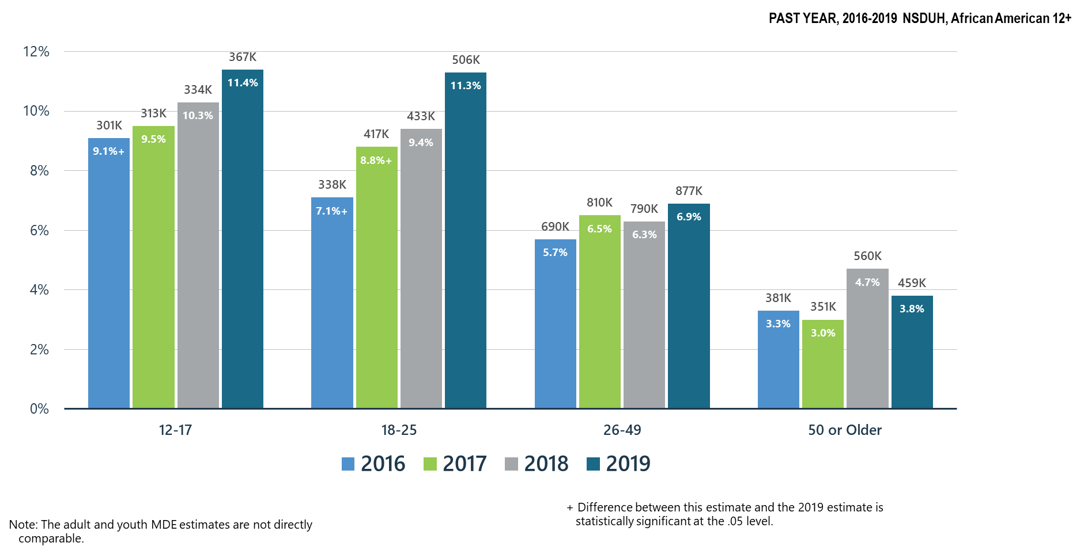
Major Depressive Episodes among African Americans

Slide 44
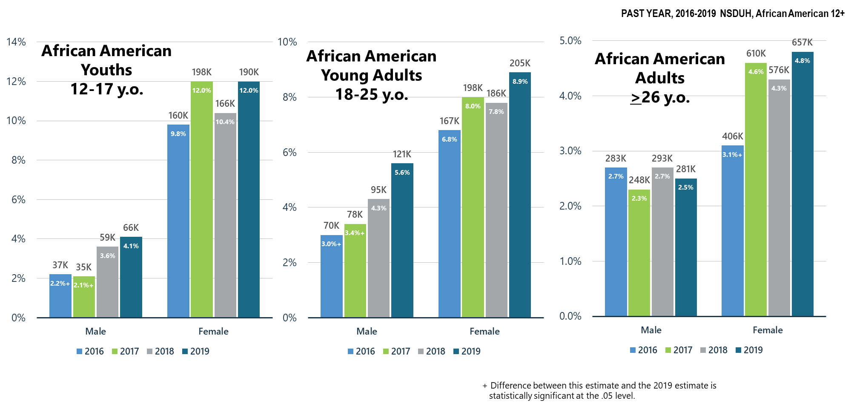
Major Depressive Episodes with Severe Impairment among African Americans

Slide 45
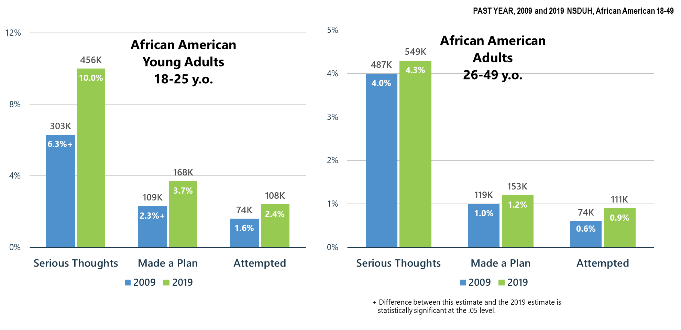
Suicidal Thoughts and Plans, and Attempts for African American Young Adults (18-25 y.o.) and African American Adults (26-49 y.o.)

Slide 46
Co-Occurring
Mental and Substance Use Disorders

Slide 47
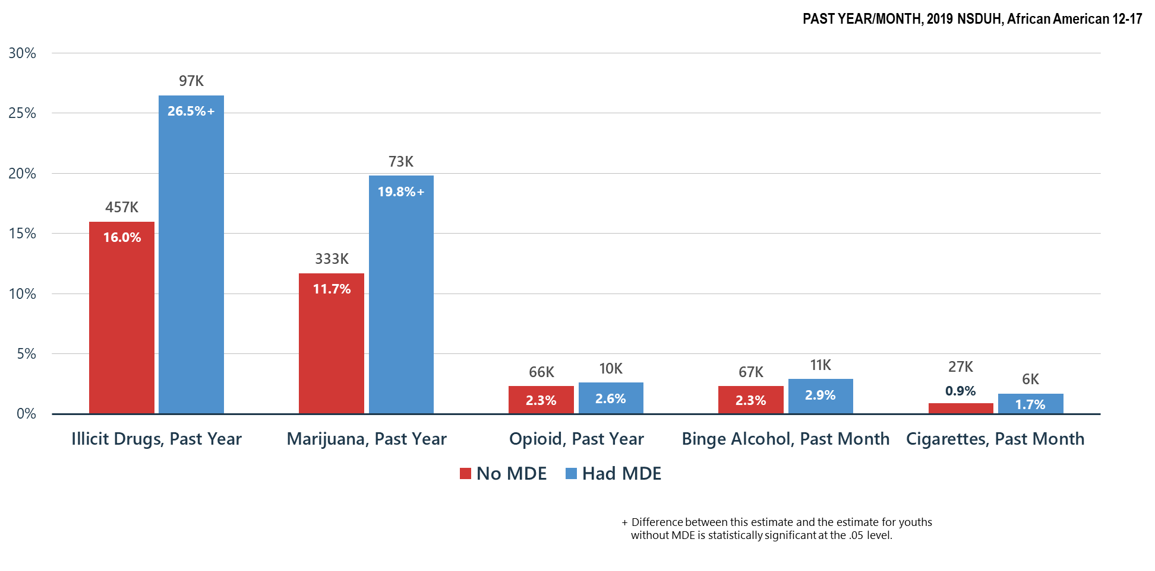
Substance Use among African American Youths (12-17 y.o.) by Past Year Major Depressive Episode (MDE) status

Slide 48
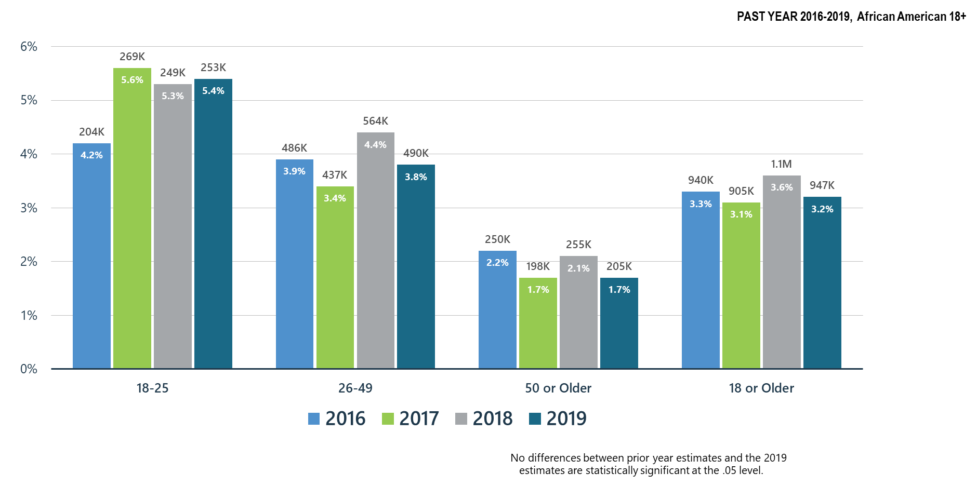
Co-Occurring Substance Use Disorder and Any Mental Illness in African American Adults

Slide 49
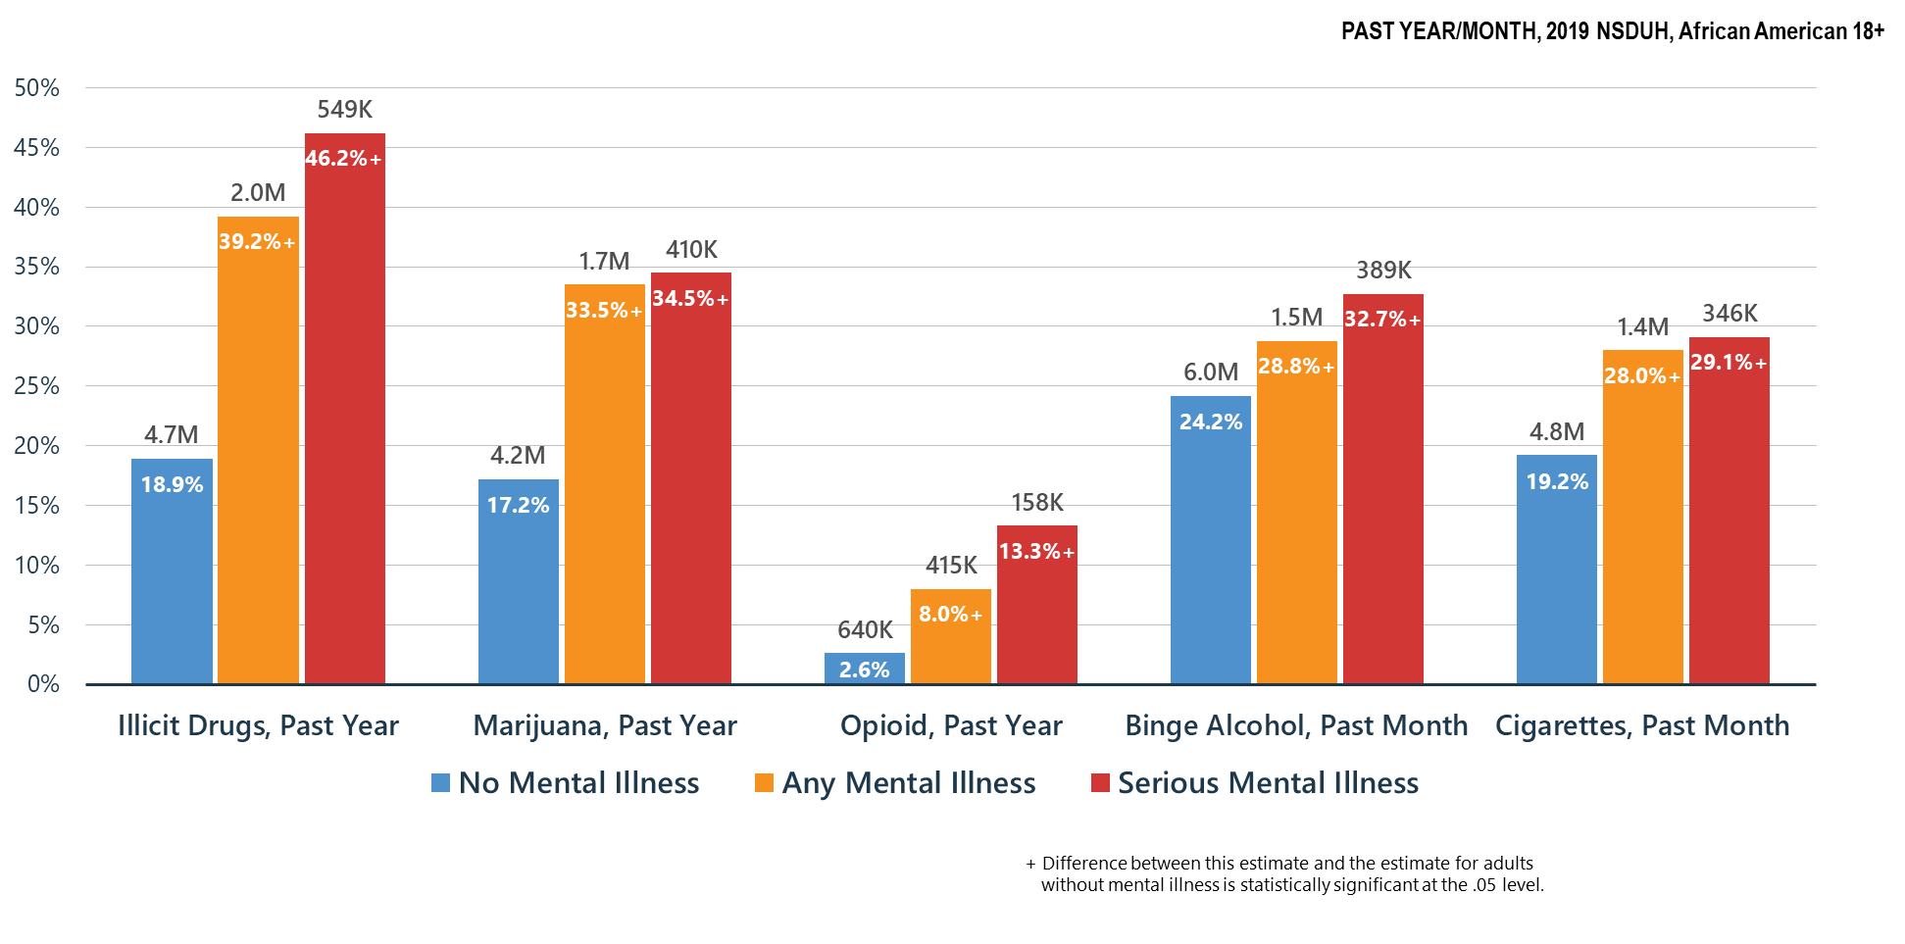
Co-Occurring Issues: Substance Use and Mental Illness among African American Adults

Slide 50
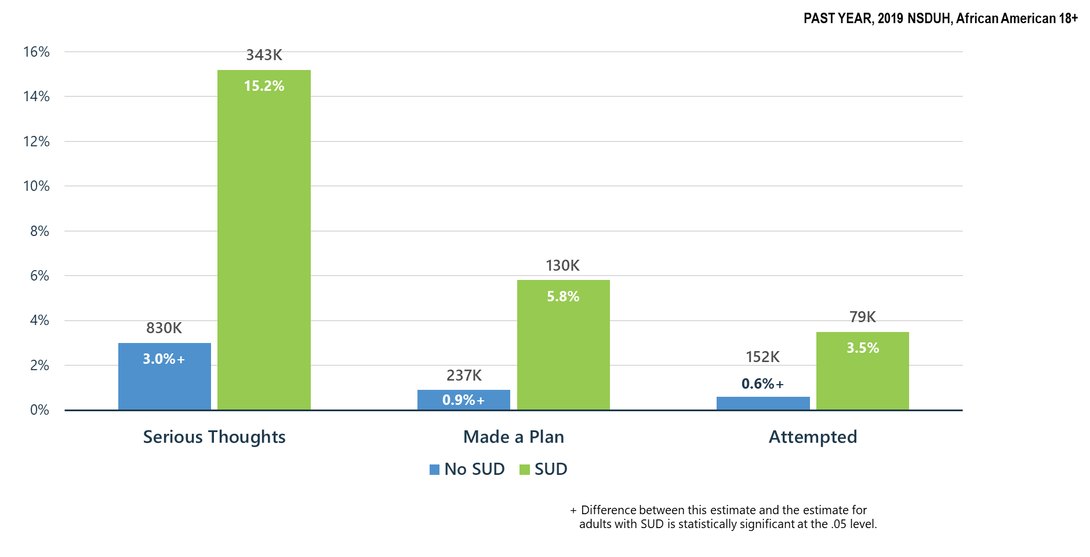
Substance Use Disorder (SUD) is Associated with Suicidal Thoughts, Plans, and Attempts among African American Adults >18 y.o.

Slide 51
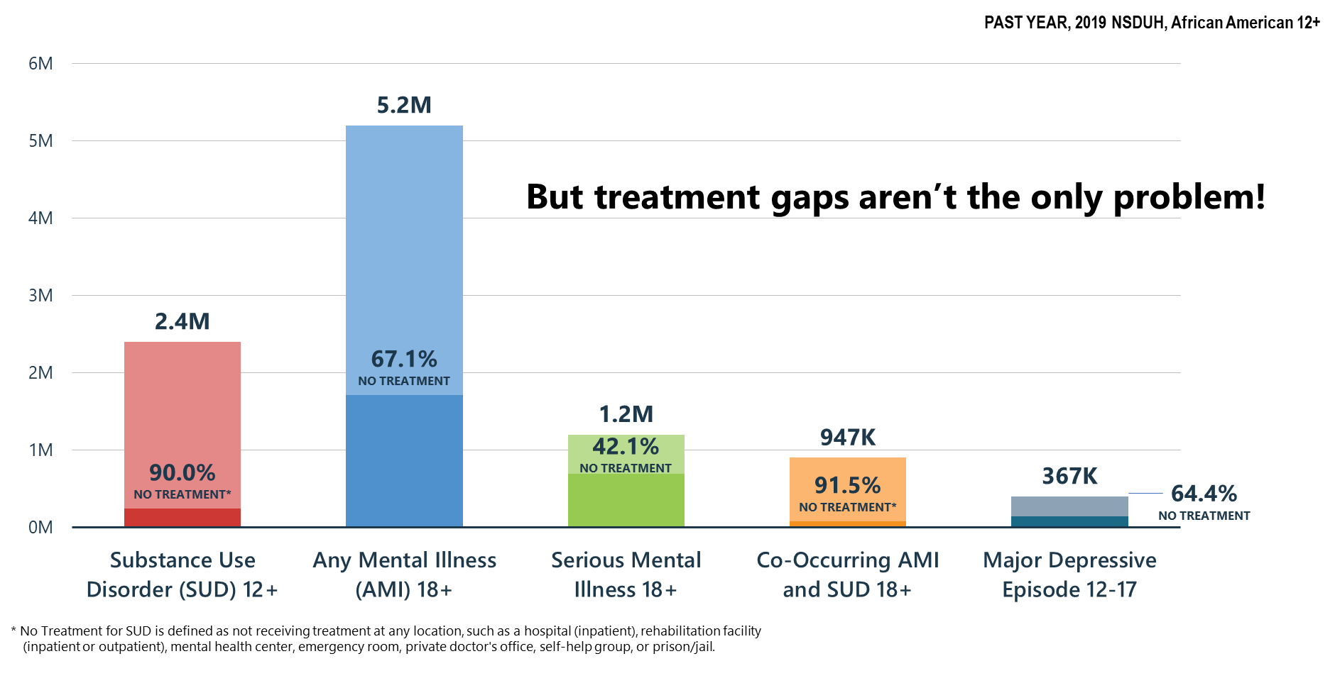
Mental and Substance Use Disorders among African Americans: High Prevalence/Huge Treatment Gaps

Slide 52
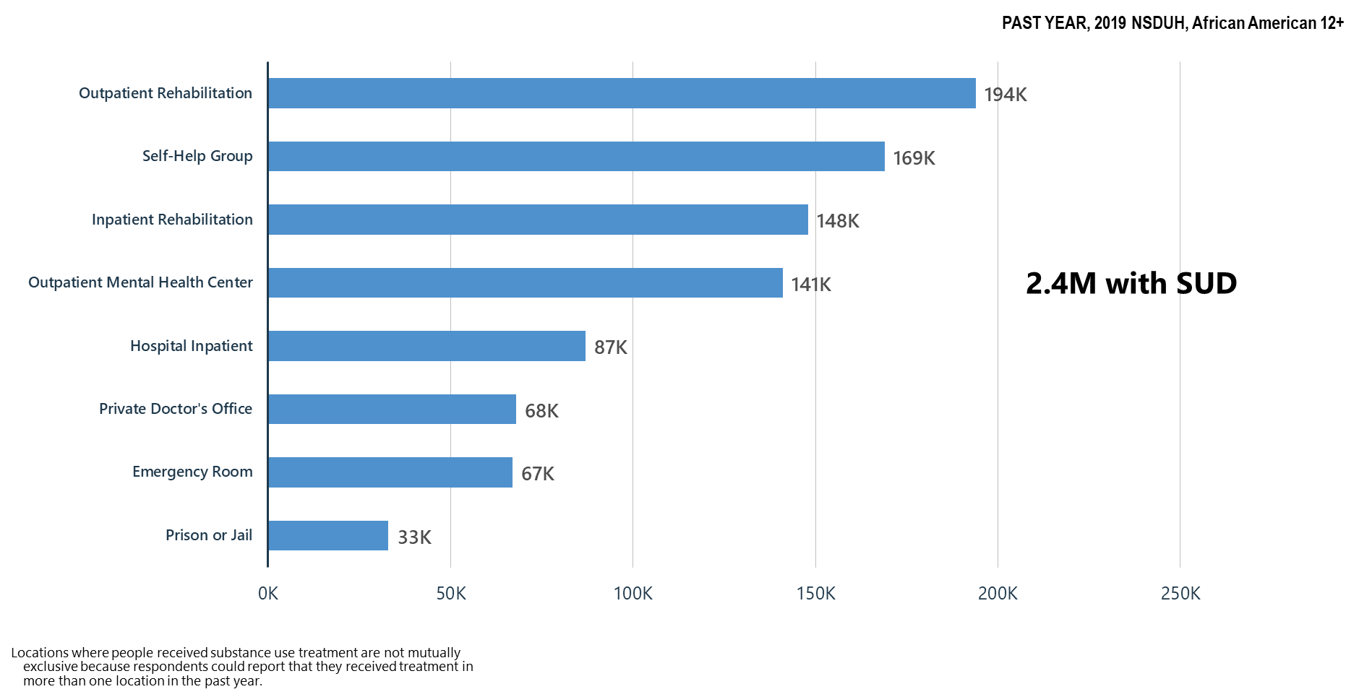
Locations Where Substance Use Treatment was Received among African Americans

Slide 53
Summary: Mental Health/Co-Occurring Issues in the United States in 2019
Suicidal thoughts, plans, and attempts were significantly increased for African Americans with substance use disorders.
Treatment gaps remain for African Americans with mental and substance use disorders.
Outpatient rehabilitation centers are the main location where substance use treatment was received.

Slide 54
What Can We Do Now?
SAMHSA must use its resources to benefit as many as possible:
Community based treatment and recovery services
Build on the Certified Community Behavioral Health Clinic model
  Crisis intervention services/suicide prevention resources
  Integrated mental health, substance use, general medical services
  Children’s mental health services-linkages with schools
Keep telemedicine/telehealth in place including use of telephone where audio/visual is not possible and pay for these services at same rate as face-to-face—no reduction in reimbursement because it is telemedicine
Continue and expand as possible technical assistance and training to behavioral health providers—clinicians and peers

Slide 55
It’s Up to Us Now
Let’s work as hard as we can to make decision-makers understand mental health and substance use needs in America—pre and post-COVID-19
Let’s keep the virus in mind in planning and implementing our services so that we can safely deliver care, but we cannot ignore the overall health needs of the American people—that is not an option
Let’s work to meet the mental health/substance use needs of our people:
  Restore our systems—mental health and substance use disorder services are ‘essential services’
  Expand our treatment and community recovery support systems permanently
  Every American life is precious and every American death—regardless of the cause is a terrible loss

