Slide 1
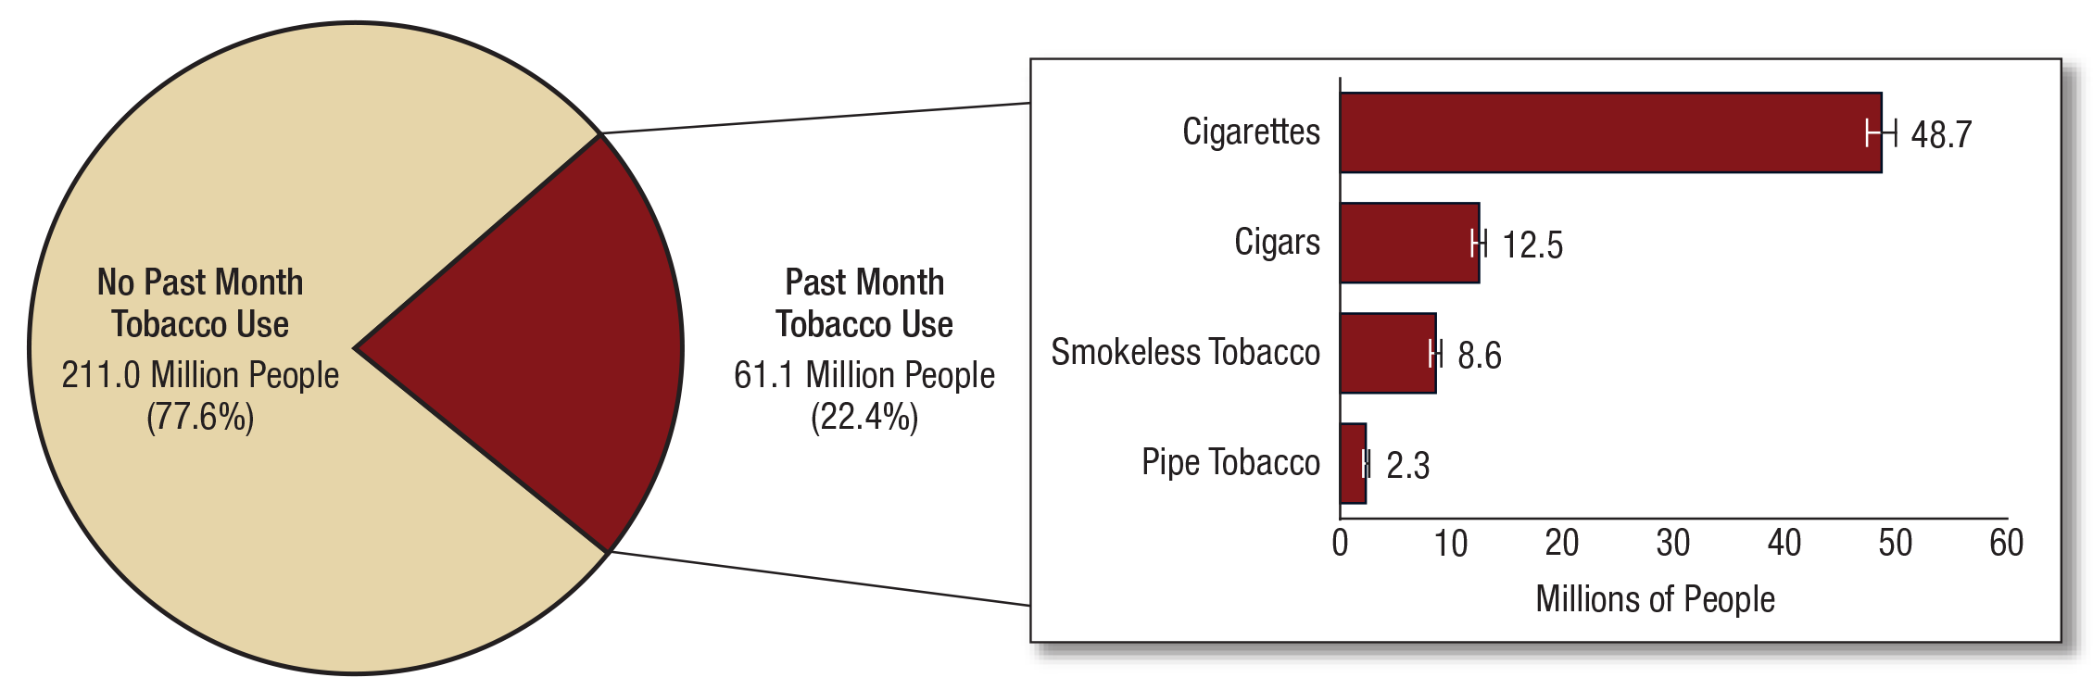
Numbers of Past Month Tobacco Users among People Aged 12 or Older: 2017
FFR1.01
Note: Estimated numbers of people refer to people aged 12 or older in the civilian, noninstitutionalized population in the United States. The numbers do not sum to the total population of the United States because the population for NSDUH does not include people aged 11 years or younger, people with no fixed household address (e.g., homeless or transient people not in shelters), active-duty military personnel, and residents of institutional group quarters, such as correctional facilities, nursing homes, mental institutions, and long-term care hospitals.
Note: The estimated numbers of current users of different tobacco products are not mutually exclusive because people could have used more than one type of tobacco product in the past month.

Slide 2
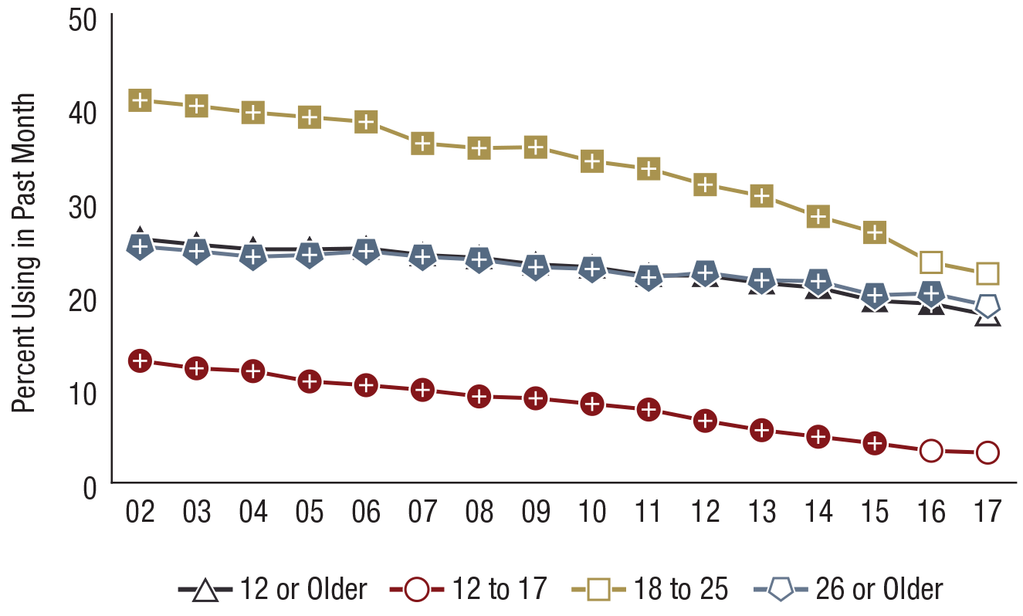
Past Month Cigarette Use among People Aged 12 or Older, by Age Group: Percentages, 2002-2017
FFR1.02
Age Group | 2002 | 2003 | 2004 | 2005 | 2006 | 2007 | 2008 | 2009 | 2010 | 2011 | 2012 | 2013 | 2014 | 2015 | 2016 | 2017
12 or Older | 26.0⁺ | 25.4⁺ | 24.9⁺ | 24.9⁺ | 25.0⁺ | 24.3⁺ | 24.0⁺ | 23.3⁺ | 23.0⁺ | 22.1⁺ | 22.1⁺ | 21.3⁺ | 20.8⁺ | 19.4⁺ | 19.1⁺ | 17.9
12 to 17 | 13.0⁺ | 12.2⁺ | 11.9⁺ | 10.8⁺ | 10.4⁺ | 9.9⁺ | 9.2⁺ | 9.0⁺ | 8.4⁺ | 7.8⁺ | 6.6⁺ | 5.6⁺ | 4.9⁺ | 4.2⁺ | 3.4 | 3.2
18 to 25 | 40.8⁺ | 40.2⁺ | 39.5⁺ | 39.0⁺ | 38.5⁺ | 36.2⁺ | 35.7⁺ | 35.8⁺ | 34.3⁺ | 33.5⁺ | 31.8⁺ | 30.6⁺ | 28.4⁺ | 26.7⁺ | 23.5 | 22.3
26 or Older | 25.2⁺ | 24.7⁺ | 24.1⁺ | 24.3⁺ | 24.7⁺ | 24.1⁺ | 23.8⁺ | 23.0⁺ | 22.8⁺ | 21.9⁺ | 22.4⁺ | 21.6⁺ | 21.5⁺ | 20.0⁺ | 20.2⁺ | 18.9

Slide 3
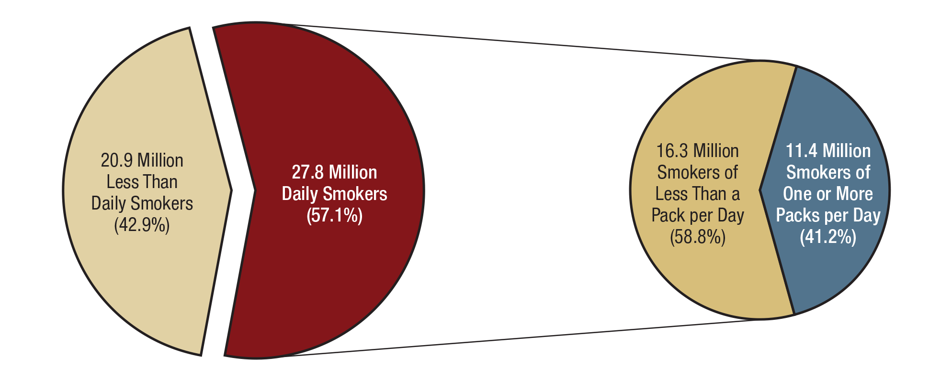
Daily Cigarette Use among Past Month Cigarette Smokers Aged 12 or Older and Smoking of One or More Packs of Cigarettes per Day among Current Daily Smokers: 2017
FFR1.03
Note: Current daily smokers with unknown data about the number of cigarettes smoked per day were excluded from the pie graph on the right.

Slide 4
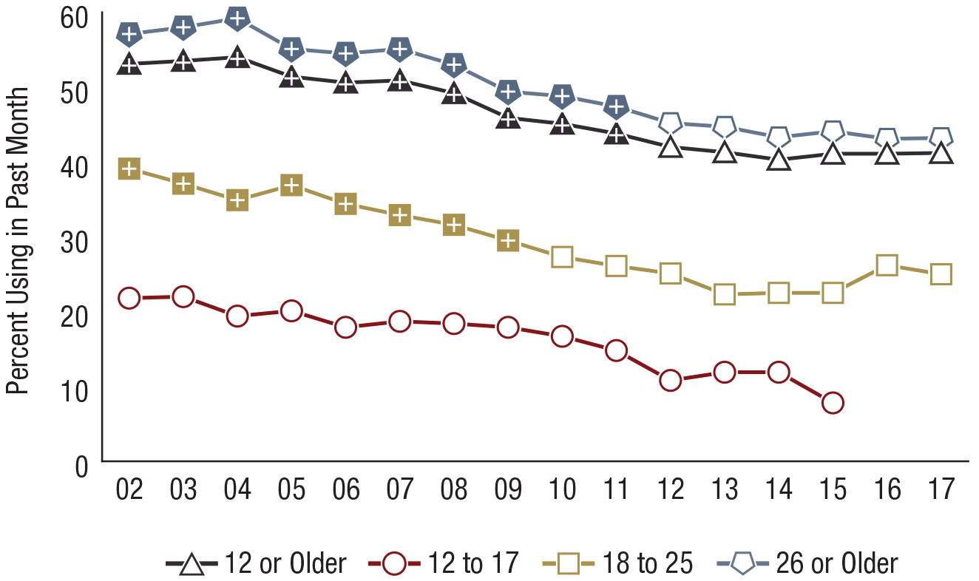
Smokers of One or More Packs of Cigarettes per Day among Past Month Daily Cigarette Smokers Aged 12 or Older, by Age Group: Percentages, 2002-2017
FFR1.04
* Low precision; no estimate reported.
Age Group | 2002 | 2003 | 2004 | 2005 | 2006 | 2007 | 2008 | 2009 | 2010 | 2011 | 2012 | 2013 | 2014 | 2015 | 2016 | 2017
12 or Older | 53.1⁺ | 53.5⁺ | 54.0⁺ | 51.4⁺ | 50.6⁺ | 50.9⁺ | 49.2⁺ | 45.9⁺ | 45.1⁺ | 43.8⁺ | 42.0 | 41.3 | 40.3 | 41.1 | 41.1 | 41.2
12 to 17 | 21.8 | 22.0 | 19.4 | 20.1 | 17.9 | 18.7 | 18.4 | 17.9 | 16.7 | 14.8 | 10.8 | 11.9 | 11.9 | 7.8 | * | *
18 to 25 | 39.1⁺ | 37.1⁺ | 34.9⁺ | 36.9⁺ | 34.4⁺ | 32.9⁺ | 31.6⁺ | 29.5⁺ | 27.3 | 26.1 | 25.1 | 22.3 | 22.5 | 22.5 | 26.2 | 25.0
26 or Older | 57.1⁺ | 58.0⁺ | 59.2⁺ | 55.1⁺ | 54.5⁺ | 55.1⁺ | 53.0⁺ | 49.4⁺ | 48.8⁺ | 47.4⁺ | 45.2 | 44.7 | 43.3 | 44.1 | 43.1 | 43.2

Slide 5
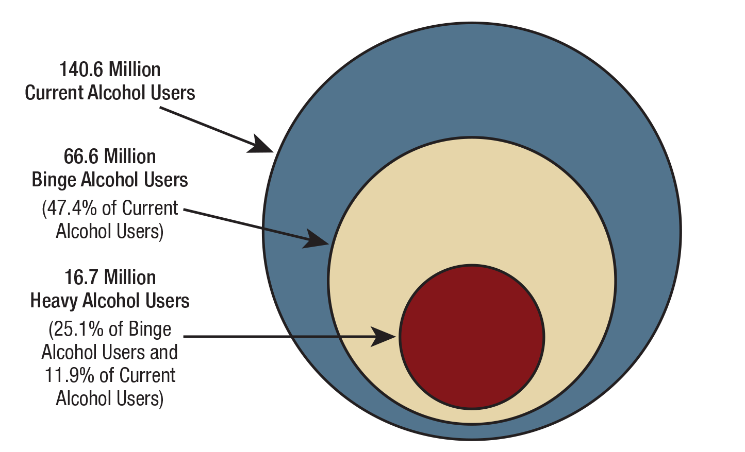
Current, Binge, and Heavy Alcohol Use among People Aged 12 or Older: 2017
FFR1.05
Note: Since 2015, the threshold for determining binge alcohol use for males is consuming five or more drinks on an occasion and for females is consuming four or more drinks on an occasion.

Slide 6
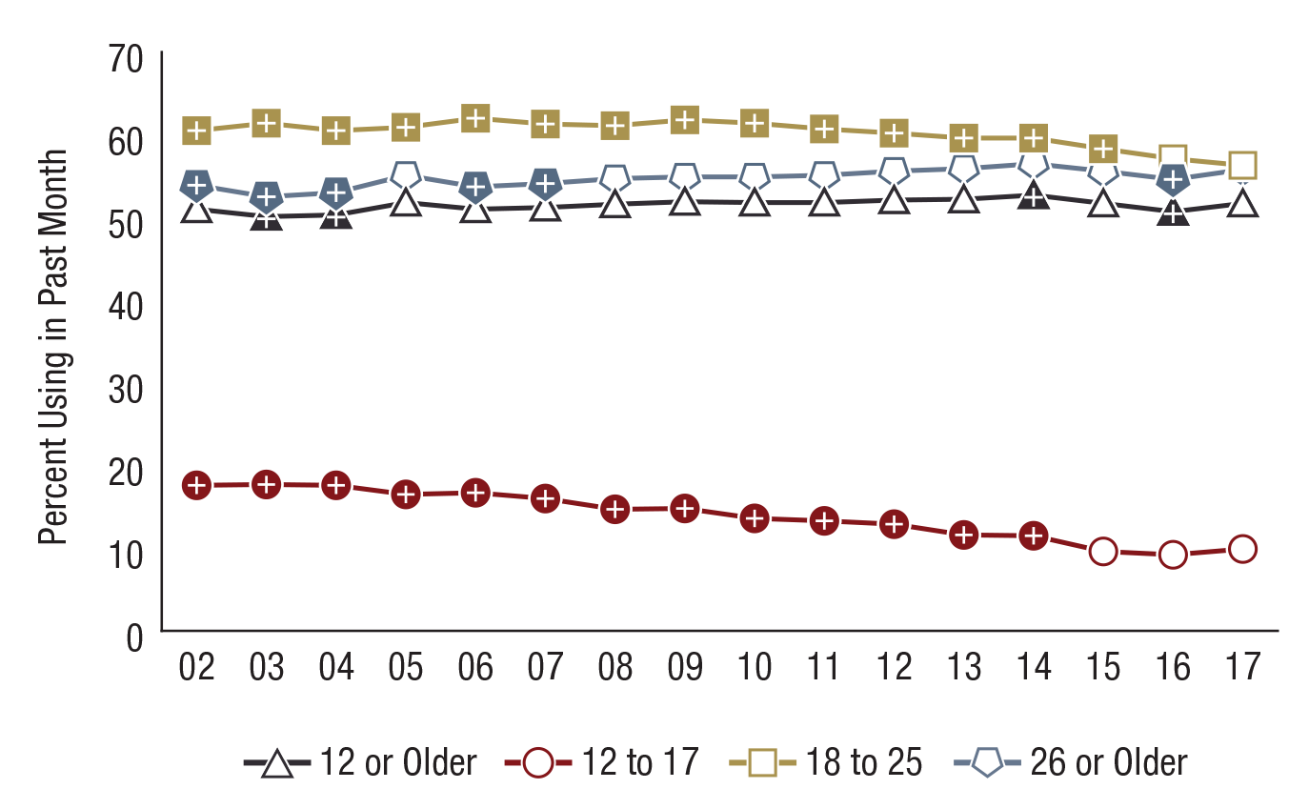
Past Month Alcohol Use among People Aged 12 or Older, by Age Group: Percentages, 2002-2017
FFR1.06
Age Group | 2002 | 2003 | 2004 | 2005 | 2006 | 2007 | 2008 | 2009 | 2010 | 2011 | 2012 | 2013 | 2014 | 2015 | 2016 | 2017
12 or Older | 51.0⁺ | 50.1⁺ | 50.3⁺ | 51.8 | 51.0 | 51.2 | 51.6 | 51.9 | 51.8 | 51.8 | 52.1 | 52.2 | 52.7⁺ | 51.7 | 50.7⁺ | 51.7
12 to 17 | 17.6⁺ | 17.7⁺ | 17.6⁺ | 16.5⁺ | 16.7⁺ | 16.0⁺ | 14.7⁺ | 14.8⁺ | 13.6⁺ | 13.3⁺ | 12.9⁺ | 11.6⁺ | 11.5⁺ | 9.6 | 9.2 | 9.9
18 to 25 | 60.5⁺ | 61.4⁺ | 60.5⁺ | 60.9⁺ | 62.0⁺ | 61.3⁺ | 61.1⁺ | 61.8⁺ | 61.4⁺ | 60.7⁺ | 60.2⁺ | 59.6⁺ | 59.6⁺ | 58.3⁺ | 57.1 | 56.3
26 or Older | 53.9⁺ | 52.5⁺ | 53.0⁺ | 55.1 | 53.7⁺ | 54.1⁺ | 54.7 | 54.9 | 54.9 | 55.1 | 55.6 | 55.9 | 56.5 | 55.6 | 54.6⁺ | 55.8

Slide 7
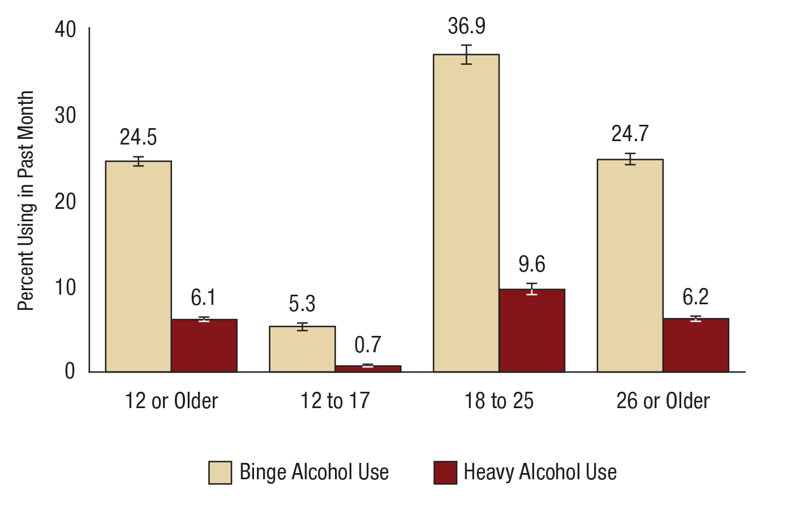
Past Month Binge and Heavy Alcohol Use among People Aged 12 or Older, by Age Group: Percentages, 2017
FFR1.07
Note: Since 2015, the threshold for determining binge alcohol use for males is consuming five or more drinks on an occasion and for females is consuming four or more drinks on an occasion.

Slide 8
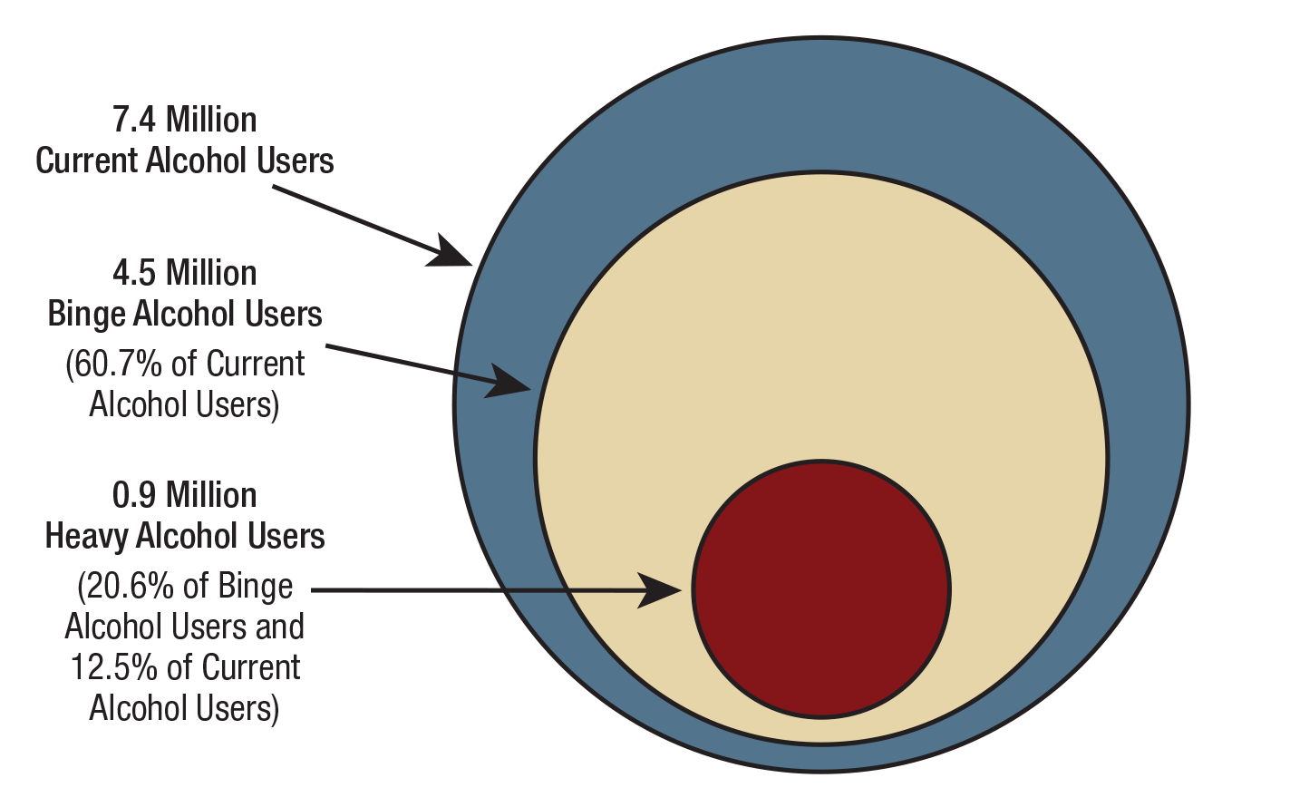
Current, Binge, and Heavy Alcohol Use among People Aged 12 to 20: 2017
FFR1.08
Note: Since 2015, the threshold for determining binge alcohol use for males is consuming five or more drinks on an occasion and for females is consuming four or more drinks on an occasion.

Slide 9
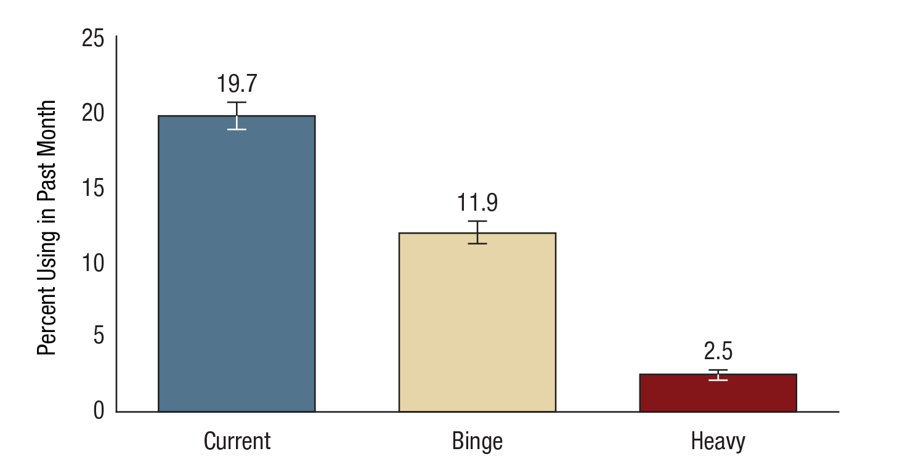
Current, Binge, and Heavy Alcohol Use among People Aged 12 to 20: Percentages, 2017
FFR1.09
Note: Since 2015, the threshold for determining binge alcohol use for males is consuming five or more drinks on an occasion and for females is consuming four or more drinks on an occasion.

Slide 10
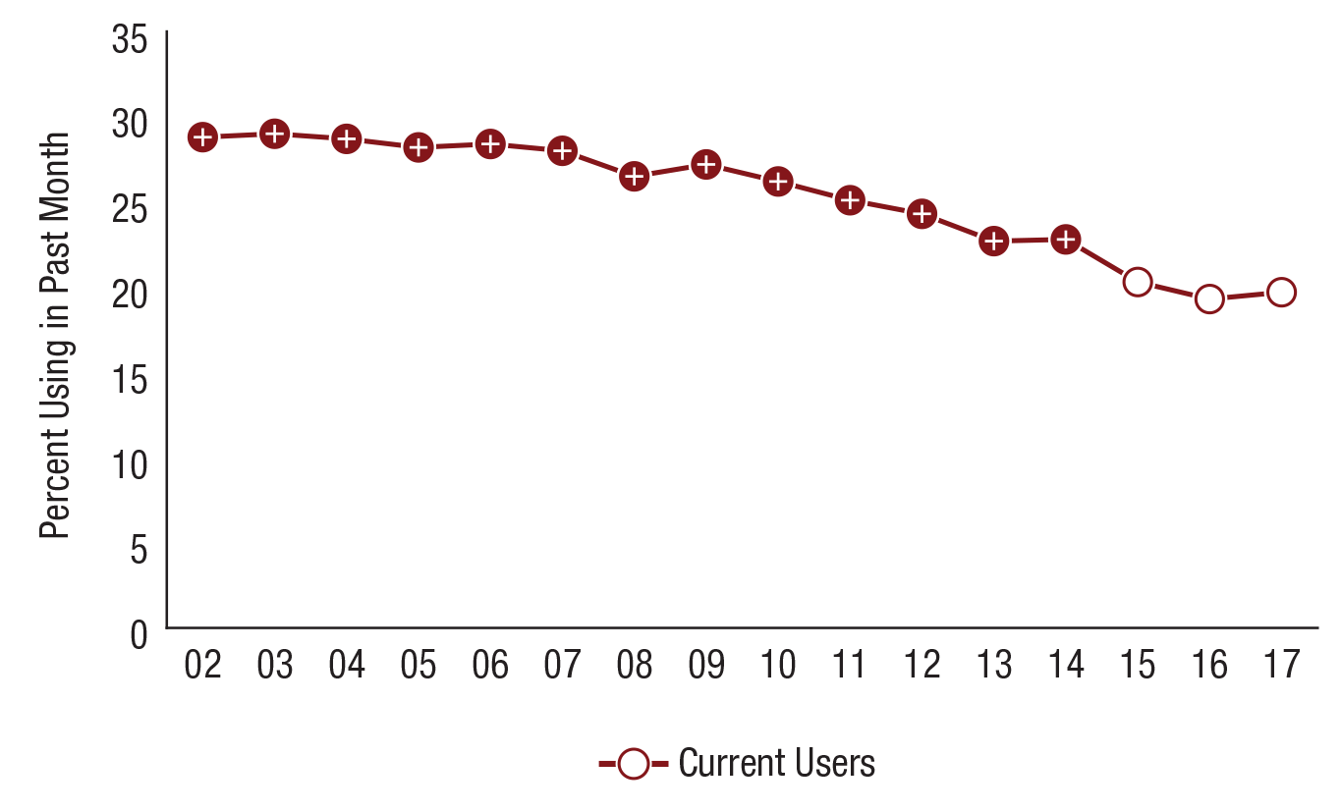
Current Alcohol Use among People Aged 12 to 20: Percentages, 2002-2017
FFR1.10
Use | 2002 | 2003 | 2004 | 2005 | 2006 | 2007 | 2008 | 2009 | 2010 | 2011 | 2012 | 2013 | 2014 | 2015 | 2016 | 2017
Current | 28.8⁺ | 29.0⁺ | 28.7⁺ | 28.2⁺ | 28.4⁺ | 28.0⁺ | 26.5⁺ | 27.2⁺ | 26.2⁺ | 25.1⁺ | 24.3⁺ | 22.7⁺ | 22.8⁺ | 20.3 | 19.3 | 19.7

Slide 11
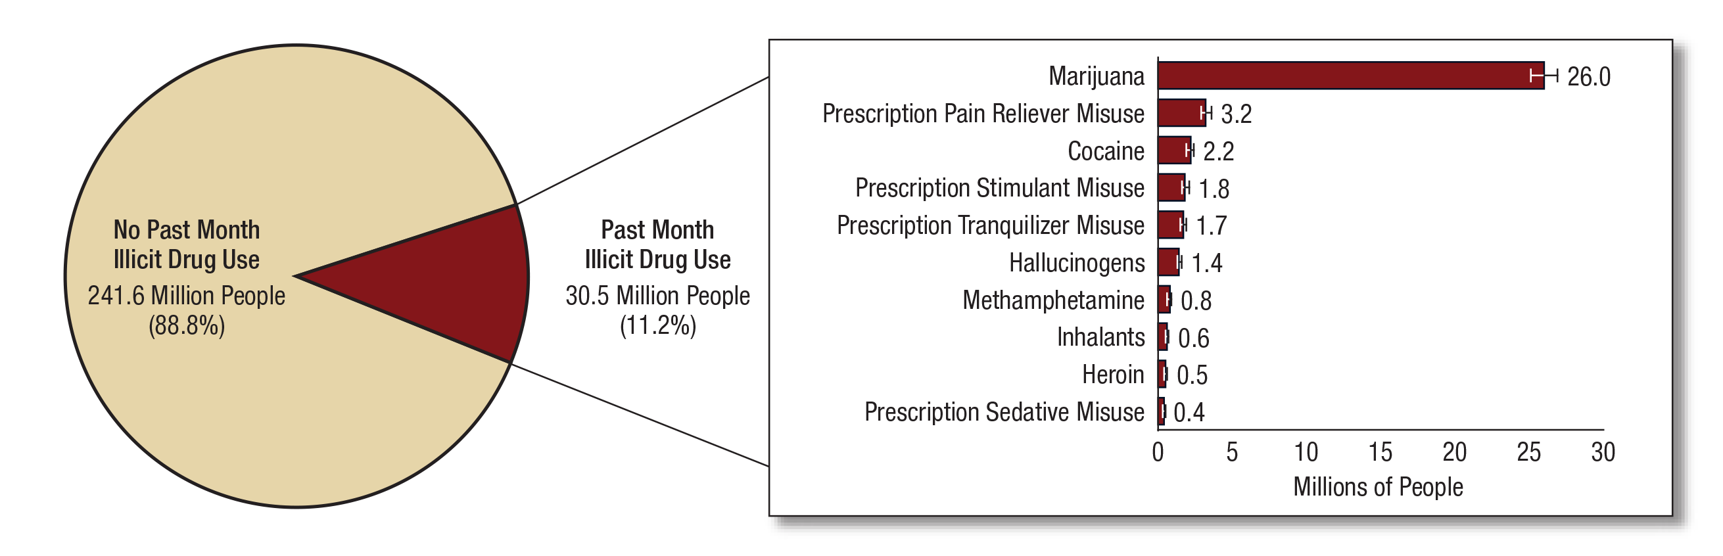
Numbers of Past Month Illicit Drug Users among People Aged 12 or Older: 2017
FFR1.11
Note: Estimated numbers of people refer to people aged 12 or older in the civilian, noninstitutionalized population in the United States. The numbers do not sum to the total population of the United States because the population for NSDUH does not include people aged 11 years or younger, people with no fixed household address (e.g., homeless or transient people not in shelters), active-duty military personnel, and residents of institutional group quarters, such as correctional facilities, nursing homes, mental institutions, and long-term care hospitals.
Note: The estimated numbers of current users of different illicit drugs are not mutually exclusive because people could have used or misused more than one type of illicit drug in the past month.

Slide 12
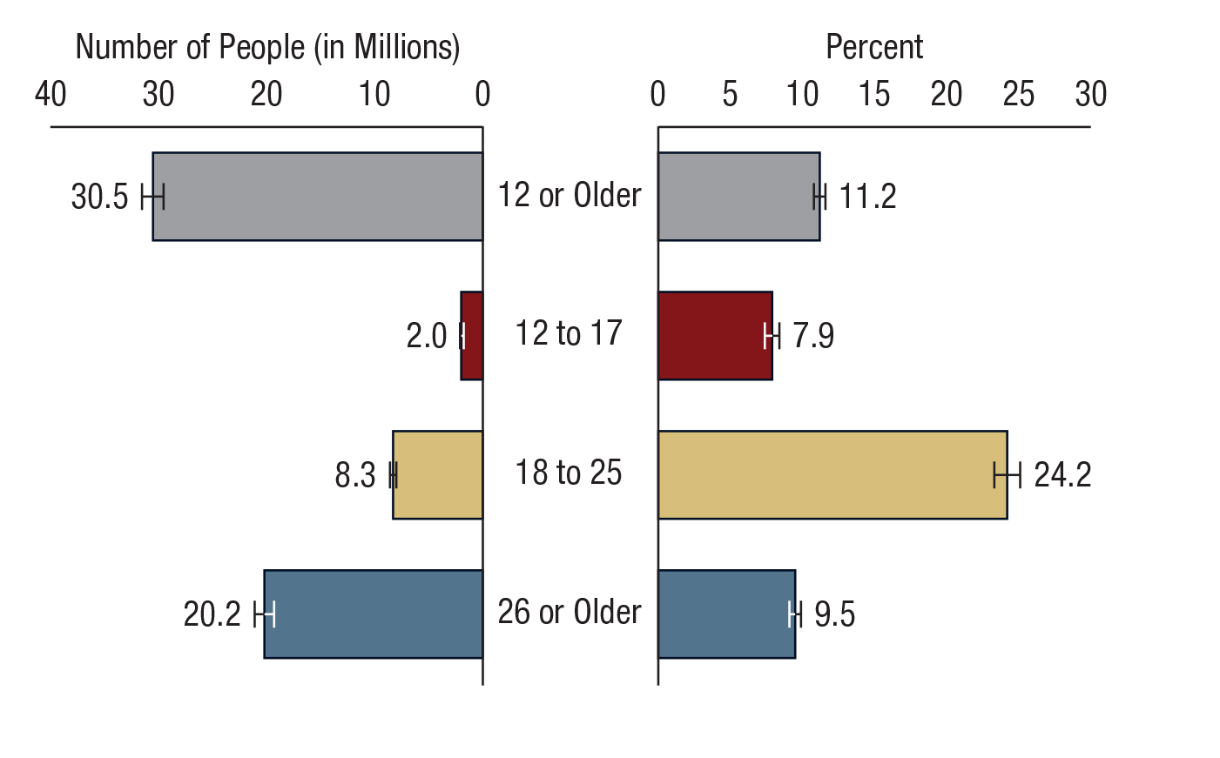
Past Month Illicit Drug Use among People Aged 12 or Older, by Age Group: 2017
FFR1.12

Slide 13
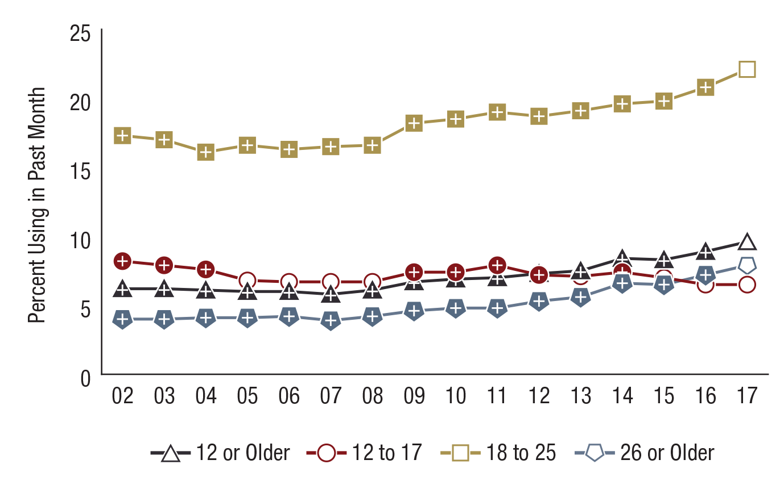
Past Month Marijuana Use among People Aged 12 or Older, by Age Group: Percentages, 2002-2017
FFR1.13
Age Group | 2002 | 2003 | 2004 | 2005 | 2006 | 2007 | 2008 | 2009 | 2010 | 2011 | 2012 | 2013 | 2014 | 2015 | 2016 | 2017
12 or Older | 6.2⁺ | 6.2⁺ | 6.1⁺ | 6.0⁺ | 6.0⁺ | 5.8⁺ | 6.1⁺ | 6.7⁺ | 6.9⁺ | 7.0⁺ | 7.3⁺ | 7.5⁺ | 8.4⁺ | 8.3⁺ | 8.9⁺ | 9.6
12 to 17 | 8.2⁺ | 7.9⁺ | 7.6⁺ | 6.8 | 6.7 | 6.7 | 6.7 | 7.4⁺ | 7.4⁺ | 7.9⁺ | 7.2⁺ | 7.1 | 7.4⁺ | 7.0 | 6.5 | 6.5
18 to 25 | 17.3⁺ | 17.0⁺ | 16.1⁺ | 16.6⁺ | 16.3⁺ | 16.5⁺ | 16.6⁺ | 18.2⁺ | 18.5⁺ | 19.0⁺ | 18.7⁺ | 19.1⁺ | 19.6⁺ | 19.8⁺ | 20.8⁺ | 22.1
26 or Older | 4.0⁺ | 4.0⁺ | 4.1⁺ | 4.1⁺ | 4.2⁺ | 3.9⁺ | 4.2⁺ | 4.6⁺ | 4.8⁺ | 4.8⁺ | 5.3⁺ | 5.6⁺ | 6.6⁺ | 6.5⁺ | 7.2⁺ | 7.9

Slide 14
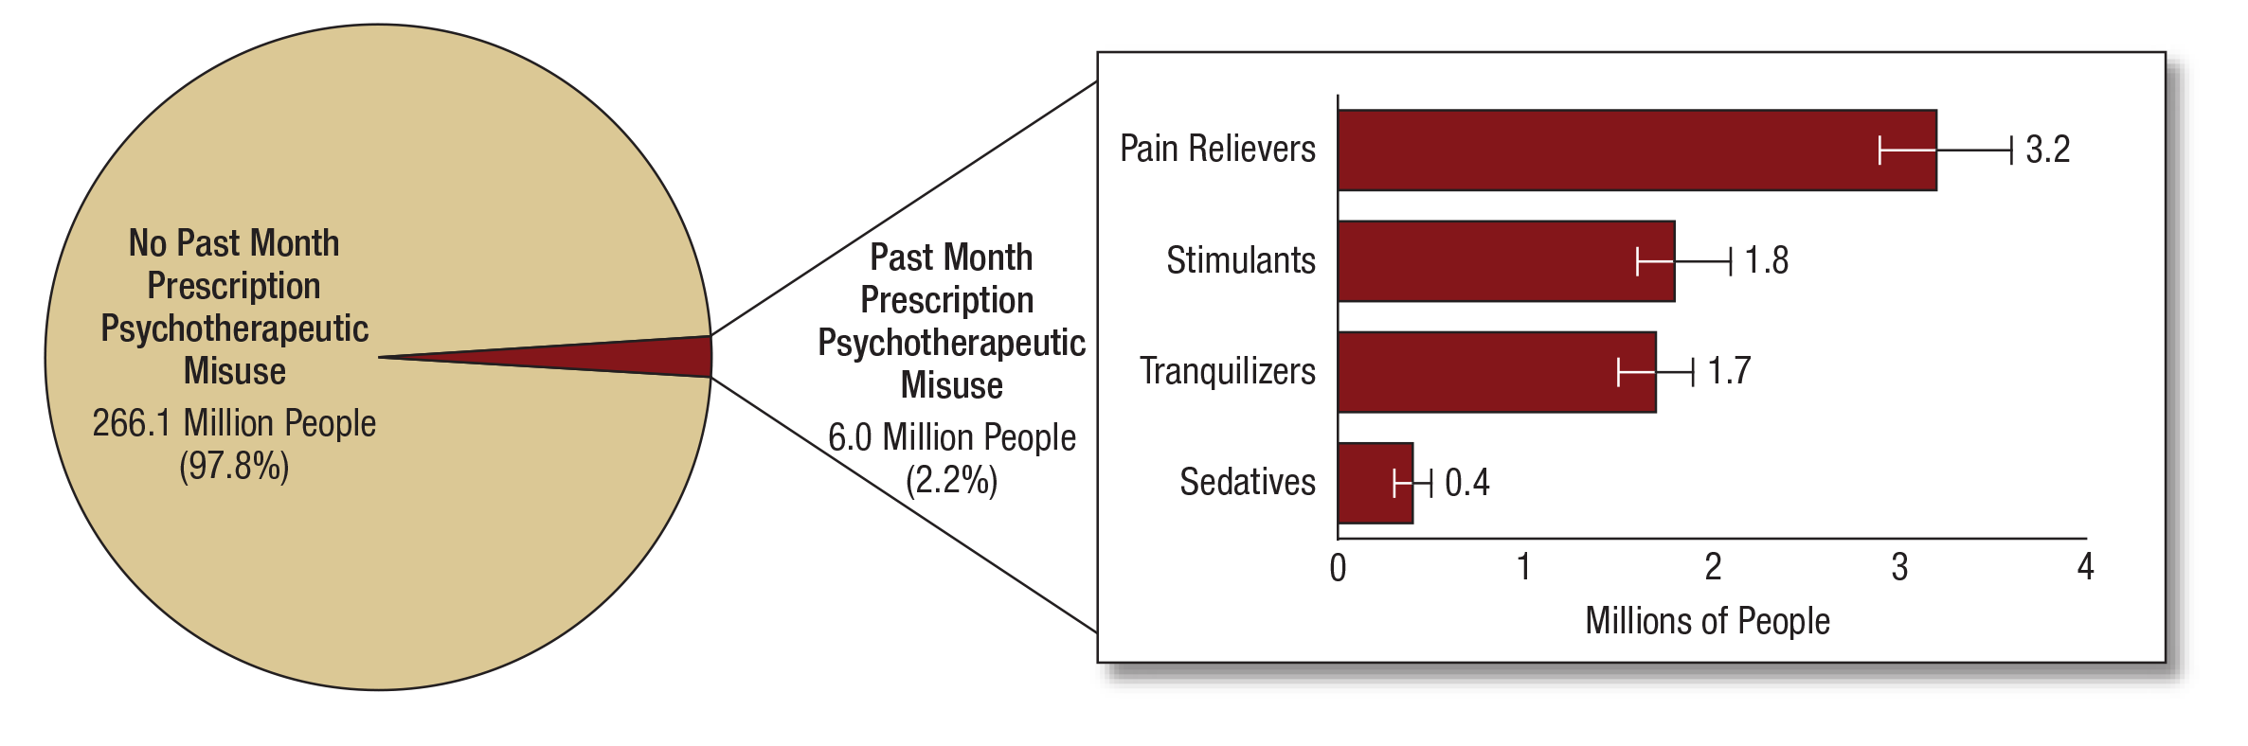
Numbers of Past Month Prescription Psychotherapeutic Misusers among People Aged 12 or Older: 2017
FFR1.14
Note: Estimated numbers of people refer to people aged 12 or older in the civilian, noninstitutionalized population in the United States. The numbers do not sum to the total population of the United States because the population for NSDUH does not include people aged 11 years or younger, people with no fixed household address (e.g., homeless or transient people not in shelters), active-duty military personnel, and residents of institutional group quarters, such as correctional facilities, nursing homes, mental institutions, and long-term care hospitals.
Note: The estimated numbers of past month misusers of different prescription psychotherapeutics are not mutually exclusive because people could have misused more than one type of prescription psychotherapeutic in the past month.

Slide 15
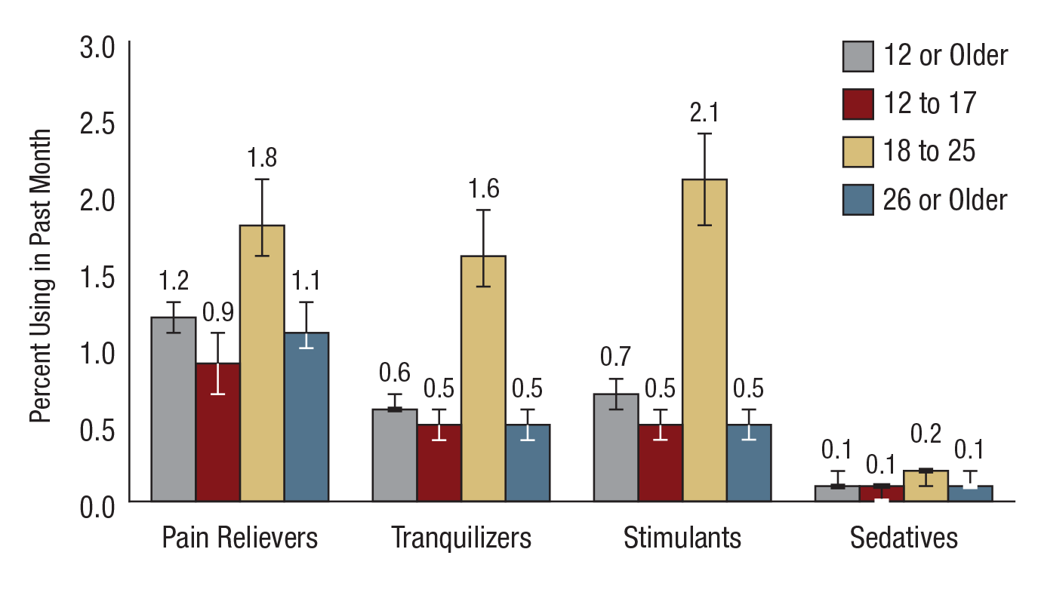
Past Month Prescription Psychotherapeutic Misuse among People Aged 12 or Older, by Age Group: Percentages, 2017
FFR1.15

Slide 16
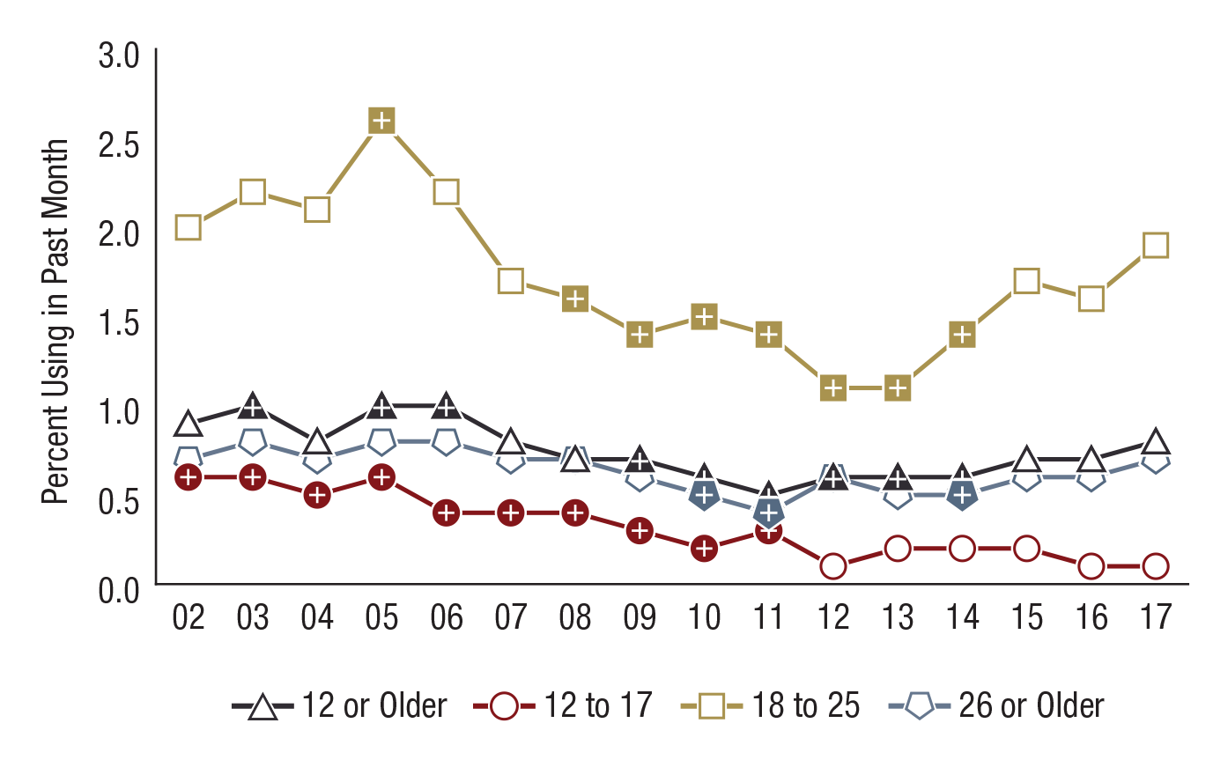
Past Month Cocaine Use among People Aged 12 or Older, by Age Group: Percentages, 2002-2017
FFR1.16
Age Group | 2002 | 2003 | 2004 | 2005 | 2006 | 2007 | 2008 | 2009 | 2010 | 2011 | 2012 | 2013 | 2014 | 2015 | 2016 | 2017
12 or Older | 0.9 | 1.0⁺ | 0.8 | 1.0⁺ | 1.0⁺ | 0.8 | 0.7 | 0.7⁺ | 0.6⁺ | 0.5⁺ | 0.6⁺ | 0.6⁺ | 0.6⁺ | 0.7 | 0.7 | 0.8
12 to 17 | 0.6⁺ | 0.6⁺ | 0.5⁺ | 0.6⁺ | 0.4⁺ | 0.4⁺ | 0.4⁺ | 0.3⁺ | 0.2⁺ | 0.3⁺ | 0.1 | 0.2 | 0.2 | 0.2 | 0.1 | 0.1
18 to 25 | 2.0 | 2.2 | 2.1 | 2.6⁺ | 2.2 | 1.7 | 1.6⁺ | 1.4⁺ | 1.5⁺ | 1.4⁺ | 1.1⁺ | 1.1⁺ | 1.4⁺ | 1.7 | 1.6 | 1.9
26 or Older | 0.7 | 0.8 | 0.7 | 0.8 | 0.8 | 0.7 | 0.7 | 0.6 | 0.5⁺ | 0.4⁺ | 0.6 | 0.5 | 0.5⁺ | 0.6 | 0.6 | 0.7

Slide 17
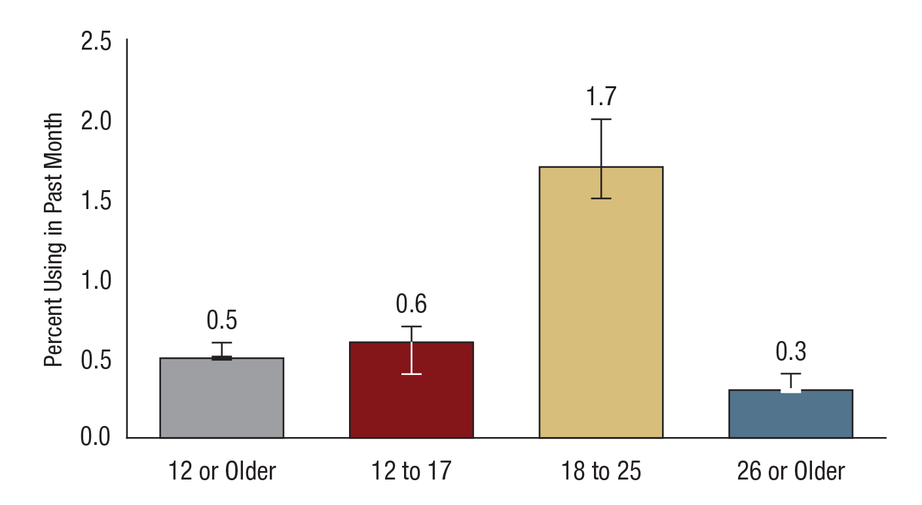
Past Month Hallucinogen Use among People Aged 12 or Older, by Age Group: Percentages, 2017
FFR1.17

Slide 18
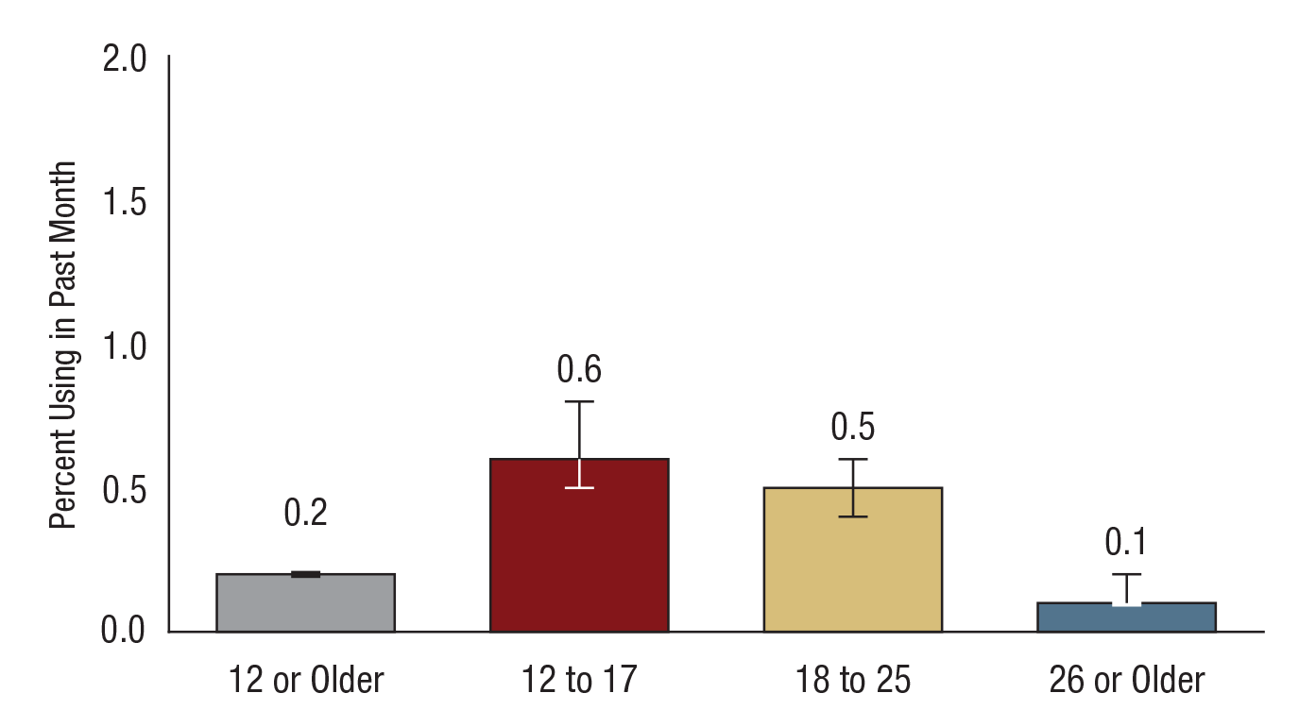
Past Month Inhalant Use among People Aged 12 or Older, by Age Group: Percentages, 2017
FFR1.18

Slide 19
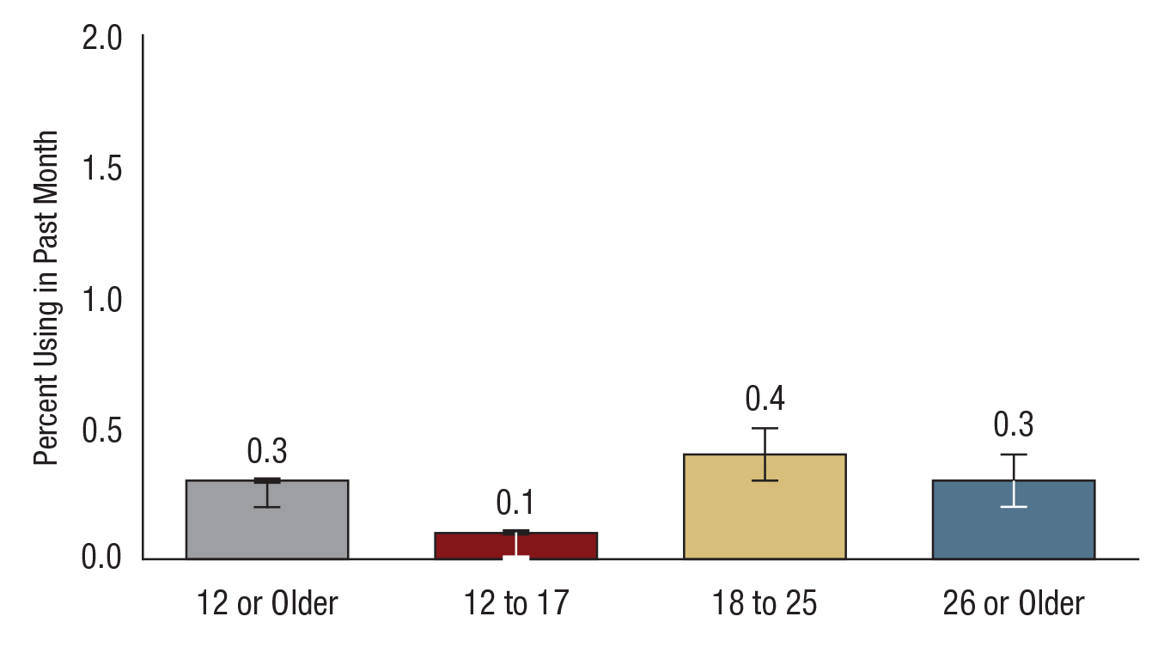
Past Month Methamphetamine Use among People Aged 12 or Older, by Age Group: Percentages, 2017
FFR1.19

Slide 20
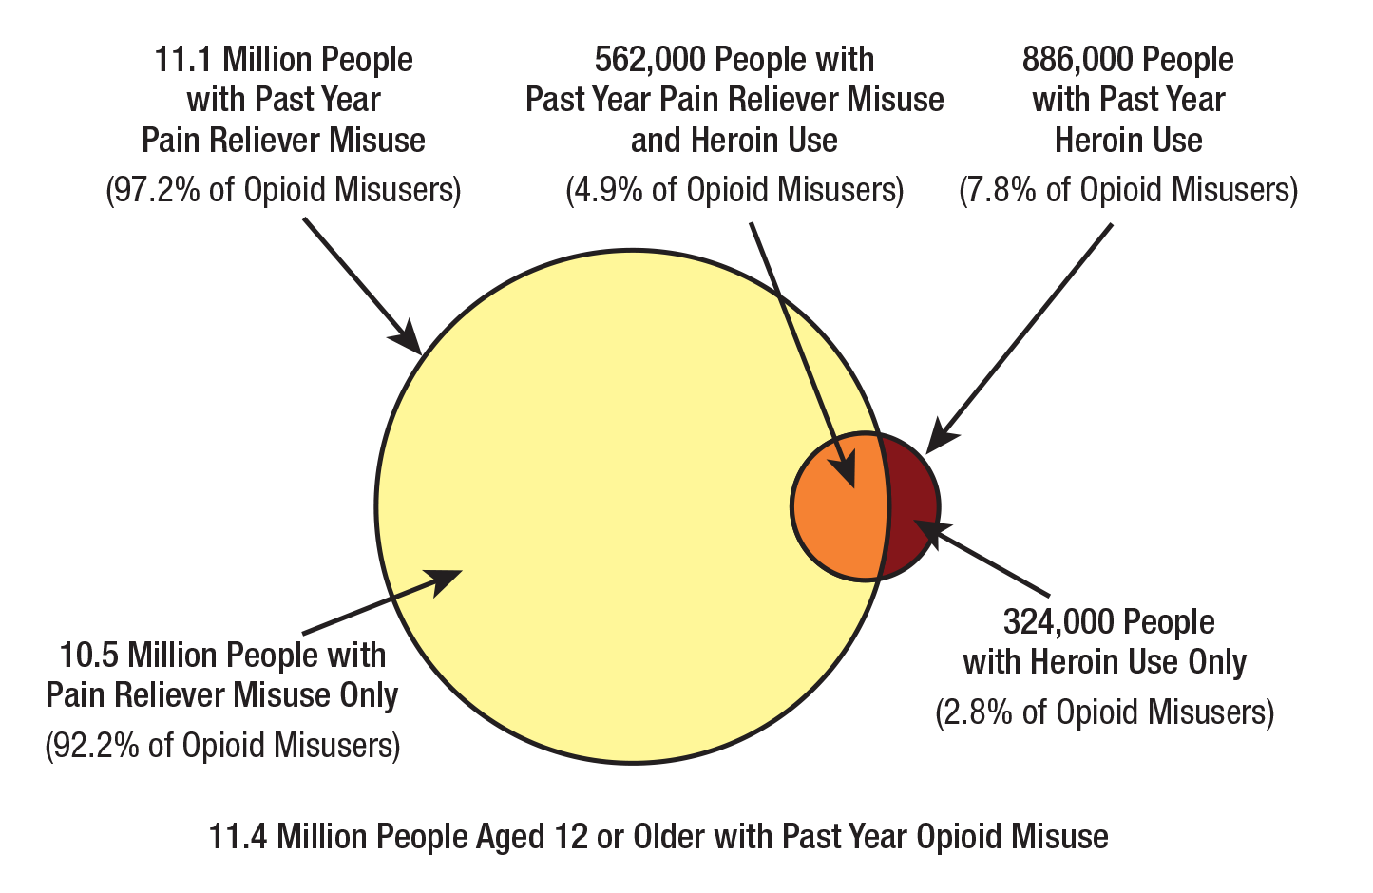
Past Year Opioid Misuse among People Aged 12 or Older: 2017
FFR1.20
Note: Opioid misuse is defined as heroin use or prescription pain reliever misuse.
Note: The percentages do not add to 100 percent due to rounding.

Slide 21
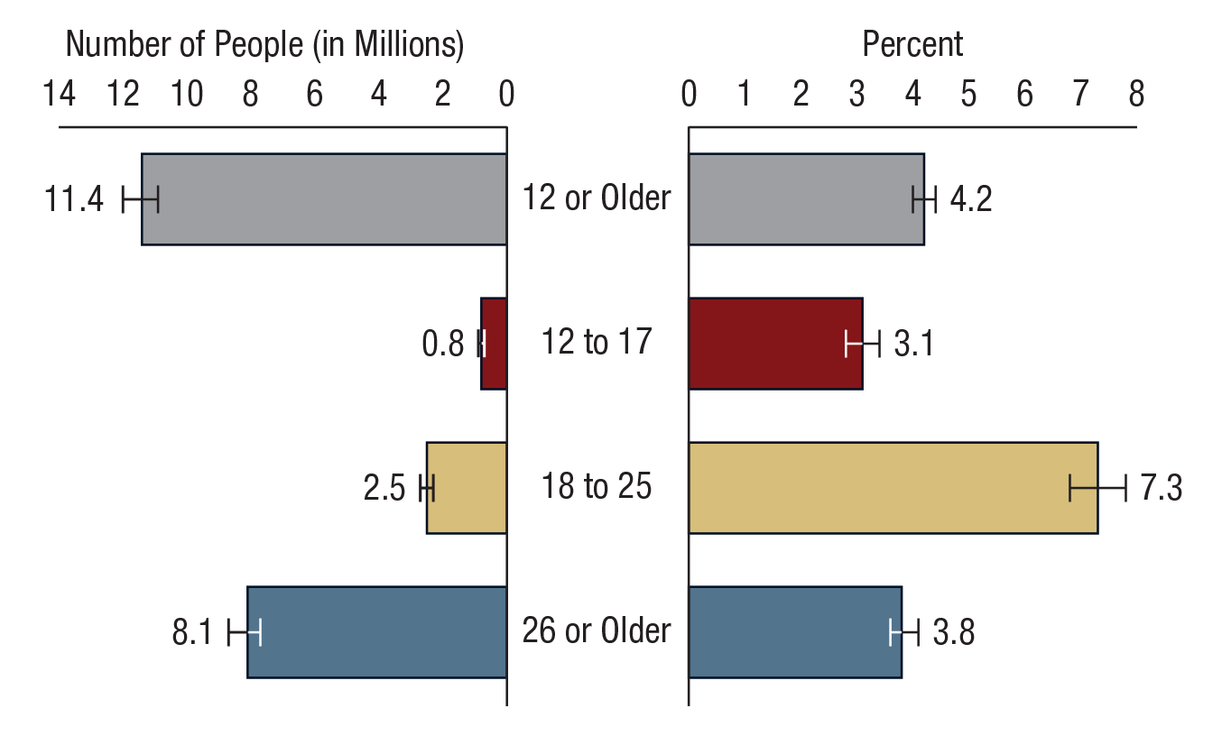
Past Year Opioid Misuse among People Aged 12 or Older, by Age Group: 2017
FFR1.21
Note: Opioid misuse is defined as heroin use or prescription pain reliever misuse.

Slide 22
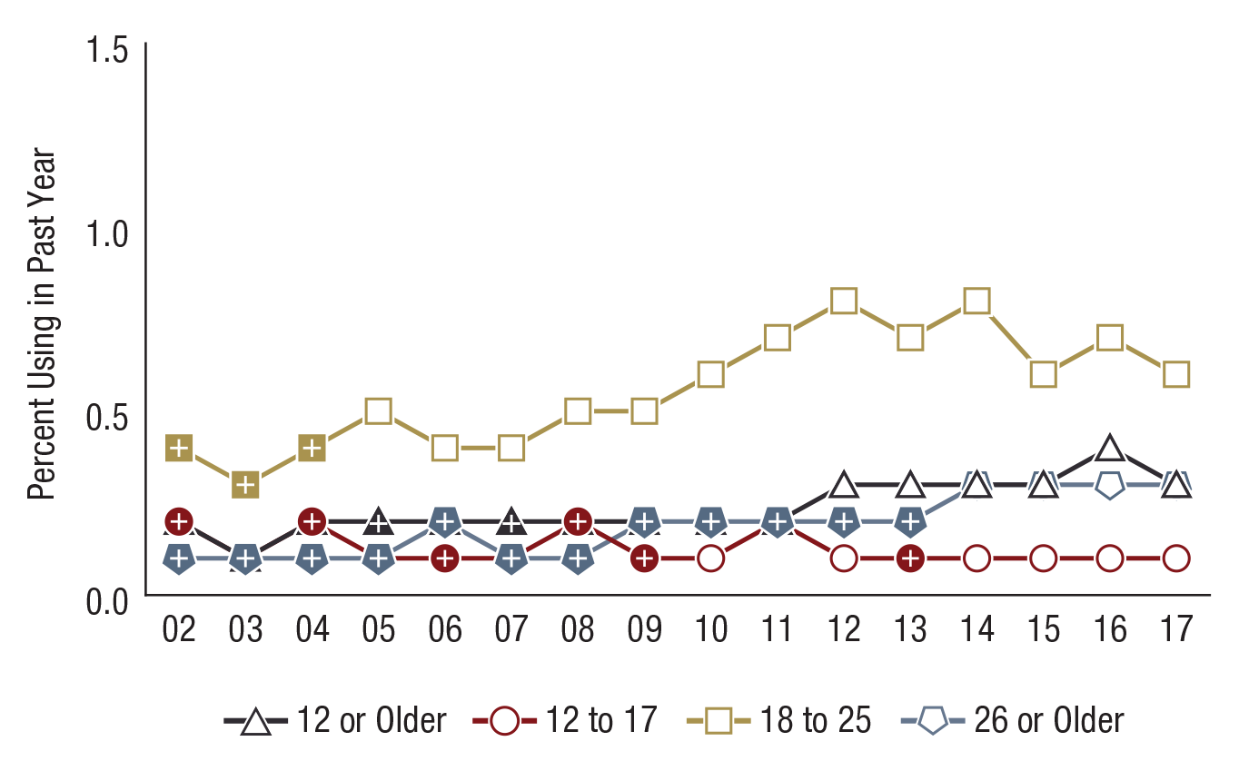
Past Year Heroin Use among People Aged 12 or Older, by Age Group: Percentages, 2002-2017
FFR1.22
Age Group | 2002 | 2003 | 2004 | 2005 | 2006 | 2007 | 2008 | 2009 | 2010 | 2011 | 2012 | 2013 | 2014 | 2015 | 2016 | 2017
12 or Older | 0.2⁺ | 0.1⁺ | 0.2⁺ | 0.2⁺ | 0.2⁺ | 0.2⁺ | 0.2⁺ | 0.2⁺ | 0.2 | 0.2⁺ | 0.3 | 0.3 | 0.3 | 0.3 | 0.4 | 0.3
12 to 17 | 0.2⁺ | 0.1⁺ | 0.2⁺ | 0.1⁺ | 0.1⁺ | 0.1 | 0.2⁺ | 0.1⁺ | 0.1 | 0.2⁺ | 0.1 | 0.1⁺ | 0.1 | 0.1 | 0.1 | 0.1
18 to 25 | 0.4⁺ | 0.3⁺ | 0.4⁺ | 0.5 | 0.4 | 0.4 | 0.5 | 0.5 | 0.6 | 0.7 | 0.8 | 0.7 | 0.8 | 0.6 | 0.7 | 0.6
26 or Older | 0.1⁺ | 0.1⁺ | 0.1⁺ | 0.1⁺ | 0.2⁺ | 0.1⁺ | 0.1⁺ | 0.2⁺ | 0.2⁺ | 0.2⁺ | 0.2⁺ | 0.2⁺ | 0.3 | 0.3 | 0.3 | 0.3

Slide 23
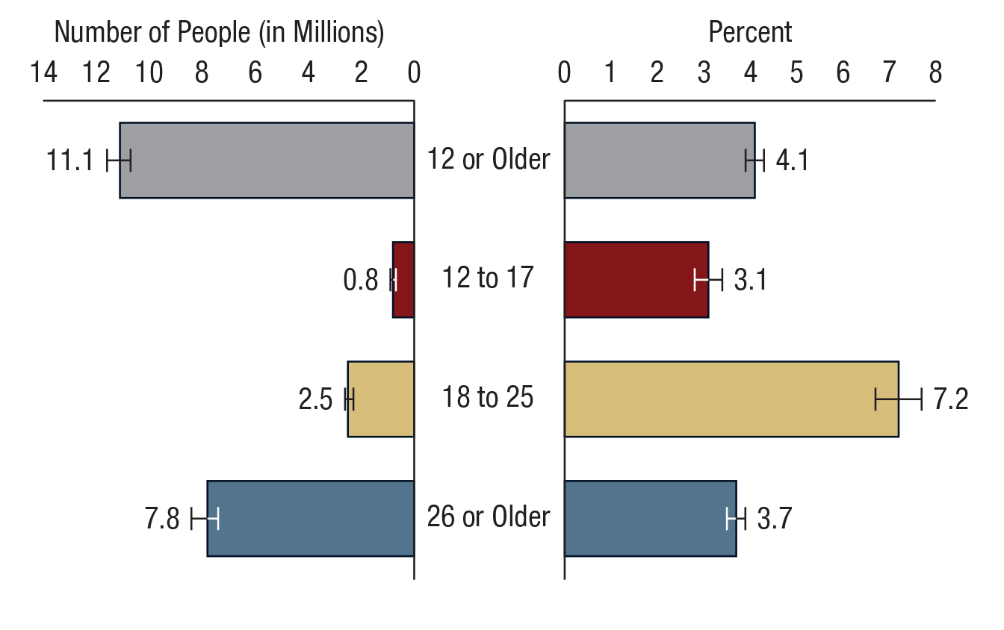
Past Year Prescription Pain Reliever Misuse among People Aged 12 or Older, by Age Group: 2017
FFR1.23

Slide 24
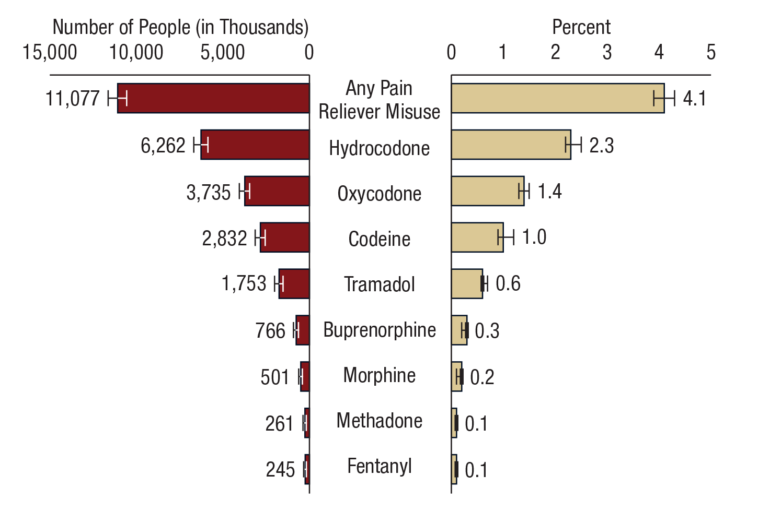
Past Year Misuse of Prescription Pain Reliever Subtypes among People Aged 12 or Older: 2017
FFR1.24
Note: The figure does not show all pain reliever subtypes from the NSDUH questionnaire.

Slide 25
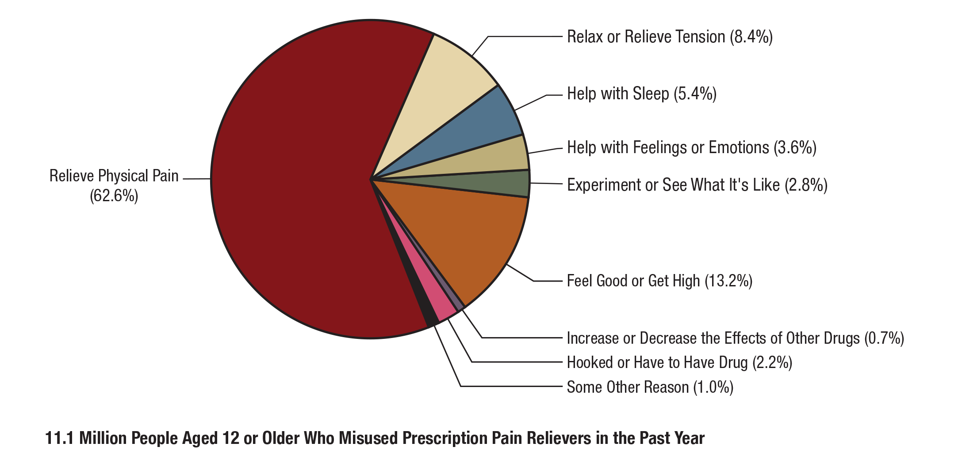
Main Reason for the Most Recent Prescription Pain Reliever Misuse among People Aged 12 or Older Who Misused Prescription Pain Relievers in the Past Year: Percentages, 2017
FFR1.25
Note: The percentages do not add to 100 percent due to rounding.

Slide 26
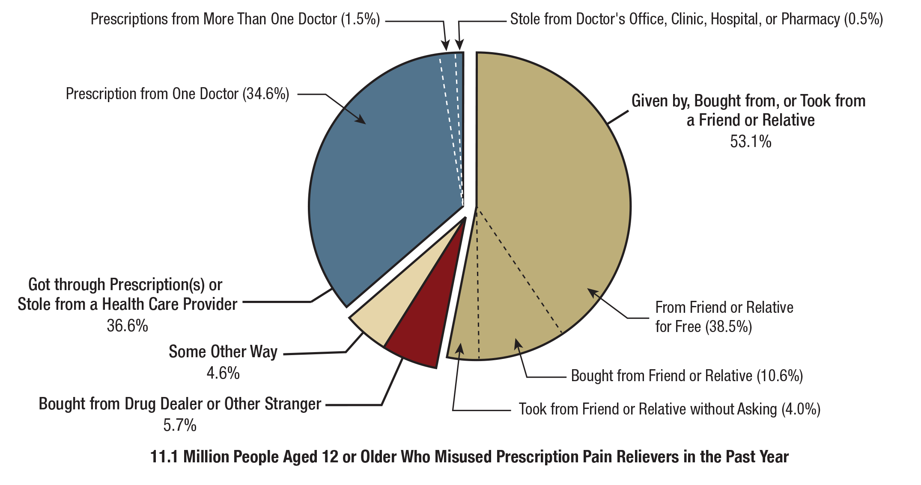
Source Where Pain Relievers Were Obtained for Most Recent Misuse among People Aged 12 or Older Who Misused Prescription Pain Relievers in the Past Year: Percentages, 2017
FFR1.26
Note: Respondents with unknown data for the Source for Most Recent Misuse or who reported Some Other Way but did not specify a valid way were excluded.

Slide 27
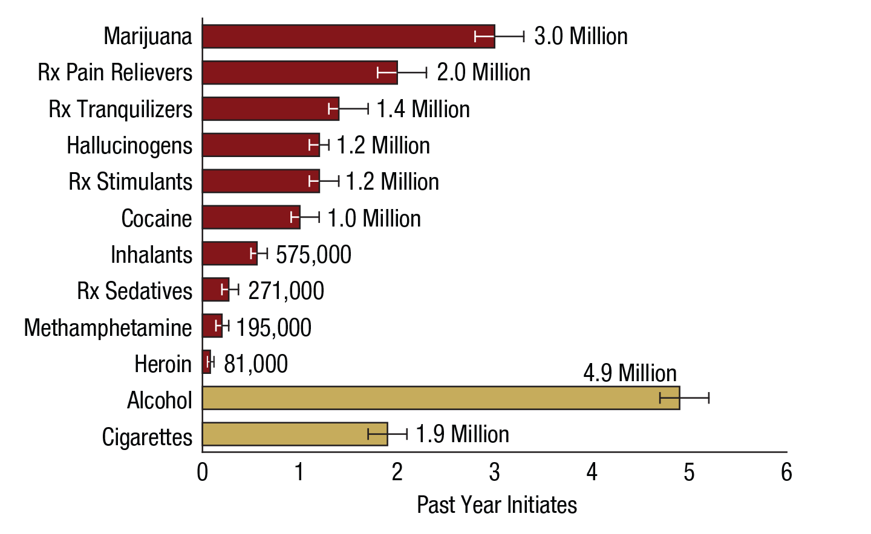
Numbers of Past Year Initiates of Substances among People Aged 12 or Older: 2017
FFR1.27
Rx = prescription.
Note: Estimates for prescription pain relievers, prescription tranquilizers, prescription stimulants, and prescription sedatives are for the initiation of misuse.

Slide 28
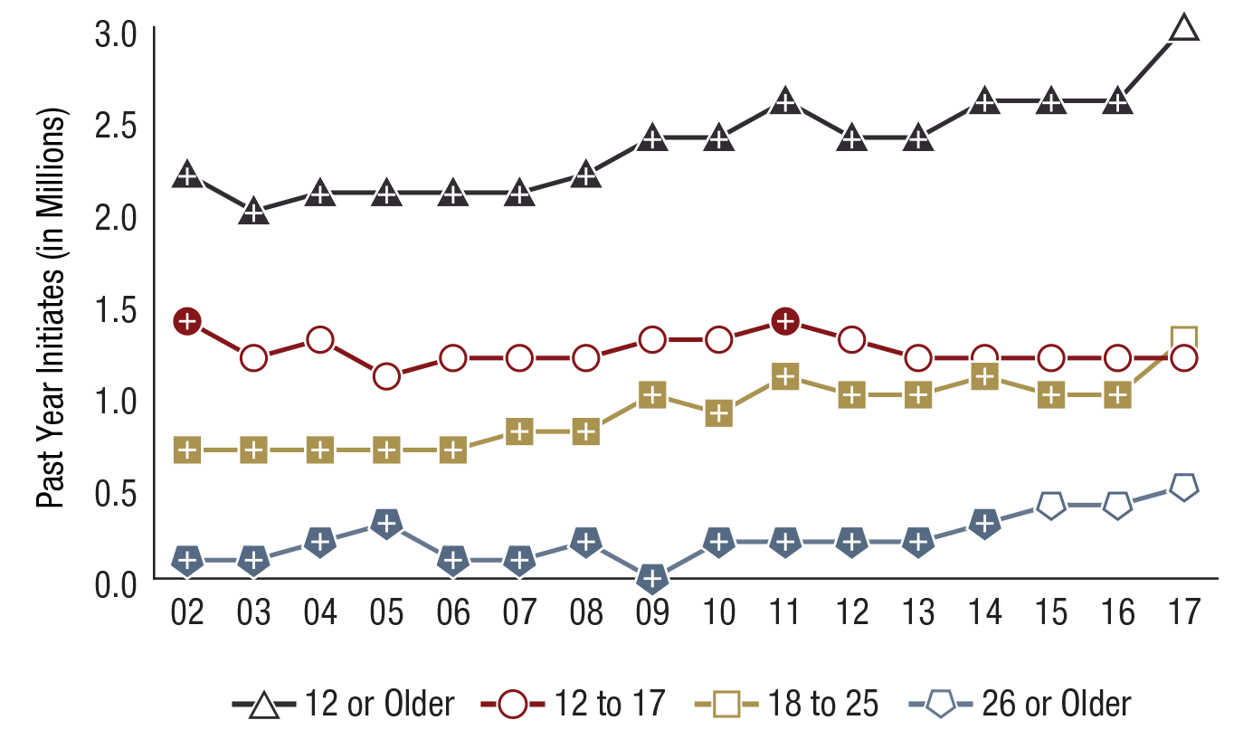
Past Year Marijuana Initiates among People Aged 12 or Older, by Age Group (in Millions): 2002-2017
FFR1.28
Note: Estimates of less than 0.1 million round to 0.0 million when shown to the nearest tenth of a million.
Age Group | 2002 | 2003 | 2004 | 2005 | 2006 | 2007 | 2008 | 2009 | 2010 | 2011 | 2012 | 2013 | 2014 | 2015 | 2016 | 2017
12 or Older | 2.2⁺ | 2.0⁺ | 2.1⁺ | 2.1⁺ | 2.1⁺ | 2.1⁺ | 2.2⁺ | 2.4⁺ | 2.4⁺ | 2.6⁺ | 2.4⁺ | 2.4⁺ | 2.6⁺ | 2.6⁺ | 2.6⁺ | 3.0
12 to 17 | 1.4⁺ | 1.2 | 1.3 | 1.1 | 1.2 | 1.2 | 1.2 | 1.3 | 1.3 | 1.4⁺ | 1.3 | 1.2 | 1.2 | 1.2 | 1.2 | 1.2
18 to 25 | 0.7⁺ | 0.7⁺ | 0.7⁺ | 0.7⁺ | 0.7⁺ | 0.8⁺ | 0.8⁺ | 1.0⁺ | 0.9⁺ | 1.1⁺ | 1.0⁺ | 1.0⁺ | 1.1⁺ | 1.0⁺ | 1.0⁺ | 1.3
26 or Older | 0.1⁺ | 0.1⁺ | 0.2⁺ | 0.3⁺ | 0.1⁺ | 0.1⁺ | 0.2⁺ | 0.0⁺ | 0.2⁺ | 0.2⁺ | 0.2⁺ | 0.2⁺ | 0.3⁺ | 0.4 | 0.4 | 0.5

Slide 29
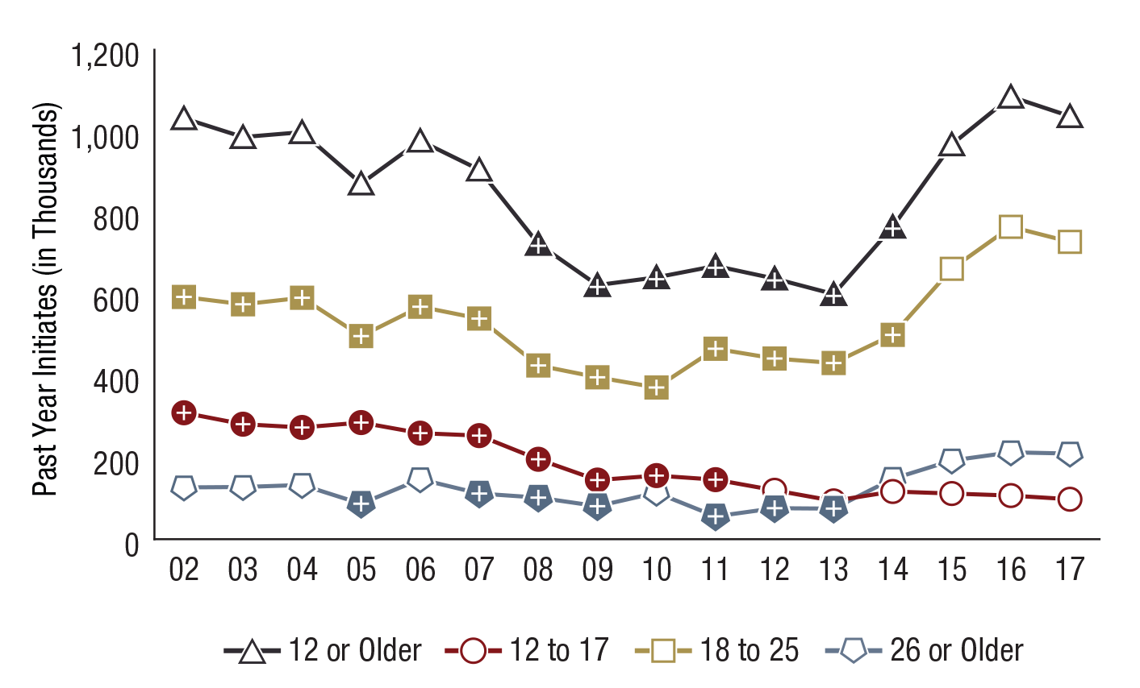
Past Year Cocaine Initiates among People Aged 12 or Older, by Age Group (in Thousands): 2002-2017
FFR1.29
Age Group | 2002 | 2003 | 2004 | 2005 | 2006 | 2007 | 2008 | 2009 | 2010 | 2011 | 2012 | 2013 | 2014 | 2015 | 2016 | 2017
12 or Older | 1,032 | 986 | 998 | 872 | 977 | 906 | 724⁺ | 623⁺ | 642⁺ | 670⁺ | 639⁺ | 601⁺ | 766⁺ | 968 | 1,085 | 1,037
12 to 17 | 310⁺ | 282⁺ | 274⁺ | 286⁺ | 260⁺ | 254⁺ | 196⁺ | 145⁺ | 156⁺ | 146⁺ | 120 | 94 | 117 | 112 | 107 | 98
18 to 25 | 594⁺ | 576⁺ | 592⁺ | 498⁺ | 570⁺ | 541⁺ | 426⁺ | 397⁺ | 372⁺ | 467⁺ | 443⁺ | 432⁺ | 501⁺ | 663 | 766 | 729
26 or Older | 127 | 128 | 133 | 87⁺ | 147 | 112⁺ | 102⁺ | 81⁺ | 114 | 56⁺ | 76⁺ | 75⁺ | 148 | 193 | 213 | 210

Slide 30
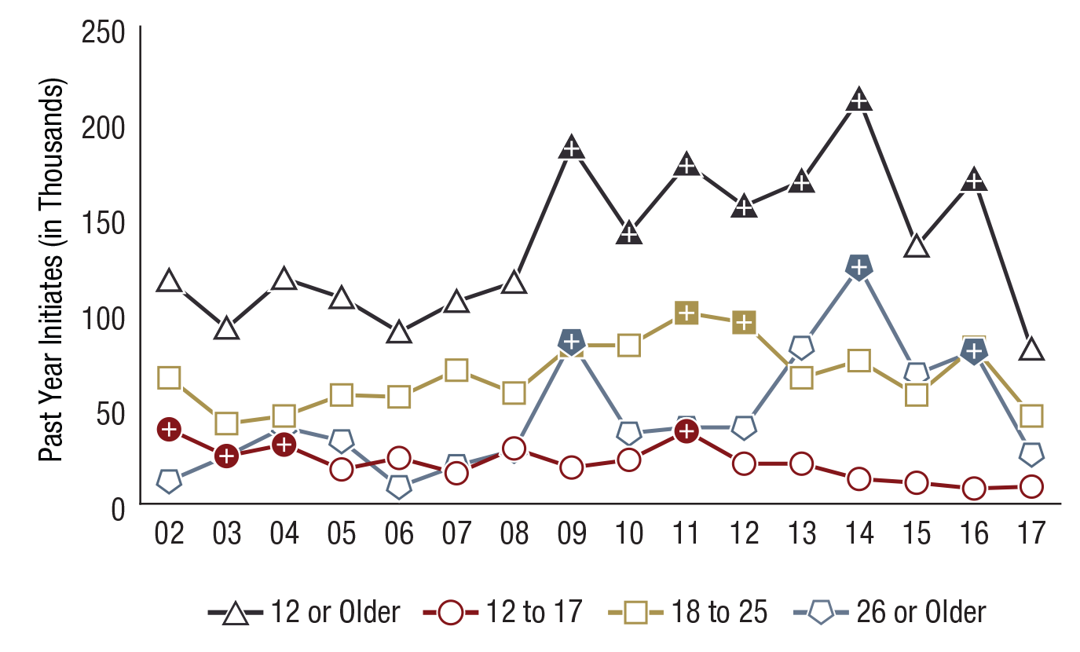
Past Year Heroin Initiates among People Aged 12 or Older, by Age Group (in Thousands): 2002-2017
FFR1.30
Age Group | 2002 | 2003 | 2004 | 2005 | 2006 | 2007 | 2008 | 2009 | 2010 | 2011 | 2012 | 2013 | 2014 | 2015 | 2016 | 2017
12 or Older | 117 | 92 | 118 | 108 | 90 | 106 | 116 | 187⁺ | 142⁺ | 178⁺ | 156⁺ | 169⁺ | 212⁺ | 135 | 170⁺ | 81
12 to 17 | 39⁺ | 25⁺ | 31⁺ | 18 | 24 | 16 | 29 | 19 | 23 | 38⁺ | 21 | 21 | 13 | 11 | 8 | 9
18 to 25 | 66 | 42 | 46 | 57 | 56 | 70 | 58 | 83⁺ | 83 | 100⁺ | 95⁺ | 66 | 75 | 57 | 82 | 46
26 or Older | 12 | 25 | 40 | 33 | 9 | 20 | 28 | 85⁺ | 37 | 40 | 40 | 82 | 124⁺ | 68 | 80⁺ | 26

Slide 31
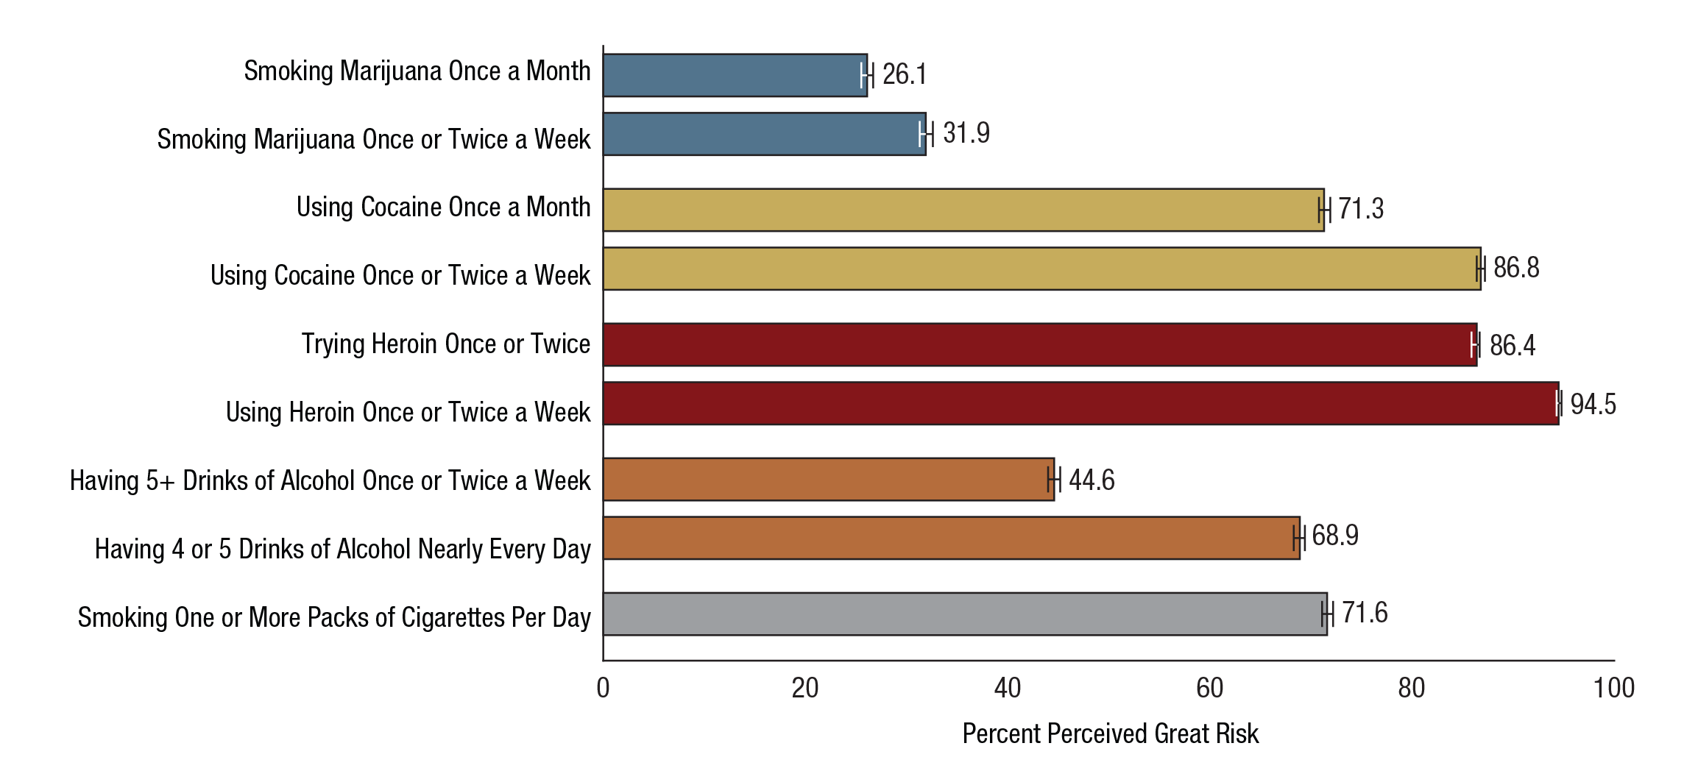
Perceived Great Risk from Substance Use among People Aged 12 or Older: Percentages, 2017
FFR1.31

Slide 32
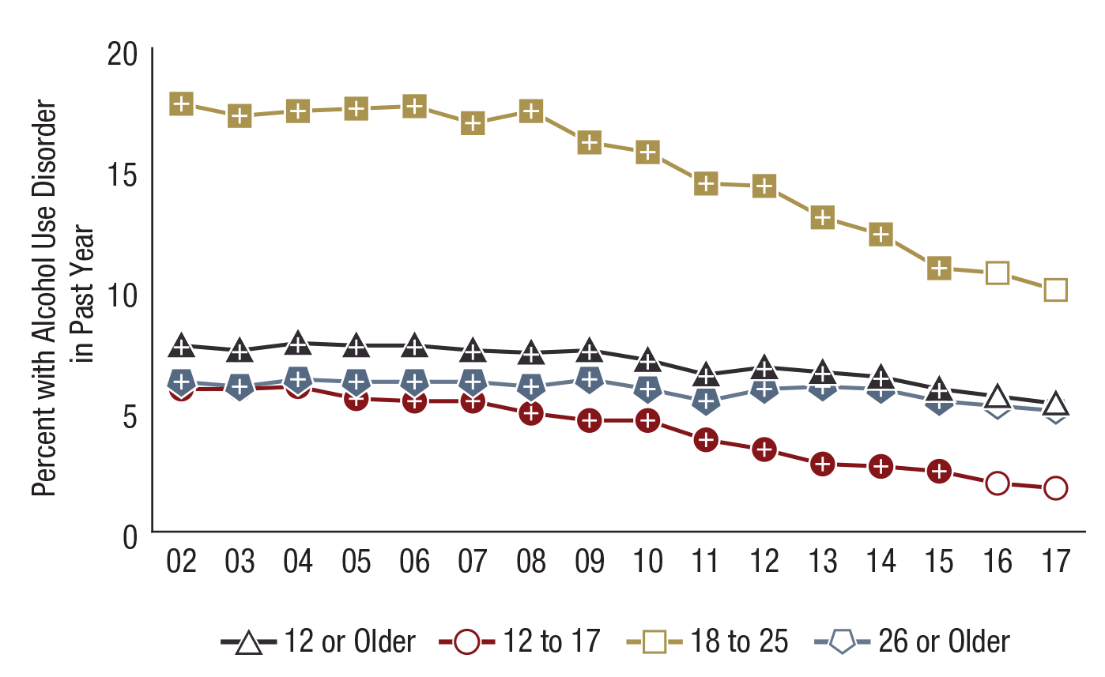
Alcohol Use Disorder in the Past Year among People Aged 12 or Older, by Age Group: Percentages, 2002-2017
FFR1.32
Age Group | 2002 | 2003 | 2004 | 2005 | 2006 | 2007 | 2008 | 2009 | 2010 | 2011 | 2012 | 2013 | 2014 | 2015 | 2016 | 2017
12 or Older | 7.7⁺ | 7.5⁺ | 7.8⁺ | 7.7⁺ | 7.7⁺ | 7.5⁺ | 7.4⁺ | 7.5⁺ | 7.1⁺ | 6.5⁺ | 6.8⁺ | 6.6⁺ | 6.4⁺ | 5.9⁺ | 5.6 | 5.3
12 to 17 | 5.9⁺ | 5.9⁺ | 6.0⁺ | 5.5⁺ | 5.4⁺ | 5.4⁺ | 4.9⁺ | 4.6⁺ | 4.6⁺ | 3.8⁺ | 3.4⁺ | 2.8⁺ | 2.7⁺ | 2.5⁺ | 2.0 | 1.8
18 to 25 | 17.7⁺ | 17.2⁺ | 17.4⁺ | 17.5⁺ | 17.6⁺ | 16.9⁺ | 17.4⁺ | 16.1⁺ | 15.7⁺ | 14.4⁺ | 14.3⁺ | 13.0⁺ | 12.3⁺ | 10.9⁺ | 10.7 | 10.0
26 or Older | 6.2⁺ | 6.0⁺ | 6.3⁺ | 6.2⁺ | 6.2⁺ | 6.2⁺ | 6.0⁺ | 6.3⁺ | 5.9⁺ | 5.4⁺ | 5.9⁺ | 6.0⁺ | 5.9⁺ | 5.4⁺ | 5.2 | 5.0

Slide 33
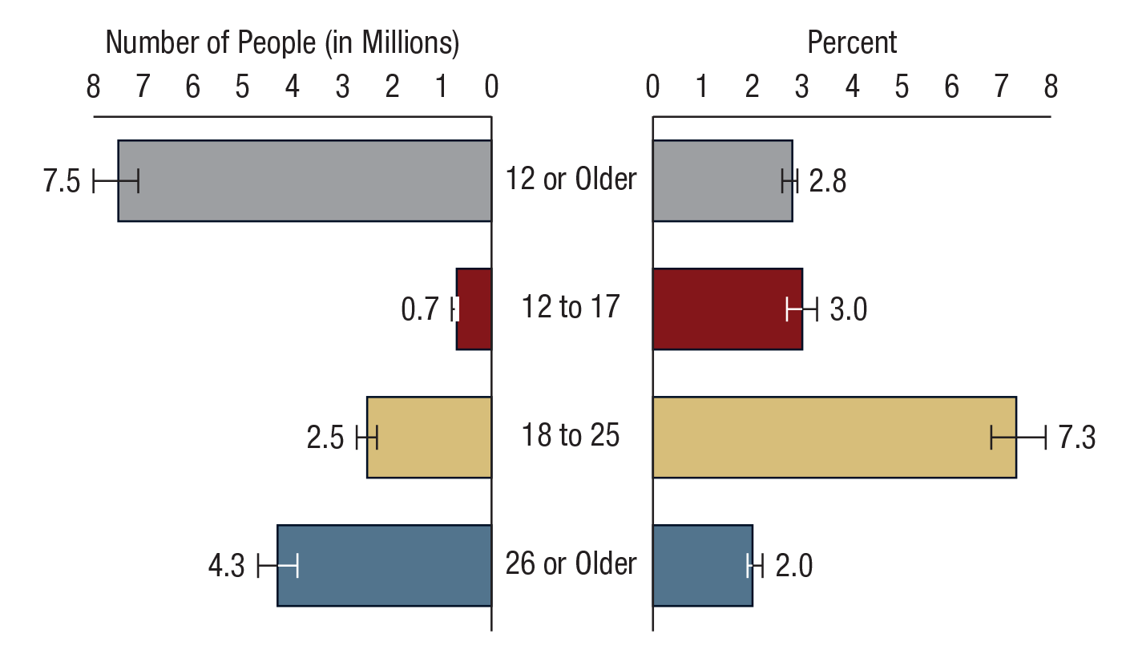
Illicit Drug Use Disorder in the Past Year among People Aged 12 or Older, by Age Group: 2017
FFR1.33

Slide 34
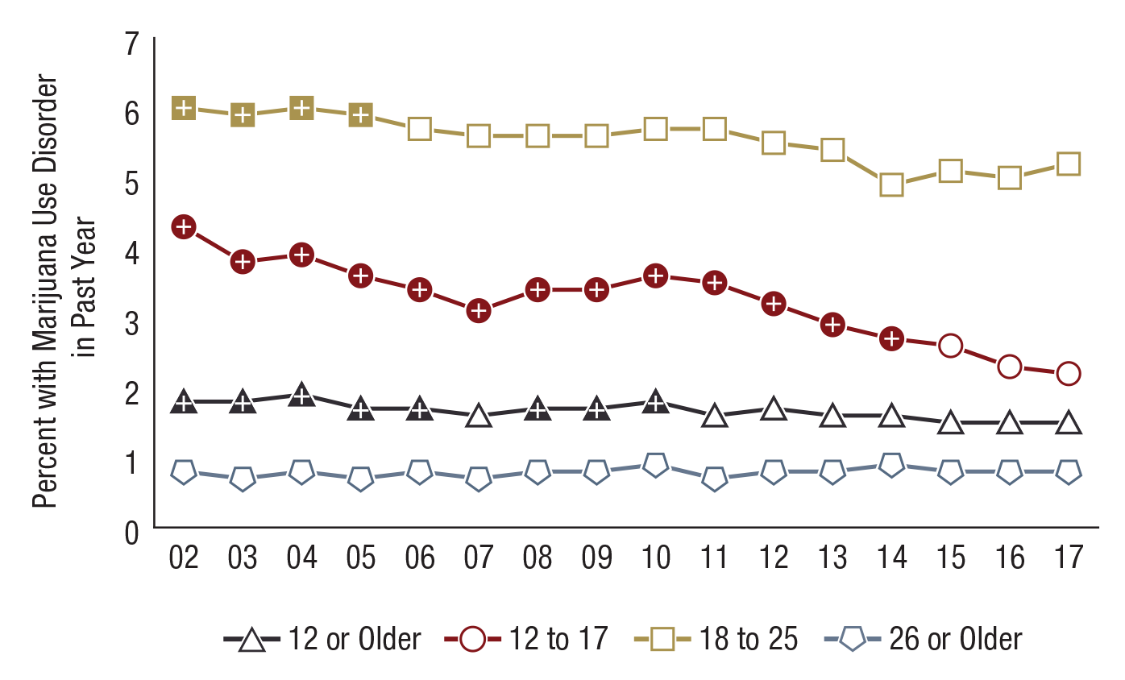
Marijuana Use Disorder in the Past Year among People Aged 12 or Older, by Age Group: Percentages, 2002-2017
FFR1.34
Age Group | 2002 | 2003 | 2004 | 2005 | 2006 | 2007 | 2008 | 2009 | 2010 | 2011 | 2012 | 2013 | 2014 | 2015 | 2016 | 2017
12 or Older | 1.8⁺ | 1.8⁺ | 1.9⁺ | 1.7⁺ | 1.7⁺ | 1.6 | 1.7⁺ | 1.7⁺ | 1.8⁺ | 1.6 | 1.7 | 1.6 | 1.6 | 1.5 | 1.5 | 1.5
12 to 17 | 4.3⁺ | 3.8⁺ | 3.9⁺ | 3.6⁺ | 3.4⁺ | 3.1⁺ | 3.4⁺ | 3.4⁺ | 3.6⁺ | 3.5⁺ | 3.2⁺ | 2.9⁺ | 2.7⁺ | 2.6 | 2.3 | 2.2
18 to 25 | 6.0⁺ | 5.9⁺ | 6.0⁺ | 5.9⁺ | 5.7 | 5.6 | 5.6 | 5.6 | 5.7 | 5.7 | 5.5 | 5.4 | 4.9 | 5.1 | 5.0 | 5.2
26 or Older | 0.8 | 0.7 | 0.8 | 0.7 | 0.8 | 0.7 | 0.8 | 0.8 | 0.9 | 0.7 | 0.8 | 0.8 | 0.9 | 0.8 | 0.8 | 0.8

Slide 35
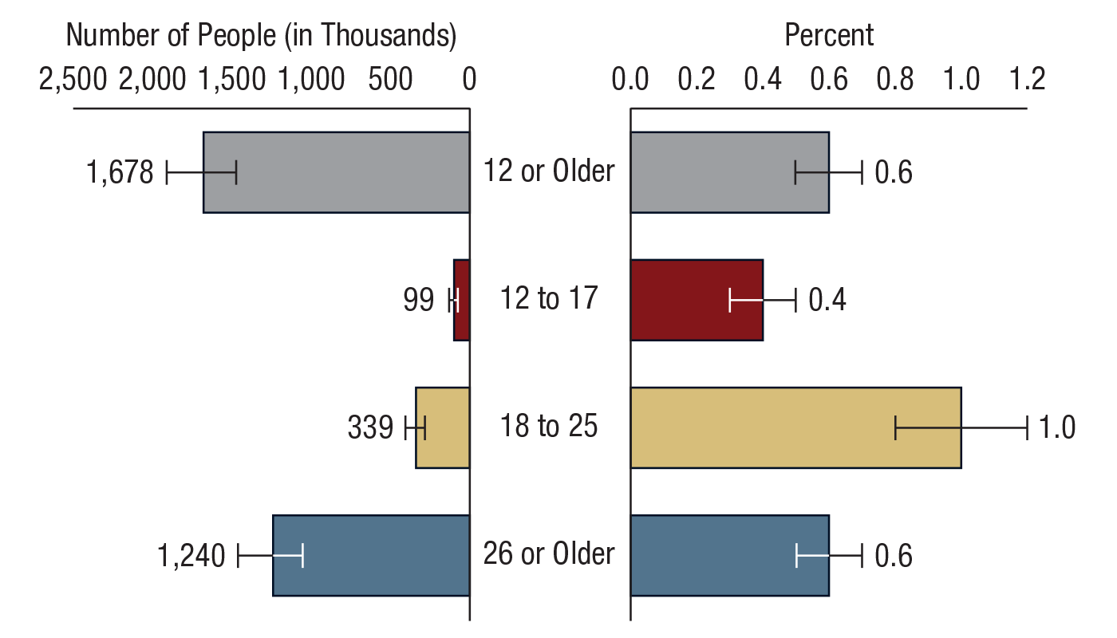
Pain Reliever Use Disorder in the Past Year among People Aged 12 or Older, by Age Group: 2017
FFR1.35

Slide 36
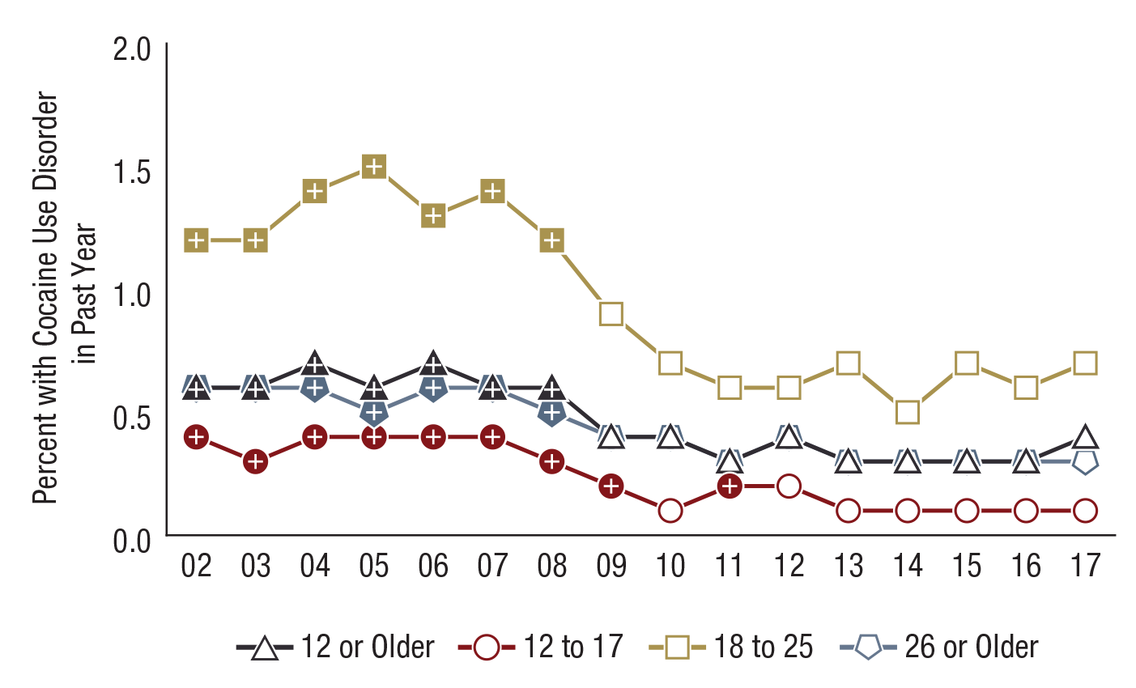
Cocaine Use Disorder in the Past Year among People Aged 12 or Older, by Age Group: Percentages, 2002-2017
FFR1.36
Age Group | 2002 | 2003 | 2004 | 2005 | 2006 | 2007 | 2008 | 2009 | 2010 | 2011 | 2012 | 2013 | 2014 | 2015 | 2016 | 2017
12 or Older | 0.6⁺ | 0.6⁺ | 0.7⁺ | 0.6⁺ | 0.7⁺ | 0.6⁺ | 0.6⁺ | 0.4 | 0.4 | 0.3 | 0.4 | 0.3 | 0.3 | 0.3 | 0.3 | 0.4
12 to 17 | 0.4⁺ | 0.3⁺ | 0.4⁺ | 0.4⁺ | 0.4⁺ | 0.4⁺ | 0.3⁺ | 0.2⁺ | 0.1 | 0.2⁺ | 0.2 | 0.1 | 0.1 | 0.1 | 0.1 | 0.1
18 to 25 | 1.2⁺ | 1.2⁺ | 1.4⁺ | 1.5⁺ | 1.3⁺ | 1.4⁺ | 1.2⁺ | 0.9 | 0.7 | 0.6 | 0.6 | 0.7 | 0.5 | 0.7 | 0.6 | 0.7
26 or Older | 0.6⁺ | 0.6⁺ | 0.6⁺ | 0.5⁺ | 0.6⁺ | 0.6⁺ | 0.5⁺ | 0.4 | 0.4 | 0.3 | 0.4 | 0.3 | 0.3 | 0.3 | 0.3 | 0.3

Slide 37
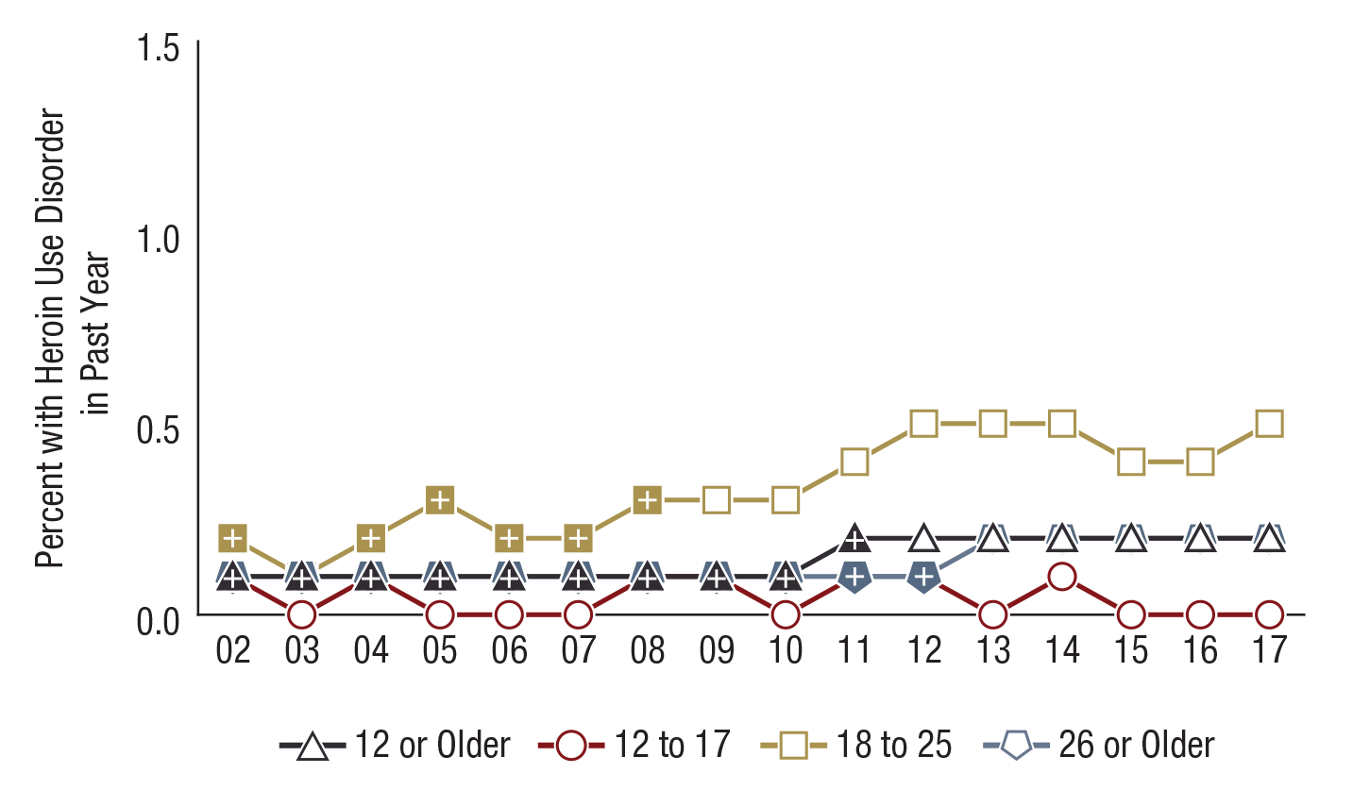
Heroin Use Disorder in the Past Year among People Aged 12 or Older, by Age Group: Percentages, 2002-2017
FFR1.37
Note: Estimates of less than 0.1 percent round to 0.0 percent when shown to the nearest tenth of a percent.
Age Group | 2002 | 2003 | 2004 | 2005 | 2006 | 2007 | 2008 | 2009 | 2010 | 2011 | 2012 | 2013 | 2014 | 2015 | 2016 | 2017
12 or Older | 0.1⁺ | 0.1⁺ | 0.1⁺ | 0.1⁺ | 0.1⁺ | 0.1⁺ | 0.1⁺ | 0.1⁺ | 0.1⁺ | 0.2⁺ | 0.2 | 0.2 | 0.2 | 0.2 | 0.2 | 0.2
12 to 17 | 0.1 | 0.0 | 0.1⁺ | 0.0 | 0.0 | 0.0 | 0.1⁺ | 0.1⁺ | 0.0 | 0.1⁺ | 0.1 | 0.0 | 0.1 | 0.0 | 0.0 | 0.0
18 to 25 | 0.2⁺ | 0.1⁺ | 0.2⁺ | 0.3⁺ | 0.2⁺ | 0.2⁺ | 0.3⁺ | 0.3 | 0.3 | 0.4 | 0.5 | 0.5 | 0.5 | 0.4 | 0.4 | 0.5
26 or Older | 0.1⁺ | 0.1⁺ | 0.1⁺ | 0.1⁺ | 0.1⁺ | 0.1⁺ | 0.1⁺ | 0.1⁺ | 0.1⁺ | 0.1⁺ | 0.1⁺ | 0.2 | 0.2 | 0.2 | 0.2 | 0.2

Slide 38
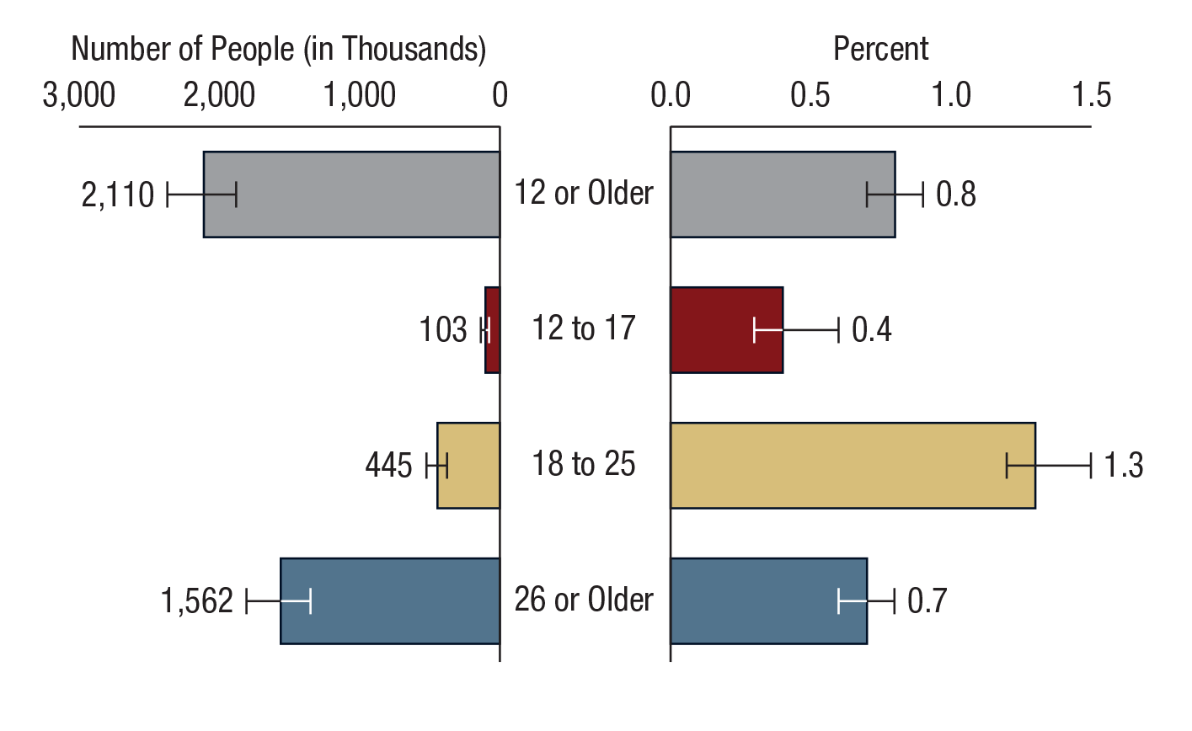
Opioid Use Disorder in the Past Year among People Aged 12 or Older, by Age Group: 2017
FFR1.38
Note: Opioid use disorder is defined as meeting DSM-IV criteria for heroin use disorder or pain reliever use disorder in the past 12 months.

Slide 39
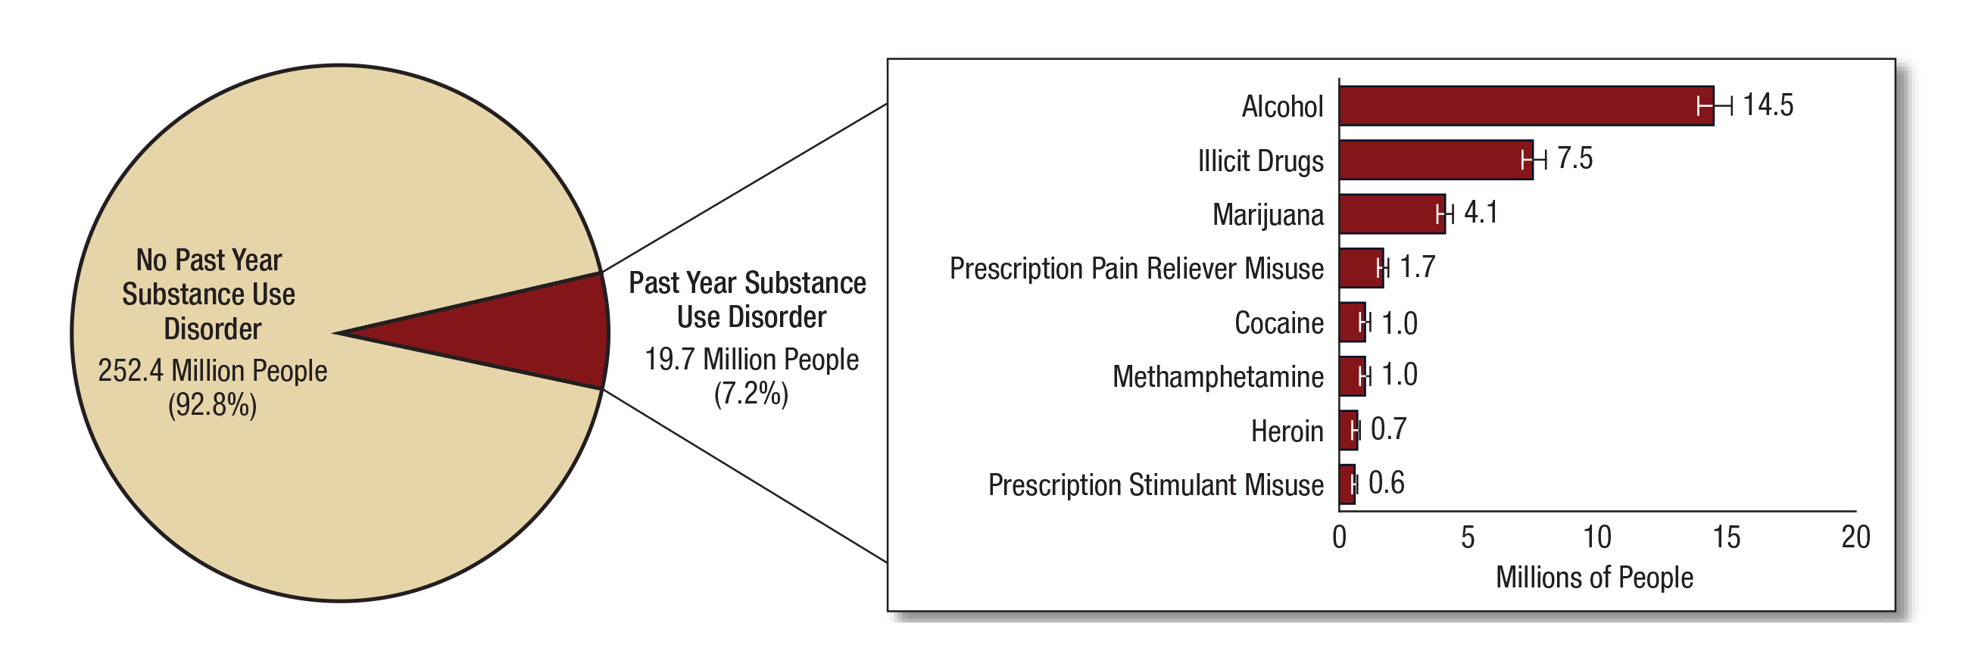
Numbers of People Aged 12 or Older with a Past Year Substance Use Disorder: 2017
FFR1.39
Note: Estimated numbers of people refer to people aged 12 or older in the civilian, noninstitutionalized population in the United States. The numbers do not sum to the total population of the United States because the population for NSDUH does not include people aged 11 years or younger, people with no fixed household address (e.g., homeless or transient people not in shelters), active-duty military personnel, and residents of institutional group quarters, such as correctional facilities, nursing homes, mental institutions, and long-term care hospitals.
Note: The estimated numbers of people with substance use disorders are not mutually exclusive because people could have use disorders for more than one substance.

Slide 40
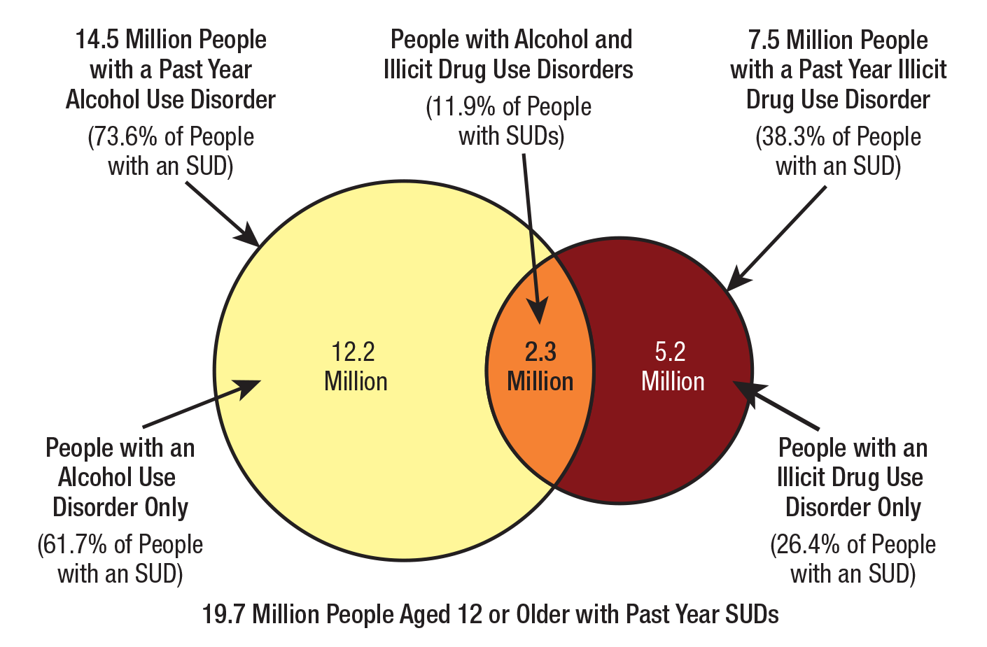
Alcohol Use Disorder and Illicit Drug Use Disorder in the Past Year among People Aged 12 or Older with a Past Year Substance Use Disorder (SUD): 2017
FFR1.40

Slide 41
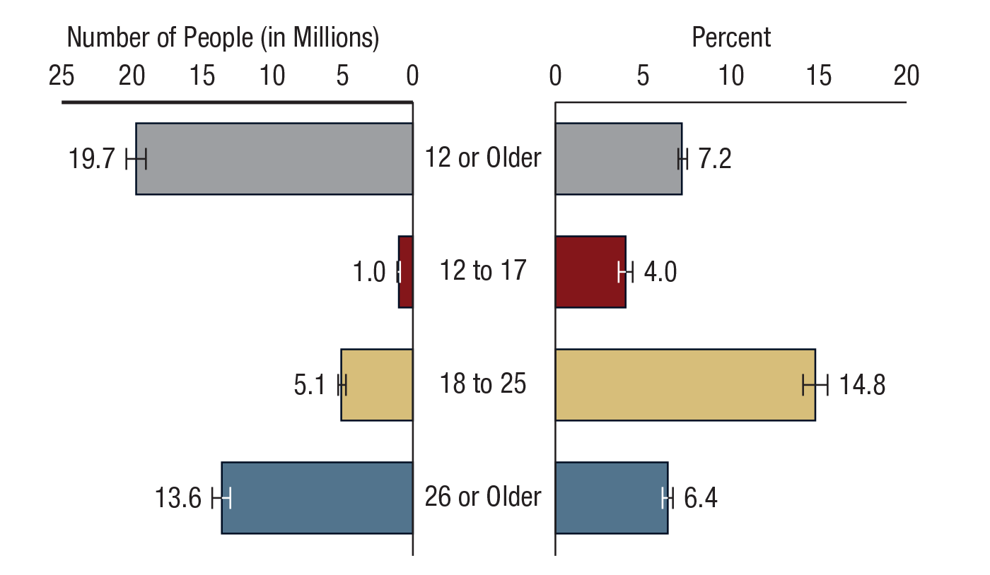
Substance Use Disorder in the Past Year among People Aged 12 or Older, by Age Group: 2017
FFR1.41

Slide 42
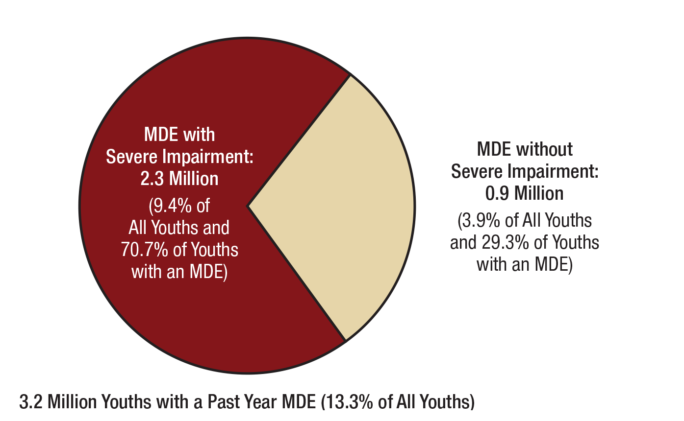
Major Depressive Episode (MDE) and MDE with Severe Impairment in the Past Year among Youths Aged 12 to 17: 2017
FFR1.42
Note: Youth respondents with unknown past year MDE data or unknown impairment data were excluded.

Slide 43
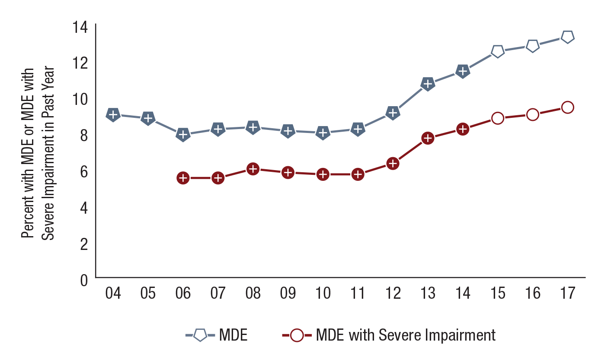
Major Depressive Episode (MDE) and MDE with Severe Impairment in the Past Year among Youths Aged 12 to 17: Percentages, 2004-2017
FFR1.43
N/A = not available.
MDE Status | 2004 | 2005 | 2006 | 2007 | 2008 | 2009 | 2010 | 2011 | 2012 | 2013 | 2014 | 2015 | 2016 | 2017
MDE | 9.0⁺ | 8.8⁺ | 7.9⁺ | 8.2⁺ | 8.3⁺ | 8.1⁺ | 8.0⁺ | 8.2⁺ | 9.1⁺ | 10.7⁺ | 11.4⁺ | 12.5 | 12.8 | 13.3
MDE with Severe Impairment | N/A | N/A | 5.5⁺ | 5.5⁺ | 6.0⁺ | 5.8⁺ | 5.7⁺ | 5.7⁺ | 6.3⁺ | 7.7⁺ | 8.2⁺ | 8.8 | 9.0 | 9.4

Slide 44
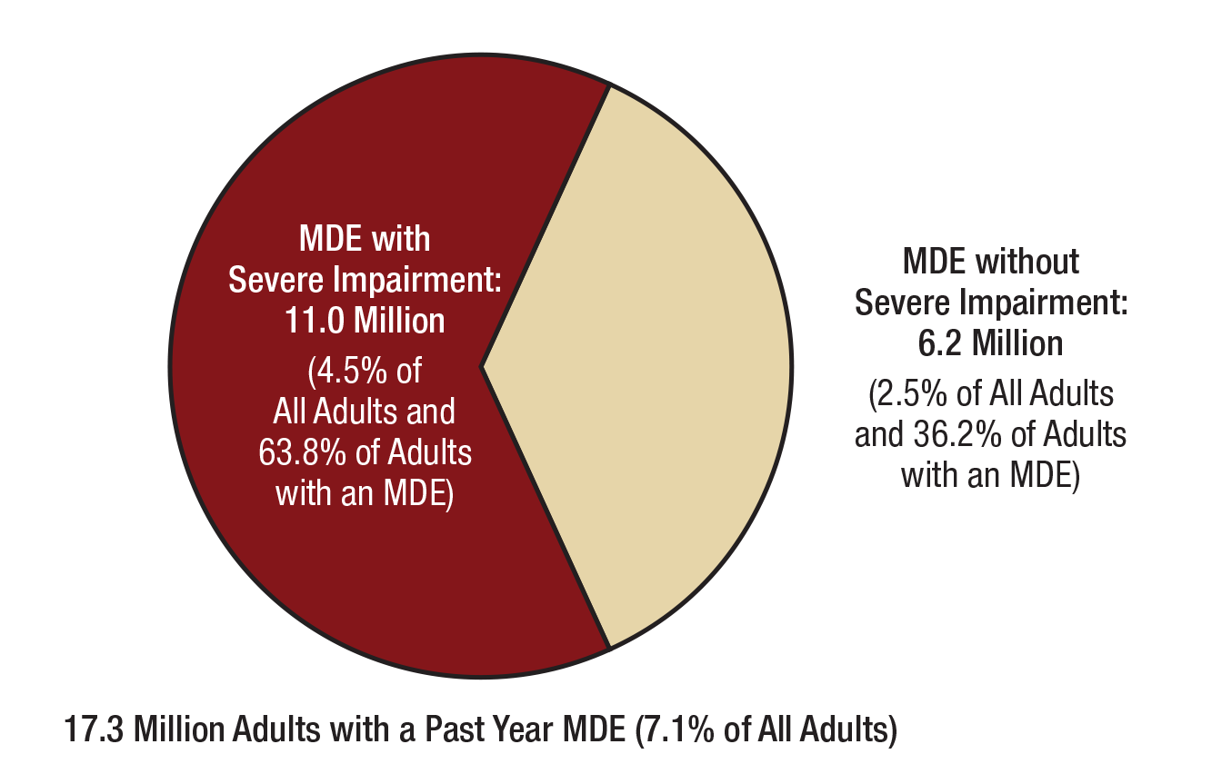
Major Depressive Episode (MDE) and MDE with Severe Impairment in the Past Year among Adults Aged 18 or Older: 2017
FFR1.44
Note: Adult respondents with unknown past year MDE data or unknown impairment data were excluded.

Slide 45
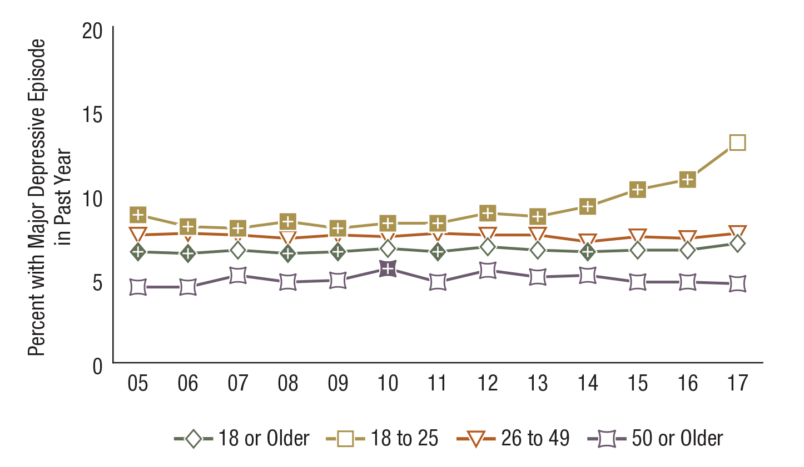
Major Depressive Episode in the Past Year among Adults Aged 18 or Older, by Age Group: Percentages, 2005-2017
FFR1.45
Age Group | 2005 | 2006 | 2007 | 2008 | 2009 | 2010 | 2011 | 2012 | 2013 | 2014 | 2015 | 2016 | 2017
18 or Older | 6.6⁺ | 6.5⁺ | 6.7 | 6.5⁺ | 6.6⁺ | 6.8 | 6.6⁺ | 6.9 | 6.7 | 6.6⁺ | 6.7 | 6.7 | 7.1
18 to 25 | 8.8⁺ | 8.1⁺ | 8.0⁺ | 8.4⁺ | 8.0⁺ | 8.3⁺ | 8.3⁺ | 8.9⁺ | 8.7⁺ | 9.3⁺ | 10.3⁺ | 10.9⁺ | 13.1
26 to 49 | 7.6 | 7.7 | 7.6 | 7.4 | 7.6 | 7.5 | 7.7 | 7.6 | 7.6 | 7.2 | 7.5 | 7.4 | 7.7
50 or Older | 4.5 | 4.5 | 5.2 | 4.8 | 4.9 | 5.6⁺ | 4.8 | 5.5 | 5.1 | 5.2 | 4.8 | 4.8 | 4.7

Slide 46
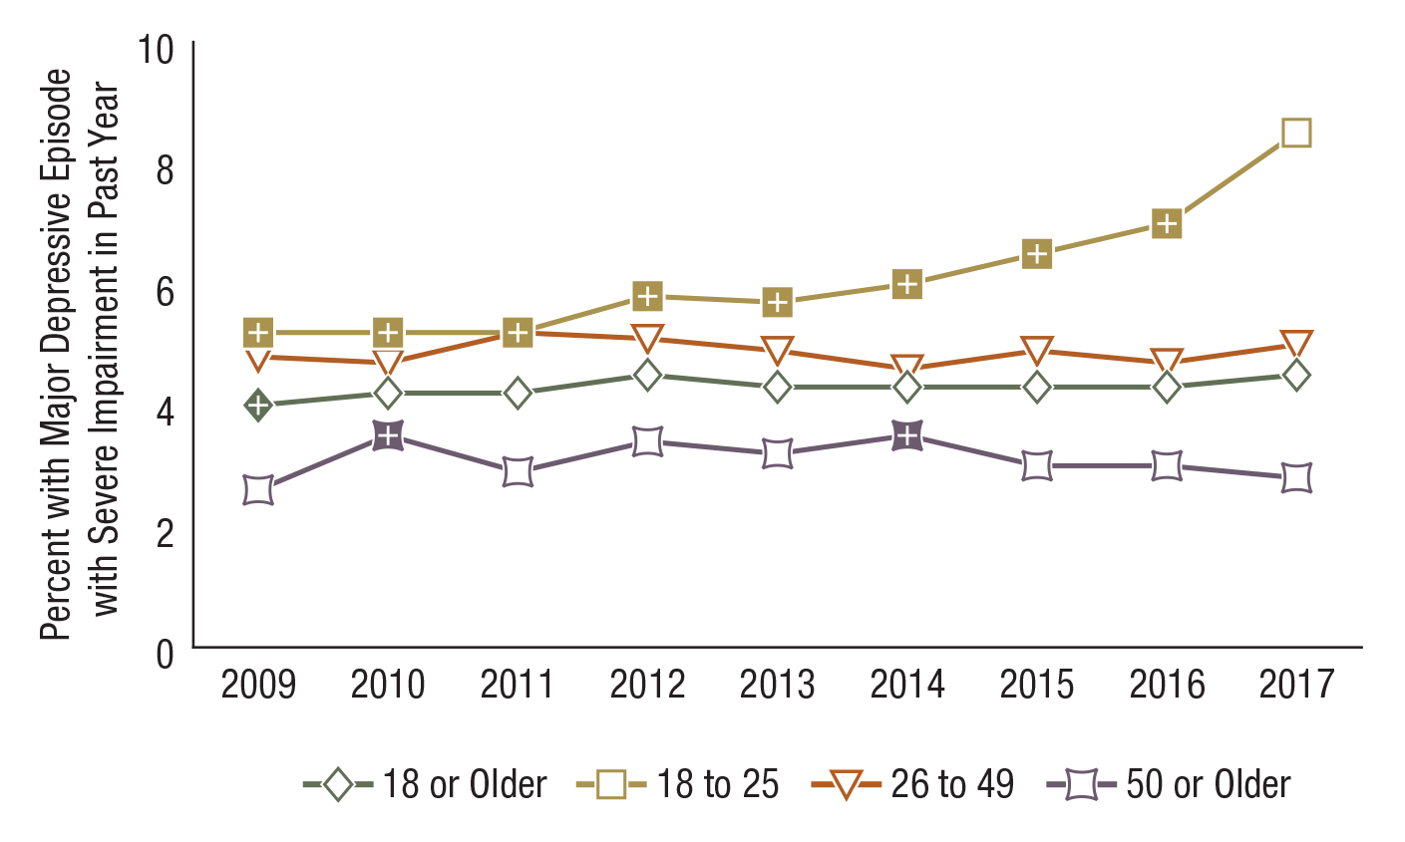
Major Depressive Episode with Severe Impairment in the Past Year among Adults Aged 18 or Older, by Age Group: Percentages, 2009-2017
FFR1.46
Age Group | 2009 | 2010 | 2011 | 2012 | 2013 | 2014 | 2015 | 2016 | 2017
18 or Older | 4.0⁺ | 4.2 | 4.2 | 4.5 | 4.3 | 4.3 | 4.3 | 4.3 | 4.5
18 to 25 | 5.2⁺ | 5.2⁺ | 5.2⁺ | 5.8⁺ | 5.7⁺ | 6.0⁺ | 6.5⁺ | 7.0⁺ | 8.5
26 to 49 | 4.8 | 4.7 | 5.2 | 5.1 | 4.9 | 4.6 | 4.9 | 4.7 | 5.0
50 or Older | 2.6 | 3.5⁺ | 2.9 | 3.4 | 3.2 | 3.5⁺ | 3.0 | 3.0 | 2.8

Slide 47
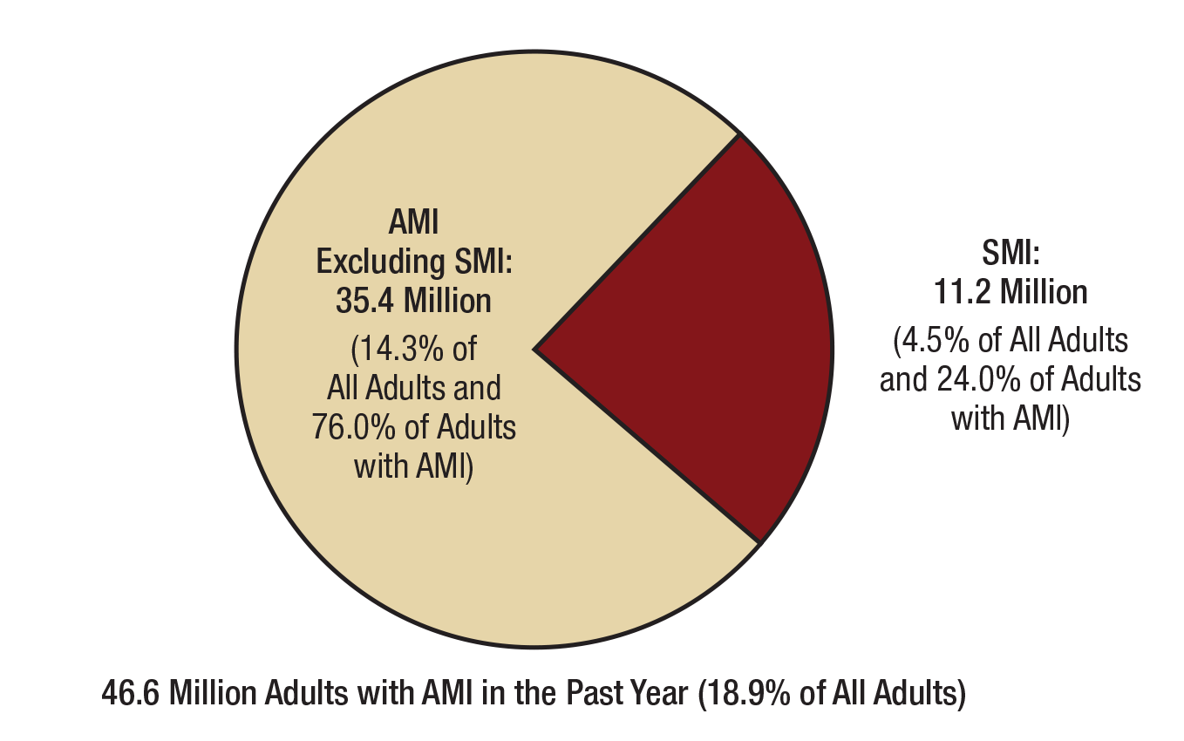
Any Mental Illness (AMI), Serious Mental Illness (SMI), and AMI Excluding SMI in the Past Year among Adults Aged 18 or Older: 2017
FFR1.47

Slide 48
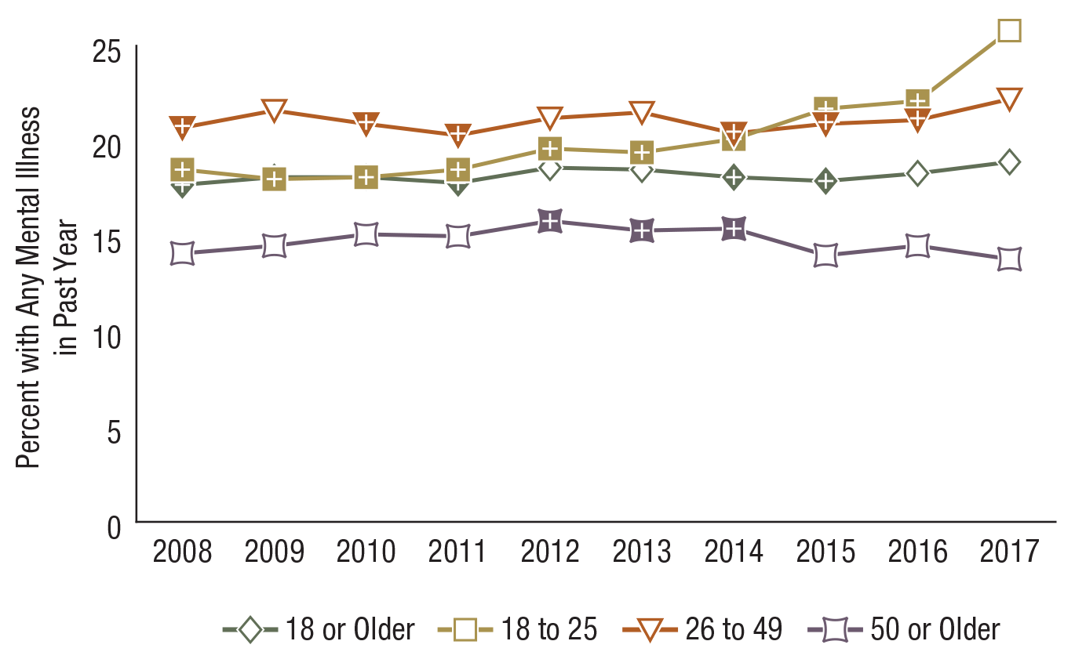
Any Mental Illness in the Past Year among Adults Aged 18 or Older, by Age Group: Percentages, 2008-2017
FFR1.48
Age Group | 2008 | 2009 | 2010 | 2011 | 2012 | 2013 | 2014 | 2015 | 2016 | 2017
18 or Older | 17.7⁺ | 18.1 | 18.1⁺ | 17.8⁺ | 18.6 | 18.5 | 18.1⁺ | 17.9⁺ | 18.3 | 18.9
18 to 25 | 18.5⁺ | 18.0⁺ | 18.1⁺ | 18.5⁺ | 19.6⁺ | 19.4⁺ | 20.1⁺ | 21.7⁺ | 22.1⁺ | 25.8
26 to 49 | 20.7⁺ | 21.6 | 20.9⁺ | 20.3⁺ | 21.2 | 21.5 | 20.4⁺ | 20.9⁺ | 21.1⁺ | 22.2
50 or Older | 14.1 | 14.5 | 15.1 | 15.0 | 15.8⁺ | 15.3⁺ | 15.4⁺ | 14.0 | 14.5 | 13.8

Slide 49
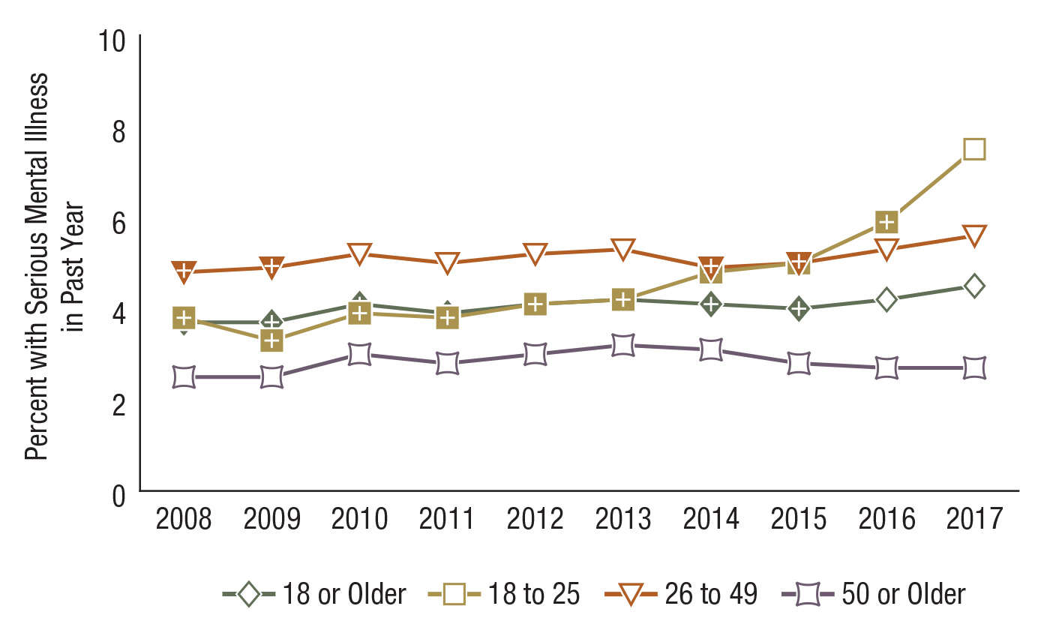
Serious Mental Illness in the Past Year among Adults Aged 18 or Older, by Age Group: Percentages, 2008-2017
FFR1.49
Age Group | 2008 | 2009 | 2010 | 2011 | 2012 | 2013 | 2014 | 2015 | 2016 | 2017
18 or Older | 3.7⁺ | 3.7⁺ | 4.1⁺ | 3.9⁺ | 4.1⁺ | 4.2 | 4.1⁺ | 4.0⁺ | 4.2 | 4.5
18 to 25 | 3.8⁺ | 3.3⁺ | 3.9⁺ | 3.8⁺ | 4.1⁺ | 4.2⁺ | 4.8⁺ | 5.0⁺ | 5.9⁺ | 7.5
26 to 49 | 4.8⁺ | 4.9⁺ | 5.2 | 5.0 | 5.2 | 5.3 | 4.9⁺ | 5.0⁺ | 5.3 | 5.6
50 or Older | 2.5 | 2.5 | 3.0 | 2.8 | 3.0 | 3.2 | 3.1 | 2.8 | 2.7 | 2.7

Slide 50
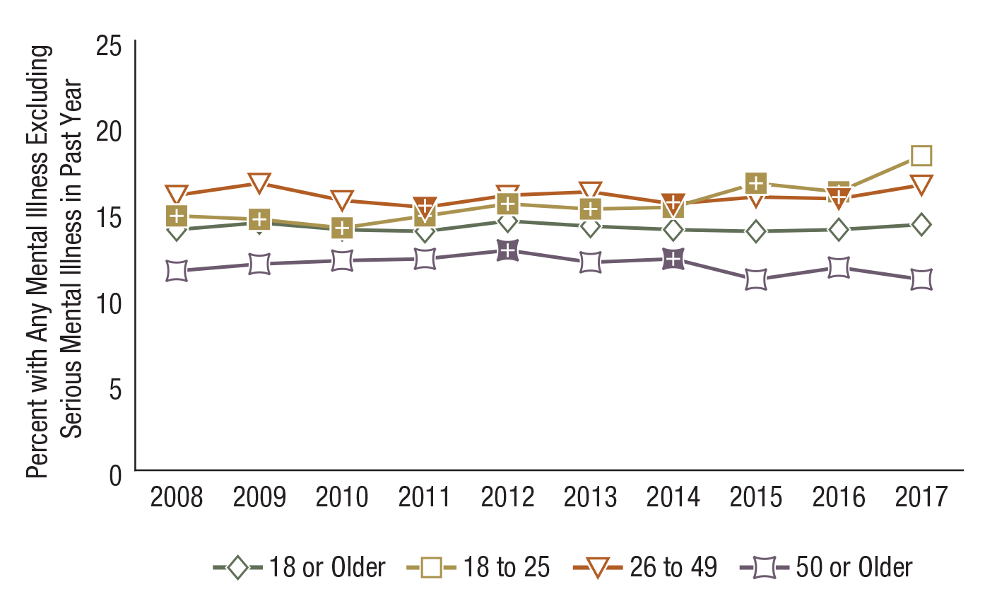
Any Mental Illness Excluding Serious Mental Illness in the Past Year among Adults Aged 18 or Older, by Age Group: Percentages, 2008-2017
FFR1.50
Age Group | 2008 | 2009 | 2010 | 2011 | 2012 | 2013 | 2014 | 2015 | 2016 | 2017
18 or Older | 14.0 | 14.4 | 14.0 | 13.9 | 14.5 | 14.2 | 14.0 | 13.9 | 14.0 | 14.3
18 to 25 | 14.8⁺ | 14.6⁺ | 14.1⁺ | 14.8⁺ | 15.5⁺ | 15.2⁺ | 15.3⁺ | 16.7⁺ | 16.2⁺ | 18.3
26 to 49 | 16.0 | 16.7 | 15.7 | 15.3⁺ | 16.0 | 16.2 | 15.5⁺ | 15.9 | 15.8⁺ | 16.6
50 or Older | 11.6 | 12.0 | 12.2 | 12.3 | 12.8⁺ | 12.1 | 12.3⁺ | 11.1 | 11.8 | 11.1

Slide 51

Past Year Substance Use Disorder (SUD) and Major Depressive Episode (MDE) Status among Youths Aged 12 to 17: Percentages, 2017
FFR1.51

Slide 52

Past Year Substance Use Disorder (SUD) and Major Depressive Episode (MDE) among Youths Aged 12 to 17: Numbers in Millions, 2017
FFR1.52
Note: Youth respondents with unknown MDE data were excluded.

Slide 53

Past Year Illicit Drug Use among Youths Aged 12 to 17, by Past Year Major Depressive Episode (MDE) Status: Percentages, 2017
FFR1.53

Slide 54

Past Year Substance Use Disorder (SUD) and Mental Illness among Adults Aged 18 or Older: Numbers in Millions, 2017
FFR1.54

Slide 55

Past Year Substance Use Disorder (SUD) and Serious Mental Illness (SMI) among Adults Aged 18 or Older: Numbers in Millions, 2017
FFR1.55

Slide 56

Past Year Substance Use Disorder among Adults Aged 18 or Older with Any Mental Illness in the Past Year, by Age Group: Percentages, 2017
FFR1.56

Slide 57

Past Year Substance Use Disorder among Adults Aged 18 or Older with Serious Mental Illness in the Past Year, by Age Group: Percentages, 2017
FFR1.57

Slide 58

Suicidal Thoughts, Plans, and Attempts in the Past Year among Adults Aged 18 or Older: Numbers in Millions, 2017
FFR1.58

Slide 59

Suicidal Thoughts in the Past Year among Adults Aged 18 or Older, by Age Group: Percentages, 2008-2017
FFR1.59
Age Group | 2008 | 2009 | 2010 | 2011 | 2012 | 2013 | 2014 | 2015 | 2016 | 2017
18 or Older | 3.7⁺ | 3.7⁺ | 3.8⁺ | 3.7⁺ | 3.9⁺ | 3.9⁺ | 3.9⁺ | 4.0 | 4.0 | 4.3
18 to 25 | 6.8⁺ | 6.1⁺ | 6.7⁺ | 6.8⁺ | 7.2⁺ | 7.4⁺ | 7.5⁺ | 8.3⁺ | 8.8⁺ | 10.5
26 to 49 | 4.0 | 4.3 | 4.1 | 3.7⁺ | 4.2 | 4.0 | 4.0 | 4.1 | 4.2 | 4.3
50 or Older | 2.3 | 2.3 | 2.6 | 2.6 | 2.4 | 2.7 | 2.7 | 2.6 | 2.4 | 2.5

Slide 60

Suicide Plans in the Past Year among Adults Aged 18 or Older, by Age Group: Percentages, 2008-2017
FFR1.60
Age Group | 2008 | 2009 | 2010 | 2011 | 2012 | 2013 | 2014 | 2015 | 2016 | 2017
18 or Older | 1.0⁺ | 1.0⁺ | 1.1⁺ | 1.0⁺ | 1.1 | 1.1 | 1.1⁺ | 1.1⁺ | 1.1⁺ | 1.3
18 to 25 | 2.0⁺ | 2.0⁺ | 1.9⁺ | 1.9⁺ | 2.4⁺ | 2.5⁺ | 2.3⁺ | 2.7⁺ | 2.9⁺ | 3.7
26 to 49 | 1.1 | 1.0 | 1.0 | 1.1 | 1.3 | 1.3 | 1.1 | 1.1 | 1.3 | 1.2
50 or Older | 0.7 | 0.6 | 0.9 | 0.7 | 0.6 | 0.6 | 0.7 | 0.7 | 0.5 | 0.6

Slide 61

Suicide Attempts in the Past Year among Adults Aged 18 or Older, by Age Group: Percentages, 2008-2017
FFR1.61
Age Group | 2008 | 2009 | 2010 | 2011 | 2012 | 2013 | 2014 | 2015 | 2016 | 2017
18 or Older | 0.5 | 0.5 | 0.5 | 0.5 | 0.6 | 0.6 | 0.5⁺ | 0.6 | 0.5 | 0.6
18 to 25 | 1.2⁺ | 1.1⁺ | 1.2⁺ | 1.2⁺ | 1.5⁺ | 1.3⁺ | 1.2⁺ | 1.6 | 1.8 | 1.9
26 to 49 | 0.4 | 0.5 | 0.4 | 0.5 | 0.5 | 0.6 | 0.5 | 0.5 | 0.5 | 0.4
50 or Older | 0.3 | 0.2 | 0.3 | 0.3 | 0.3 | 0.3 | 0.3 | 0.3 | 0.2 | 0.3

Slide 62

Need for Substance Use Treatment in the Past Year among People Aged 12 or Older, by Age Group: 2017
FFR1.62

Slide 63

Received Any Substance Use Treatment in the Past Year among People Aged 12 or Older, by Age Group: 2017
FFR1.63

Slide 64

Received Specialty Substance Use Treatment in the Past Year among People Aged 12 or Older, by Age Group: 2017
FFR1.64

Slide 65

Received Specialty Substance Use Treatment in the Past Year among People Aged 12 or Older Who Needed Substance Use Treatment in the Past Year, by Age Group: 2017
FFR1.65

Slide 66

Perceived Need for Substance Use Treatment among People Aged 12 or Older Who Needed but Did Not Receive Specialty Substance Use Treatment in the Past Year: 2017
FFR1.66

Slide 67

Reasons for Not Receiving Substance Use Treatment in the Past Year among People Aged 12 or Older Who Felt They Needed Treatment in the Past Year: Percentages, 2017
FFR1.67
Note: Respondents could indicate multiple reasons for not receiving substance use treatment; thus, these response categories are not mutually exclusive.

Slide 68

Received Treatment in the Past Year for Depression among Youths Aged 12 to 17 with a Past Year Major Depressive Episode (MDE) or MDE with Severe Impairment: Percentages, 2004-2017
FFR1.68
N/A = not available.
MDE Status | 2004 | 2005 | 2006 | 2007 | 2008 | 2009 | 2010 | 2011 | 2012 | 2013 | 2014 | 2015 | 2016 | 2017
MDE | 40.3 | 37.8⁺ | 38.8 | 39.0 | 37.7 | 34.6⁺ | 37.8 | 38.4 | 37.0⁺ | 38.1 | 41.2 | 39.3 | 40.9 | 41.5
MDE with Severe Impairment | N/A | N/A | 46.5 | 43.9 | 42.6⁺ | 38.8⁺ | 41.1⁺ | 43.5 | 41.0⁺ | 45.0 | 44.7 | 44.6 | 46.7 | 47.5

Slide 69

Received Treatment in the Past Year for Depression among Adults Aged 18 or Older with a Past Year Major Depressive Episode (MDE) or MDE with Severe Impairment: Percentages, 2009-2017
FFR1.69
MDE Status | 2009 | 2010 | 2011 | 2012 | 2013 | 2014 | 2015 | 2016 | 2017
MDE | 64.3 | 68.2 | 68.1 | 68.0 | 68.6 | 68.6 | 67.2 | 65.3 | 66.8
MDE with Severe Impairment | 71.5 | 72.9 | 73.7 | 73.1 | 76.4⁺ | 73.7 | 72.7 | 72.2 | 72.1

Slide 70

Sources of Mental Health Services in the Past Year among Youths Aged 12 to 17: 2017
FFR1.70
Note: Mental health service for youths aged 12 to 17 is defined as having received treatment/counseling for emotional or behavioral problems not caused by substance use.

Slide 71

Sources of Mental Health Services in the Past Year among Youths Aged 12 to 17: Percentages, 2009-2017
FFR1.71
Note: Mental health service for youths aged 12 to 17 is defined as having received treatment/counseling for emotional or behavioral problems not caused by substance use.
Source | 2009 | 2010 | 2011 | 2012 | 2013 | 2014 | 2015 | 2016 | 2017
Specialty Mental Health Setting | 12.0⁺ | 12.1⁺ | 12.6⁺ | 12.7⁺ | 13.6⁺ | 13.7⁺ | 13.3⁺ | 14.7 | 14.8
Education Settings | 12.1⁺ | 12.4⁺ | 11.9⁺ | 12.9 | 13.0 | 13.2 | 13.2 | 13.1 | 13.3
General Medical Setting | 2.5⁺ | 2.5⁺ | 2.5⁺ | 2.5⁺ | 2.8⁺ | 2.9 | 2.7⁺ | 2.9 | 3.3
Child Welfare Setting | 0.4 | 0.4 | 0.6⁺ | 0.4 | 0.4 | 0.4 | 0.3 | 0.4 | 0.4
Juvenile Justice Setting | 0.4⁺ | 0.3⁺ | 0.4⁺ | 0.3⁺ | 0.2 | 0.3 | 0.2 | 0.2 | 0.2

Slide 72

Type of Mental Health Services Received in the Past Year among Adults Aged 18 or Older: Percentages, 2002-2017
FFR1.72
Note: Mental health service is defined as having received inpatient care or outpatient care or having used prescription medication for problems with emotions, nerves, or mental health.
Service Type | 2002 | 2003 | 2004 | 2005 | 2006 | 2007 | 2008 | 2009 | 2010 | 2011 | 2012 | 2013 | 2014 | 2015 | 2016 | 2017
Any Mental Health Service | 13.0⁺ | 13.2⁺ | 12.8⁺ | 13.0⁺ | 12.9⁺ | 13.3⁺ | 13.5⁺ | 13.4⁺ | 13.8⁺ | 13.6⁺ | 14.5 | 14.6 | 14.8 | 14.2 | 14.4 | 14.8
Inpatient | 0.7⁺ | 0.8 | 0.9 | 1.0 | 0.7⁺ | 1.0 | 0.9 | 0.8 | 0.8⁺ | 0.8⁺ | 0.8 | 0.9 | 1.0 | 0.9 | 0.9 | 1.0
Outpatient | 7.4 | 7.1 | 7.1 | 6.8⁺ | 6.7⁺ | 7.0⁺ | 6.8⁺ | 6.4⁺ | 6.6⁺ | 6.7⁺ | 6.6⁺ | 6.6⁺ | 6.7⁺ | 7.1⁺ | 6.9⁺ | 7.5
Prescription Medication | 10.5⁺ | 10.9⁺ | 10.5⁺ | 10.7⁺ | 10.9⁺ | 11.2⁺ | 11.4 | 11.3⁺ | 11.7 | 11.5 | 12.4 | 12.5 | 12.6 | 11.8 | 12.0 | 12.1

Slide 73

Type of Mental Health Services Received in the Past Year among Adults Aged 18 or Older with Any Mental Illness in the Past Year: Percentages, 2008-2017
FFR1.73
Note: Mental health service is defined as having received inpatient care or outpatient care or having used prescription medication for problems with emotions, nerves, or mental health.
Service Type | 2008 | 2009 | 2010 | 2011 | 2012 | 2013 | 2014 | 2015 | 2016 | 2017
Any Mental Health Service | 40.9 | 40.2⁺ | 42.4 | 40.8 | 41.0 | 44.7 | 44.7 | 43.1 | 43.1 | 42.6
Inpatient | 3.7 | 3.2 | 2.7 | 3.3 | 3.0 | 3.3 | 3.8 | 3.4 | 3.3 | 3.3
Outpatient | 24.1 | 22.5⁺ | 23.4⁺ | 24.0 | 22.4⁺ | 24.4 | 24.3 | 25.4 | 24.5 | 25.7
Prescription Medication | 35.5 | 34.8 | 36.9 | 35.6 | 35.3 | 38.9⁺ | 38.7⁺ | 36.7 | 37.1 | 35.7

Slide 74

Type of Mental Health Services Received in the Past Year among Adults Aged 18 or Older with Serious Mental Illness in the Past Year: Percentages, 2008-2017
FFR1.74
Note: Mental health service is defined as having received inpatient care or outpatient care or having used prescription medication for problems with emotions, nerves, or mental health.
Service Type | 2008 | 2009 | 2010 | 2011 | 2012 | 2013 | 2014 | 2015 | 2016 | 2017
Any Mental Health Service | 65.7 | 66.5 | 67.5 | 64.9 | 62.9 | 68.5 | 68.5 | 65.3 | 64.8 | 66.7
Inpatient | 8.6 | 8.6 | 6.7 | 8.8 | 6.2 | 8.3 | 8.8 | 7.0 | 7.6 | 7.6
Outpatient | 46.2 | 44.6 | 42.5 | 44.1 | 39.0⁺ | 46.9 | 44.2 | 43.6 | 42.6 | 45.3
Prescription Medication | 59.7 | 61.1 | 61.0 | 58.2 | 57.8 | 62.1 | 61.4 | 57.3 | 58.0 | 58.9

Slide 75

Perceived Unmet Need for Mental Health Services in the Past Year among Adults Aged 18 or Older, by Mental Illness Status: Percentages, 2002-2017
FFR1.75
AMI = any mental illness;
MI = mental illness;
N/A = not available;
SMI = serious mental illness.
MI Status | 2002 | 2003 | 2004 | 2005 | 2006 | 2007 | 2008 | 2009 | 2010 | 2011 | 2012 | 2013 | 2014 | 2015 | 2016 | 2017
All Adults | 5.4 | 5.1 | 5.1 | 5.1 | 4.8⁺ | 4.9⁺ | 4.7⁺ | 5.3 | 4.9⁺ | 4.6⁺ | 4.9⁺ | 4.6⁺ | 4.9⁺ | 4.6⁺ | 4.8⁺ | 5.5
Adults with AMI | N/A | N/A | N/A | N/A | N/A | N/A | 20.6⁺ | 22.1 | 21.0⁺ | 20.7⁺ | 20.8⁺ | 19.3⁺ | 20.8⁺ | 20.3⁺ | 20.7⁺ | 23.7
Adults with SMI | N/A | N/A | N/A | N/A | N/A | N/A | 43.7 | 46.3 | 42.0 | 43.1 | 41.6 | 38.6⁺ | 42.9 | 38.2⁺ | 39.7⁺ | 44.2

Slide 76

Reasons for Not Receiving Mental Health Services in the Past Year among Adults Aged 18 or Older with a Perceived Unmet Need for Mental Health Services Who Did Not Receive Mental Health Services, by Mental Illness Status: Percentages, 2017
FFR1.76
AMI = any mental illness; SMI = serious mental illness.
Note: Respondents could indicate multiple reasons for not receiving mental health services; thus, these response categories are not mutually exclusive.

Slide 77

Receipt of Mental Health Services and Specialty Substance Use Treatment in the Past Year among Adults Aged 18 or Older with Past Year Mental Illness and Substance Use Disorders: Percentages, 2017
FFR1.77
Note: Mental health service is defined as having received inpatient care or outpatient care or having used prescription medication for problems with emotions, nerves, or mental health. Specialty substance use treatment refers to treatment at a hospital (inpatient only), rehabilitation facility (inpatient or outpatient), or mental health center in order to reduce or stop drug or alcohol use, or for medical problems associated with drug or alcohol use.
Note: The percentages do not add to 100 percent due to rounding.

Slide 78

Receipt of Mental Health Services and Specialty Substance Use Treatment in the Past Year among Adults Aged 18 or Older with Past Year Serious Mental Illness and Substance Use Disorders: Percentages, 2017
FFR1.78
Note: Mental health service is defined as having received inpatient care or outpatient care or having used prescription medication for problems with emotions, nerves, or mental health. Specialty substance use treatment refers to treatment at a hospital (inpatient only), rehabilitation facility (inpatient or outpatient), or mental health center in order to reduce or stop drug or alcohol use, or for medical problems associated with drug or alcohol use.

